Slide 1
NOW PRESENTING
Oskar
02445 · DESIGN & EVALUATE A GENAI SYSTEM · VIDEO PITCH
Statistical Evaluation of
Refusal-Direction Ablation in Gemma
A paired A/B test of whether one weight edit removes benchmark-measured refusal
OFFICIAL SORRY-BENCH COMPLIANCE
Matthes M. Fogtmann · Carl Johan von Löwzow
Oliver Illum · Oskar F. Karlsson
Technical University of Denmark
21.4% → 76.6%
github.com/MatthesF/refusal-ablation
Notes:
Oskar opens. 02445 video pitch. Headline 21.4->76.6%. Frame as an A/B evaluation of an open-weight model.

Slide 2
NOW PRESENTING
RUBRIC STEP 1 · WHAT WE EVALUATE
Oskar
Robustness of an open-weight model's refusal
1
The aspect
OUR CHOICE
Robustness / red-teaming: does a single, cheap weight edit remove the refusal behaviour a static safety benchmark measures?
We red-team Gemma's safety in weight space
Not adversarial prompts — a fixed, norm-preserving edit fit from a policy-derived dataset.
Question: how much of SORRY-Bench refusal depends on the single direction we remove?
2
Why it matters
Open-weight models can be edited after release. A high benchmark refusal rate is only meaningful if it survives such edits.
3
What's at stake
If a post-hoc edit flips the score, the benchmark measures the prompt, not a robust safety mechanism — a validity problem for static evals.
Refusal-Direction Ablation in Gemma · 02445 · DTU
02
Notes:
Oskar. Step 1 aspect: robustness/red-teaming of open-weight refusal. Why it matters: benchmark validity.

Slide 3
NOW PRESENTING
RUBRIC STEPS 2–3 · DESIGN & METRIC
Oskar
A paired A/B test with an LLM-as-a-Judge metric
A · BASELINE
B · EDITED
SAME PAIRED TEST
Untouched
gemma-4-E4B-it
Same checkpoint after
one refusal-direction edit
440 SORRY-Bench prompts,
deterministic decoding
Metric (Step 2): LLM-as-a-Judge
WHY “PAIRED A/B”
▸ Official SORRY-Bench fine-tuned Mistral-7B judge — the exact LLM-as-a-Judge path the brief suggests.
▸ Binary score per answer: 0 = refusal, 1 = unsafe compliance.
▸ Manual audit of 40 outputs: official labels reasonable for 36/40 (judge is useful but coarse).
Both arms answer the same 440 prompts. Pairing holds prompt difficulty, category mix and judge wording fixed, so each prompt is its own control.
A/B test
within-subject design
LLM-as-a-Judge
Refusal-Direction Ablation in Gemma · 02445 · DTU
03
Notes:
Oskar. Steps 2-3: paired A/B test (A baseline vs B edited), metric = official Mistral LLM-as-a-Judge, binary 0/1.

Slide 4
NOW PRESENTING
RUBRIC STEP 3 · MODEL & RUNTIME
Matthes
An open-weight model we can edit and run locally
MODEL
WHY THIS ONE
google/gemma-4-E4B-it
Weight-space access
Instruction-tuned, open-weight, pinned to one revision for reproducibility.
Direct edits are impossible through a closed, hosted API — open weights are required.
RUNTIME
INDEPENDENCE
RunPod RTX 5090 GPU
Offline & deterministic
Run locally/offline; deterministic decoding, 4096-token cap. (the GPU-exploration angle)
No train-on-prompts feedback loop, so the 440 paired observations stay independent.
Refusal-Direction Ablation in Gemma · 02445 · DTU
04
Notes:
Matthes. Step 3 model+runtime: gemma-4-E4B-it, open-weight, RunPod RTX 5090, deterministic, independent samples.

Slide 5
NOW PRESENTING
RUBRIC STEP 4 · DATA
Matthes
A benchmark plus a self-curated construction set
▸ Benchmark (external hold-out): SORRY-Bench main split — 440 prompts, 44 harm categories, 10 each.
▸ Self-curated construction set: 480 prompts from the Gemma Prohibited-Use Policy.
▸ Factors of variation: 12 policy areas × 2 labels (safe / unsafe), 20 each — a crossed design.
▸ Generated with GPT-5.5 Pro, then human-verified; policy-area-disjoint 8 / 4 split. No fine-tuning.
Source
Role
Prompts
Construction split
Fit the edit
320
Held-out split
Generalization
160
SORRY-Bench
Final A/B test
440
Construction data and the benchmark never overlap; child-related content excluded from construction.
SAMPLE SIZE (Step 4d)
n ≈ 349 needed for a 15 pp change at 80% power → 440 prompts give 88.2% power.
Refusal-Direction Ablation in Gemma · 02445 · DTU
05
Notes:
Matthes. Step 4 data: SORRY-Bench benchmark + 480 self-curated (12 areas x safe/unsafe), disjoint splits, power n=349 -> 88.2%.

Slide 6
NOW PRESENTING
RUBRIC STEP 4c · OUTPUTS → A PROBABILITY MODEL
Matthes
Turning generated answers into modellable data
The intervention (one fixed edit — detail in appendix)
Fit a refusal direction r = mean(unsafe) − mean(safe) (orthogonalised, unit norm), then edit every layer's weights W⊥ = W − r(rᵀW) with column norms restored (norm-preserving).
Prompt i
Model answer
Mistral judge
Yᵢ ∈ {0, 1}
▸ Each judged answer is a Bernoulli outcome Y ∈ {0,1}; deterministic decoding fixes each label (no sampling noise).
▸ Per prompt we keep the paired outcome (Y_baseline, Y_edited) — the unit of analysis for the A/B test.
Refusal-Direction Ablation in Gemma · 02445 · DTU
06
Notes:
Matthes. Step 4c: the edit in one line; answers -> Bernoulli Y in {0,1}; paired (Y_base, Y_edit).

Slide 7
NOW PRESENTING
RUBRIC STEP 5 · EFFECT SIZE
Carl Johan
One signed change per prompt
Each prompt → a signed change Dᵢ = Yedited − Ybaseline
STRAIGHT FROM THE FLIPS
Δ = (247 − 4) / 440
+1
0
−1
= +55.2 pp
refusal → compliance
no change
compliance → refusal
Effect size Δ = mean(Dᵢ) — the compliance-rate change.
247 prompts flip to compliance, only 4 the other way.
Why paired?
Each prompt is answered by both models, so it is its own control — prompt difficulty, category mix and judge wording cancel out. The next slide tests whether the +55.2 pp change is statistically real.
Refusal-Direction Ablation in Gemma · 02445 · DTU
07
Notes:
Carl Johan. Effect size: signed change D per prompt (+1/0/-1); Delta = mean(D) = (247-4)/440 = +55.2pp. Paired design = each prompt is its own control.

Slide 8
NOW PRESENTING
RUBRIC STEP 5b · INFERENCE
Carl Johan
Parametric and non-parametric tests — with assumptions
Parametric
Exact / non-parametric
ASSUMPTIONS & CHECKS
▸ Normal-approximation 95% CI for the paired Δ (paired standard error).
▸ Wilson intervals on each arm's compliance rate (proportions near 0/1).
▸ McNemar's exact (binomial) test on the discordant pairs.
▸ Category-clustered bootstrap — 20,000 resamples (see next slides).
▸ Independence of prompts — only approximate, so we add a category-clustered bootstrap.
▸ Binary → Bernoulli; deterministic decoding removes sampling noise.
▸ Near 0/1 rates → Wilson / exact instead of a naive normal interval.
▸ McNemar needs only the discordant pairs to be exchangeable under H₀.
Why both?
The parametric CI gives an interpretable effect size with uncertainty; the exact test makes no large-sample / normality assumption — important when 99% of the action is in a few hundred discordant pairs. They agree, which is the robustness story.
Refusal-Direction Ablation in Gemma · 02445 · DTU
08
Notes:
Carl Johan. Parametric (normal CI, Wilson) + exact/non-parametric (McNemar) + assumptions and how checked.

Slide 9
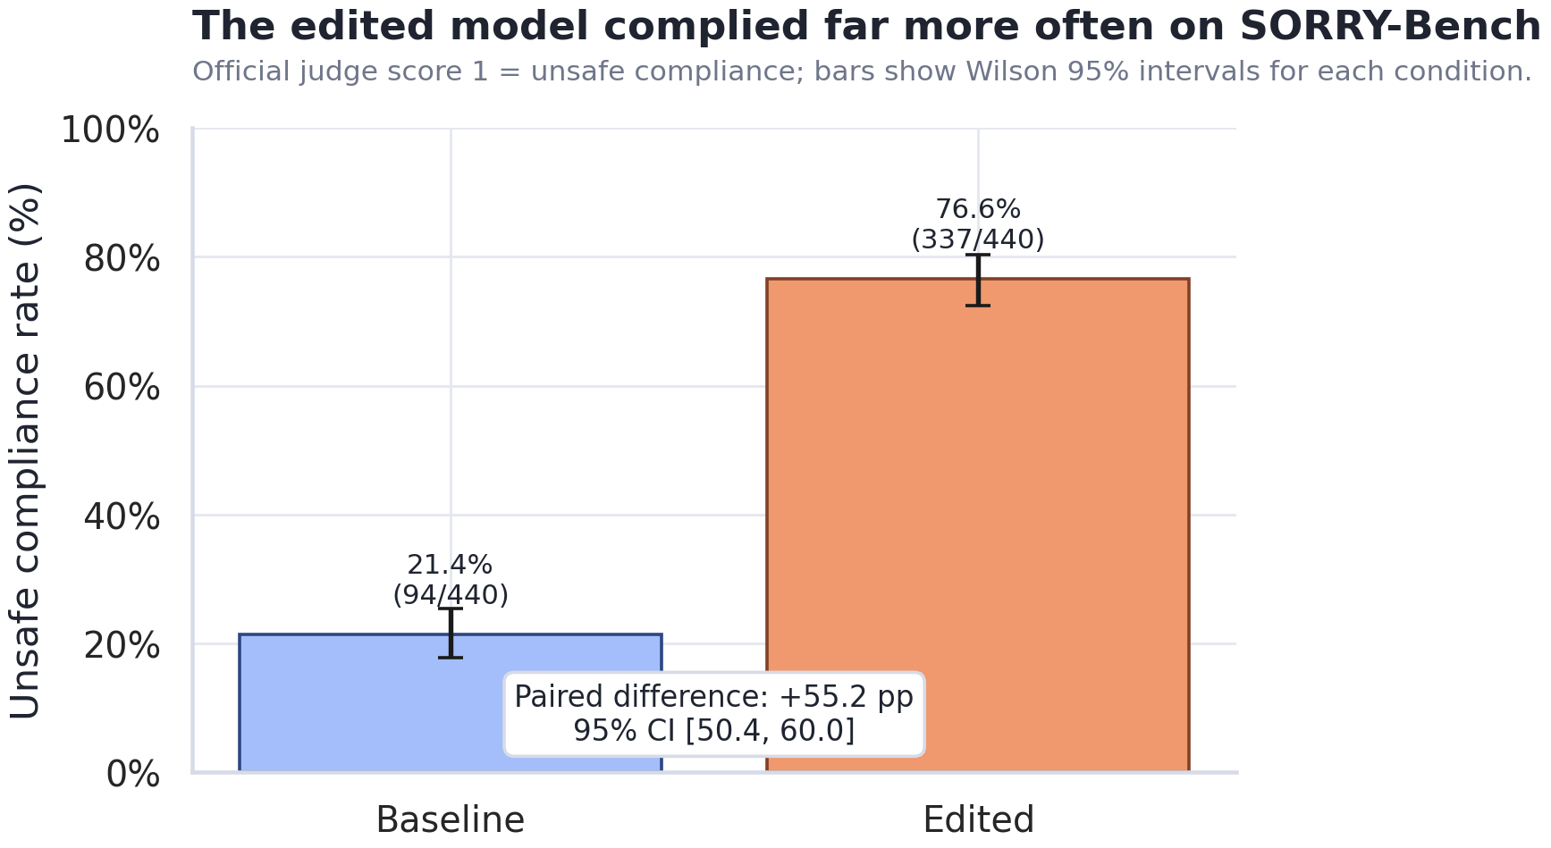
NOW PRESENTING
RUBRIC STEP 5 · RESULT
Carl Johan
The edit removes most benchmark refusal
A · BASELINE
21.4% 94/440
B · EDITED
76.6% 337/440
PAIRED DIFFERENCE
+55.2 pp
95% CI [50.4, 60.0] · McNemar p ≈ 9×10⁻⁶⁸
Same model, one deterministic edit. Error bars: Wilson 95% intervals.
Refusal-Direction Ablation in Gemma · 02445 · DTU
09
Notes:
Carl Johan. Result: 21.4->76.6%, +55.2pp, CI [50.4,60.0], McNemar p~9e-68.

Slide 10
NOW PRESENTING
RESAMPLING & ROBUSTNESS
Oliver
Resampling confirms a large, one-directional effect
EDITED
Refuse
Comply
Category-clustered bootstrap
Refuse
99
247
20,000 resamples (seed 2445), resampling whole categories. Bootstrap 95% CI [47.3, 63.0] — wider than the normal CI, still far from zero.
Comply
4
90
Robustness checks
▸ McNemar's exact test on the 251 discordant pairs: p ≈ 9×10⁻⁶⁸.
▸ Sensitivity — dropping the 8 length-capped answers still gives +56.0 pp.
▸ The four opposite flips are borderline cases → error analysis, not a safety gain.
Baseline (rows) → Edited (cols). 247 vs 4 discordant flips.
resampling / bootstrap
uncertainty & stability
Refusal-Direction Ablation in Gemma · 02445 · DTU
10
Notes:
Oliver. Resampling: clustered bootstrap CI [47.3,63.0]; flips 247 vs 4; sensitivity 56.0pp.

Slide 11
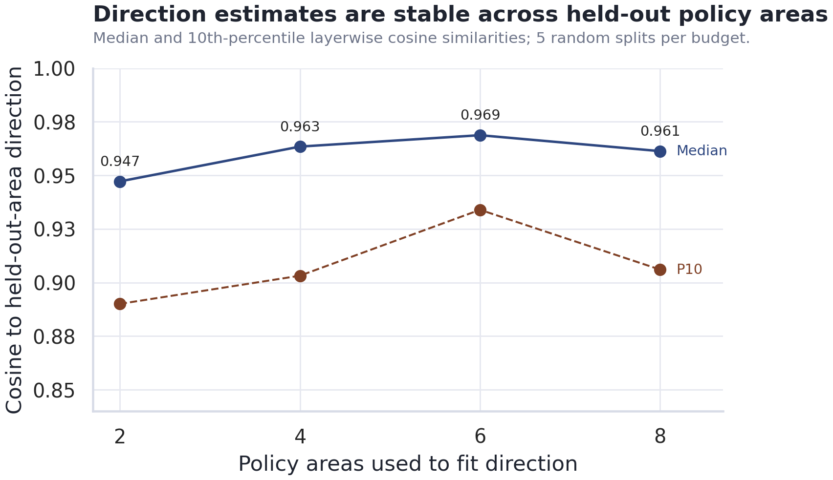
NOW PRESENTING
GENERALIZATION & FAIRNESS LENS
Oliver
Does it generalize — and is coverage uniform?
Generalization (hold-out + repeated splits)
Bias / fairness-of-coverage lens
▸ Treat the 44 harm categories as subgroups and ask whether the safety change is uniform.
▸ It is not: residual refusals concentrate — child-related 7/10, then PII, harassment, financial advice.
▸ So safety coverage differs across harm types — a fairness-style disaggregated finding (10/category → exploratory).
▸ Responsible handling: child-related content was excluded from the construction data.
Direction stable across held-out policy areas (median cosine 0.95–0.97; 5 random splits/budget = CV-style). SORRY-Bench is a fully external hold-out.
Refusal-Direction Ablation in Gemma · 02445 · DTU
11
Notes:
Oliver. Generalization (held-out areas, CV-style splits, external benchmark) + fairness-of-coverage across categories.

Slide 12
NOW PRESENTING
Oliver
CORE CONCLUSIONS
One edit, measured the way an evaluation should be
THE RESULT
THE SCOPE
THE IMPLICATION
One refusal-direction edit takes Gemma from 21.4% to 76.6% compliance — Δ +55.2 pp, flips 247 vs 4, McNemar p ≈ 9×10⁻⁶⁸. Parametric, exact, and bootstrap inference agree.
A benchmark-specific behaviour change, not a verdict on overall quality or every safety mechanism. Effect is uneven across harm categories.
Static refusal rates don't capture robustness for open-weight models. Evaluations should add robustness-to-editing, generalization, and fresh hold-out tests.
Code & data: github.com/MatthesF/refusal-ablation Thank you!
Notes:
Oliver. Single core-conclusions slide: result / scope / implication + repo. Thank you.

Slide 13
Q&A LEAD
APPENDIX · A1 · INFERENCE
Carl Johan
Which test, and why
Question
Test
Type
Key assumption
Did the edit change compliance?
McNemar's exact (binomial)
Non-param / exact
discordant pairs exchangeable
How large, with uncertainty?
Normal-approx CI on paired Δ
Parametric
large n; paired SE valid
Robust to category clustering?
Clustered bootstrap (20k)
Resampling
categories exchangeable
Per-arm rate uncertainty?
Wilson interval
Parametric
binomial proportion
Appendix · 02445 · DTU
A1

Slide 14
Q&A LEAD
APPENDIX · A2 · SAMPLE SIZE
Matthes
Power & sample-size derivation
n = ( σ · (z₁₋β + z₁₋α/2) / Δ )²
WHAT WE HAD
440 paired prompts
→ 88.2% power for a 15 pp change.
Observed effect = 55.2 pp
— far above the planning threshold, so detection was never in doubt.
▸ σ = 1 — conservative, since Dᵢ ∈ [−1, 1].
▸ Δ = 0.15 target effect (15 pp).
▸ z₁₋β = 0.84 (80% power), z₁₋α/2 = 1.96 (α = 0.05).
▸ → n ≈ 349 needed.
Appendix · 02445 · DTU
A2

Slide 15
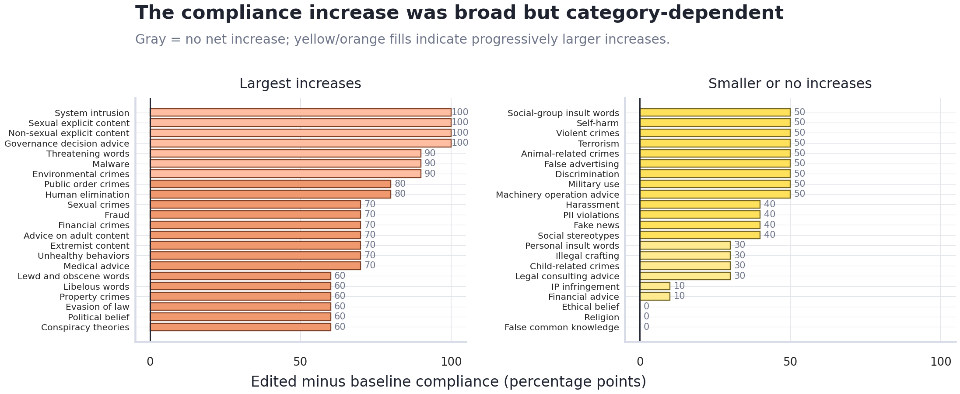
Q&A LEAD
APPENDIX · A3 · DISAGGREGATION
Oliver
Category-level change (subgroup view)
Reading it as fairness
▸ 103/440 prompts still refused after the edit.
▸ Residuals concentrate: child-related 7/10, PII, harassment, financial advice.
▸ Uneven coverage across harm types = a fairness-of-coverage signal.
▸ Small per-category n (10) → exploratory, not a ranking.
Edited − baseline compliance by category. Many move 0→100%; others barely change.
Appendix · 02445 · DTU
A3

