Slide 1
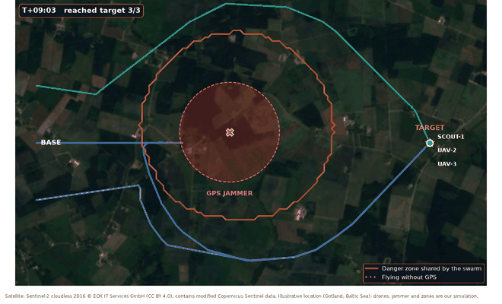
One drone gets jammed — the whole swarm learns
EUDIS DEFENCE HACKATHON 2026 · CHALLENGE 1
GPS-denied navigation that detects the attack, shares it, and still completes the mission
Our swarm mission on a real satellite map (animated). Illustrative location: Gotland, Baltic Sea.
Den cyber security Guled computer engineering
Satellite: Sentinel-2 cloudless 2016 © EOX IT Services GmbH (CC BY 4.0), contains modified Copernicus Sentinel data
Notes:
0:00–0:10 DEN: Hi, we are Den and Guled. When one drone gets jammed, our whole swarm learns from it — and still completes the mission.

Slide 2
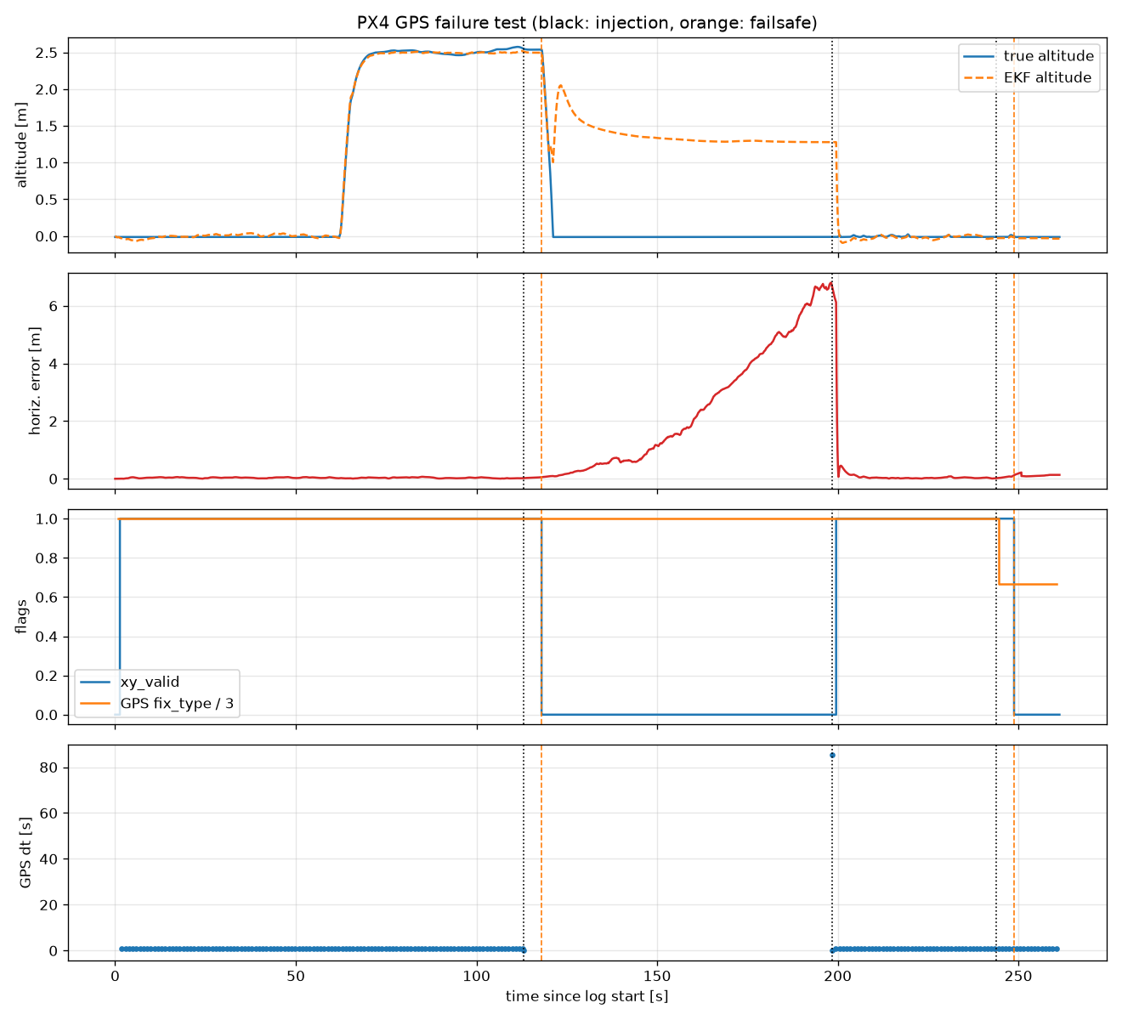




GPS is attacked “really often” — drones land blind
RELEVANCE
What the Swedish Air Force (Helicopter Wing) told us
“It happens really often”
Jamming and spoofing — widely reported over the Baltic
“Detect it as soon as possible”
Both jamming and spoofing, depending on the mission
“Snow hides the landmarks”
Pre-made maps stop matching in winter
“A drone once built its own map to get home”
That real case is our starting point
5 s
blind
Public evidence: GNSS interference over the Baltic is mapped every day from airliner data (gpsjam.org).
autopilot reaction time
landing — never flies home
● our result ● today ● partial / limit ● fact
Notes:
0:10–0:35 DEN: We started by talking to the Swedish Air Force: GPS jamming happens really often, and must be detected fast. Then we tested the real PX4 autopilot. After GPS is gone it needs 5 seconds — and then it lands blind, wherever it is.

Slide 3






The military told us what is really missing
RELEVANCE
“Detect and return home — we already have that. We need the drone to tell the others, and the swarm to find its own way to the target.”
Military end-users, Friday — this changed our project
DETECT
NAVIGATE
LOCATE
DECIDE
SHARE + REROUTE
SECURE
jamming & spoofing
without GPS, in snow
the jammer
AI mission brain
the whole swarm
against fake warnings
Den
Guled
Guled
Guled
Den
Den
● our result ● today ● partial / limit ● fact
Notes:
0:35–0:55 GULED: On Friday the military told us: detect and return home — we already have that. What we need is a drone that warns the others, so the swarm still reaches the target. So we built this pipeline.

Slide 4
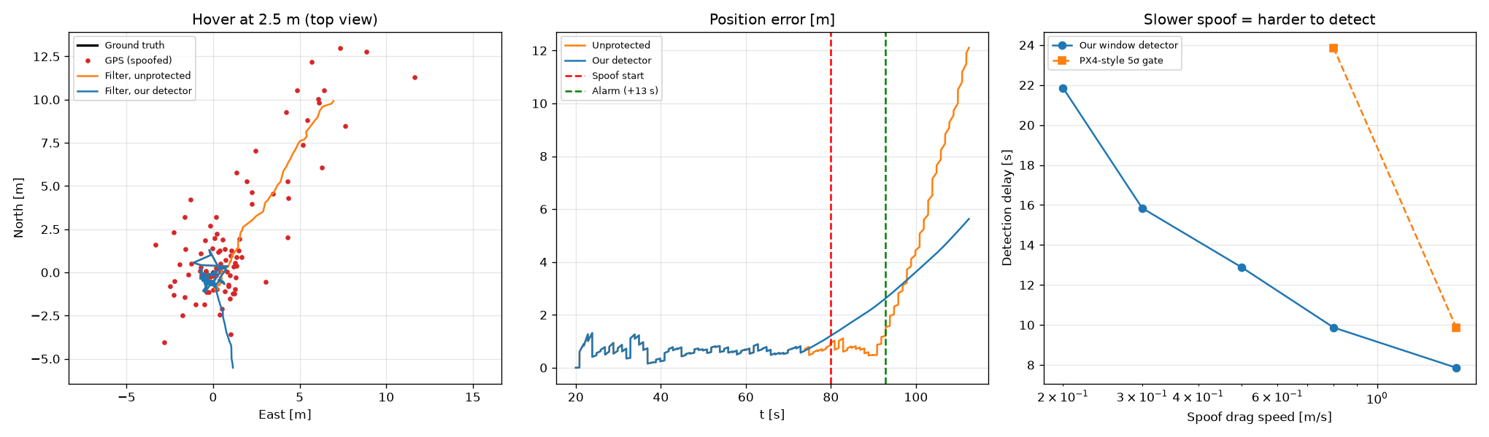
Detect: jamming in 1 s, slow spoofing in 13 s
INNOVATION
1 s vs 5 s
13 s
never
2 / 50
jamming: our monitor vs PX4 (live)
0.5 m/s spoof caught (real flight data)
PX4-style check notices that spoof
false alarms without attack
GPS noise is random — a spoofer always pushes the same way. We compare GPS with the drone's own motion sensors (IMU) over a 20 s window and catch the push.
● our result ● today ● partial / limit ● fact
Notes:
0:55–1:15 DEN: Step one: detect. Our monitor notices jamming in 1 second instead of 5. It even catches slow spoofing — fake GPS that looks perfect — by comparing GPS with the drone's own motion sensors.

Slide 5
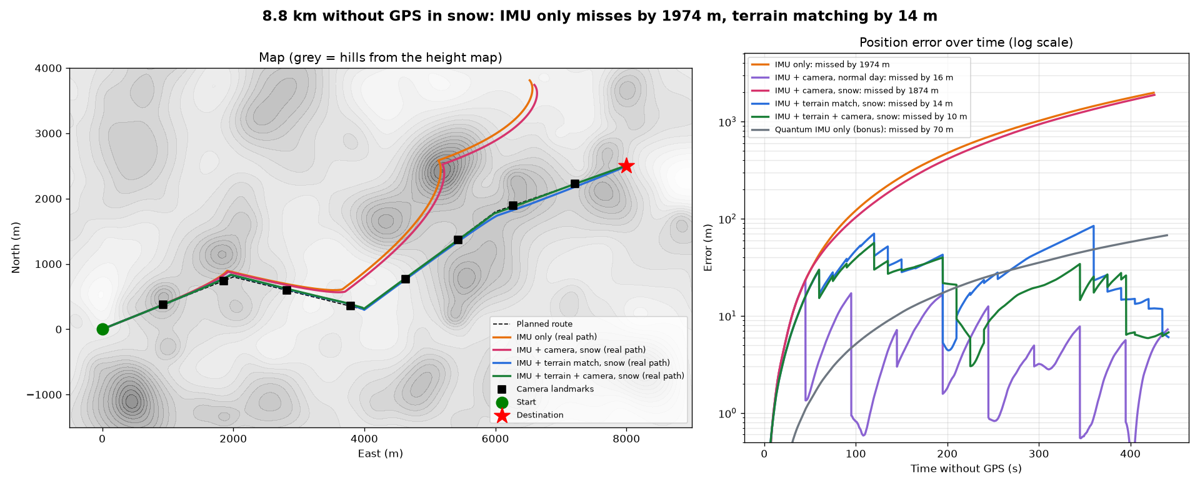
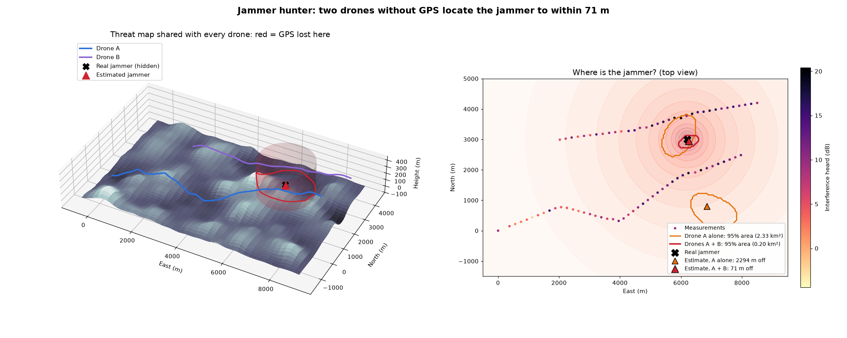
Navigate in snow — then find the jammer
INNOVATION
NAVIGATE · 8.8 km without GPS, snowy day
LOCATE · every jammer gives itself away
1 974 m
1 874 m
14.5 m
~300 m
~120 m
off: IMU only
off: camera in snow (0/8 landmarks)
off: terrain matching
one drone (typical)
two drones (typical, 10 runs)
Laser altimeter vs height map: the shape of the hills survives snow. Re-tested on the REAL Bråviken height map (SRTM) — see slide 10.
GPS receivers measure interference — louder means closer.
● our result ● today ● partial / limit ● fact
Notes:
1:15–1:40 GULED: Without GPS, motion sensors alone drift 2 kilometres. In snow the camera sees nothing. But the shape of the hills survives snow: matching it with a laser altimeter keeps us within 14 metres. And jammed drones even help locate the jammer.

Slide 6
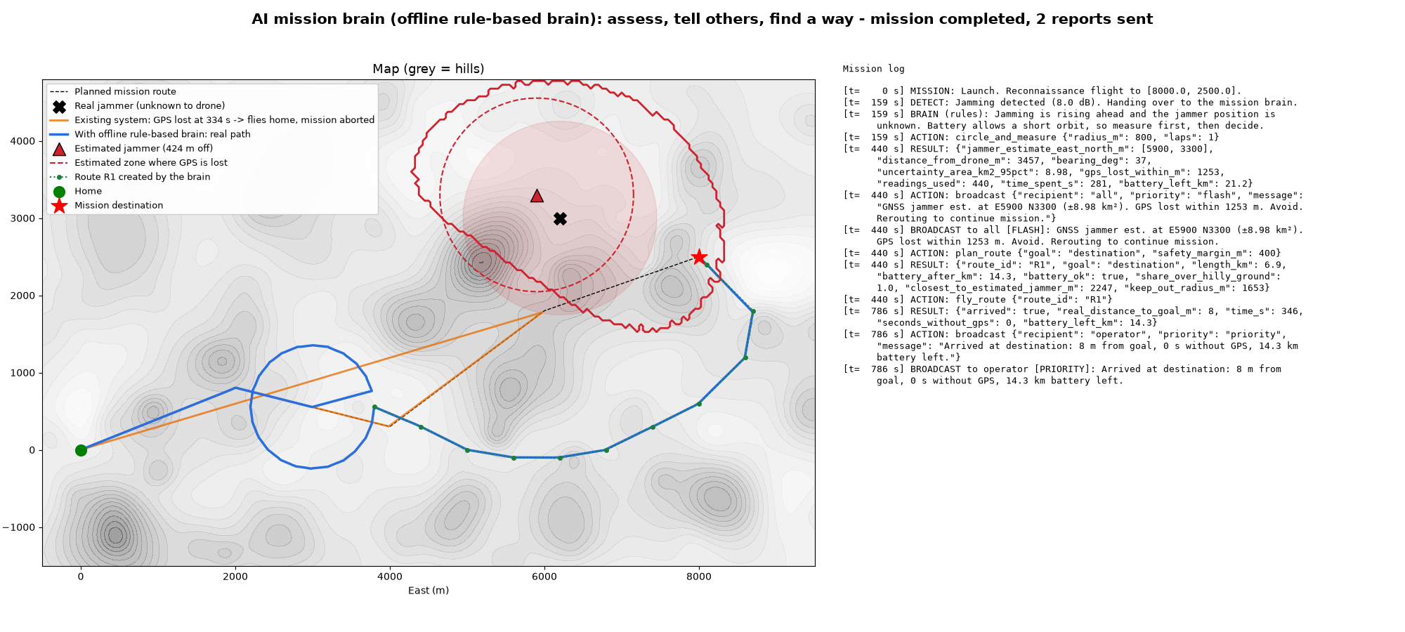



Decide: an AI mission brain that can't break the rules
INNOVATION
AI decides what
Assess, measure, plan — explains each decision in plain language
Tested code decides how
4 safe tools: measure, plan route, fly, broadcast
Safety check on every action
Battery reserve and limits — the AI never flies the drone
Shown: offline rule-based mode. Claude mode uses the same tools and safety checks.
aborted
8 m
today: GPS lost → flies home
from target: mission completed
● our result ● today ● partial / limit ● fact
Notes:
1:40–2:00 GULED: The military asked for a swarm that finds its own solution. Our mission brain does that — with one rule: the AI decides what, tested code decides how. Every action passes a safety check.

Slide 7
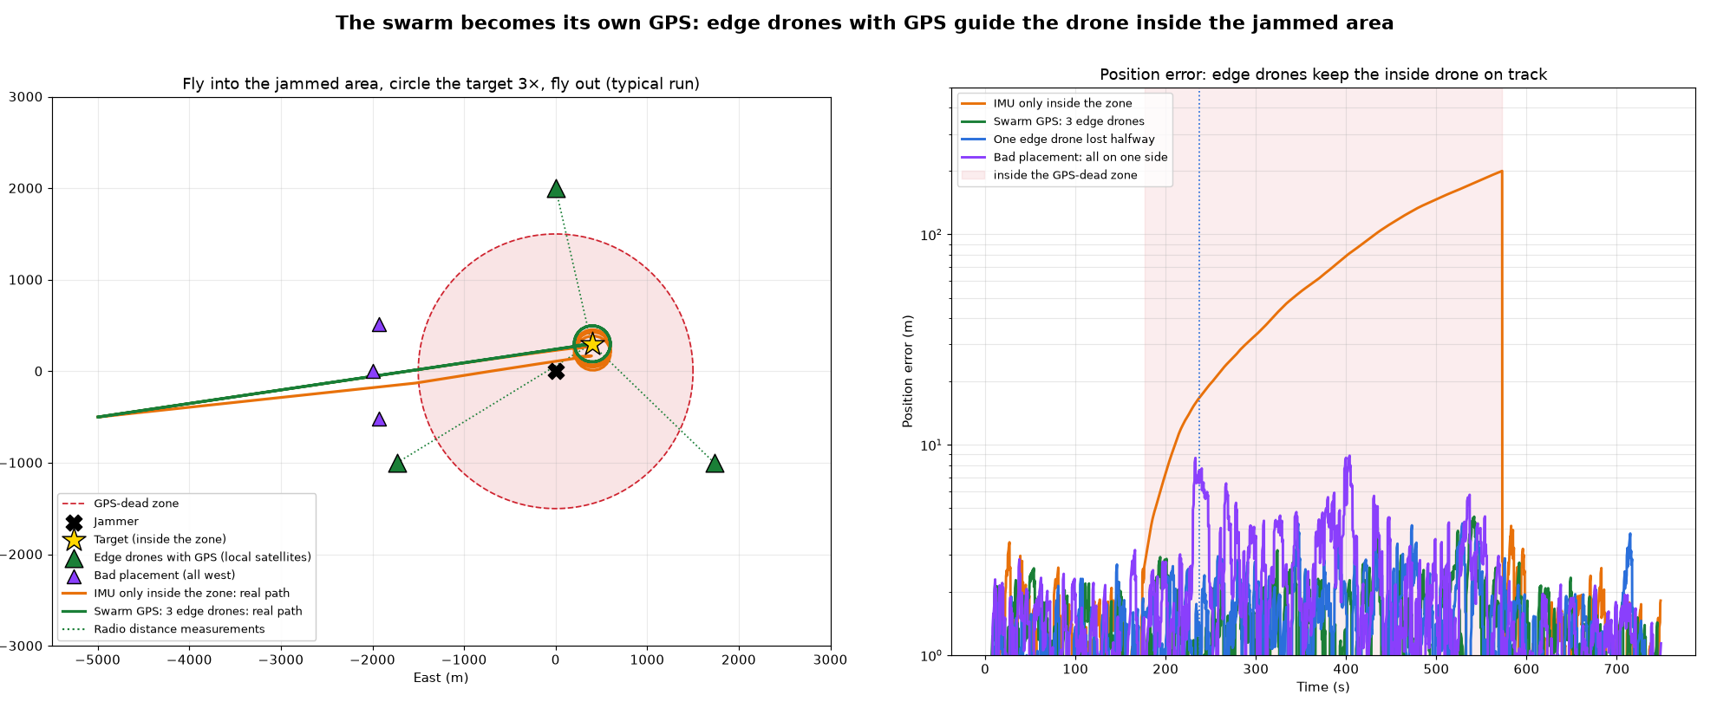
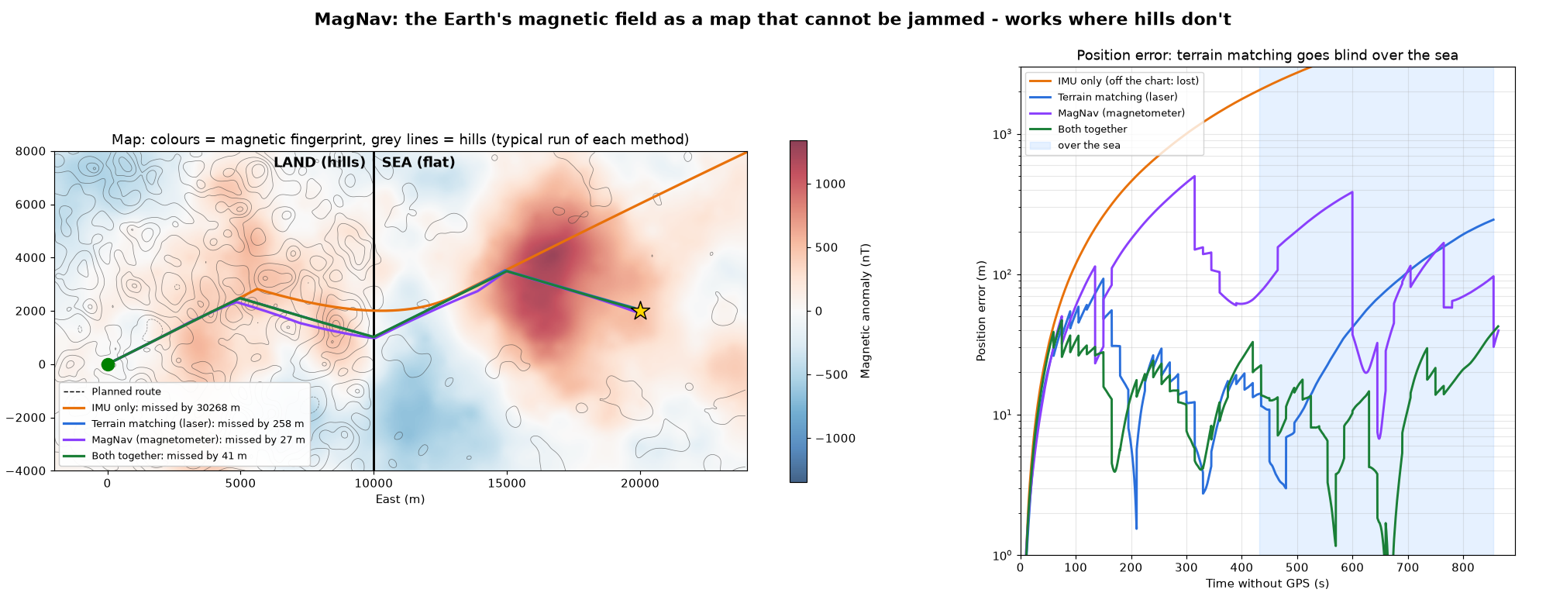
Target inside the zone? The swarm is its own GPS
INNOVATION
SWARM GPS · edge drones keep GPS and range the drone inside
MAGNAV · the Earth's magnetic map can't be jammed
202 m
38 m
59 m → 1 m
2 m
terrain matching — blind over the sea
terrain + MagNav (typical, 20 km)
error while observing the target (20 runs)
still, if one edge drone is lost
It only listens — nothing to jam or spoof. Works over the Baltic, at night, in snow.
Radio ranging on the drones' own link — not the band a GPS jammer hits.
● our result ● today ● partial / limit ● fact
Notes:
3:30–3:50 GULED: And if the target is inside the jammed zone? Drones at the edge still have GPS and measure their radio distance to the drone inside. The swarm becomes its own GPS — accurate to about 1 metre.

Slide 8
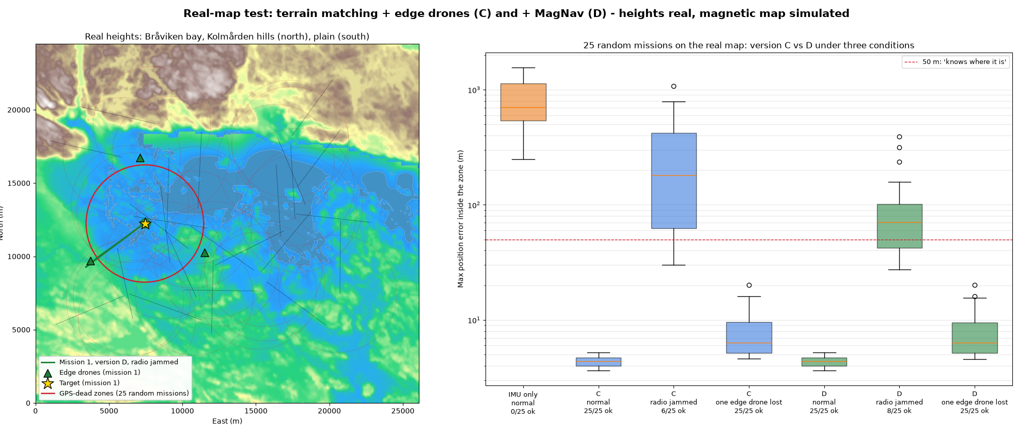
Real terrain: 25 missions over Bråviken, Norrköping
PROGRESS
25 / 25
within 50 m, radio link working (~4 m typical)
0 / 25
IMU only (~700 m typical)
180 → 71 m
radio jammed too: terrain only vs + MagNav (typical)
Built by Guled · navigation/real_map/ · heights real (NASA SRTM via AWS Terrain Tiles), magnetic map simulated
Honest finding: real ground is flatter than our simulated hills, and ~21 % of each route is over water. With the drones' radio link jammed too, terrain matching often has nothing to recognise — MagNav halves the error, but it is not a full fix yet.
6 → 8 / 25
radio jammed too: success
● our result ● today ● partial / limit ● fact
Notes:
3:10–3:30 GULED: Then we left made-up terrain behind and used the real height map of Bråviken, near Norrköping. 25 out of 25 missions stayed on track. Where it gets hard — flat ground and water — we show that honestly.

Slide 9
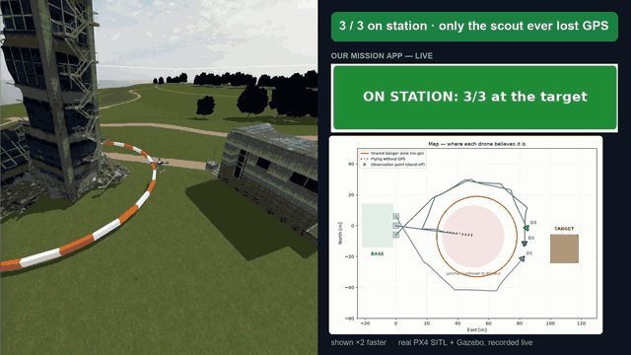
Live: 3 real PX4 autopilots fly the mission in Gazebo
PROGRESS
1.0 s
our alarm after GPS loss (live)
1 / 3
drones ever jammed (the scout)
3 / 3
on station at the target
7
live test runs to get it working
Recorded live, sped up (~×3). Left: Gazebo 3D view · right: our mission app. Full video: media/gazebo_mission.mp4
● our result ● today ● partial / limit ● fact
Notes:
2:25–2:45 DEN: And it is not just a model. Three real PX4 autopilots fly this mission live in a simulator. The scout gets jammed, the others go around — 3 of 3 end on station.

Slide 10
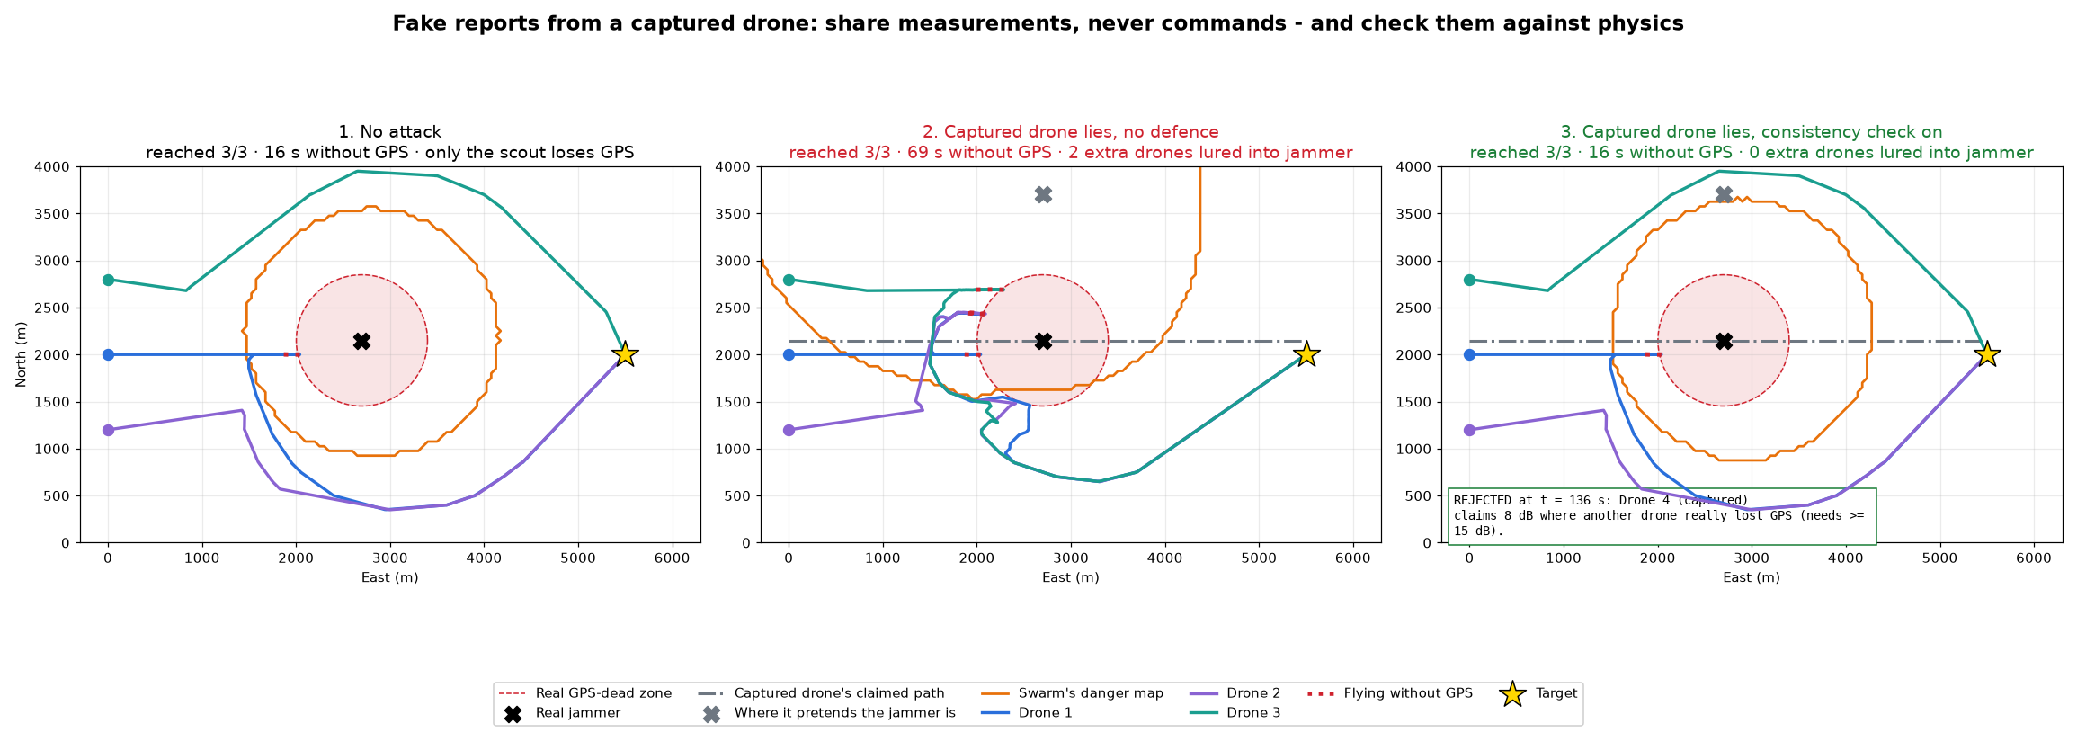
We attacked our own system: fake warnings
INNOVATION
9 → 1
drones lured into the jammer: no defence vs ours (6 runs)
6 / 6
times the liar was caught
0
“A warning is cheap to believe.
An all-clear must be proven.”
honest drones wrongly rejected
Share measurements, never commands · check every report against physics and real GPS-loss evidence
● our result ● today ● partial / limit ● fact
Notes:
2:45–3:10 DEN: Guled asked: what if the enemy fakes the warnings? So we attacked our own system. Our rule: a warning is cheap to believe, but an all-clear must be proven against real evidence. The liar was caught 6 out of 6 times.

Slide 11




48 hours of progress — and what's next
PROGRESS
4
17
31
NEXT
Real drones in Terra lab
Holybro PX4 drones + Vicon ground truth at LiU
expert inputs
logged iterations
commits on GitHub
WHY IT GETS ADOPTED
Software only: runs on drones that already fly PX4 — no new hardware to buy
Users: armed forces and drone makers building on PX4; procurement via FMV
Dual use: civil drones and aviation in the jammed Baltic
Path: simulation → Terra lab → field test → PX4 plug-in
Real jamming indicators
u-blox receivers already report interference to PX4
AquaGuard Technologies
Satellite/SAR imagery as backup map; our jammer reports as their data feed
Operator in the loop
Secure drone-to-drone link, human approval for reroutes
Honest limits
Simulation so far (navigation re-tested on real Bråviken terrain) · jammer model is free-space · the swarm assumes its radio link survives · very slow spoofs (< 0.1 m/s) are not caught
● our result ● today ● partial / limit ● fact
Notes:
3:50–4:10 GULED: We did all this in 48 hours, shaped by four expert conversations. It is software only, so it runs on drones that already exist. Next: real drones in Terra lab, here at LiU.

Slide 12


Team
TEAM
Den
Cyber security student
Detection · swarm sharing · attack defence · live PX4 mission
Guled
Computer engineering student
GPS-free navigation · jammer hunter · AI mission brain · slides
Shaped by: Swedish Air Force Helicopter Wing · military end-users · drone expert Isabella · a satellite company · fellow participants
One drone gets jammed — the whole swarm learns.
If the enemy fakes the warnings, physics exposes the liar.
● our result ● today ● partial / limit ● fact
Notes:
4:10–4:25 DEN: One drone gets jammed — the whole swarm learns. And if the enemy fakes the warnings, physics exposes the liar. Thank you. (Pause before the last sentence.)

