Slide 1
Net-Centric Computing (CSC406) Lecture 4 Virtualization
By
F. U. Ambursa
Department of Computer Science,
Federal University Birnin Kebbi

Slide 2
TODAY’S LECTURE
Virtualization
Characteristics of virtualized environments
Taxonomy of virtualization techniques
Virtualization and cloud computing
Pros and cons of virtualization

Slide 3
Introduction
Virtualization is a broad concept that refers to the creation of a virtual version of something, whether hardware, a software environment, storage, or a network.
Virtualization is a large umbrella of technologies and concepts that are meant to provide an abstract environment—whether virtual hardware or an operating system—to run applications.
The term virtualization is often synonymous with hardware virtualization, which plays a fundamental role in efficiently delivering Infrastructure-as-a-Service (IaaS) solutions for cloud computing.
In fact, virtualization technologies have a long trail in the history of computer science and have been available in many flavors by providing virtual environments at the operating system level, the programming language level, and the application level.
Moreover, virtualization technologies provide a virtual environment for not only executing applications but also for storage, memory, and networking.

Slide 4
Intro. Cont.
Virtualization technologies have gained renewed interested recently due to the confluence of several phenomena:
Increased performance and computing capacity.
PCs have resources enough to host a virtual machine manager and execute a virtual machine.
Supercomputers can provide compute power that can accommodate execution of thousands of virtual machines.
Underutilized hardware and software resources.
Lack of space.
Greening initiatives.
Rise of administrative costs
virtualization has now become a fundamental requisite for any data center management infrastructure.

Slide 5
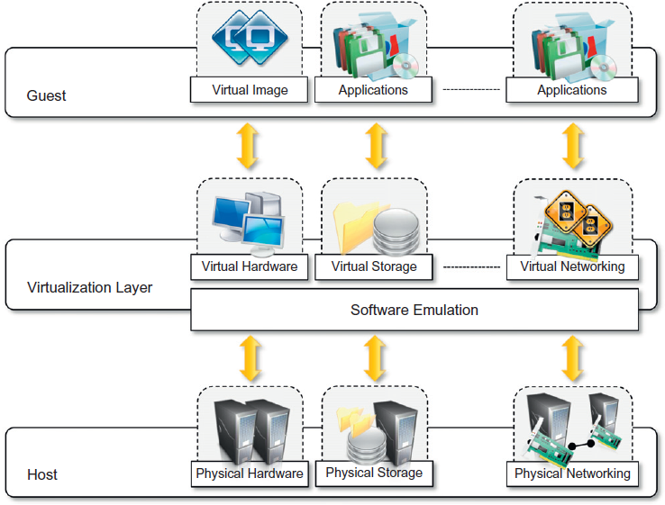
Characteristics of virtualized environments
In a virtualized environment there are three major components: guest, host, and virtualization layer.
The guest represents the system component that interacts with the virtualization layer rather than with the host, as would normally happen.
The host represents the original environment where the guest is supposed to be managed.
The virtualization layer is responsible for recreating the same or a different environment where the guest will operate.

Slide 6
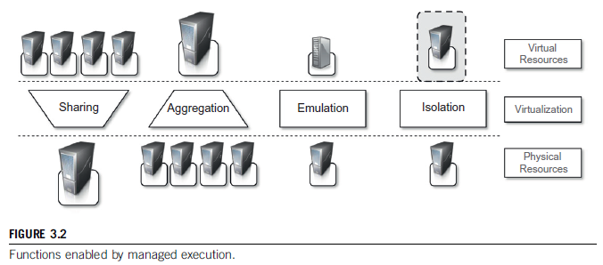
Characteristics of virtualized environments
Increased security
Managed execution
Portability

Slide 7
Taxonomy of virtualization techniques
Virtualization covers a wide range of emulation techniques that are applied to different areas of computing.
A classification of these techniques helps us better understand their characteristics and use
Virtualization is mainly used to emulate execution environments, storage, and networks.
execution virtualization constitutes the oldest, most popular, and most developed area.

Slide 8
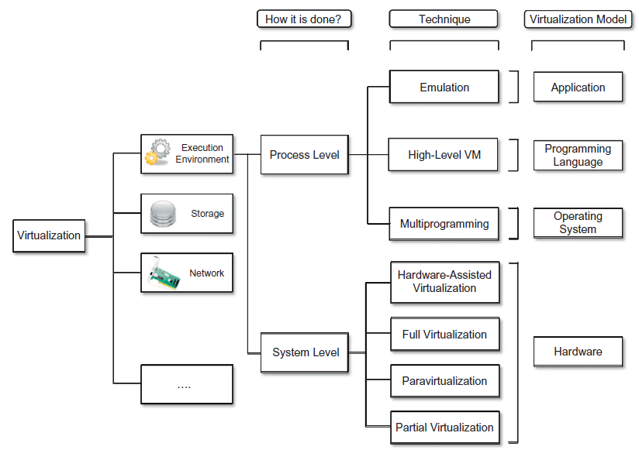
Taxonomy of virtualization techniques

Slide 9
1. Execution virtualization
Includes all techniques that aims to emulate an execution environment that is separate from the one hosting the virtualization layer
Can be implemented directly on top of the hardware by the operating system, an application, or libraries dynamically or statically linked to an application image.
Hardware-level Execution virtualization
Programming language-level Execution virtualization
Application-level Execution virtualization

Slide 10
Machine reference model
Virtualizing an execution environment at different levels of the computing stack requires a reference model that defines the interfaces between the levels of abstractions, which hide implementation details.
From this perspective, virtualization techniques actually replace one of the layers and intercept the calls that are directed toward it.
Therefore, a clear separation between layers simplifies their implementation, which only requires the emulation of the interfaces and a proper interaction with the underlying layer.
Modern computing systems can be expressed in terms of the reference model described in Figure 3.4.

Slide 11
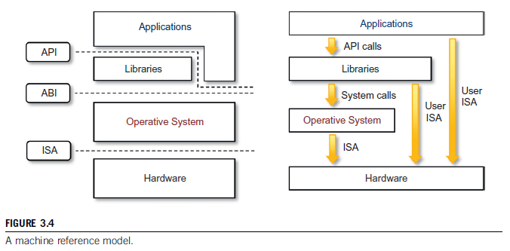
Machine reference model

Slide 12
Machine reference model Cont…
At the bottom layer, the model for the hardware is expressed in terms of the Instruction Set Architecture (ISA)
ISA defines the instruction set () for the processor, registers, memory, and interrupt management.
ISA is the interface between hardware and software
ISA is important to the operating system (OS) developer (System ISA) and developers of applications (device drivers or performance-critical applications) that directly manage the underlying hardware (User ISA).

Slide 13
Division of Instruction Set
The instruction set exposed by the hardware has been divided into different security classes that define who can operate with them:
privileged and
nonprivileged instructions.
Non privileged instructions
instructions that can be used without interfering with other tasks because they do not access shared resources.
This category contains, for example, all the floating, fixed-point, and arithmetic instructions.
Privileged Instructions
Instructions that are executed under specific restrictions and are mostly used for sensitive operations, which expose (behavior-sensitive) or modify (control-sensitive) the privileged state.
For instance, behavior-sensitive instructions are those that operate on the I/O, where as control-sensitive instructions alter the state of the CPU registers.

Slide 14
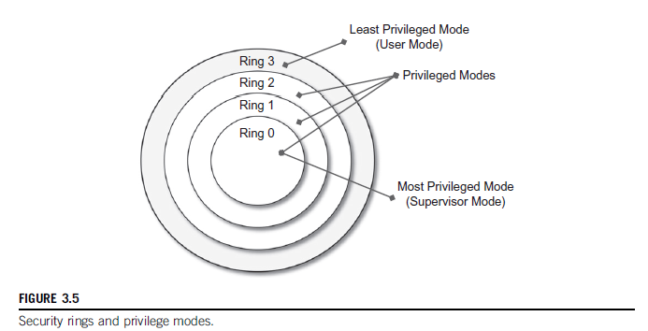
Division of Instruction Set

Slide 15
Hardware-level Execution virtualization
Hardware-level virtualization is also called system virtualization, since it provides ISA to virtual machines, which is the representation of the hardware interface of a system.
This is to differentiate it from process virtual machines, which expose ABI to virtual machines.

Slide 16
Hardware-level Execution virtualization
Hypervisors /virtual machine manager (VMM).
A fundamental element of hardware virtualization
recreates a hardware environment in which guest operating systems are installed.
The design and architecture of a virtual machine manager, together with the underlying hardware design of the host machine, determine the full realization of hardware virtualization, where a guest operating system can be transparently executed on top of a VMM as though it were run on the underlying hardware.

Slide 17
Hardware-level Execution virtualization
Types of Hypervisors
two major types of hypervisor
Type I
run directly on top of the hardware
Type II
require the support of an operating system to provide virtualization services
(see Figure 3.7).

Slide 18
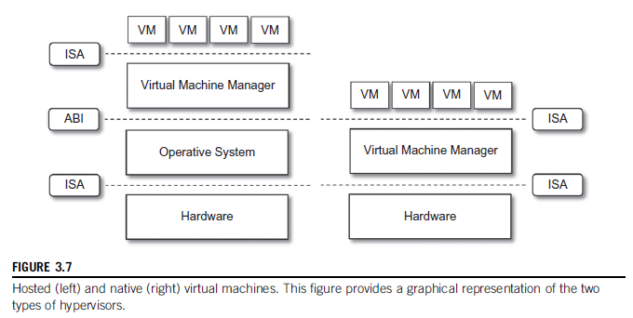
Hardware-level Execution virtualization
Types of Hypervisors

Slide 19
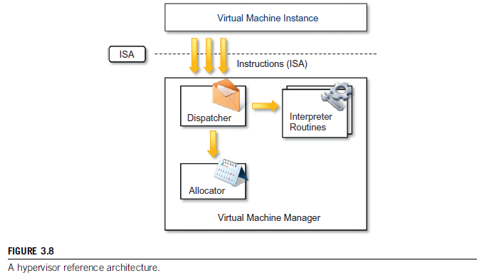
Hypervisor (VMM) Architecture
Hypervisor (VMM) Architecture
Three main modules
Dispatcher
Allocator
Interpreter

Slide 20
Hypervisor (VMM) Architecture
The dispatcher constitutes the entry point of the monitor and reroutes the instructions issued by the virtual machine instance to one of the two other modules.
The allocator is responsible for deciding the system resources to be provided to the VM: whenever a virtual machine tries to execute an instruction that results in changing the machine resources associated with that VM, the allocator is invoked by the dispatcher.
The interpreter module consists of interpreter routines. These are executed whenever a virtual machine executes a privileged instruction: a trap is triggered and the corresponding routine is executed.

Slide 21
Hypervisor (VMM) Architecture
The design and architecture of a virtual machine manager, together with the underlying hardware design of the host machine, determine the full realization of hardware virtualization, where a guest operating system can be transparently executed on top of a VMM as though it were run on the underlying hardware.
The criteria that need to be met by a virtual machine manager to efficiently support virtualization were established by Goldberg and Popek in 1974. Three properties have to be satisfied:
Equivalence. A guest running under the control of a virtual machine manager should exhibit the same behavior as when it is executed directly on the physical host.
Resource control. The virtual machine manager should be in complete control of virtualized resources.
Efficiency. A statistically dominant fraction of the machine instructions should be executed without intervention from the virtual machine manager.

Slide 22
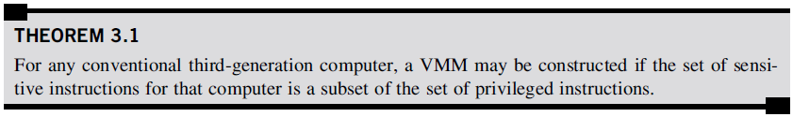
Hypervisor (VMM) Architecture
The major factor that determines whether these properties are satisfied is represented by the layout of the ISA of the host running a virtual machine manager.
Popek and Goldberg provided a classification of the instruction set (Fig. 3.9) and proposed three theorems that define the properties that hardware instructions need to satisfy in order to efficiently support virtualization.

Slide 23
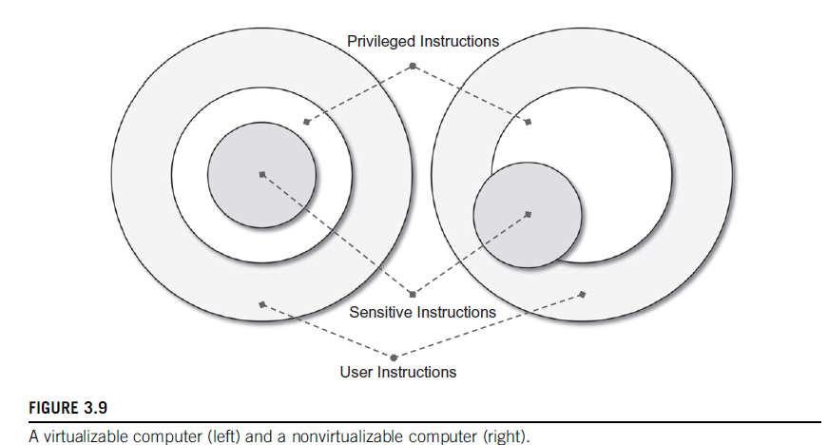
Hypervisor (VMM) Architecture

Slide 24
Hardware virtualization techniques
Hardware-assisted virtualization. This term refers to a scenario in which the hardware provides architectural support for building a virtual machine manager able to run a guest operating system in complete isolation.
Full virtualization. Full virtualization refers to the ability to run a program, most likely an operating system, directly on top of a virtual machine and without any modification, as though it were run on the raw hardware.
Paravirtualization. This is a not transparent virtualization solution that allows implementing thin virtual machine managers. Paravirtualization techniques expose a software interface to the virtual machine that is slightly modified from the host and, as a consequence, guests need to be modified.
Partial virtualization. provides a partial emulation of the underlying hard-ware, thus not allowing the complete execution of the guest operating system in complete isolation.

Slide 25
Programming language-level virtualization
Programming language-level virtualization is mostly used to achieve ease of deployment of applications, managed execution, and portability across different platforms and operating systems.
It consists of a virtual machine executing the byte code of a program, which is the result of the compilation process.
Originally created as a platform for developing Internet applications, Java became one of the technologies of choice for enterprise applications, and a large community of developers formed around it.

Slide 26
Programming language-level virtualization
The Java virtual machine was originally designed for the execution of programs written in the Java language, but other languages such as Python, Pascal, Groovy, and Ruby were made available.
Currently, the Java platform and .NET Framework represent the most popular technologies for enterprise application development.
The main advantage of programming level virtual machines, also called process virtual machines, is the ability to provide a uniform execution environment across different platforms.

Slide 27
Application-level virtualization
Application-level virtualization is a technique allowing applications to be run in runtime environments that do not natively support all the features required by such applications. In this scenario, applications are not installed in the expected runtime environment but are run as though they were.

Slide 28
2. Storage virtualization
Storage virtualization allows us to harness a wide range of storage facilities and represent them under a single logical file system.
There are different techniques for storage virtualization, one of the most popular being network-based virtualization by means of storage area networks (SANs).
SANs use a network-accessible device through a large bandwidth connection to provide storage facilities.

Slide 29
3. Network Virtualization
It is a process of logically segmenting or grouping physical network(s) and making them operate as single or multiple independent network(s) called “Virtual Network(s)”.
Enables virtual networks to share network resources.
Allows communication between nodes in a virtual network without routing of frames.
Enforces routing for communication between virtual networks.
Restricts management traffic, including ‘Network Broadcast’, from propagating to other virtual network.

Slide 30
3. Network virtualization
Network virtualization combines hardware appliances and specific software for the creation and management of a virtual network.
Network virtualization can aggregate different physical networks into a single logical network (external network virtualization) or provide network-like functionality to an operating system partition (internal network virtualization).
The result of external network virtualization is generally a virtual LAN(VLAN)
A VLAN is an aggregation of hosts that communicate with each other as though they were located under the same broadcasting domain

Slide 31
Virtualization and cloud computing
Virtualization plays an important role in cloud computing since it allows for the appropriate degree of customization, security, isolation, and manageability that are fundamental for delivering IT services on demand.
Virtualization technologies are primarily used to offer configurable computing environments and storage.
Network virtualization is less popular and, in most cases, is a complementary feature, which is naturally needed in build virtual computing systems.

Slide 32
Virtualization and cloud computing
Particularly important is the role of virtual computing environment and execution virtualization techniques.
Among these, hardware and programming language virtualization are the techniques adopted in cloud computing systems.
Hardware virtualization is an enabling factor for solutions in the Infrastructure-as-a-Service (IaaS) market segment, while programming language virtualization is a technology leveraged in Platform-as-a-Service (PaaS) offerings.

Slide 33
Virtualization and cloud computing
Besides being an enabler for computation on demand, virtualization also gives the opportunity to design more efficient computing systems by means of consolidation, which is performed transparently to cloud computing service users.
Since virtualization allows us to create isolated and controllable environments, it is possible to serve these environments with the same resource without them interfering with each other.
This opportunity is particularly attractive when resources are underutilized, because it allows reducing the number of active resources by aggregating virtual machines over a smaller number of resources that become fully utilized.
This practice is also known as server consolidation, while the movement of virtual machine instances is called virtual machine migration ( Figure 3.10).

Slide 34
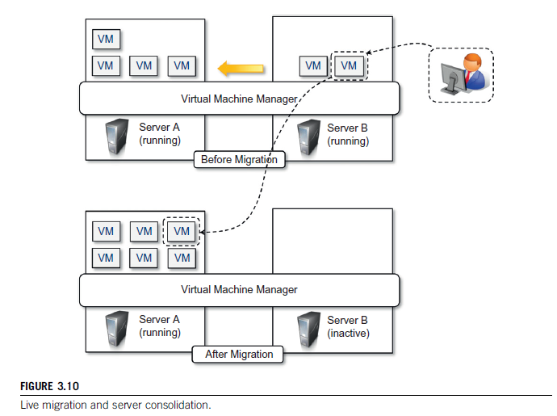
Virtualization and cloud computing
Live Migration and Server Consolidation

Slide 35
Pros and cons of virtualization
Advantages of virtualization
Managed execution and isolation are perhaps the most important advantages of virtualization.
Portability is another advantage of virtualization, especially for execution virtualization techniques.
achieve a more efficient use of resources.
Multiple systems can securely coexist and share the resources of the underlying host, without interfering with each other.
This is a prerequisite for server consolidation.

Slide 36
Pros and cons of virtualization
Disadvantages of Virtualization
Performance degradation
Since virtualization interposes an abstraction layer between the guest and the host, the guest can experience increased latencies.
Inefficiency and degraded user experience
Virtualization can lead to an inefficient use of the host. In particular, some of the specific features of the host cannot be exposed by the abstraction layer and then become inaccessible.
The virtual machine can sometime simply provide a default graphic card that maps only a subset of the features available in the host.
some of the features of the underlying operating systems may become inaccessible unless specific libraries are used.
Security holes and new threats

Slide 37
Thank You! Any Question?

