Slide 1
Classifying Art Styles With Machine Learning
Presented by Matthew Klawitter

Slide 2
The Question: Can artistic styles be classified?

Slide 3
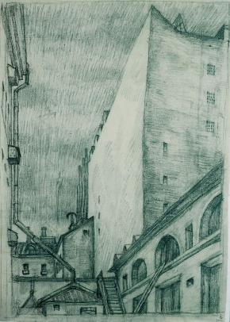
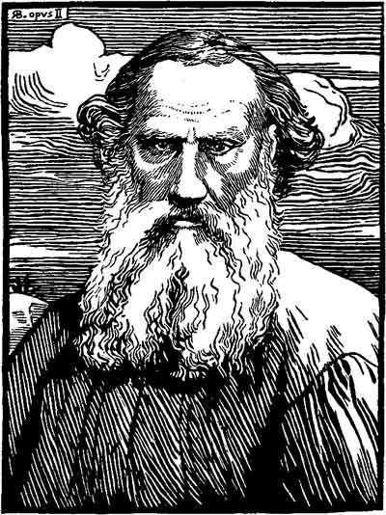
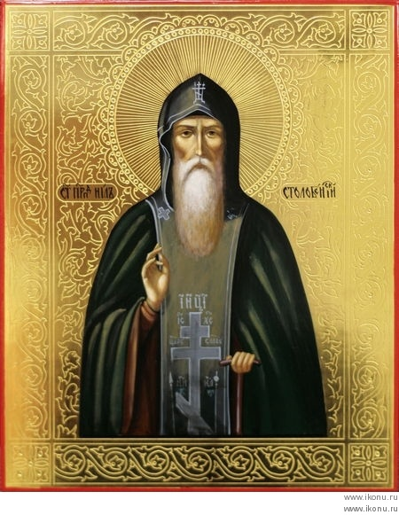
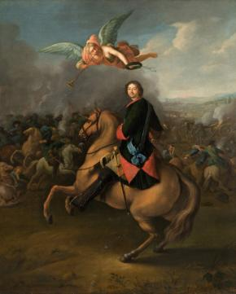
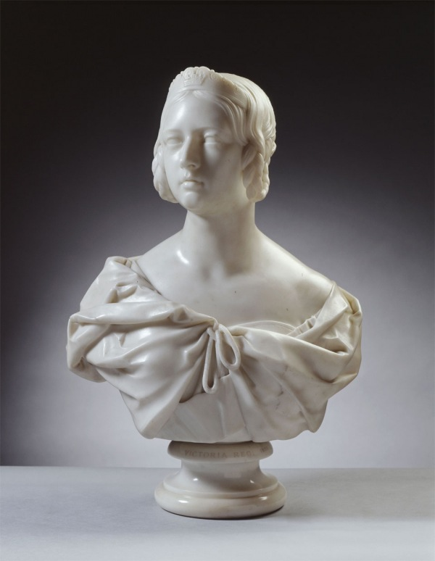
Examples
Drawings
Engraving
Iconography
Paintings
Sculptures

Slide 4
Similar Research

Slide 5
Why is this problem difficult with automation?
What makes this problem so difficult is that rules cannot be simply wrote to detect different styles of art.
It is incredibly easy for a human to identify whether a piece of art is a drawing or painting, but generally the rules and patterns that we can see, cannot easily be converted to a series of steps.
A much more convenient way to attempt this problem is through the application of machine learning by allowing algorithms to attempt to organize and classify data in a way it can naturally understand.

Slide 6
The Data Set Utilized
Source: https://www.kaggle.com/thedownhill/art-images-drawings-painting-sculpture-engraving/home
Effectively is a data set containing five different categories of self labeled images: Drawings, Engravings, Iconography, Paintings, and Sculptures. Many of these images originated from wikiart and online museums that allow access to their archive such as The Metropolitan Museum of Art.
The data is generally self-contained wherein the main features of these different styles of art are more or less represented within the data set.
The main factors outside of the data set that affects the problem at hand are figuring out how

Slide 7
Data Set Cont.
A small amount of preprocessing was performed on the data set before utilized with the algorithm. Most notable, each image was resized down to 64x64 dimensions and put into a numpy array, where it was then normalized by converting it into a float and dividing by 255.
The data set was self-labeled, with images stored in a folder denoting the classification they belonged to.
Testing was generally performed on a subset of data that was included with the data set. Generally data was split between 80% for training, and 20% for testing.
Originally, as outline in the project proposal, the goal was to obtain an accuracy of at least 50%, preferably greater, by utilizing this data set. While this established goal was not very significant, I was ultimately able to surpass this goal at 67% accuracy.
A few problems include a few corrupted image files, and duplicate data which was later removed.

Slide 8
Possible Application Features
Possible application features include the ability to take pictures and identify the art style contained within a specific image. Additionally, it may be possible to utilize this to transfer art style from one image and redraw it on another (much like deep dreaming). Through the inclusion of another dataset, it may be possible to train the model to not only identify the style, but perhaps the author and name as well.
Which features were implemented?
The ability to generate a model based on images and labels provided to the algorithm
The ability to process and image to determine its art style

Slide 9
Methodology to Solving the Problem
How did I go about solving it?
My flowchart
Which algorithm did I utilize?
Keras, utilizing a tensor flow backend

Slide 10
Results and Comparison
Success Rates, Confusion Matrix, and Error Rate
Accuracy = ~67%
Misclassification Rate = ~32%
Feature subsets were not
explored.
Which features were very
helpful/effective? The
distinctiveness of each
image, and unique image
types
Confusion Matrix | P_Drawing | P_Engraving | P_Icon | P_Painting | P_Sculpture
T_Drawing | 139 | 43 | 8 | 0 | 31
T_Engraving | 34 | 73 | 3 | 0 | 5
T_Icon | 22 | 14 | 374 | 0 | 20
T_Painting | 85 | 25 | 69 | 165 | 61
T_Sculpture | 48 | 23 | 5 | 0 | 271

Slide 11
What I Learned about the Field

Slide 12
Demonstration
Environment/Preparation
Specific Programming Steps (Going through each file, line by line)
Challenges to reproduce this
Showcasing the application in work

Slide 13
Future Steps…
Explore Keras and the Tensor Flow framework in more details
Adjust the model to obtain a higher accuracy
Obtain more data, and perhaps replace the paintings data…
Expand into classifying other art styles such as water colors, printmaking, photography, and architecture
Perhaps attempting to add more features and porting it as a mobile application?
Overall usability and appeal is somewhat low currently due to accuracy and the current implementation. Through further development and porting to a mobile platform this is expected to increase.

Slide 14
Questions?

