Slide 1
Visualization of mapping
Brief basic-summary and visual

Slide 2
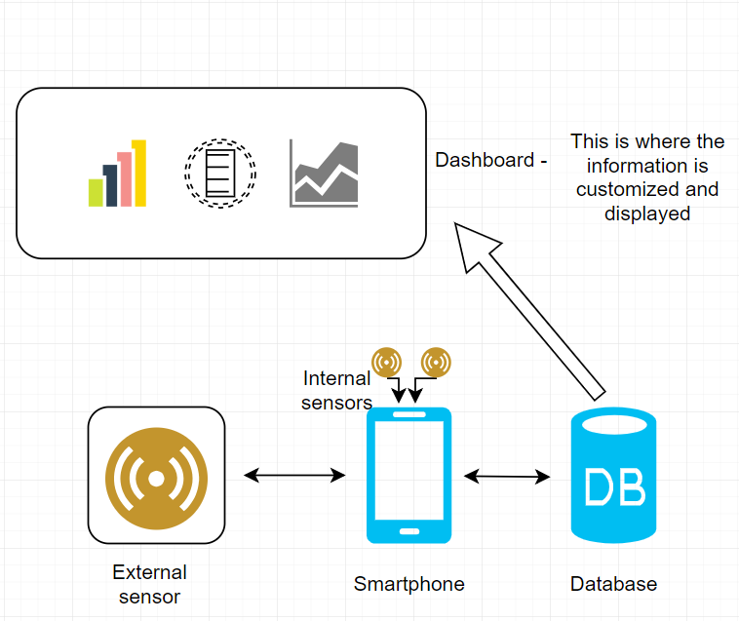
Summary: This project uses internal smartphone sensors and external Bluetooth capable sensors to collect a range of data and then transmit that information to a database. From there, this information can then be displayed in a variety of different visualizations on dashboard.
The basic structure of this project:
Collect Data
Send Data
Store Data
Display Data

Slide 3
How this works:
The majority of smartphones sold today have a range of built-in sensors that can be used for different things. With our smartphone application we can use these sensors and read the values they collect.
As all smartphone have Bluetooth as standard, it is also possible to connect Bluetooth devices to the application and extend the range of sensors that the user can gather information from.
This application will then send that information to a database to store it. We will be using Thingsboard.com for this part. On this website users can configure the settings to store information from multiple devices (smartphones) and store them separately so as to display it when needed.

Slide 4
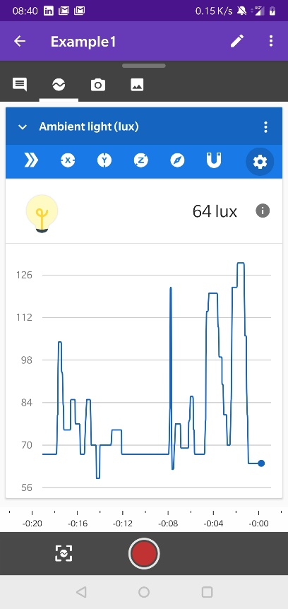
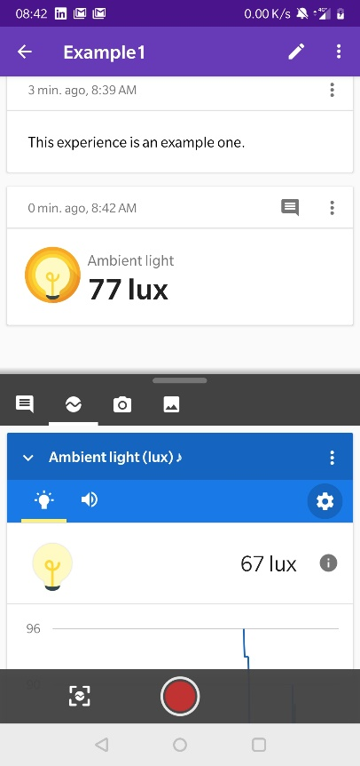
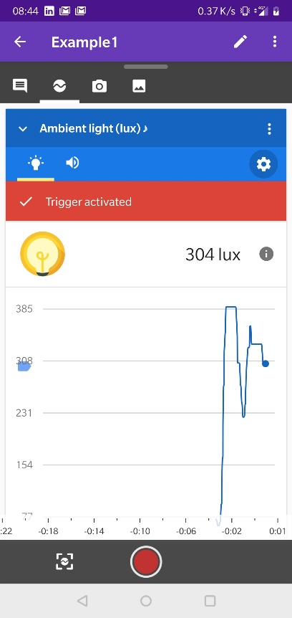
Record and interact with the data
View the senor Take notes and Set triggers
data as it is collected your own records to set off alarms

Slide 5
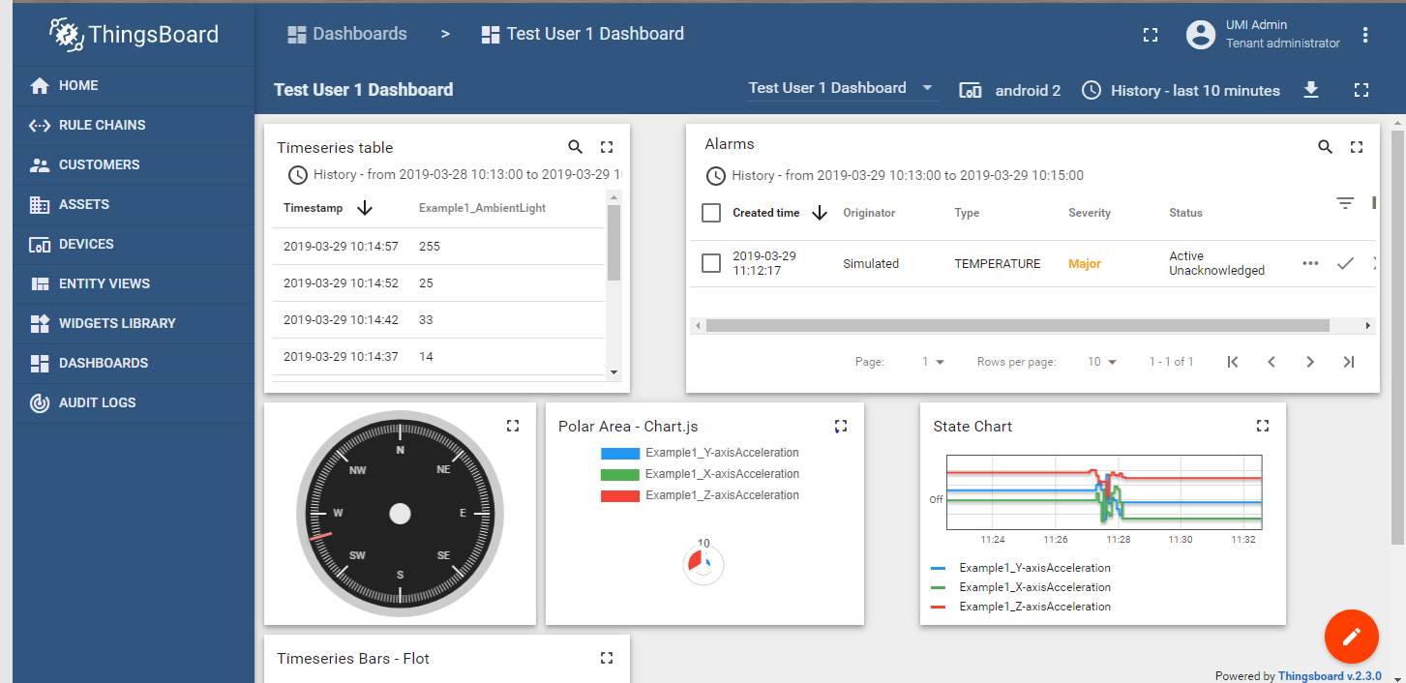
Display the data collected in a range of ways

