Slide 1
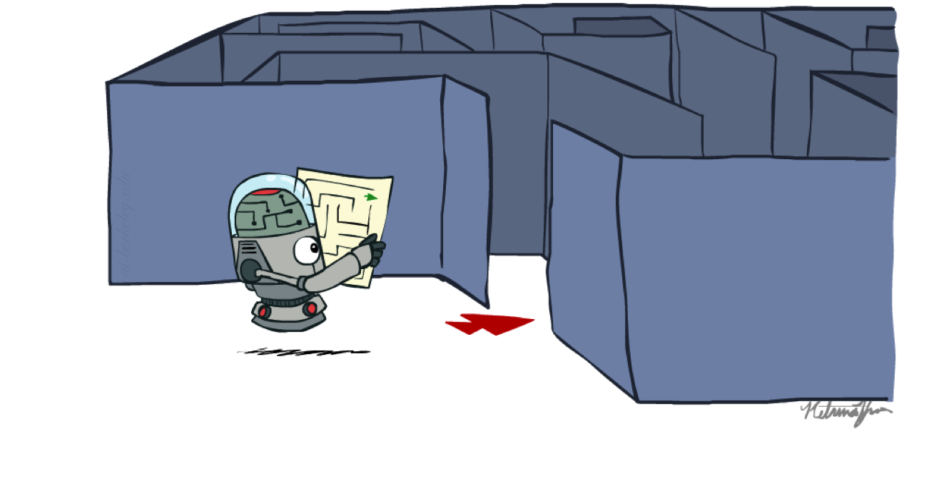
CSE 3521: HW1_Programming: Search Algorithms

Slide 2
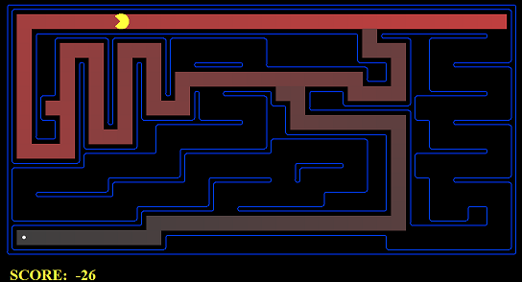
Introduction
In this homework, you are to implement four search algorithms --- DFS, BFS, UCS, and A* --- so that a Pac-Man planning agent can complete the search problem. You are to implement the "graph" search rather than the "tree" search version.
Please note the difference between the “search process (nodes that are expanded)” and the “solution (a path from the start state to the goal state)”
What to return is a solution (i.e., a sequence of actions)
There is an autograder that you can run

Slide 3
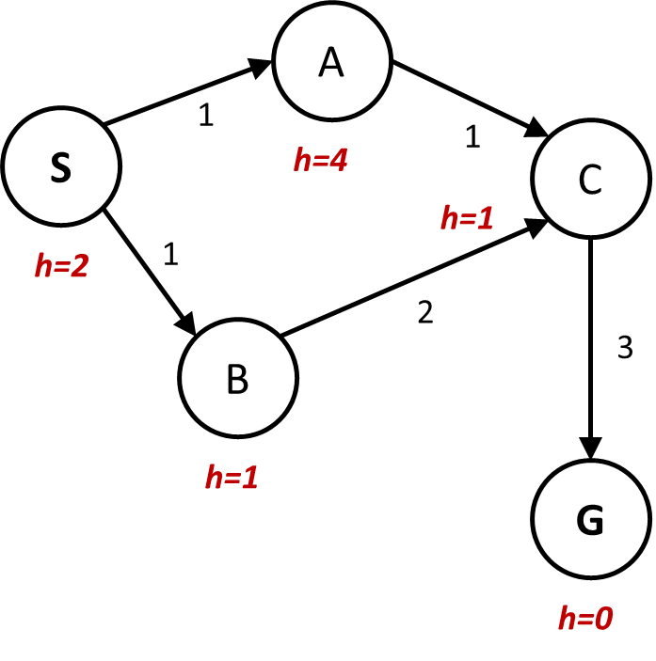
Introduction
All the search algorithms are the same except for fringe/exploration strategies. Thus, focus on implementing the first algorithm (say DFS) and the others will become easier.
A search problem
Start state
Goal states
Successor functions: with actions, costs, and next states
What you need to return:
A list of actions!
Problem.getStartState()
problem.isGoalState(state)
problem.getSuccessors(state)
Example: [“go north-east”, “go south-east”, “go-south”]

Slide 4
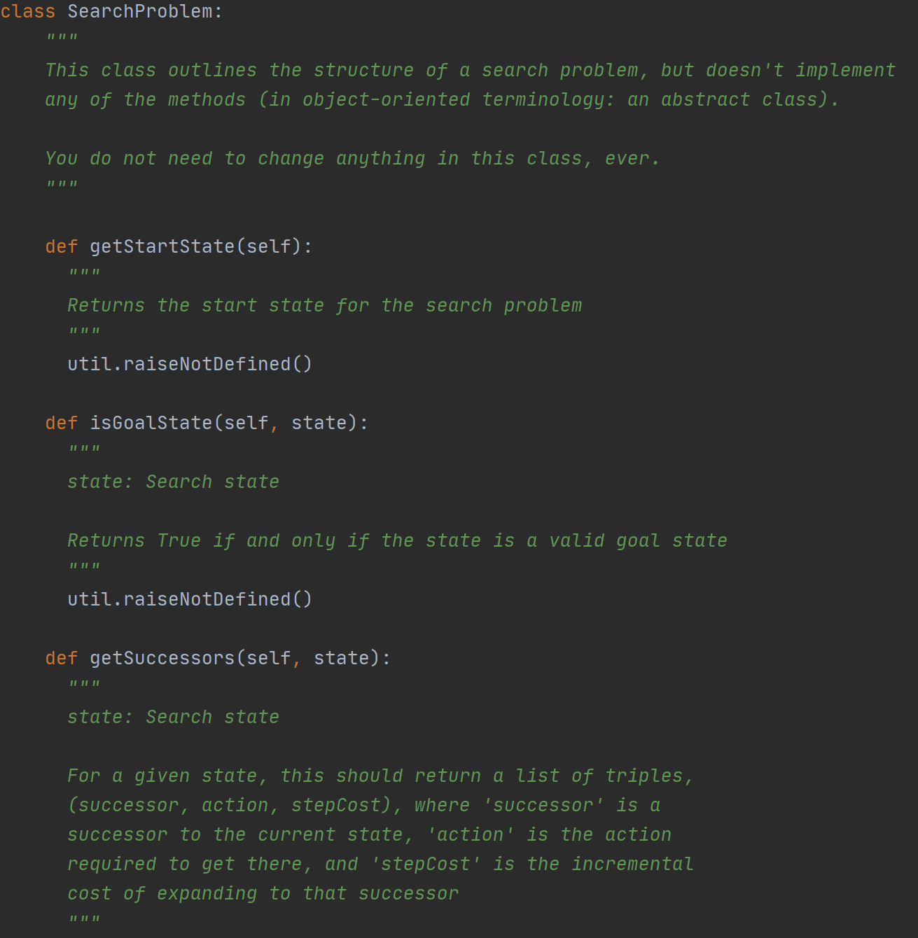
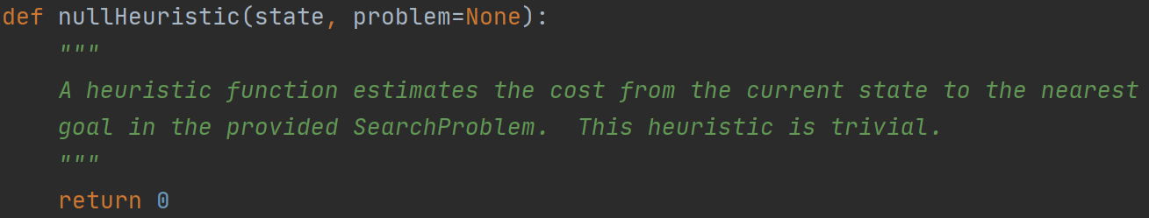
Introduction (in search.py)
You don’t need to implement any of these on the right-hand side or bottom side. Just read through them and understand the input and output of these functions.

Slide 5
Other notes
Please carefully read the pseudo-code of the "graph" search in the slides. It is very important where you:
(a) check the close-set
(b) inset states into the close-set
I have seen some earlier cases where you may do (a) when you add a node into the fringe but not when you expand that node. There is a big difference between them.
If you are not sure what the differences are, create some toy examples yourselves (on paper), and go through them.

Slide 6
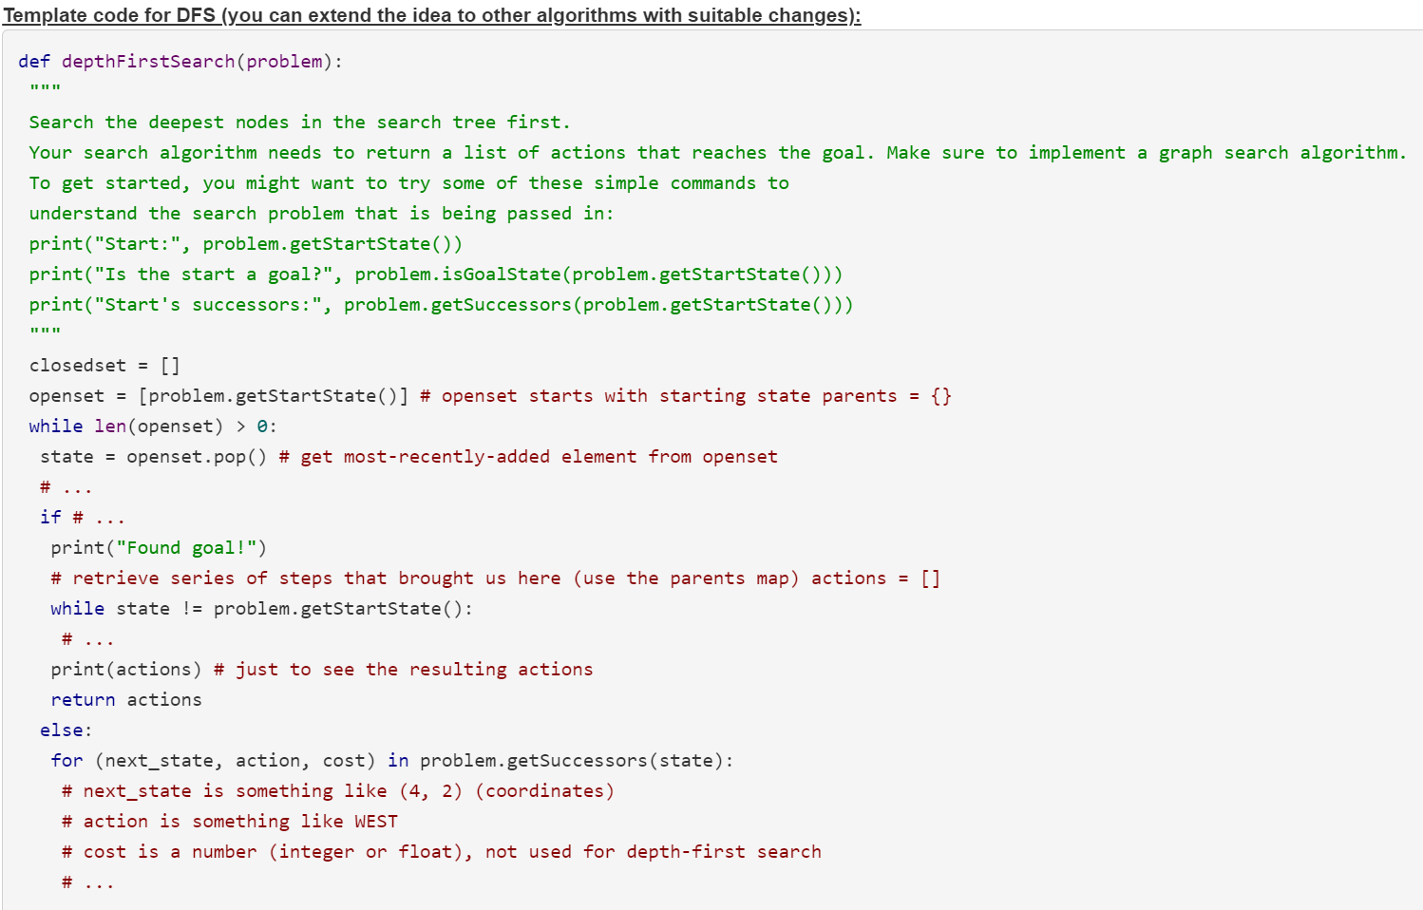
An example template (no need to follow this!)

