Slide 1
Air Pollution and Oil Boilers in NYC

Slide 2
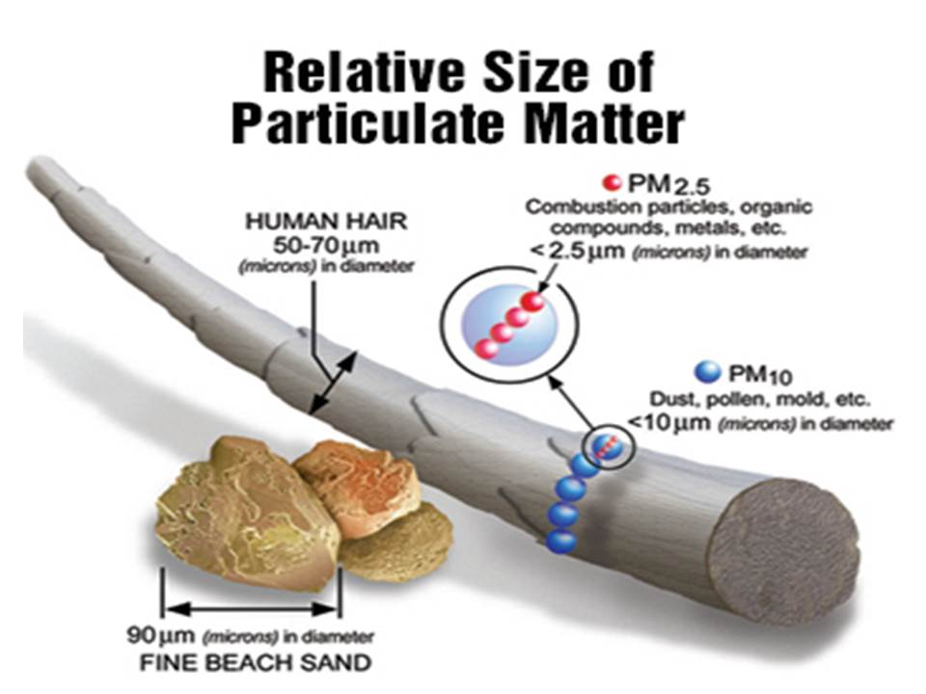
Air Pollution and Public Health
In NYC fine particulate matter (PM 2.5) causes:
3,000 deaths
2,000 hospital admissions for lung and heart conditions
6,000 Asthma ER Visits
every year

Slide 3
The Need to Regulate Heating Oil
1% of all buildings in the city produce 86% of the total soot pollution from buildings
Mayor Bloomberg passed PlaNYC in 2011 which affected over 10,000 buildings. The law required all buildings burning #6 oil to convert by mid-2015

Slide 4
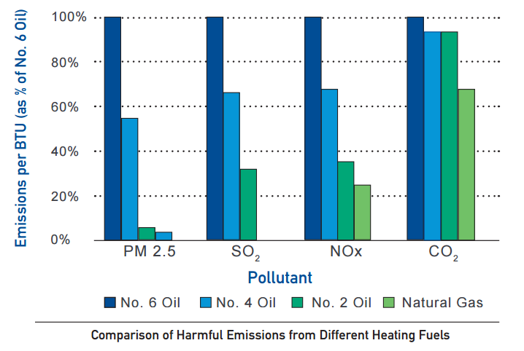
Heating Fuels and Pollution
*from Environmental Defense Fund

Slide 5
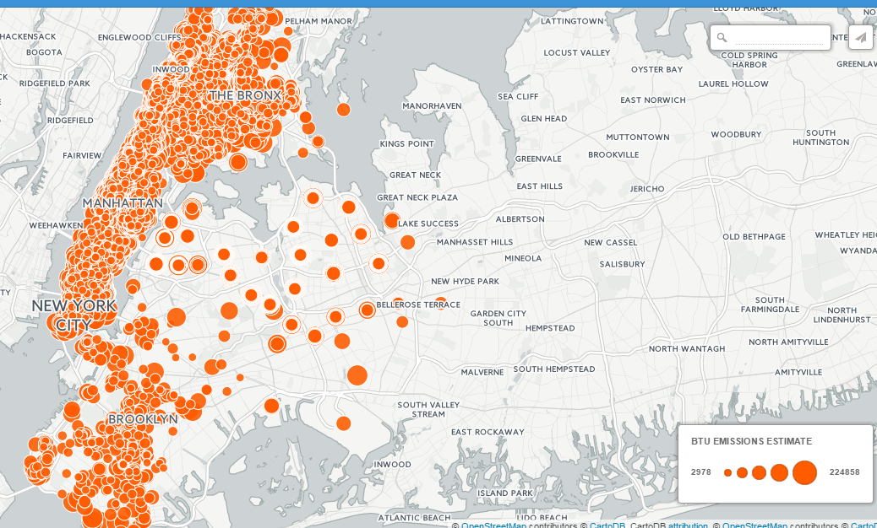
2011 Dirty Oil Boilers

Slide 6
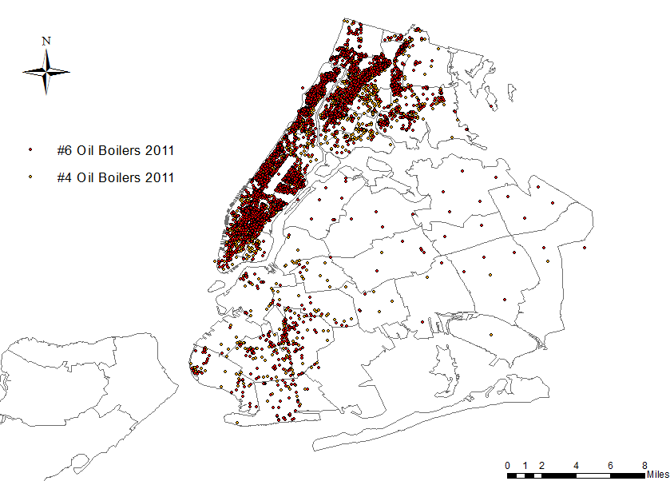

Slide 7
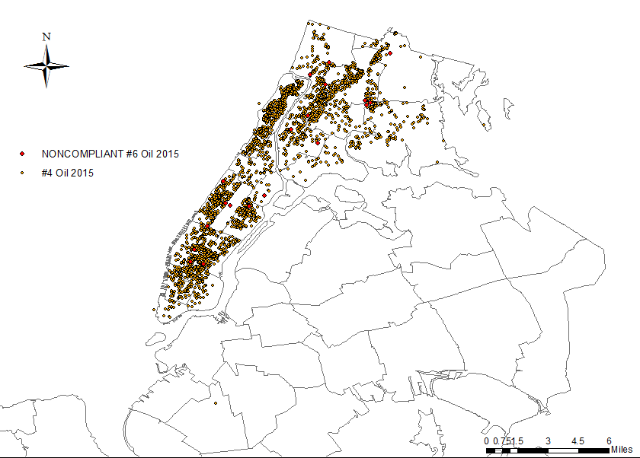

Slide 8
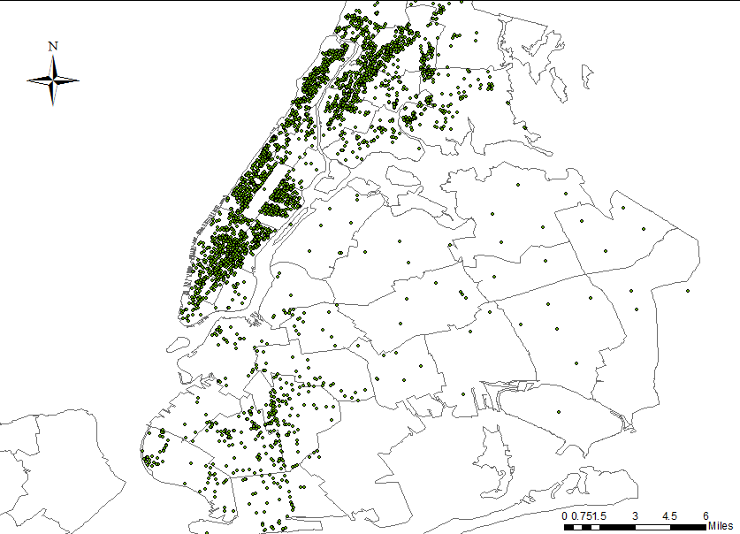
Cleaner Oil Boilers

Slide 9
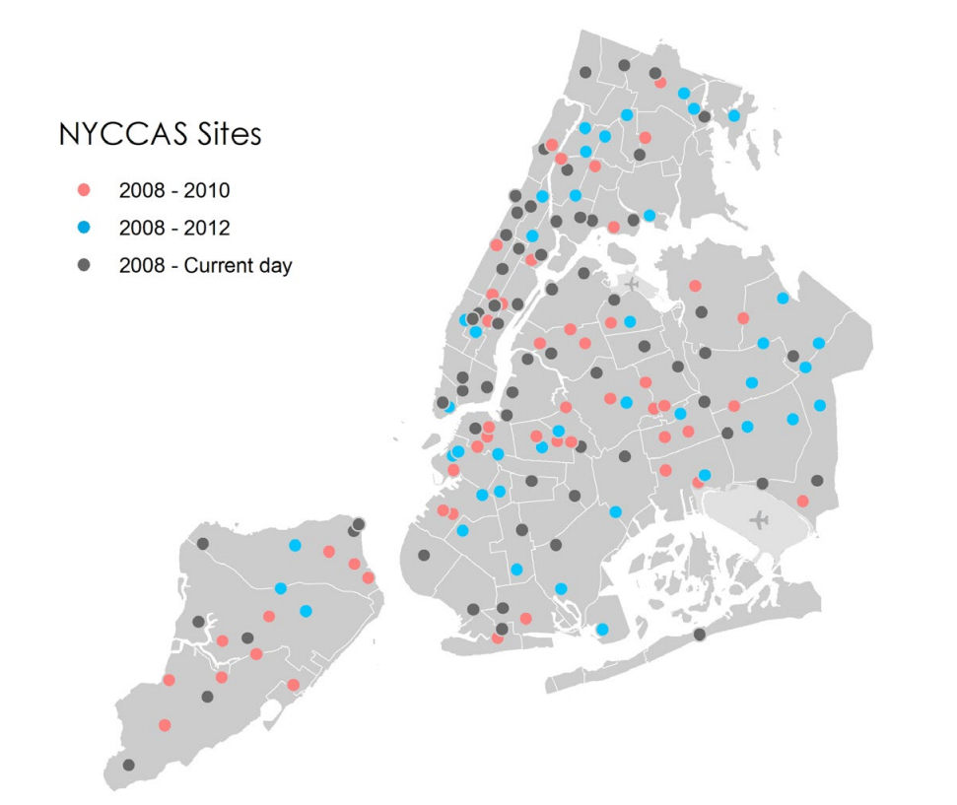
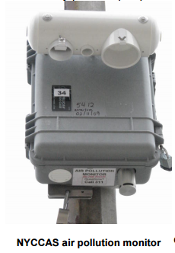
New York City Community Air Survey (NYCCAS)

Slide 10
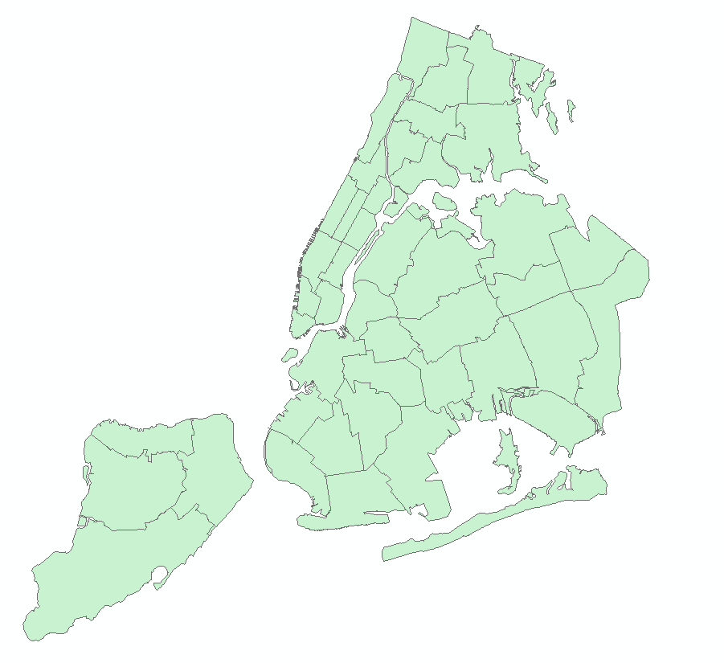
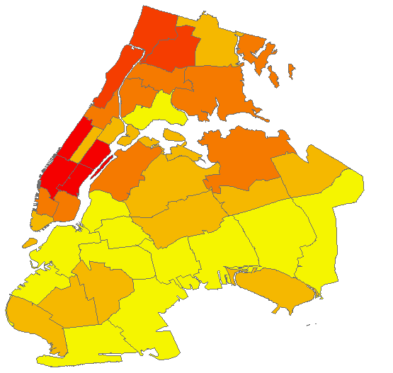
Shapefile Data Merges

Slide 11
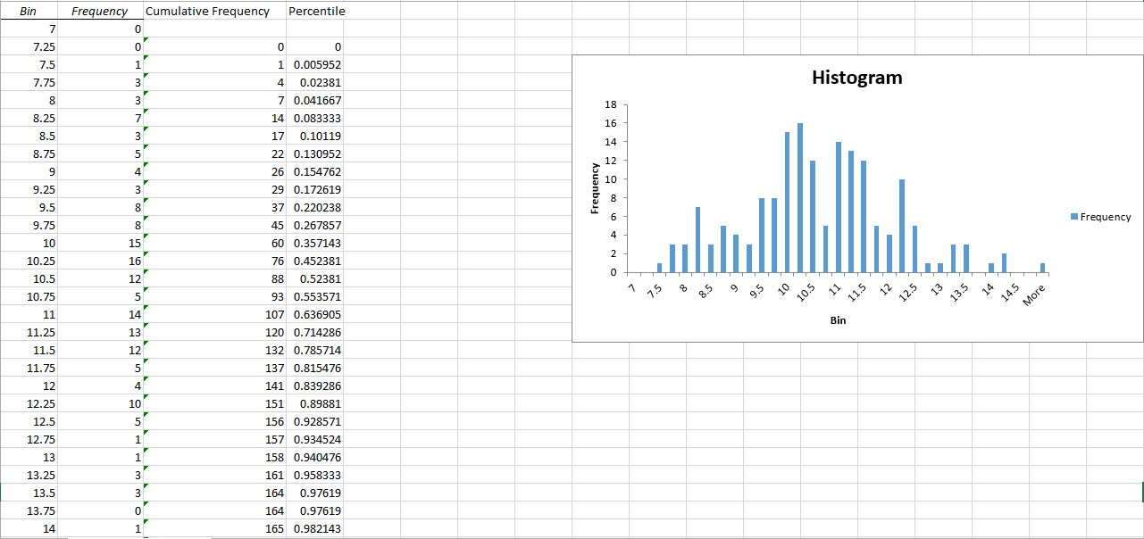
Creating Consistent Scales

Slide 12
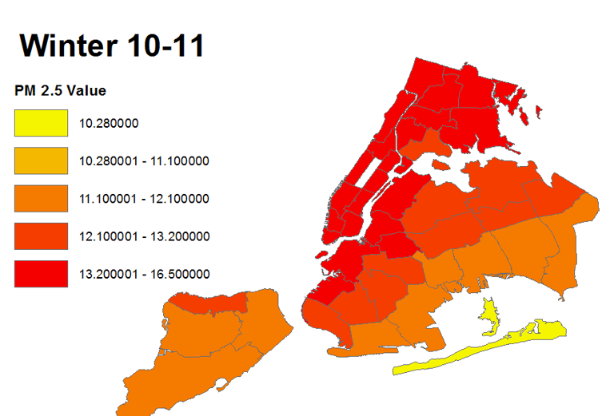
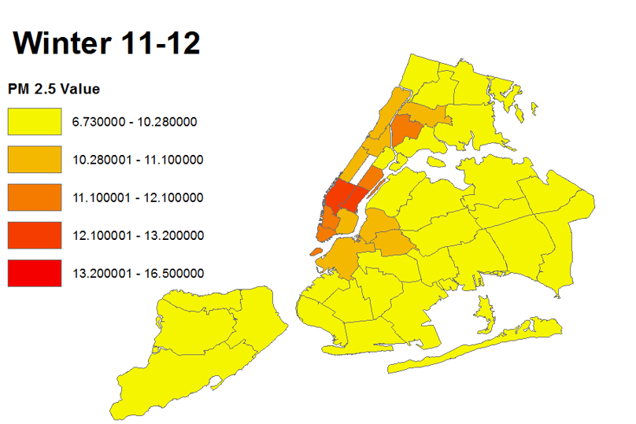
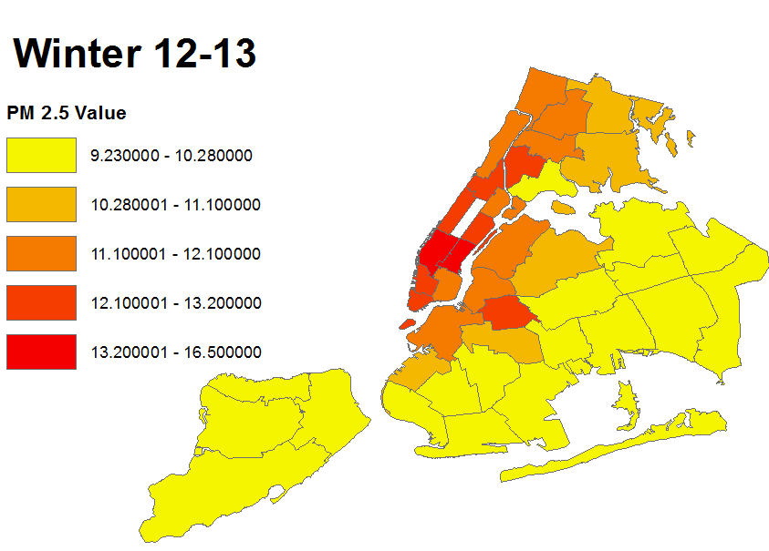
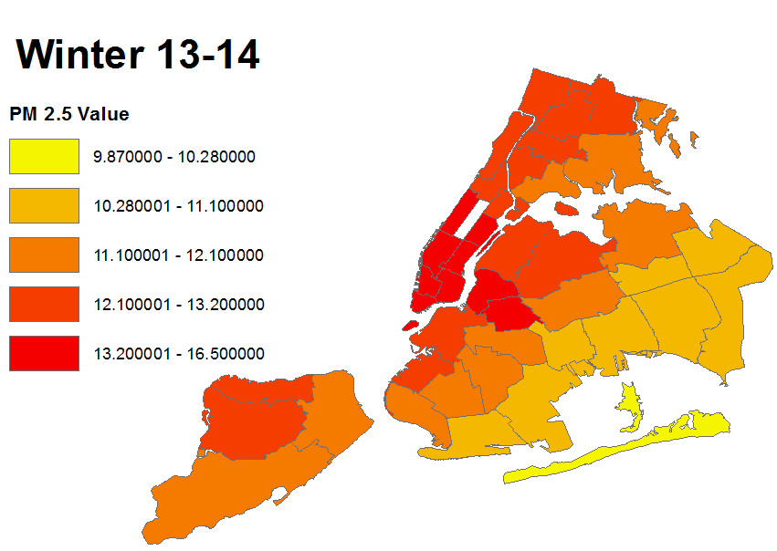

Slide 13
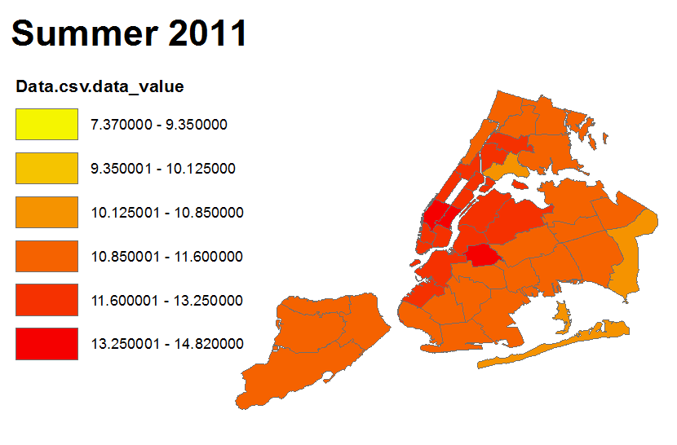
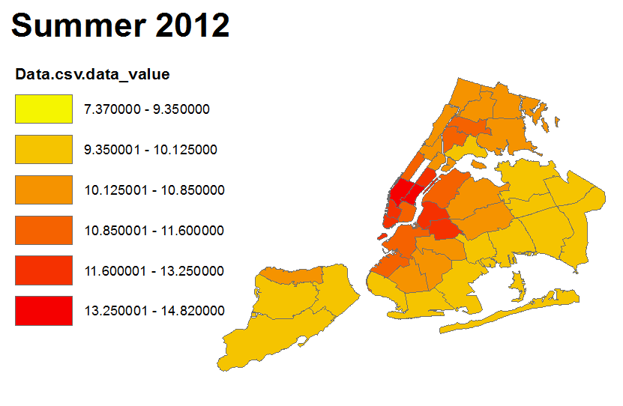

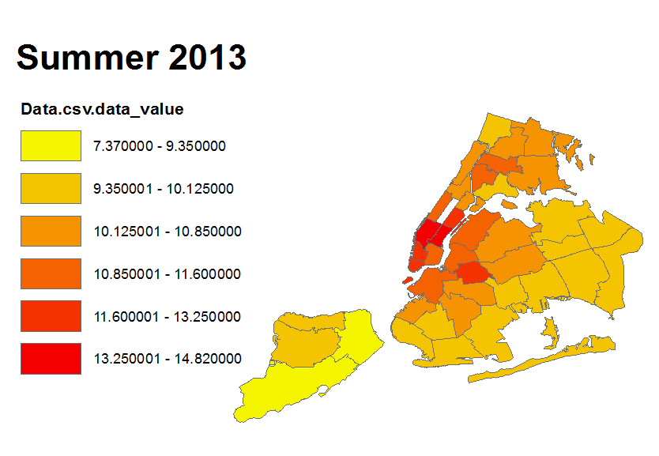
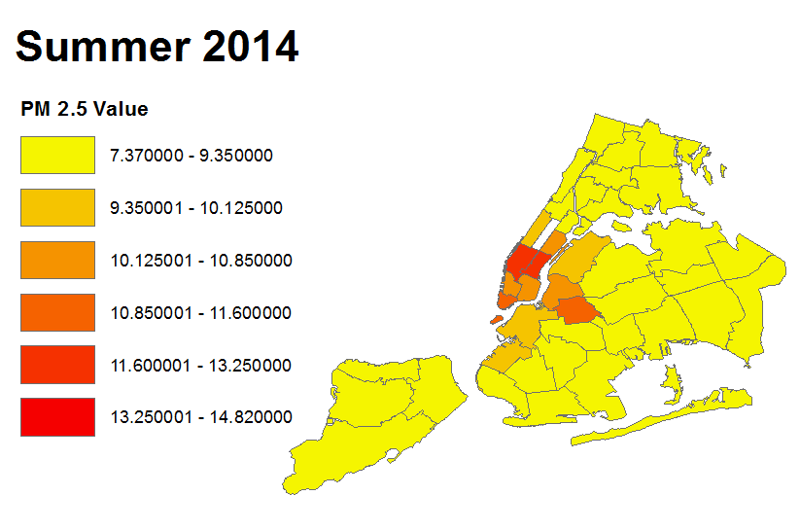

Slide 16

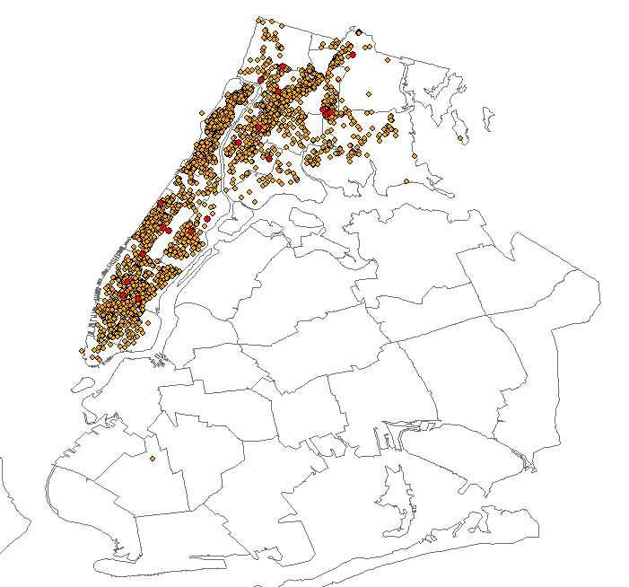
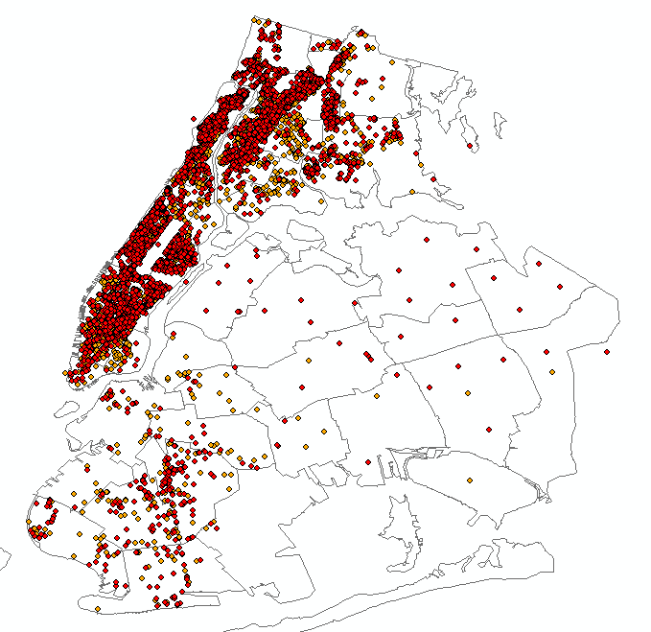
Dirty Oil Boilers 2011 vs 2015

Slide 17
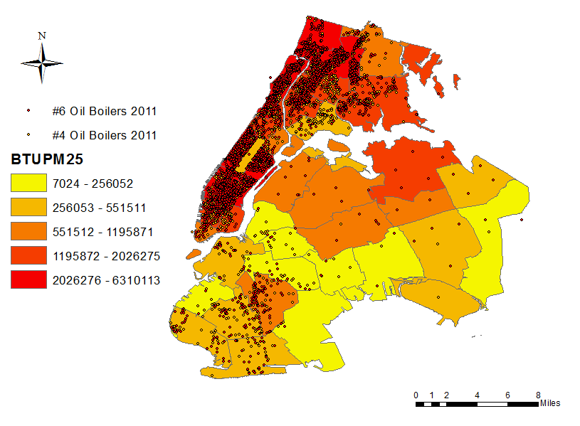
Estimating Pollution from Oil Boilers

Slide 18
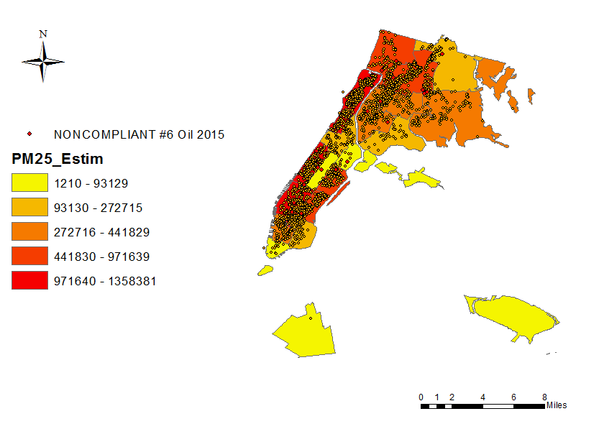
Estimating Pollution from Oil Boilers

Slide 19
Estimating Pollution from Oil Boilers 2011 vs 2015

Slide 20
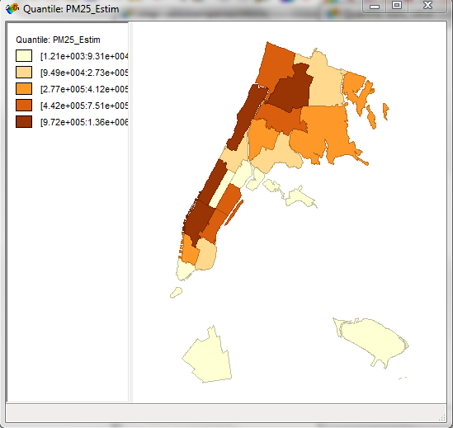
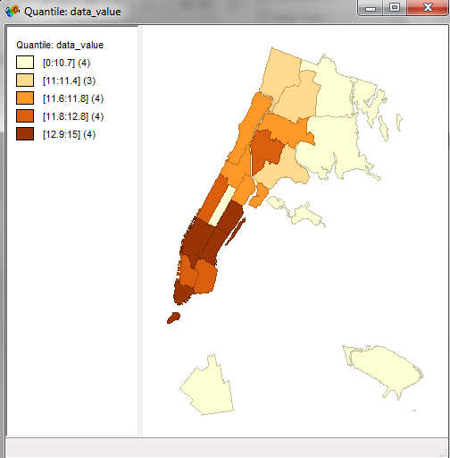
Comparing my Metric with Pollution Levels

Slide 21
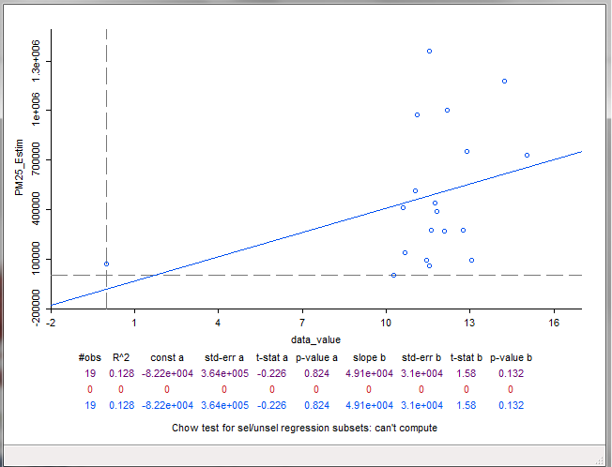
Comparing my Metric with Pollution Levels

Slide 22
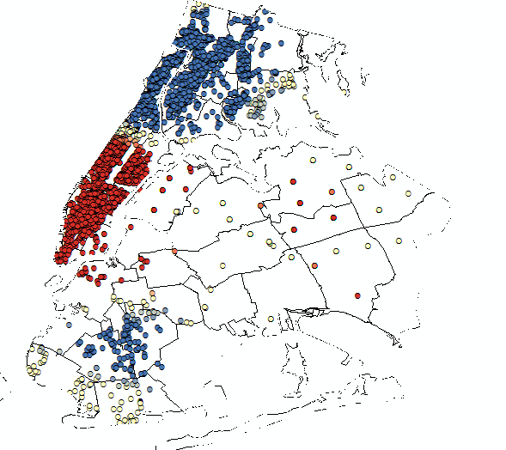
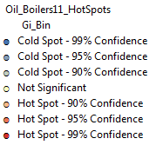
Hot Spot Analysis

Slide 23
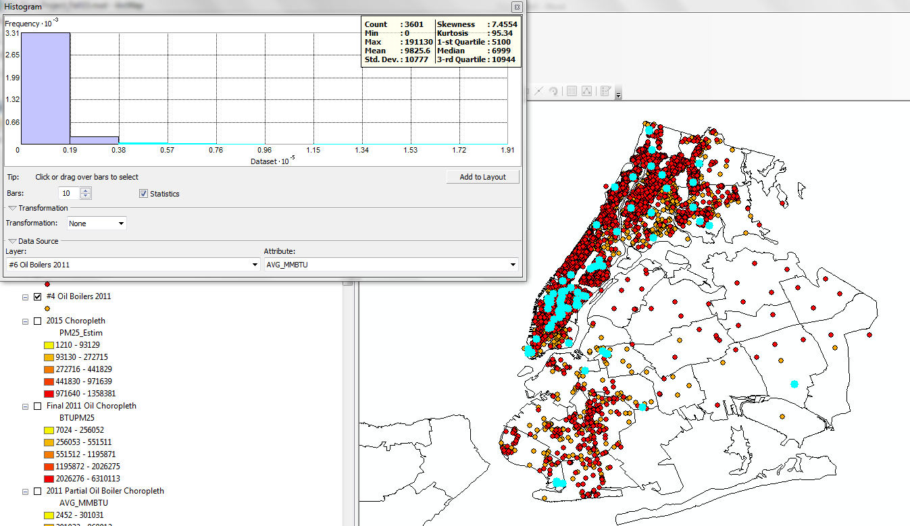

Slide 24
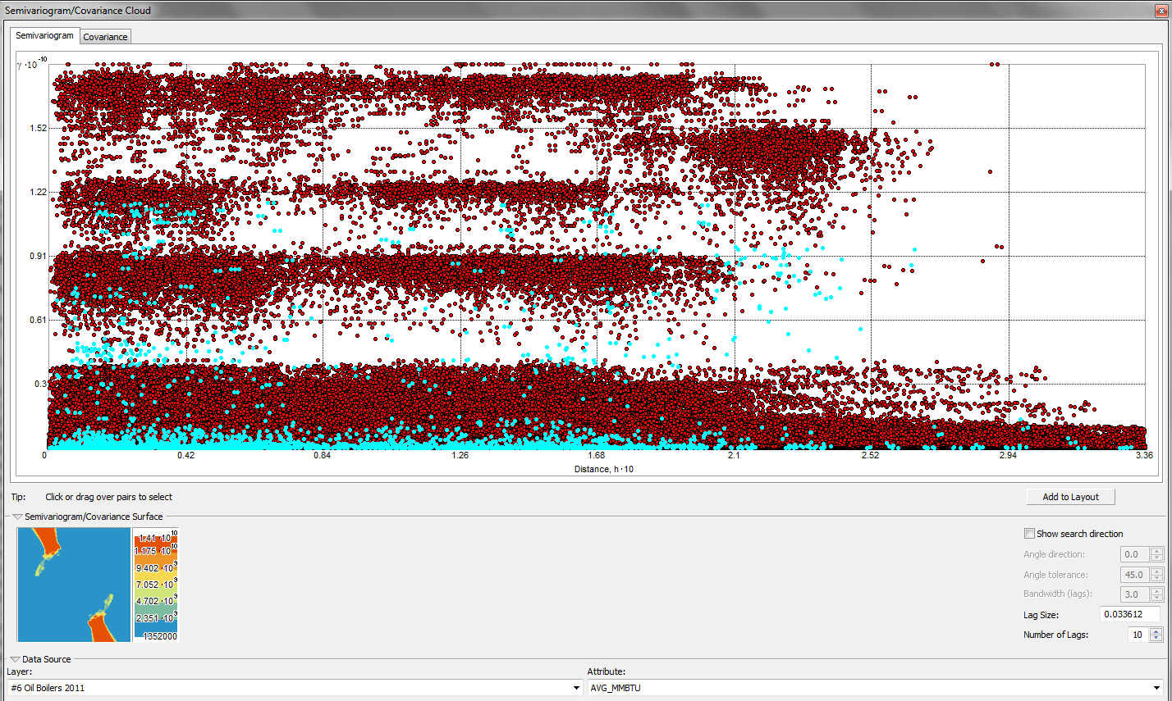

Slide 25
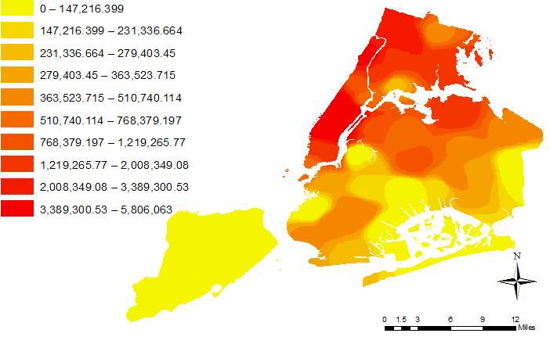
IDW

Slide 26
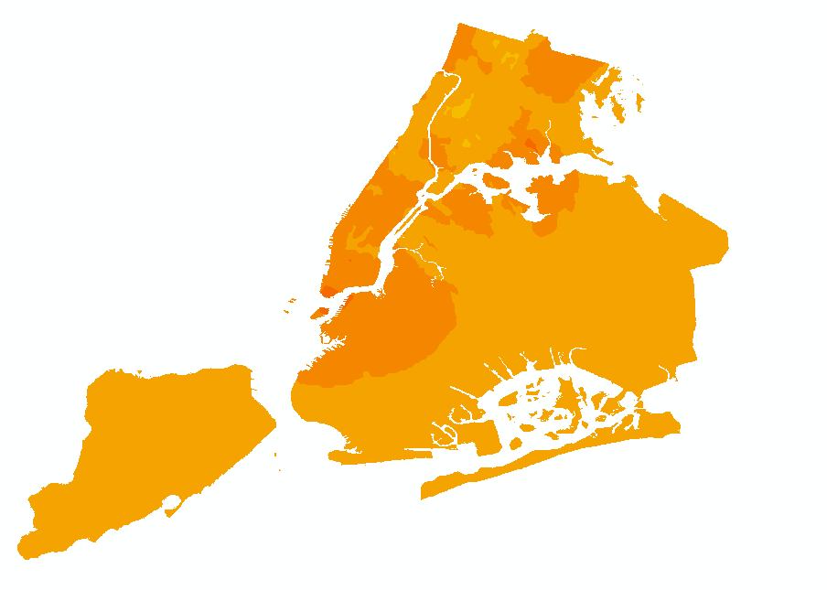
Kriging

Slide 27
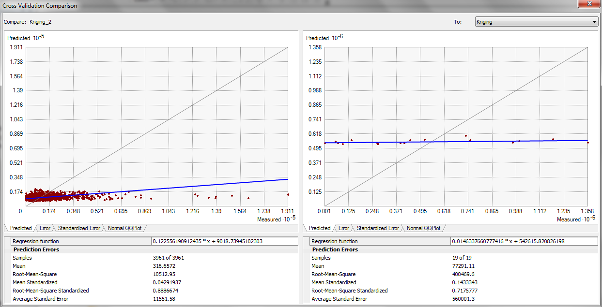
Analyzing the Kriging Model

Slide 28
Did PlaNYC Meet It’s Goals?
Original goal was to reduce building PM 2.5 pollution by 65% and PM2.5 pollution from all sources by 5% overall.
According to my estimates, PM 2.5 pollution from #4/#6 oil boilers decreased by over 80%
This does not include PM 2.5 pollution estimates from cleaner fuels (#2 and natural gas)

