Slide 1
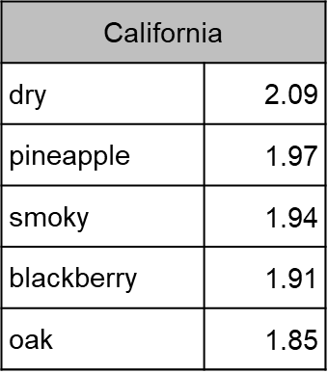
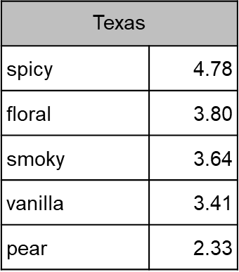
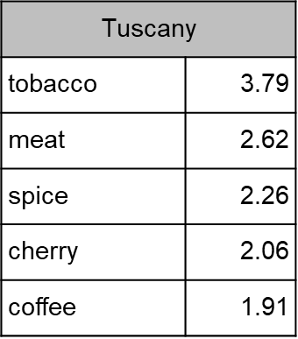
California
dry | 2.09
pineapple | 1.97
smoky | 1.94
blackberry | 1.91
oak | 1.85
Texas
spicy | 4.78
floral | 3.80
smoky | 3.64
vanilla | 3.41
pear | 2.33
Tuscany
tobacco | 3.79
meat | 2.62
spice | 2.26
cherry | 2.06
coffee | 1.91

