Slide 1
Main Title logo
Notes:
Assignment Description:
https://queensuca.sharepoint.com/teams/GROUP-Amsterdam/Shared%20Documents/803%20-%20Ethics/Team%20Project/Assignment.docx?web=1

Slide 2
MMA 803 AI Ethics & Policy AI Powered Smartphone Eye Test
Professor Tina Dacin
Team Amsterdam
January 22, 2023

Slide 3

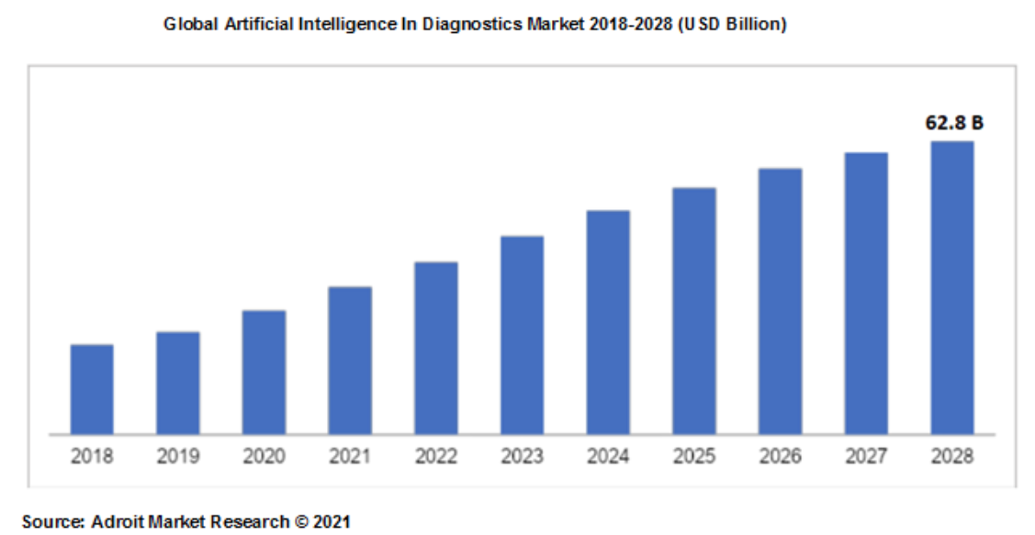
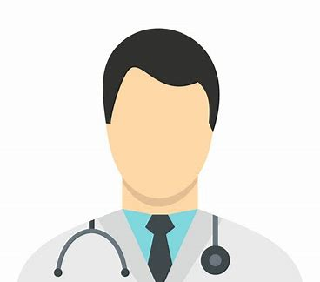
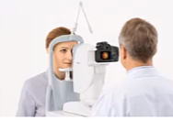


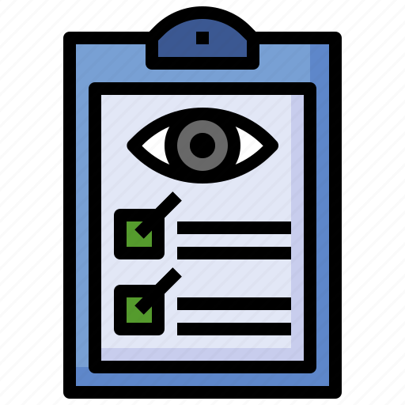
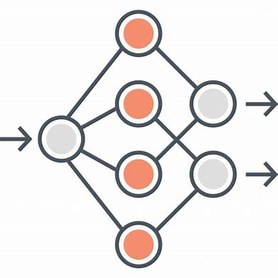
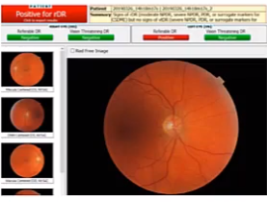
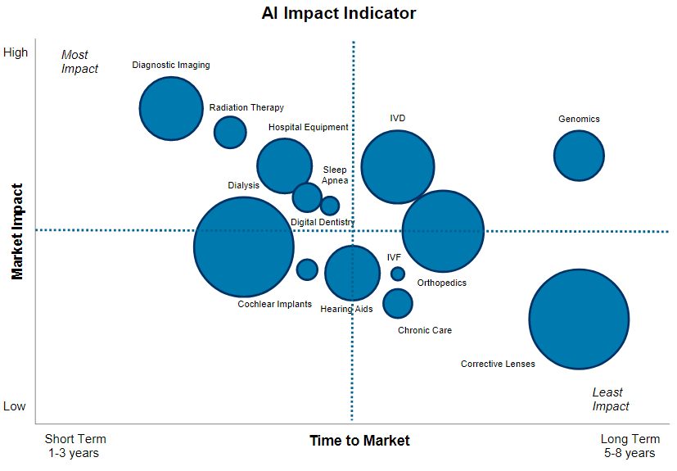
An Idea for Good (Background & Market )
Our Idea – Smartphone powered eye exam
Market Size - Global AI Diagnostic
1
2
Patients visit approved community health centers
Medical assistants takes images using smartphone device
Data is uploaded voutput is generated by neural network based AI system
3
Competitive Positioning
5
4
Transferred using cloud
“Scalable and novel problem-solving using deep learning AI for eye-exams and partnering with centralized community health centers to roll-out in markets”
Source: AI In Diagnostics Market Report 2021-2028 | Adroit Market Research,
Size of the bubble represents Market Value
Notes:
Our Project Idea – Explanation of the overall process
In developing countries e.g. Africa, millions suffer from blindness due to lack of diagnosis and testing, while >80% of such eye-diseases are completely preventable
Current system of manual screening is not practical solution since it cannot scale and requires both i) billion of dollars of sophisticated equipment and ii) trained on-site Ophthalmologists to conduct these tests
Our AI based innovation uses smart-phone and basic readily available optical lens to conduct fully automated eye-exam to detect eye diseases in less than 5 minutes per patient
Our distribution/implementation strategy is based on partnership with thousands of community health centers run by UNICEF in Africa. The local medical staff will be trained online via zoom sessions and teach-in videos to use the our technology.
The images are uploaded anonymized by patient id into the system without much personal information about the patient identity. Only information required may be age, gender or prior health conditions.
Our application is developed using deep neural network system that was trained using over 200,000 eye disease images and tested over out of sample 50,000 images and final model had an accuracy of over 90%.
Furthermore, we partnered with Toronto General Hospital for Clinical Trials using over 1000 volunteers for eye tests using on both conventional high-precision rentinal machines and our software with over 99% matching, ensuing in Patents and FDA approval.
The AI system predicts the eye condition of patient and provides results of vision tests. Moreover, using tele-opthalmology in case of critical conditions images are sent to licensed optometrist within our partner network via charitable eye hospitals.
Based on the reports from licensed optometrist patients are referred to central tertiary hospitals in the country for further treatments.
Market Size and Competitive Position
The market for AI in healthcare is estimated to be worth 62Bn $ globally by 2028.
Fast-growing volume of medical data generated by current healthcare systems is the key reason fueling this growth
Cost reduction will be a major driver of AI adoption as traditional healthcare systems struggle to cope with ever increasing costs of providing care
Currently AI applications are focused on Diagnostic Imaging, Radiation Therapy, Hearing Aids, subsectors are readily available
However, we believe AI in the longer run is expected to have a meaningful impact, in eye exams and corrective lenses given the cost/scale benefits

Slide 4
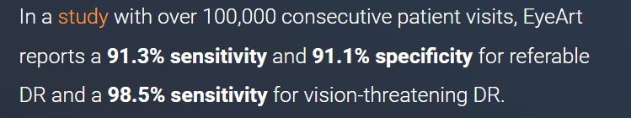
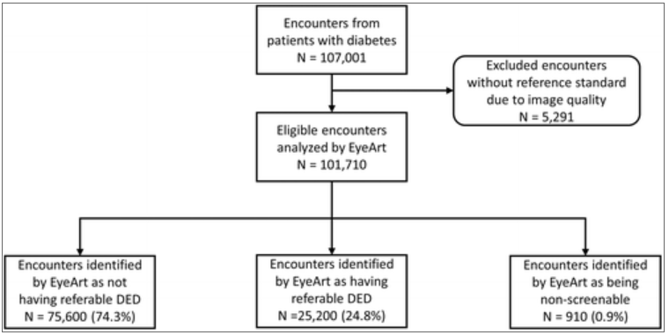
Research Process and Privacy Considerations
Evidence of Research
Health Organizations
Value Exchange
Data Privacy
How to Anonymize
Value Considerations | Smartphone AI System | Legacy Manual System
Cost per Test | $ 10 -20 | $ 50 -100
Time per Test | 5-10 minutes | 30-60 minutes
Resource Needed | Medical Tech | Expert Ophthalmologist
Human Error Risk | Low | High
Meaningful
Consents
Seek informed consent from patients explaining in layman terms for the purposes we will use data for secondary tasks like research and analytics with an opt in/out option
Anonymize
Follow de-identification guidelines. Anonymize data using Safe Harbor standard in the HIPAA Privacy Rule
Privacy
Business Model:
High quality automated results with faster turnaround and lower costs offering compelling advantages for partnership and data sharing with large public sector organization or hospitals
There is no capital expenditure requirements or need for expert doctor to administer the test
“Clinical Research conducted using AI based eye-screening technology through automated retinal images of patients automatically detected retinopathy with over 91% accuracy in patients”
We will not collect any data point which is not required for e.g. social security, zip code, phone number etc
No paper-based records kept for any patient
As a policy we will only share data with health care research organization in aggregated form with no geographical, soci-economical data points
We will not capture any data using patient device or cookies information
Source:
Bhaskaranand, Ramachandra, Bhat, Cuadros,. Nittala, Sadda, and Solanki. A Study of More Than 100,000 Consecutive Encounters from People with Diabetes. Diabetes Technology & Therapeutics.Nov 2019.635-643.http://doi.org/10.1089/dia.2019.0164
Notes:
Evidence of Research
Research conducted on use of AI to detect eye diseases proves that AI based eye-exams can be safe and effective in real world.
AI based eye-exams offer easy-to-use, automated tool for medical practitioners to address growing need for automated screening and monitoring.
Research done with over 100,000 cohort showed over 91% accuracy
The research also showed that AI based eye-exams offer cost and time benefits over legacy manual systems
Partnership with Health Organizations – Value Creation for both parties
Large public sector health organization have Big Data i.e. millions of retinal images for different types of eye-diseases which are required to Train & Test our Deep learning AI Models
We plan to partner with large government hospital as it offers value for both parties. Amsterdam consulting gets the data required to train and test AI models also valuable advise from experts doctors to improve technology
Meanwhile, our technology offers tremendous value to governments and large hospitals as AI based testing is ~80% lower in terms of costs and time savings
Most large public sector hospitals have ESG budgets for health care efforts in developing markets. Our technology can help provide eye-care for much larger population in Africa with fraction of the cost.
Moreover, the millions of test conducted using our system will provide R&D statistics for public sector research hospitals on anonymized basis
Data Privacy Considerations
We sill use meaningful consent from patients and explain which information will be used in anonymized manner by i) whom ii) under what circumstances iii) for what purpose.
Patients will have an option to opt in or opt out with revoking option at any time
We will use industry best practice for de-identification and anonymization of data using Safe Harbor Standards
We will remove personal identifiers from medical record data which make it difficult for any party to re-created link to individual albeit keeping analytical effectiveness of data
We will not collect any unnecessary data (social security, geographic or socio economic info)
We will not capture any secondary device or cookies data from the patients

Slide 5
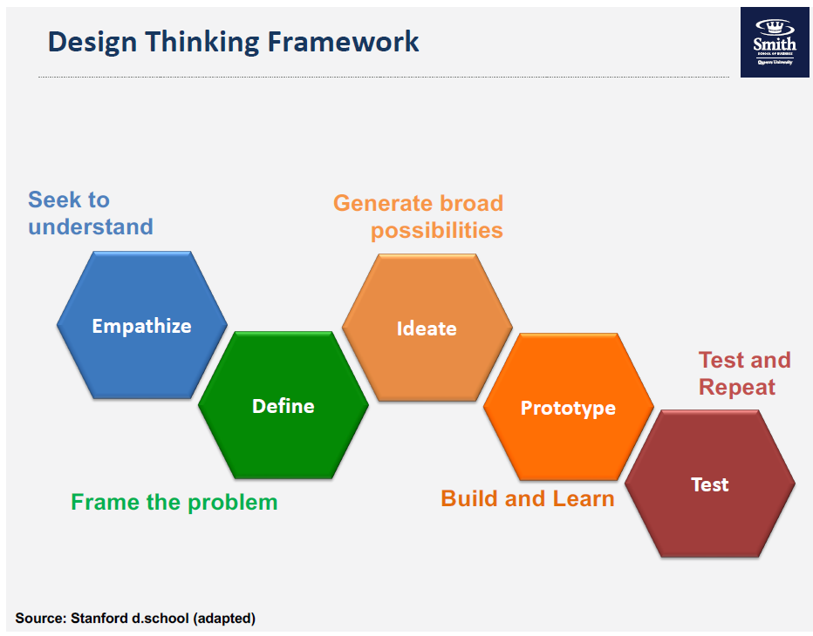
Requirements Gathering and Design
Connect with a broad stakeholder group
Identify regional data sets
Ensure health professionals and support staff can provide lived experience
Identify current barriers to access
Collect and test ideas with practitioners and clients
Collect regional specific common hardware availability
Notes:
Human Centric design ensure the users and clients of the product are the center of every stage of the production. By actively engaging the population we aim to serve at all stages of development, we ensure that assumptions and unknowns are collected and exposed as much as possible

Slide 6
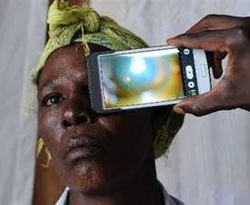
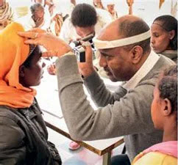
Minimum Viable Product
Assume the initial data set is biased
Local translators for UI and support materials
User Acceptance Testing in the field
Test and Re-train the model with regional data
Address pain points discovered in UAT
Expand pilot to additional regions
Notes:
Getting a MVA into the hands of the people who will be using it every day will give us vital improvements which will assist in the app’s usability and ensure that any barriers to adoption are exposed before a wild roll out is conducted.

Slide 7


Data procurement & financing
Data
Objective:
Obtain large volumes of structured optometry data with identifier for patient’s vision status (i.e., presence/severity of various eye conditions).
Problem:
Most available data would exist within developed countries with rigid health information privacy laws, making large-scale collection difficult.
Solution:
Mitigate data sensitivity by anonymizing & compressing data at source before extraction; removing personal identifiers and export only engineered features (i.e., not entire file) from each instance of data.
Financing
In addition to conventional venture capital funding sources, the specific nature of this project may render it eligible for several philanthropic and/or governmental funding contracts.
These vectors may provide access to favourable funding conditions, or to valuable publicity for subsequent funding rounds or final commercial roll-out.

Slide 8
Product Development
Product development will be completed in three phases:
Phase I
Establish internal model & data inventory system
Phase II
Develop & test modelling framework
Phase III
Seek regulatory approval as SAMD product
Open discussions with data providers
Source vendor for hardware components
Develop client-level software interface
Internally test hardware/software integration
Formalize hardware distribution lines
Build network of local technicians
Building vendor network
Internal development
Ready for pilot deployment
Notes:
Step 1 – Data Gathering:
Data related to eye diseases and conditions is widely available with hospitals and research centers globally. We would need to partner with Hospitals, University Researchers, NGOs, Global Eye Health Organizations to get access to the data. We don’t see any issue in source and availability of data but access to the data would require partnerships with health care organizations. We think patient data will be anonymized and most holders of large data bases with R&D functions have patient consent to utilize data.
Step 2 – Develop and Test the Application
The next step would be to utilize the data sets and develop supervised ML algorithm which trains the model based on all the known categories of eye testing conditions. Work with health care experts to perform validation based on Test data sets and clinical trials (Level 1 to 3) using live patient information to intelligently improve the software over time with a target of reaching over 90% accuracy.
Step 3 – Regulatory Approvals
We believe since our software uses smartphones, the regulatory approval process should be simpler. We would apply for FDA ‘Software as Medical Device (SAMD) evaluation. Devices which help medical practitioners in diagnosis are classified as Class II (Medium Risk) ⁽⁵⁾

Slide 9







Product Implementation
Pilot project:
Monitored deployment to selected clinics
Commercial roll-out:
Full-scale deployment to target market
First 12 months following approval
Conduct 1,000 tests in each of 10 selected sites
Evaluate model efficacy in target market
Market to eligible target clients using tiered pricing:
Client type | Fee
Commercial hospitals | $20/test
Government contracts | $10/test
NGOs & developing countries | $5/test
Notes:
Step 4 – Pilot Project & Full Deployment
Post clinical trials and regulatory approvals, we will launch a pilot project in a small sample jurisdiction across 10 cities (hospitals or primary health centers) in developing countries targeting 1000 tests in each location over 12 months.
Based on the pilot project's outcome, we will revisit our model and make any necessary improvements before final commercial launch.
Our pricing strategy would be another pricing strategy would be to monetize the AI software through a 3-tiered system based on ‘Fee per test’ done via the software.
Tier 1 – For commercial hospitals or business market price of $20 per test
Tier 2 – For government contracts market price of $10 per test
Tier 3 – As an ESG initiative, for under-developed countries we would offer price of $5 per test

Slide 10
Ethical Implications & Solutions
Model Bias
Value Proposition
Data Privacy & Security
Demographics included in the dataset used to build the model may differ from actual demographics in developing countries due to a number of environmental and hereditary reasons.
E.g., 99% of cataract cases occur in developing countries as residents in these countries tend to get greater exposure to UV radiation.
Stakeholders involved may have different agendas that will lead the project to deviate from its intended objectives to provide greater accessibility to individuals in need.
E.g., While the project intends to provide individuals with equitable access to health care, local private hospitals may choose to prioritize certain groups of individuals over others.
Improper IT security measures and privacy protocols lead to the leakage of personal and sensitive information, causing harm to the individuals, local communities and the nations they reside in.
E.g., should an external party obtain patient health records and sell them to employers, certain individuals may be discriminated against for their state of health.
Mitigation Measure
Mitigation Measure
Mitigation Measure
Establish a monitoring committee to review the performance of the model periodically.
Continue to improve the algorithm as more representative data is collected in developing countries.
Set up agreements with buyer entities to establish project goals with measurable targets (e.g., accessibility score by demographic clusters). Establish a committee to periodically review stakeholder alignment with proposed targets.
Develop a corporate manual to define the data collection, analysis and storage/disposal process, and provide training to staff periodically.
Work with industry experts to test the system controls to ensure its resiliency.

Slide 11
Thank you.

Slide 12
Appendix

Slide 13
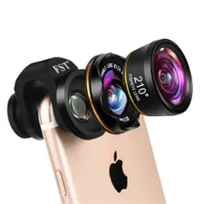
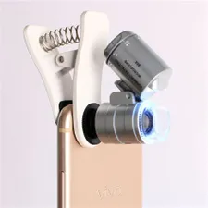
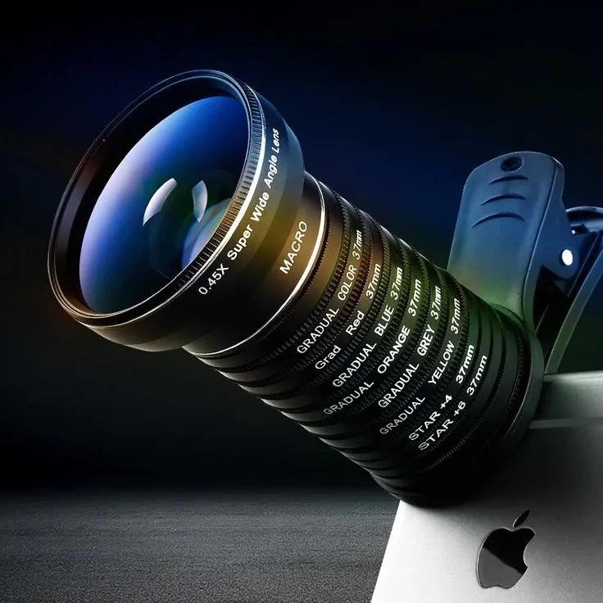
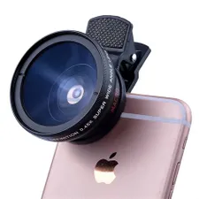
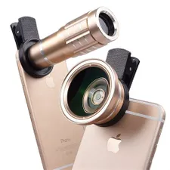
Appendix I: Example images of lens attachment
Notes:
Identifying the most common cellular phone make and model in each region will be a key component to ensure hardware compatibility

