Slide 1
2017-18 Software Engineering Capstone Project
By: Jackson Lawler and Nick Setliff

Slide 2
The App
An application that utilizes augmented reality (AR) to the benefit of students and faculty on campus
Students can use the app to navigate to specific buildings
Students can use the app to navigate to current events happening around campus
Students can view department-specific bulletin boards around campus with up-to-date information and events
Faculty will have a simple template to add documents/articles to bulletin boards as well as add events at custom location nodes around campus

Slide 3
Survey Results
70% of survey respondents reported iOS as their mobile operating system
88% thought an AR navigational app would help students find their way around campus
55% were likely to very likely to use an AR navigational app
95% thought an AR navigational app that provided locations and navigation to current events would be useful
80% were likely to very likely to use an AR app that provided locations and navigation to current/cultural events
100% thought an AR app with fitness features would be beneficial to students
92% were likely to use an AR app with fitness features

Slide 4
Vision and Scope Modifications
As a result of the survey data we gathered, we altered our requirements as follows:
iOS users are the priority/majority
Xamarin cross-platform app is still a possibility/technology we’re looking into, but as ARKit and ARCore are two separate frameworks, a lot of the code would not be shared.
Dropped support for AR bulletin boards
It didn’t make a lot of sense to be forced to go to a specific location to access information.
If added in a subsequent release, the information should be available regardless of the user’s location.

Slide 5
SceneKit Library
SceneKit combines a high-performance rendering engine with a descriptive API for import, manipulation, and rendering of 3D assets.
SCNNode
A structural element of a scene graph, representing a position and transform in a 3D coordinate space, to which you can attach geometry, lights, cameras, or other displayable content.
Used to create the arrows that will guide the user to their desired location

Slide 6
ARKit Library
Integrates the device’s camera and motion features to produce augmented reality experiences.
ARSession
A shared object that manages the device camera and motion processing needed for augmented reality experiences
Instance is included with an ARSCNView object
Requires a session configuration via ARConfiguration
ARWorldTrackingConfiguration
Uses the rear facing camera to precisely track a device’s position and orientation
ARSCNView
Blends virtual 3D content(SCNNode) with the device’s camera view of the world

Slide 7
CoreLocation Library
CoreLocation provides services for determining a device’s geographic location, altitude, orientation, or position.
CLLocationManager
An object that is used to start and stop the delivery of location-related events to your application.
CLLocationCoordinate2D
The latitude and longitude associated with a location

Slide 8
Combining it all
The steps we’re following in our prototype:
Setup a ARSCNView
Create a SCNNode of a 3D arrow
Get the user’s coordinates
Calculate the initial bearing from the user’s coordinates to the center of the sculpture garden
Transform our SCNNode to point towards the bearing
Add the SCNNode to the ARSCNView

Slide 9
var sceneView = ARSCNView()
var locationManager = CLLocationManager()
var loc = locationManager.location.coordinate // User’s lat/lon
var sculptureGarden = CLLocationCoordinate2D(latitude: 36.971542, longitude: -82.558492)
var bearing = loc.calculateBearing(to: sculptureGarden) // Bearing in radians
var arrowNode = createArrowNode()
arrowNode.transform = SCNMatrix4Mult(arrowNode.transform, SCNMatrix4MakeRotation(bearing, 0.0, 1.0, 0.0)) // Rotate arrowNode around the y-axis by bearing radians
sceneView.scene.rootNode.addChildNode(arrowNode)
extension CLLocationCoordinate2D {
func calculateBearing(to coordinate: CLLocationCoordinate2D) -> Double {
let a = sin(coordinate.longitude.toRadians() - longitude.toRadians()) * cos(coordinate.latitude.toRadians())
let b = cos(latitude.toRadians()) * sin(coordinate.latitude.toRadians()) - sin(latitude.toRadians()) * cos(coordinate.latitude.toRadians()) * cos(coordinate.longitude.toRadians() – l ongitude.toRadians())
return atan2(a, b)
}
}

Slide 10
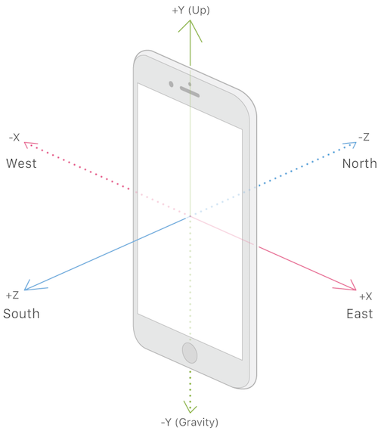
Issues
We’re currently setting ARWorldTrackingConfiguration to gravityAndHeading which modifies the coordinate system so the y-axis is parallel to gravity, its x- and z-axes are oriented to compass heading, and its origin is the initial position of the device.
This works great to orientate our node to a real world location, but makes placement of the node harder to determine.
ARKit has an ARAnchor object that can be used for plane detection and object placement. We’re looking into detecting flat surfaces directly in front of the user’s device and attaching our arrow node to that anchor, so that the arrow will always be visible in the direction the user is facing.

Slide 11
Next Steps
Map the latitude and longitude coordinates of nodes around campus and implement them as a graph data structure
Implement shortest path algorithm
Implement UI
Setup a webserver to host an application that will allow the addition of new coordinate nodes

