Slide 1
(I)nventory (M)anagement (S)ystem
By Matthew burt

Slide 2
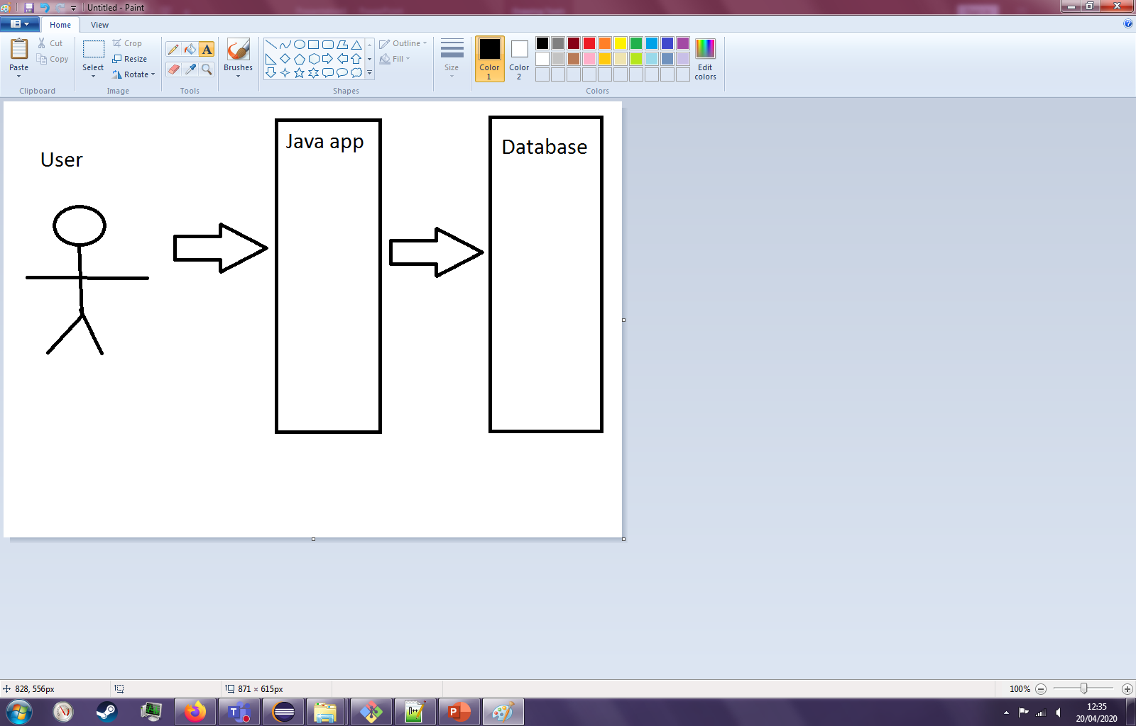
Project Specification
This project aims to provide an inventory management system for games workshop. The service will provide a list of customers, items they can purchase, and orders by customers of items.
This project relies on a Java command line style application to provide the interactivity between the SQL Database and the user.

Slide 3
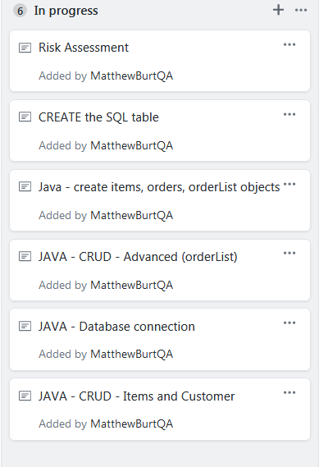
Initial plan
The initial plan for this project was to first create an SQL prototype on GCP, then create an SQL schema for this that is run by the Java application. Following that, once the database is up, the plan from there was to then create all objects required, and then implement their associate CRUD functionality.

Slide 4
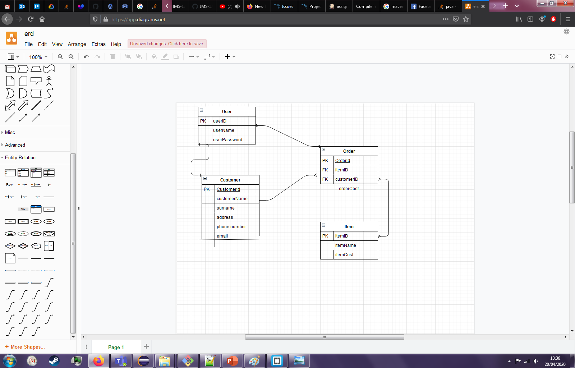
System ERD

Slide 5


My Journey as a Consultant
Graduate university in November – some programming under my belt, without confidence
Join QA consultancy in the March cohort:
- learnt how to use git workflow
- learn about CI pipeline and how to implement and use
- affirmed java knowledge, and learnt more.
- become more proficient at writing java on a whole
- gotten better at SQL.

Slide 6
Continuous integration
Core component of a good CI pipeline is contiunuous integration! Setting up the integration of all components of the project build/deployment phase saves dev time by the bucketload!

Slide 7
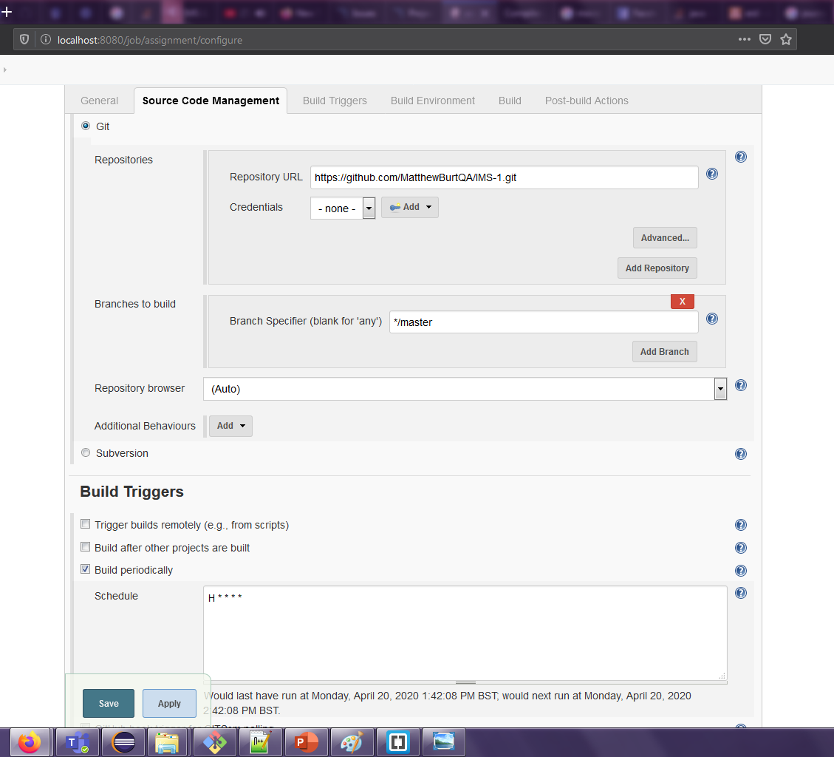
Grab project from github
Run a build of this every hour!

Slide 8
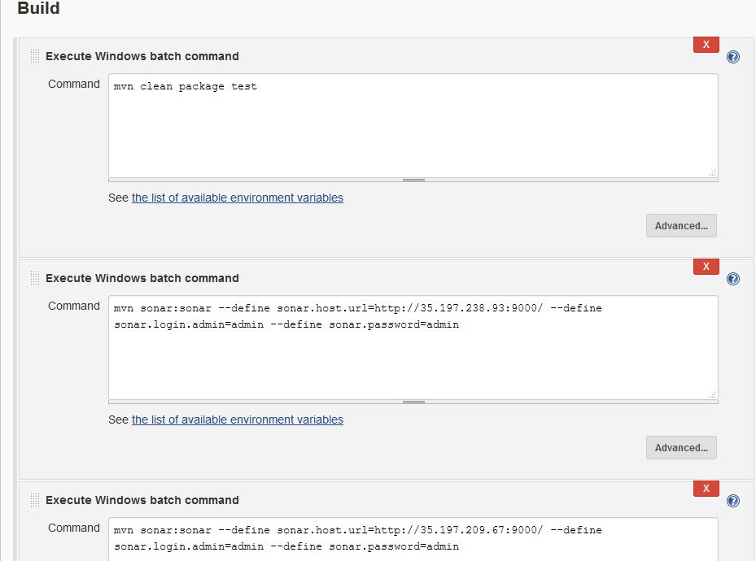
Maven build command
Sonarqube to me and to you!

Slide 9
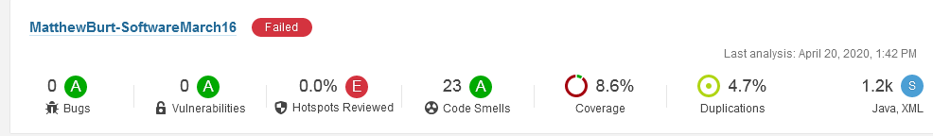
Sonarqube
Soak in the “Failed”, as that is the last that will ever been seen.
Reason: a lot of my test cases fell over due to me not updating them as I went along, then things breaking last minute. Lesson learned.
Why this occurred: While working, I started to rely on old style testing of “create actor, actor interact with system, examine result”. This was bad practice and I will not let this happen again. Test based development is still quite new to me but I understand how to do it much better after this project. Test coverage is low, due to me only testing core components. To improve on this I would test ALL get/set, as well as “moving parts methods”. Moving parts methods is a term I use for methods that in some way change/move forwards to program in some way, and like the moving parts in a machine, these are potential breaking points. A good test set up would have covered this, however I have learnt from this.

Slide 10
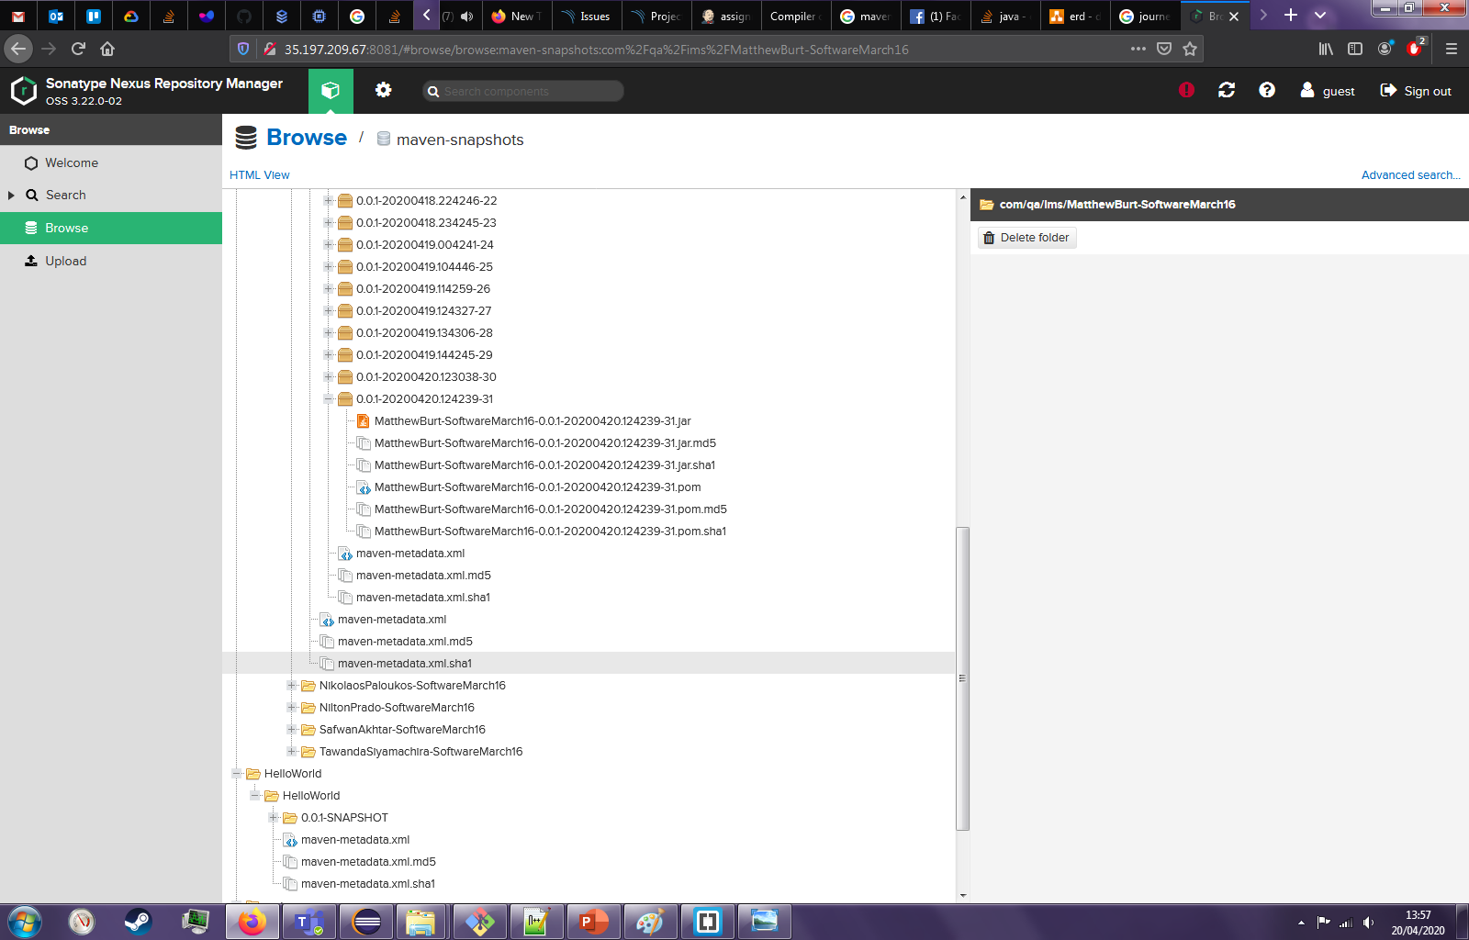
The Fat Jar and the Nexus Repo
Fat JAR has all the dependencies built in. On the left you can see the nexus artefact repo, which holds all the build snapshots taken over the course of the project. This is very helpful for version control as well as deployment. Another crucial part of the CI pipeline.

Slide 11
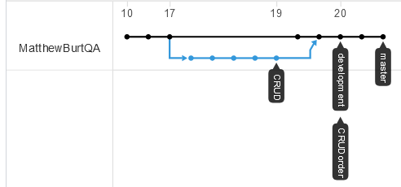
The Github workflow
Black line – master
Blue line – feature
Blue points – these points are where feature branches were merged in. These did not show up properly on the network diagram, due to how I managed the local end of the git. From here forwards I will make sure my sub branches are pushed too, making the diagram more clear. The Github work flow on this project, combined with a Kanban board, not only helped me gauge progress over the course of the project, but also keep myself on track.

Slide 12
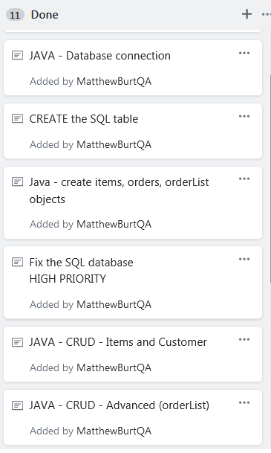
A review
SQL schema functioning with dependencies
SQL Table on line working with remote access
Git project
Barebones test driven development
CI pipeline
Java code for basic CRUD functionality
Kanban board (browse to the right)
Git workflow

Slide 13
A retrospective
Things I could improve on:
Handling illness better
TDD – My test coverage was low, partly due to lack of tests and partly due to badly implemented tests falling down In front of Jenkins.
More commits – my commit rate was low, partly due to features being quite straight forwards to implement, partly because features worked pretty fast on primary implementation!
Features on the project:
Implementation of users, using SHA2 encryption on passwords so not even DB owners can browse users passwords.
Advanced Order functionality using INNER JOINS to calculate prices of the table instead of user manually inputting them.
More test cases! My initial approach was not quite in depth enough, and could have benefitted to referring back to sonarqube more often, which, going forwards, will be a regular thing.
While loop on runtime to keep application running after instructions

