Slide 1
PRO TEAMS
By Matthew burt

Slide 2
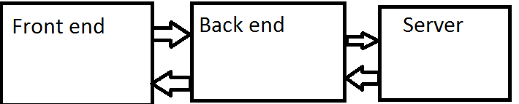
Project Specification
This project is a hobby-esque project of producing a back end, front end and database for holding information passed from front to back
This project uses a mixture of technologies and languages. For the front end, HTML/CSS/JSCRIPT and the back end is written in Java using SPRING

Slide 3
Risk Assessment

Slide 4
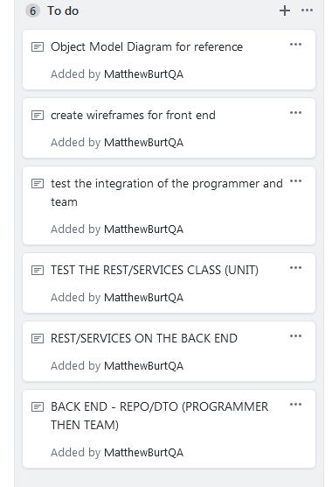
Initial plan
The initial workflow of this project, was to first get back end functionality, then connect to the cloud, and implement a front end to access the cloud.

Slide 5
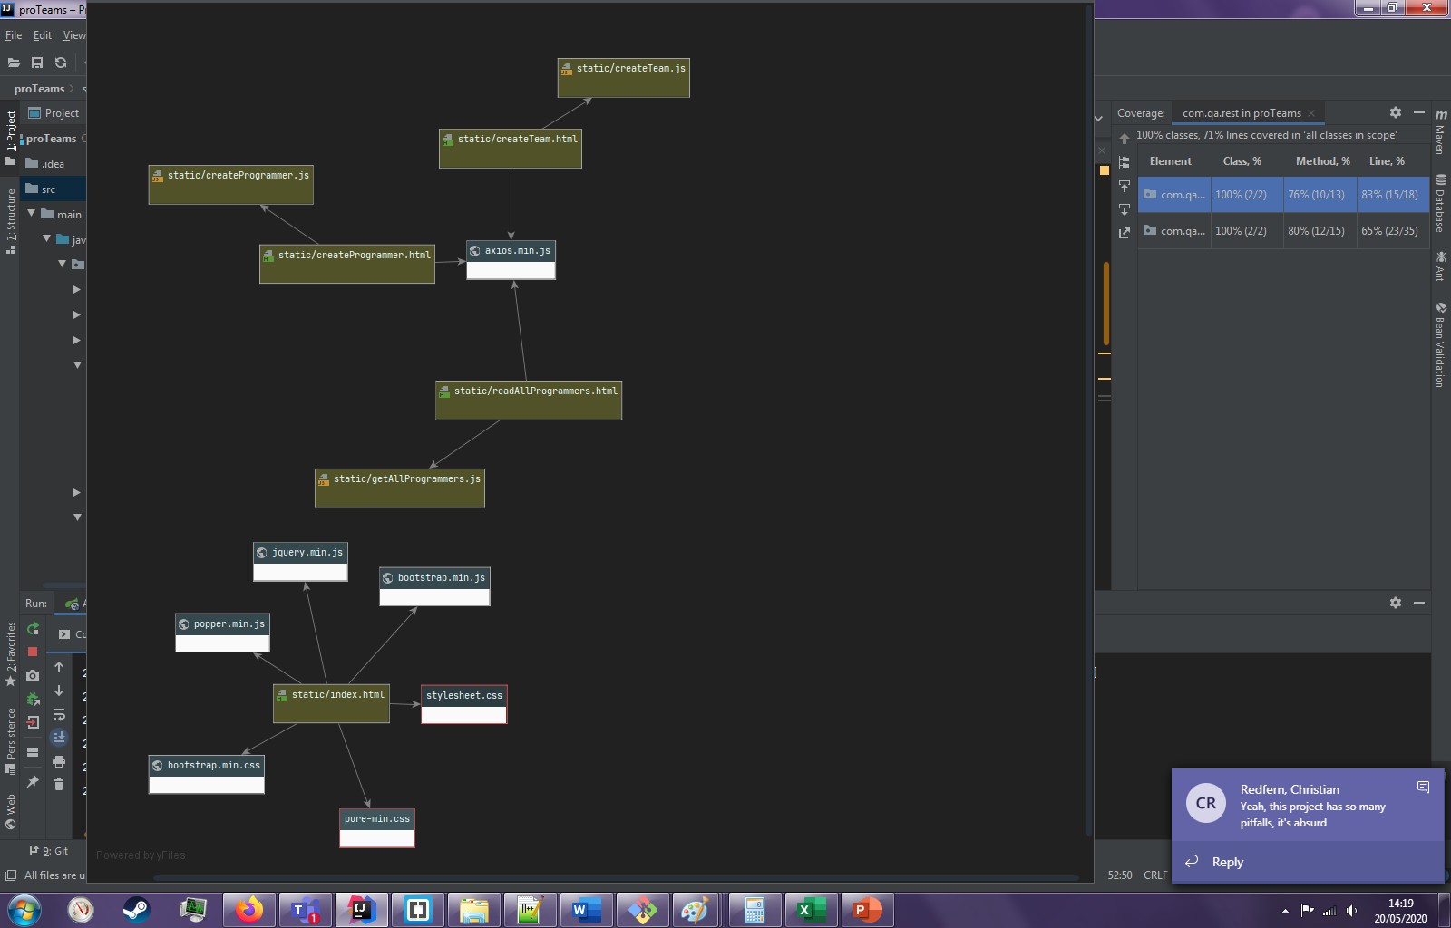
System UML Model

Slide 6
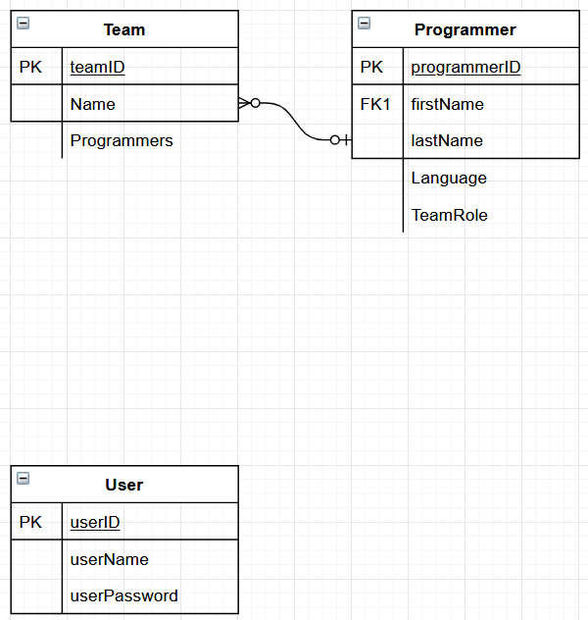
ERD
This ERD displays the two repo’s, Team and Programmer. An additional feature that was to be implemented was a log in system using a user table that holds name and password as well as an ID. This could be encrypted during sign up via PHP to make sure product owners cannot see the users passwords, as is safe practice.

Slide 7
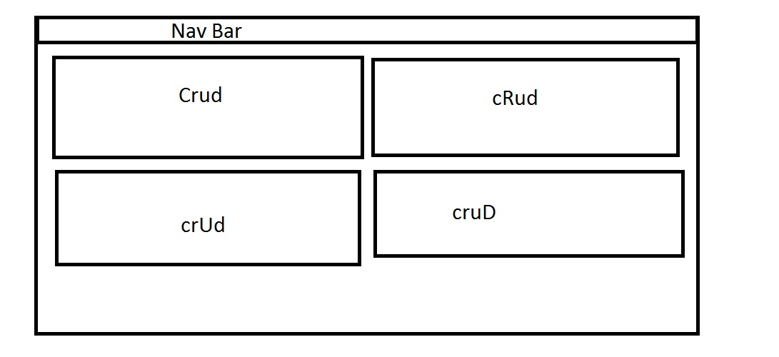
General layout wireframe
Use of PureCSS splits pages into grids, with buttons handled by bootstrap. The two play well together, and PureCSS makes layout much much easier. With this design, I had the idea of parallax scrolling for each CRUD functionality (scroll shows a new page essentially. Bold design choice)

Slide 8
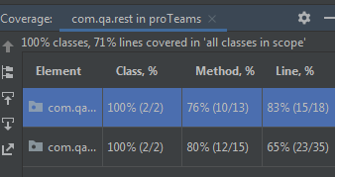
Test Coverage
Missing percentage: Some getters and setters. And, the method for update not working

Slide 9

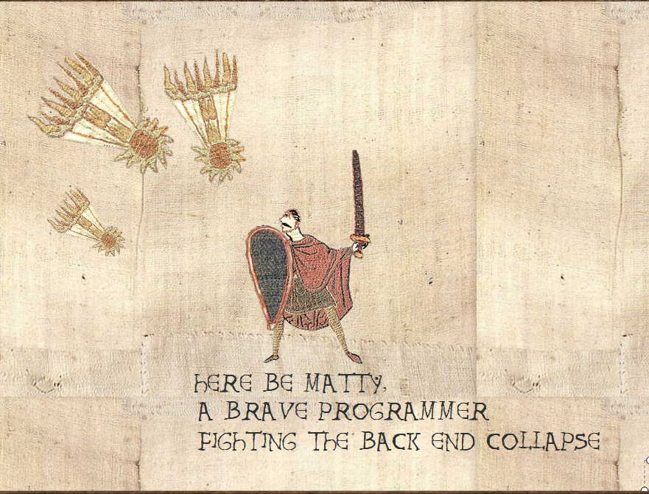
Project Problems
First iteration of front end did not work, solution not found to problem for a great deal of time
Front end file structure was non-functional until this morning, causing the front end to be lacking.
Look at that image, it’s a good representation of the project issues.

Slide 10

My Journey as a Consultant
Done my second assignment as of now
Learnt how to use Spring, set up API calls, build a front end, and how to test my work better.
Learnt how to use selenium testing, which, if I had a second opportunity with a working front end, I would use. Heavily.

Slide 11
Continuous integration
Core component of a good CI pipeline is contiunuous integration! Setting up the integration of all components of the project build/deployment phase saves dev time by the bucketload!
This projects CI PIPELINE had major issues for me, due to no access to SonarQube, and no GCP database, due to running out of google credit.

Slide 12
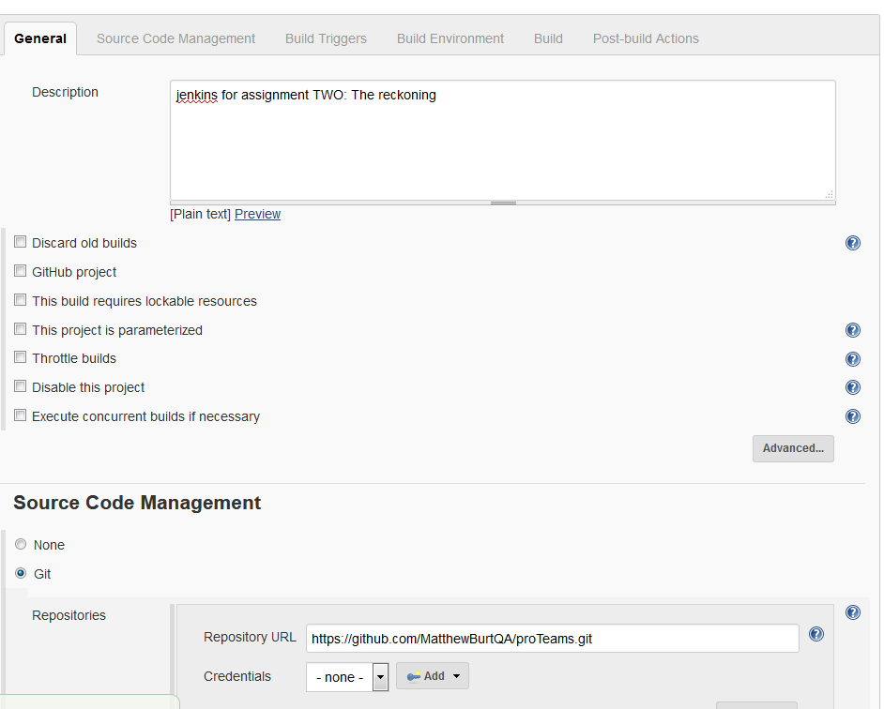
Grab project from github and give the CI a description!

Slide 13
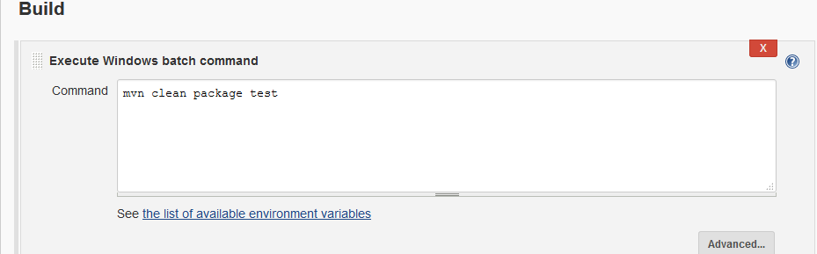
Maven build command
This is pretty much the current CI pipeline due to Nexus being weird and no SonarQube due to google credit
Worth mentioning that the deployment of this kind of application uses is WAR format and called to run by another program!

Slide 14
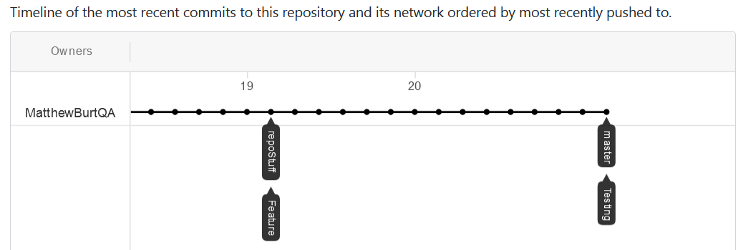
The Github workflow
See how theres one line? I merged before creating this slide. Probably shouldn’t have but it is what it is. So, we have one long line, and you can see the points in time where branches were merged back into master! Usual model was used, a master branch, dev branch then features off the dev. Sadly, due to this being the second attempt on the project, the sheer length of time spent is not shown fully here.

Slide 15
A review
Overall, I learnt a lot from this project!
Also found much more to improve on!
Things to take note of: my testing coverage from this project and my last project

Slide 16
A retrospective
Things I could improve on:
Handle stress better when the project collapses!
Features on the project:
Basic basic front end features, create of both types, to prove back end touched by front end
Mostly working back end!
High test coverage (compared to before ☺ )
Future features
Fully implemented front end, using pure CSS/css/html/jscript
Fix problematic update methods
Once previous step finished, test.
Then finally, implement more! A user log in system using SHA to encrypt log in information as it enters table, so table owners can’t browse users passwords, as that would be really really really really sketchy!

