Slide 1
Introduction
Matthew Duck

Slide 2
Journey
Java
MYSQL
Maven
Mockito

Slide 3
Version Control
Dev branch
Feature branches
Commits

Slide 4
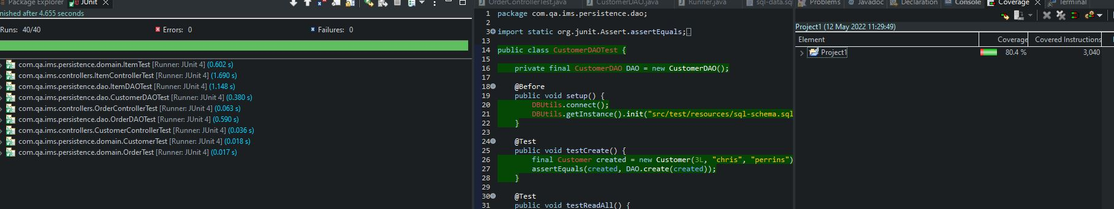
Testing

Slide 5
Sprint Review
Dev Sprint
Test Sprint

Slide 6
Conclusion

