Slide 1
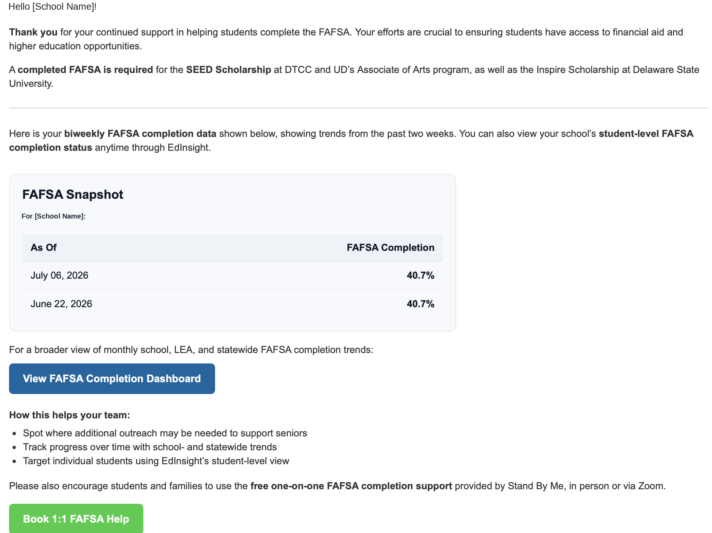
Biweekly FAFSA Completion Email
A school-specific FAFSA update with a two-week snapshot, dashboard link, and support resources.
1
Biweekly
snapshot
2
Dashboard
link
Current rate plus
two-week
comparison.
Opens broader
FAFSA completion
trends.
3
Support
resources
Free FAFSA
completion help.
Delaware
Department of Education

Slide 2
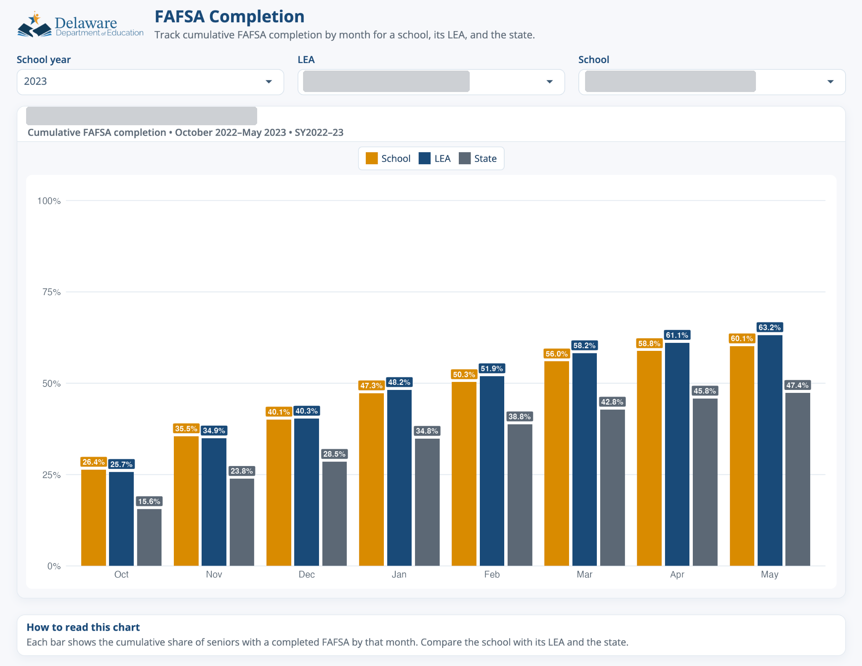
FAFSA Completion Dashboard Overview
The dashboard helps users track cumulative FAFSA completion by month for a selected school, its LEA, and the state.
1
School year filter
2
LEA and school filters
Select a school year
to view data.
Select an LEA and school
to view the corresponding
data.
3
Cumulative
completion chart
View the monthly
cumulative FAFSA
completion for the
school, LEA, and state.
4
Quick
interpretation note
Use these notes to
understand what the
chart shows.
Delaware
Department of Education

Slide 3
How to Read the FAFSA Completion Chart
Use the grouped bars and labels to compare a selected school with its LEA and the state over time.
4
Read the value labels
The percentages above
each bar show the exact
cumulative FAFSA
completion values.
2
Percent on the
y-axis
The chart shows the
cumulative share of
seniors with a
completed FAFSA.
3
Compare school,
LEA, and state
Each month shows
side-by-side bars for
the selected school,
its LEA, and the state.
1
Months on the
x-axis
The months show
the cumulative
reporting timeline
(October–May).
Delaware
Department of Education

