Slide 1
Film Finder
Group 4 Presentation

Slide 2
Project Requirements

Slide 3
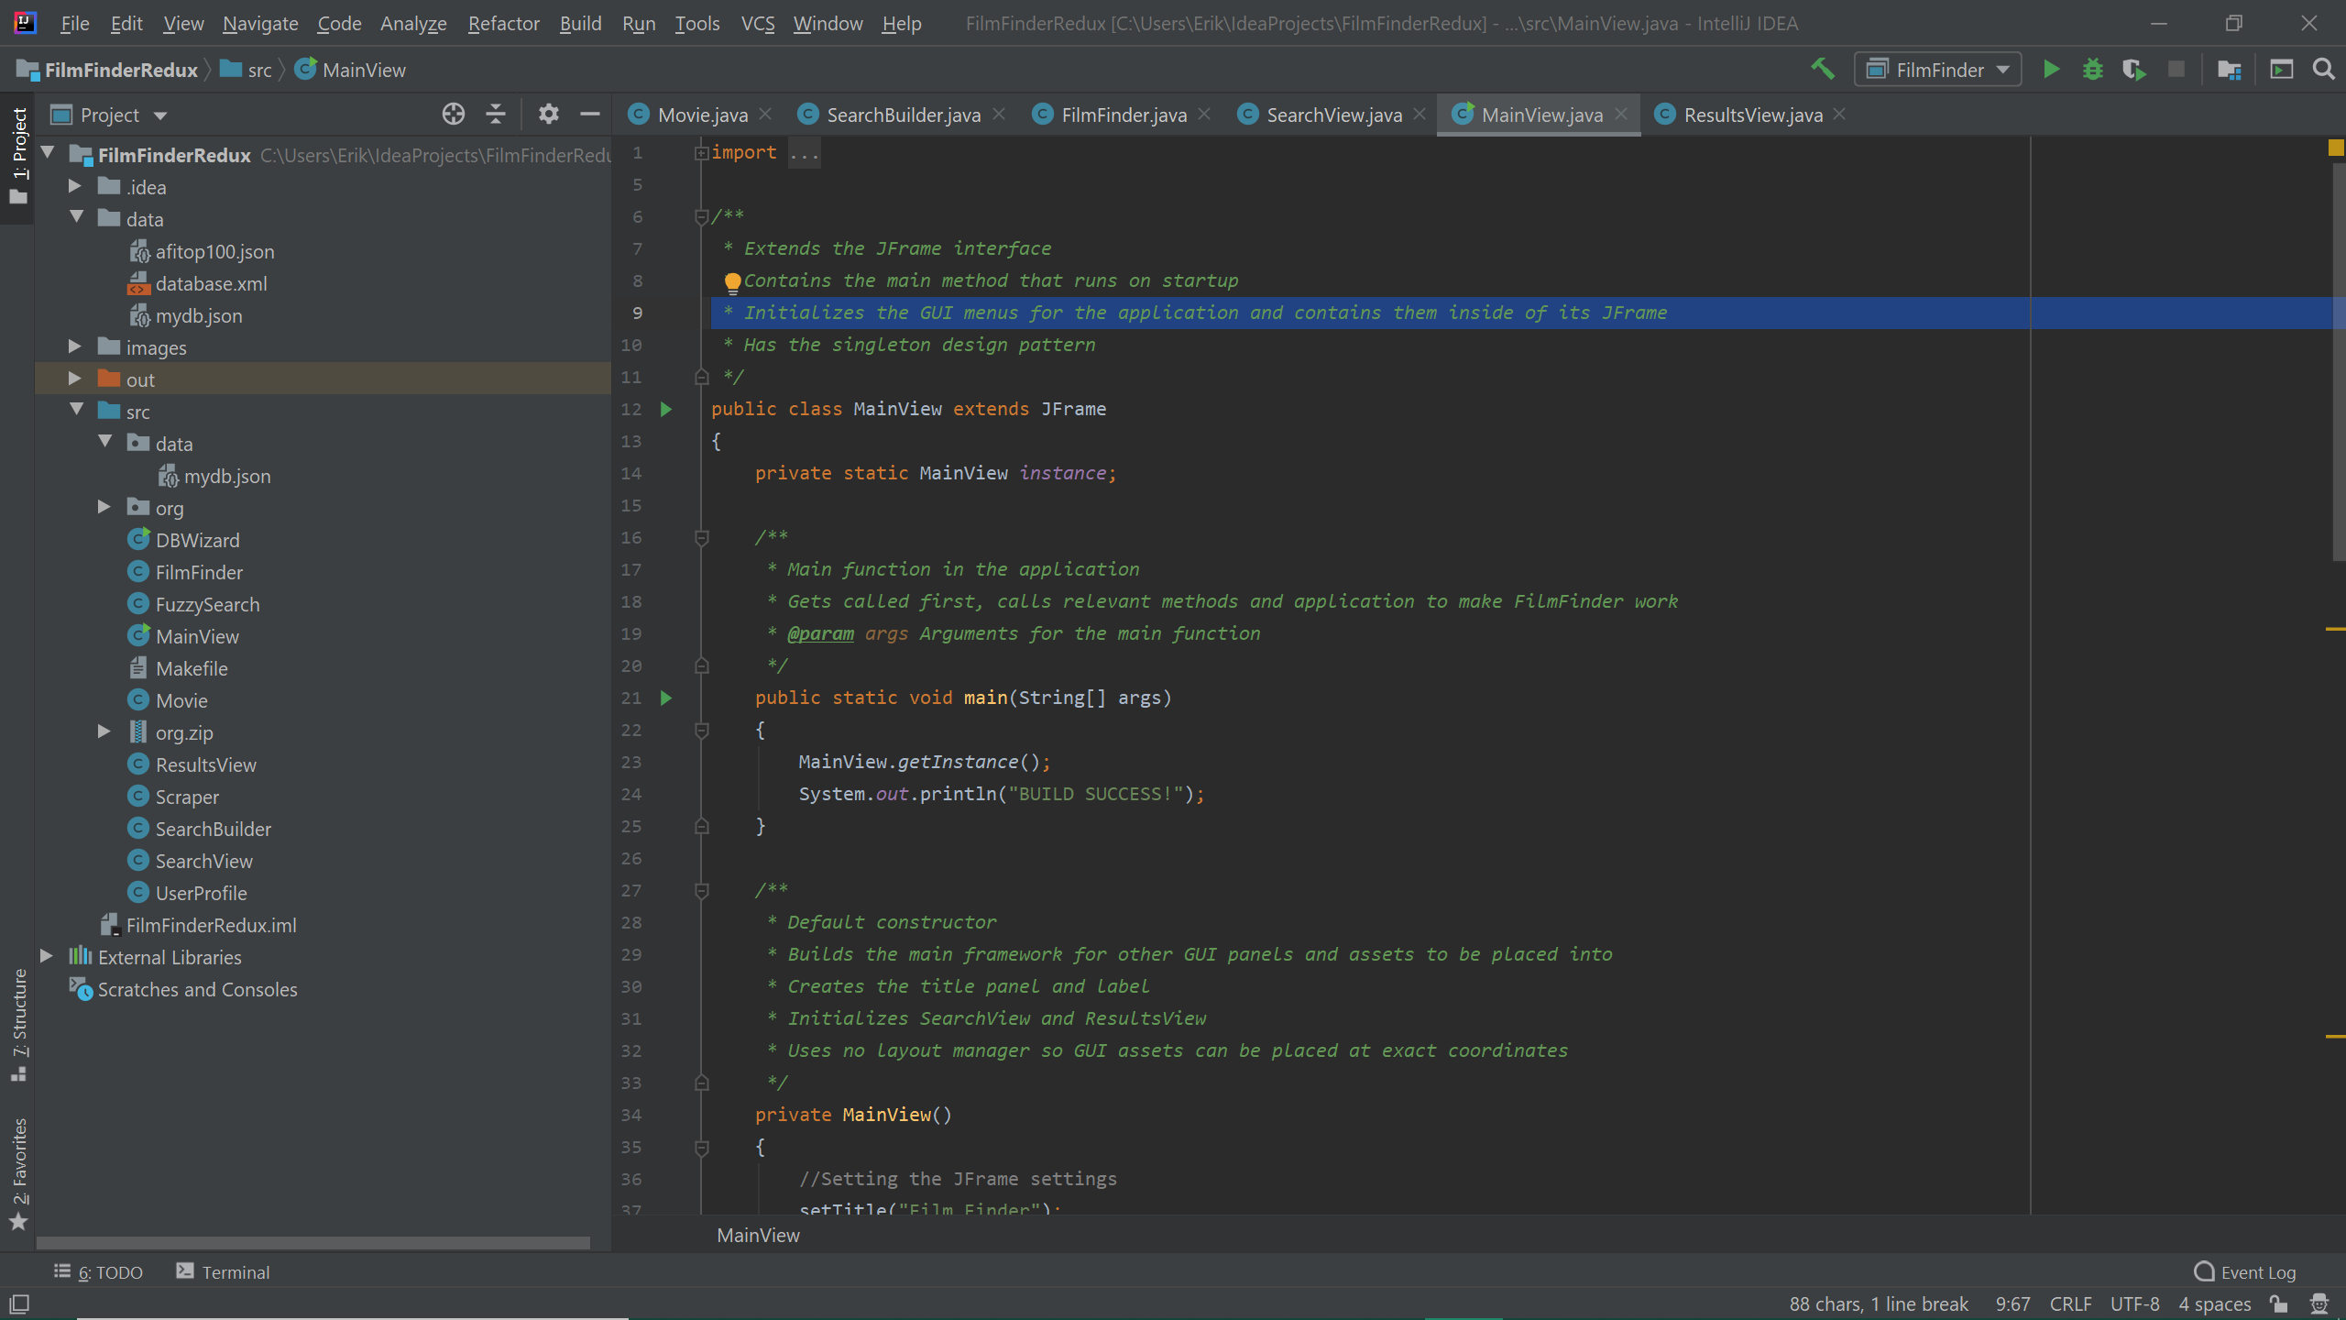
Software Developed in Java

Slide 4
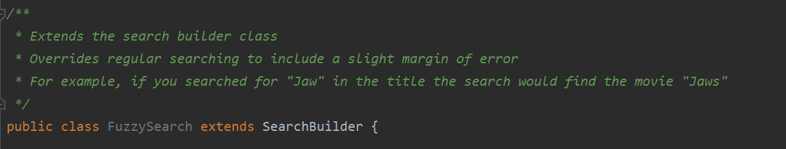
Use of Inheritance

Slide 5
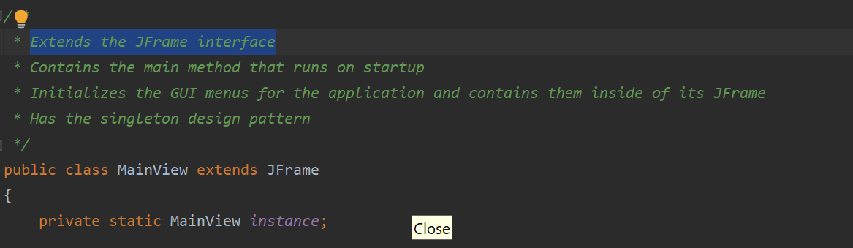
Use of Interfaces

Slide 6
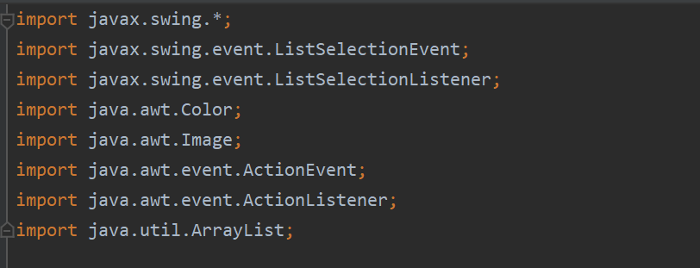
Use of Packages

Slide 7
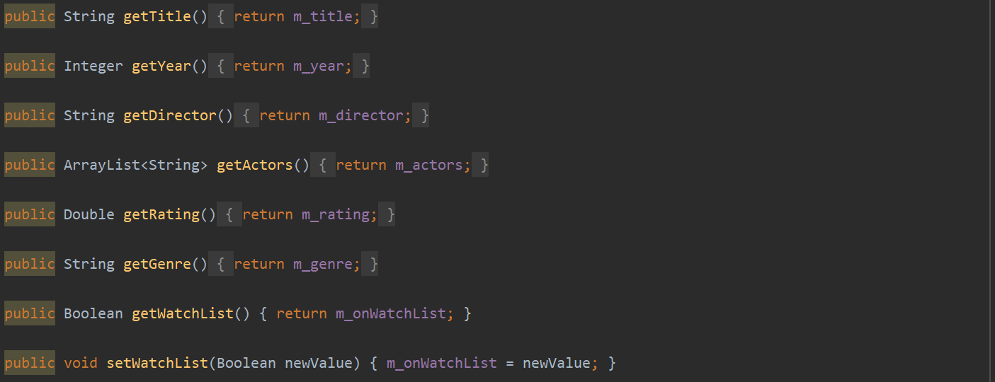
Proper use of modifiers (Visibility, final & abstract)

Slide 8
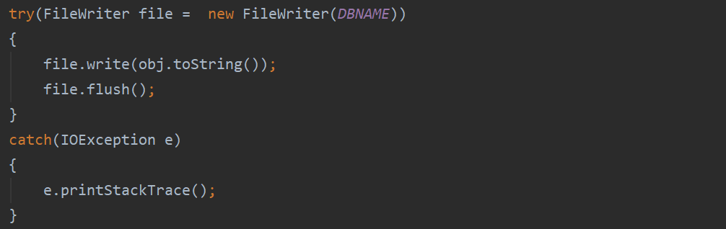
Use of Exception Handling and Error checking

Slide 9
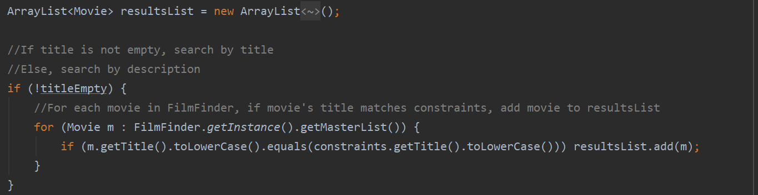
Use of appropriate collection data structures and their iterators

Slide 10
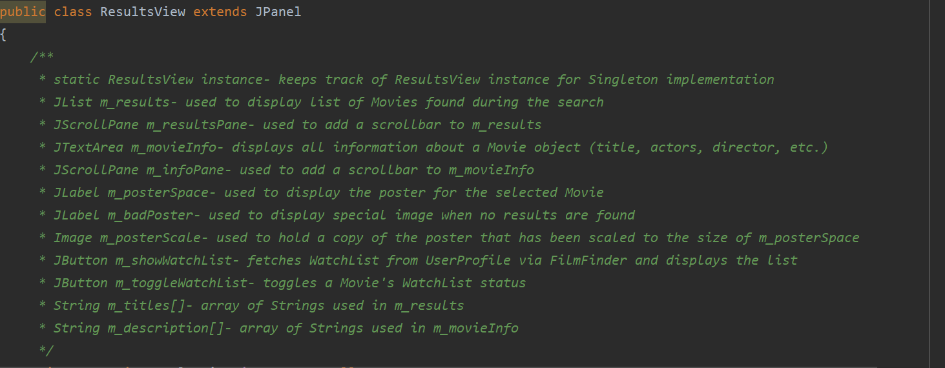
Javadocs are complete and accurate

Slide 11
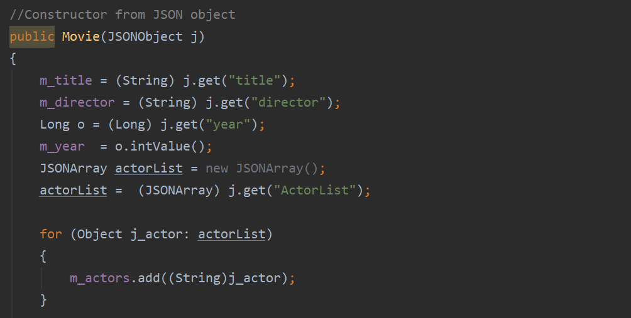
Use of appropriate programming constructs to retrieve and store data

Slide 12
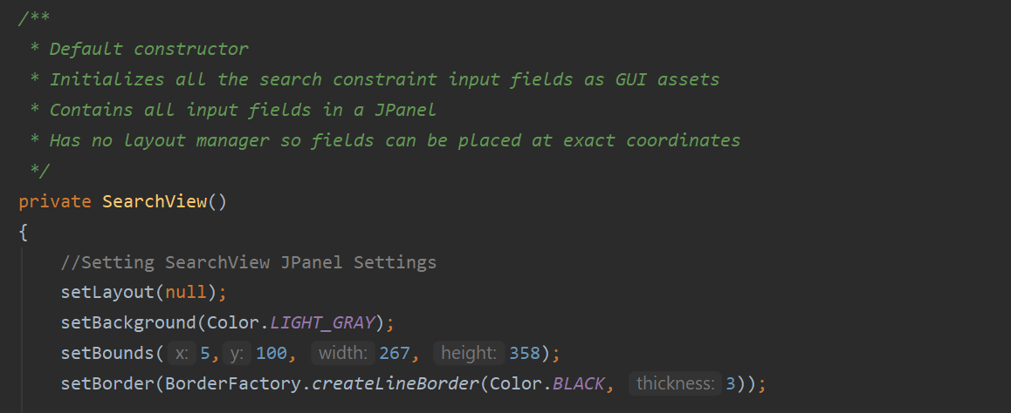
Use of appropriate programming constructs to build a suitable user interface, including display areas, buttons, lists and icons

Slide 13
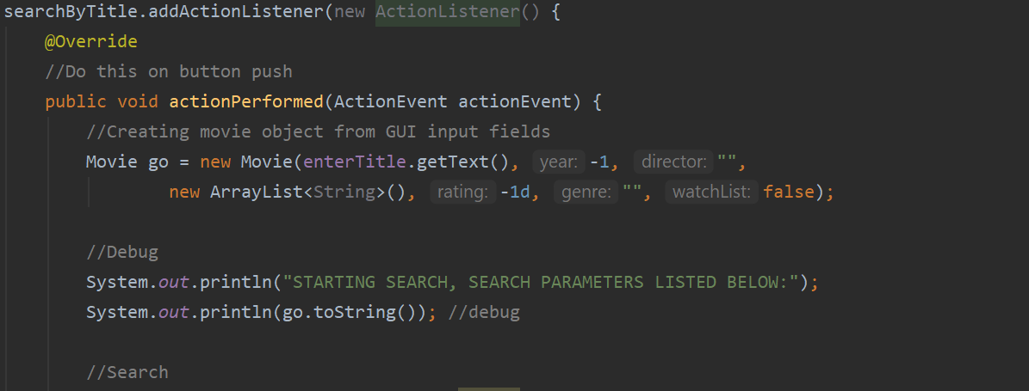
Appropriate good practices: action listener implementation

Slide 14
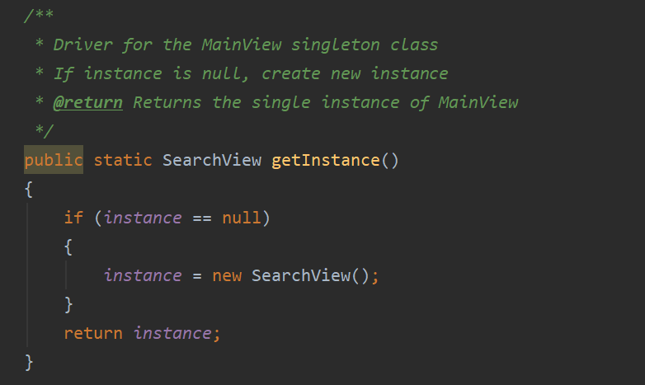
Design pattern: Singleton

Slide 15
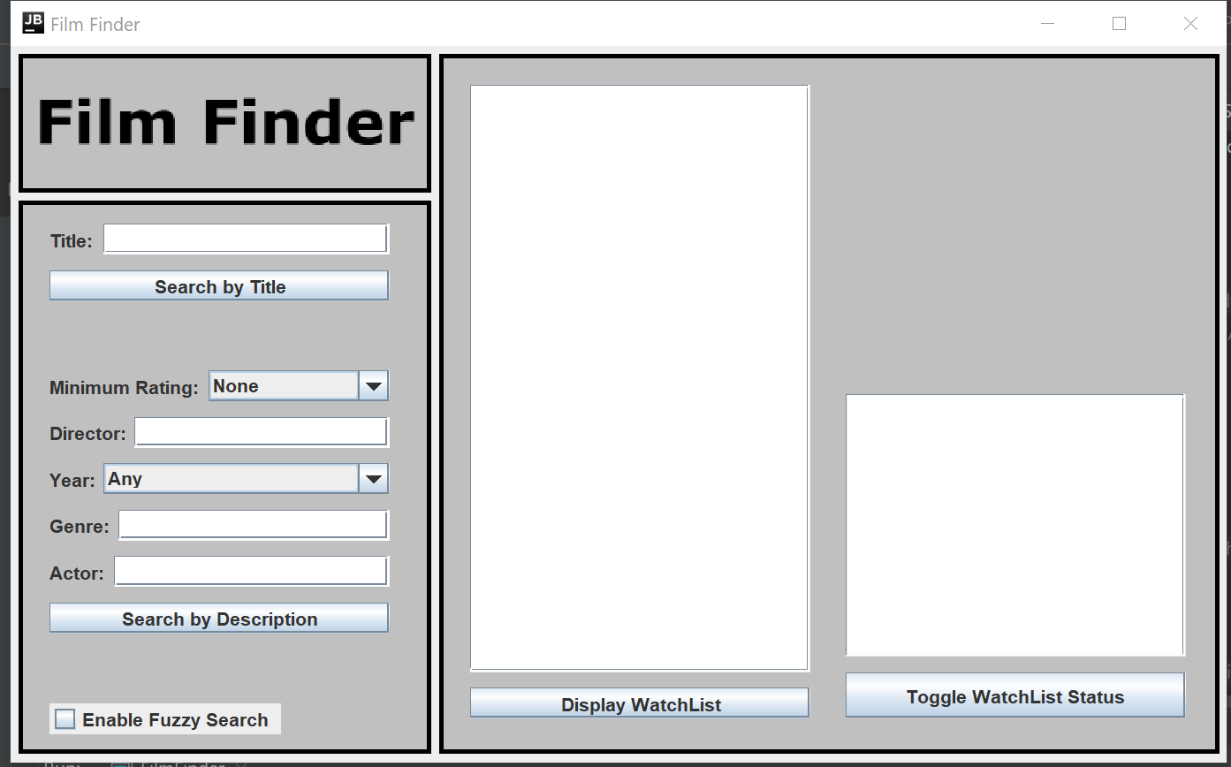
Graphical user interface

Slide 16
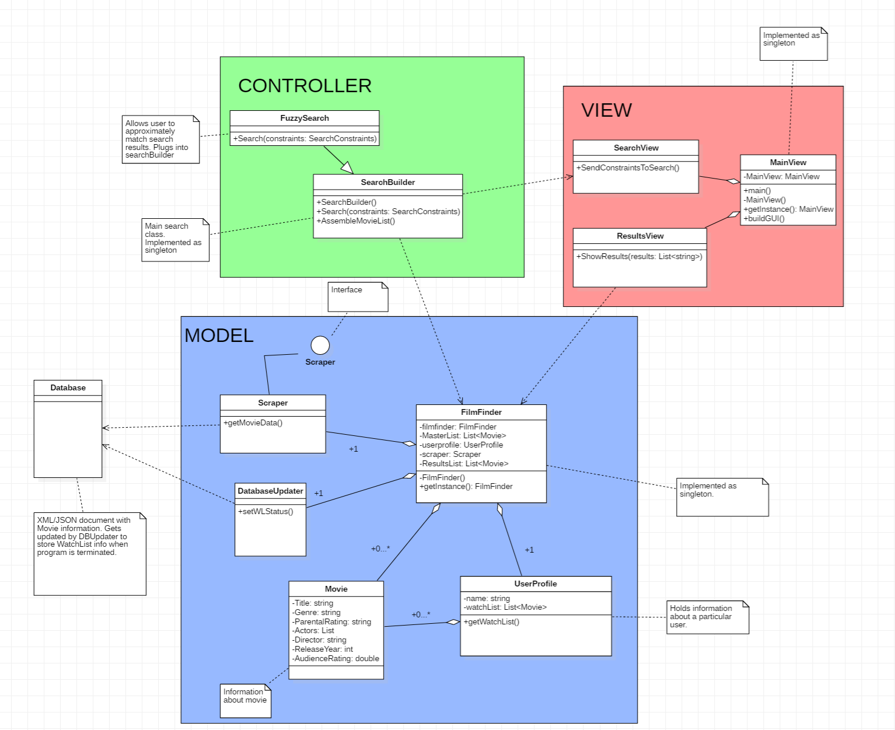
Model-View-Control

Slide 17
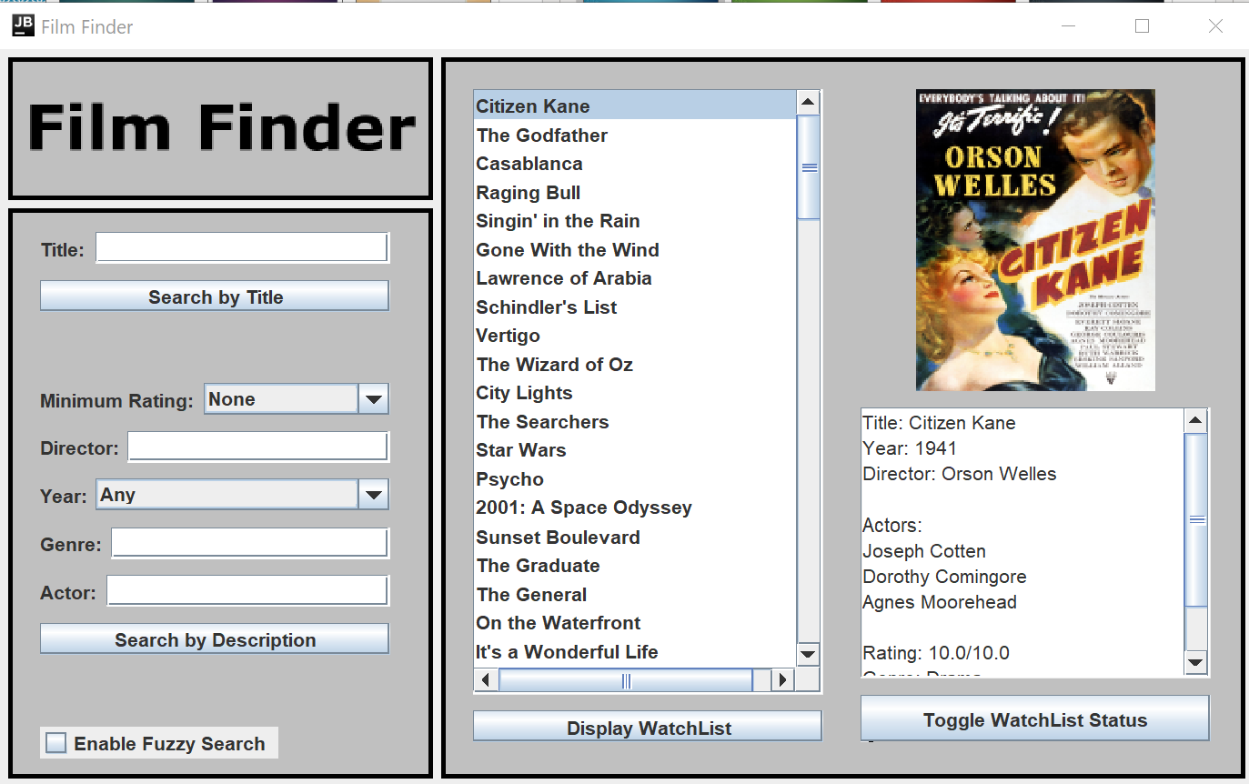
Nicely Formatted text and a clean readable ui

Slide 18
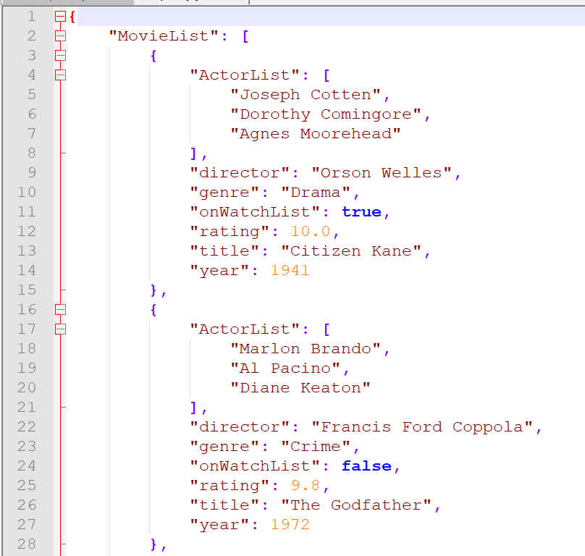
Formal Storage and information retrieval

Slide 19
Software executes with no crashes or major glitches...

