Slide 1
League of Legends AI
MattHew FreNCH, EriC JOHNSON, Nawavi Naleem

Slide 2

Motivation for the project?
To get a good grade
League of Legends is a free, multiplayer, online strategy game in which two teams fight each other to destroy the opponent’s base. The faster and more accurate decision making of a player determine who shall win.
Our job was to create a fast AI which could possibly play League of Legends faster and much more accurate than the skilled human player.

Slide 3
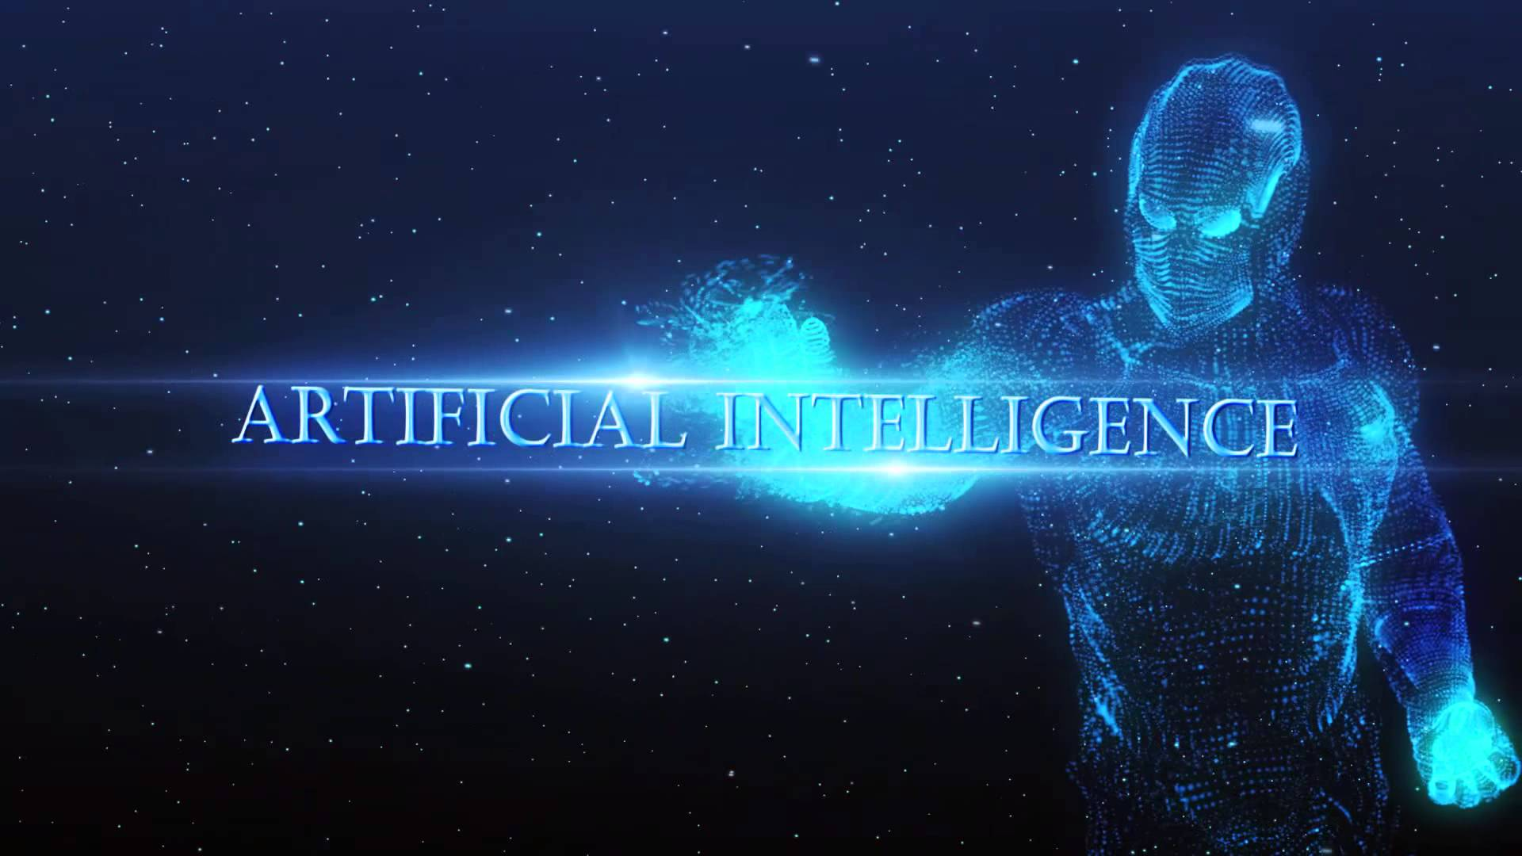

Slide 4

AI can be much more accurate with detection throughout the game as opposed to a human player. This is because a computer can react, compute decisions, and eliminate scenarios much quicker.

Slide 5
Motivation for the project..(CONT.)
Ai is developed by matt
Before parallelism, the ai played at a beginner level
In this project, we are focusing on improving the speed of detection and decision-making by using parallelism

Slide 6

THE LOGIC BEHIND THE SCENCES: DETECTION MANAGER
Detection Manager is the visual cortex of AI.
Detection Manger is the key component to analysis

Slide 7
APPLICATION (BENEFITS OF OPENMP)
OPEN MP - USED
GPU, CUDA, …
REASON TO USE
GPU: DATA TRANSFER (SEND/RECV) LATENCY
CUDA:

Slide 8
Benchmark Results & Overview
Beginning
After parallelism
One second
0.001 seconds

