Slide 1

Bayesian Machine Learning
Stochastic Gradient Langevin Dynamics

Slide 2
Classical Vs Bayesian Machine Learning
Optimizes to find one parameter
Fast
Overconfident in predictions
Finds distribution of parameters
Slow
Gives uncertainty

Slide 3
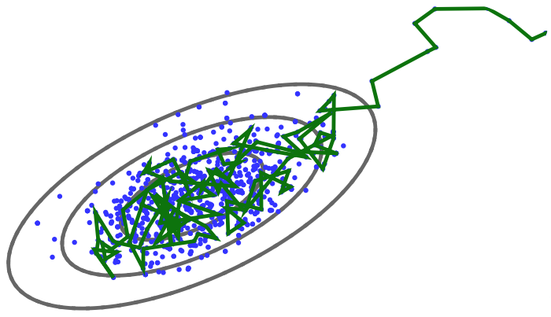
Monte Carlo Markov Chain (McMC)
MCMC produces a sequence of correlated, approximate samples from a target distribution π(θ). This sequence follows a random walk, with Markov steps. A sample is accepted or rejected according to the Metropolis Hastings Algorithm.
MCMC is asymptotically exact: given infinite time, the samples it produces converge to π(θ)

Slide 4
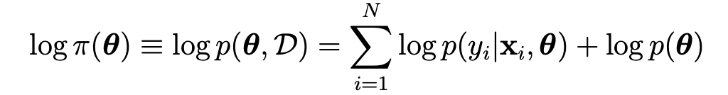
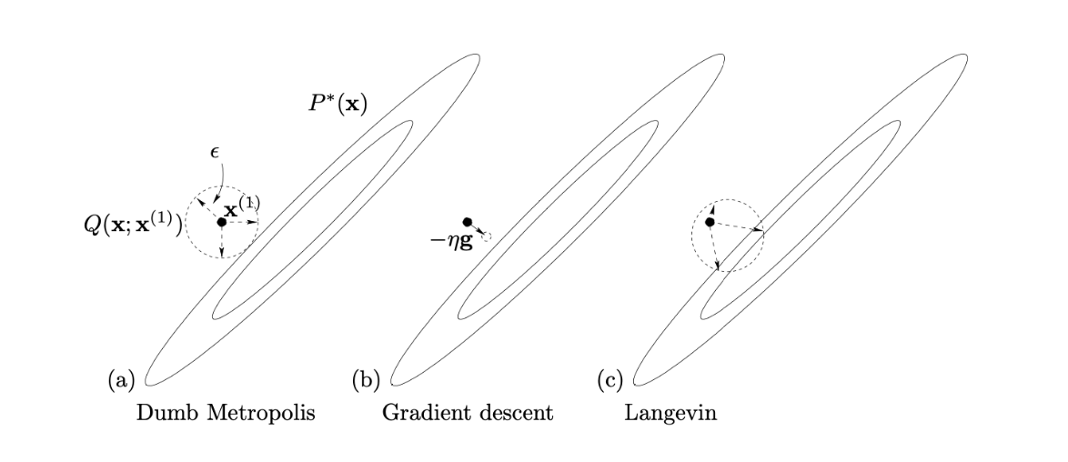

Langevin Dynamics
Finding an estimate of parameters is done by maximizing the log joint probability:
This is done by taking gradient descent, with: $g_{t}= −∇_{θ}\log{p(θ_{t}, D)}$
Langevin Update: ${ θ}_{t+1}=θ_{t}−\frac{1}{2}εg_{t}+η$
Gaussian Update: $θ_{t+1}∼N(θ_{t}, σ^{2})$
Including the gradient information into the proposal helps with performance in high-dimensional spaces

Slide 5
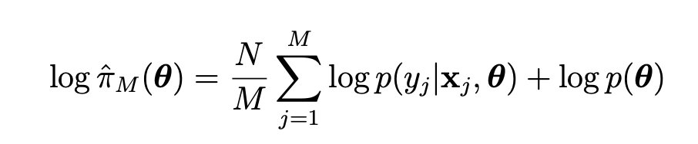
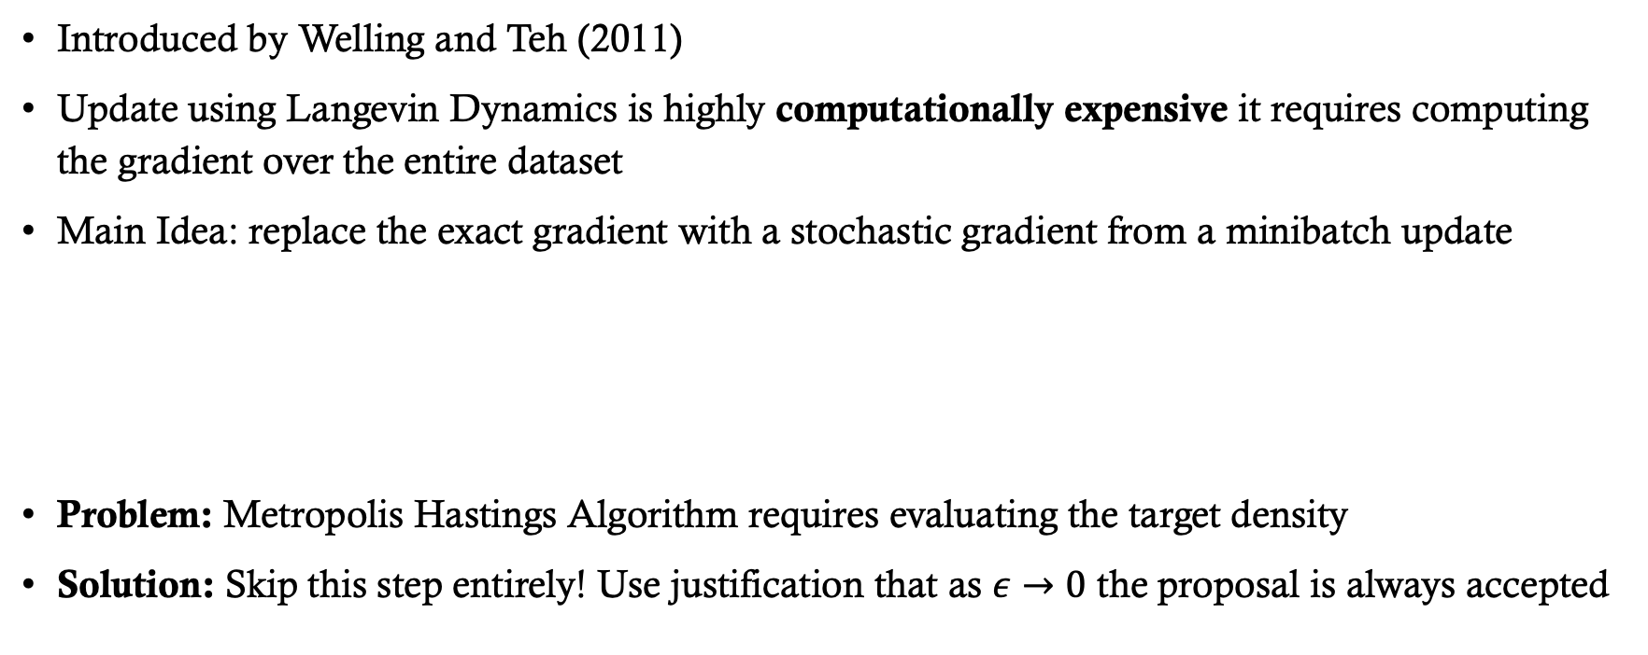
Stochastic Gradient Langevin Dynamics
Introduced by Welling and Teh (2011)
Update using Langevin Dynamics is highly computationally expensive it requires computing the gradient over the entire dataset
Main Idea: replace the exact gradient with a stochastic gradient from a minibatch update
Problem: Metropolis Hastings Algorithm requires evaluating the target density
Solution: Skip this step entirely! Use justification that as $ε→0$ the proposal is always accepted

Slide 6
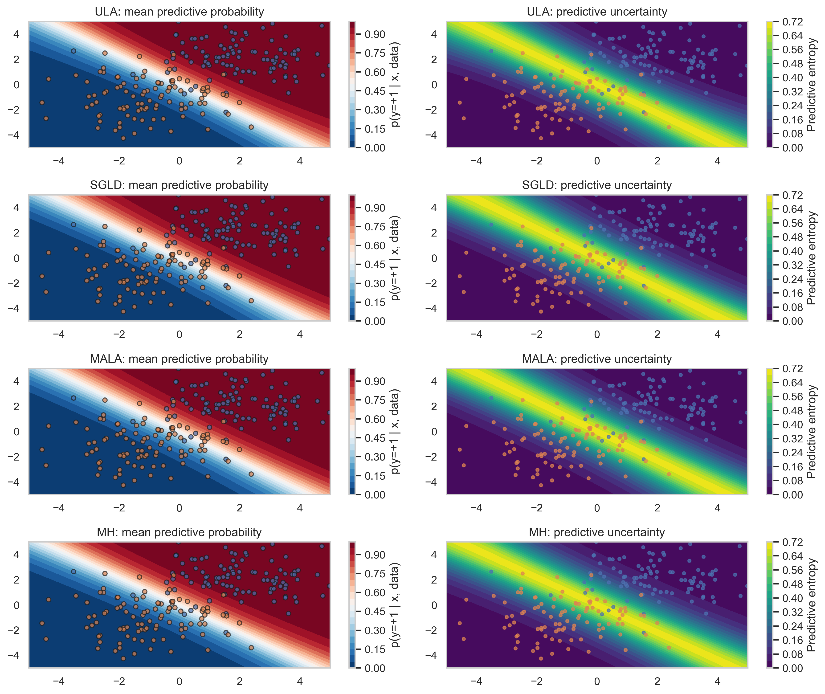
Applied to simple Classification task

Slide 7


Possible Future work
Use the samplers within a Bayesian Neural Network (Main modern application of SGLD)
Apply the algorithms to tasks beyond binary classification
Implement improved variants of SGLD (e.g., momentum-based or preconditioned versions)
Apply to more challenging datasets (e.g., multi-class classification)
Investigate further intricacies of the algorithm (e.g., step-size selection $ε$)

