Slide 1
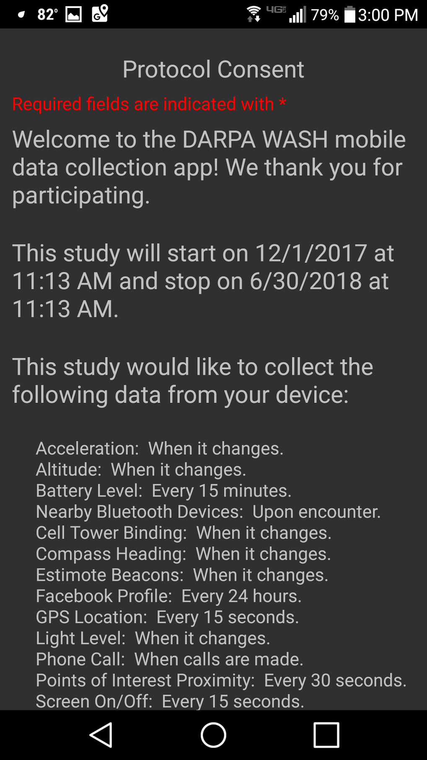
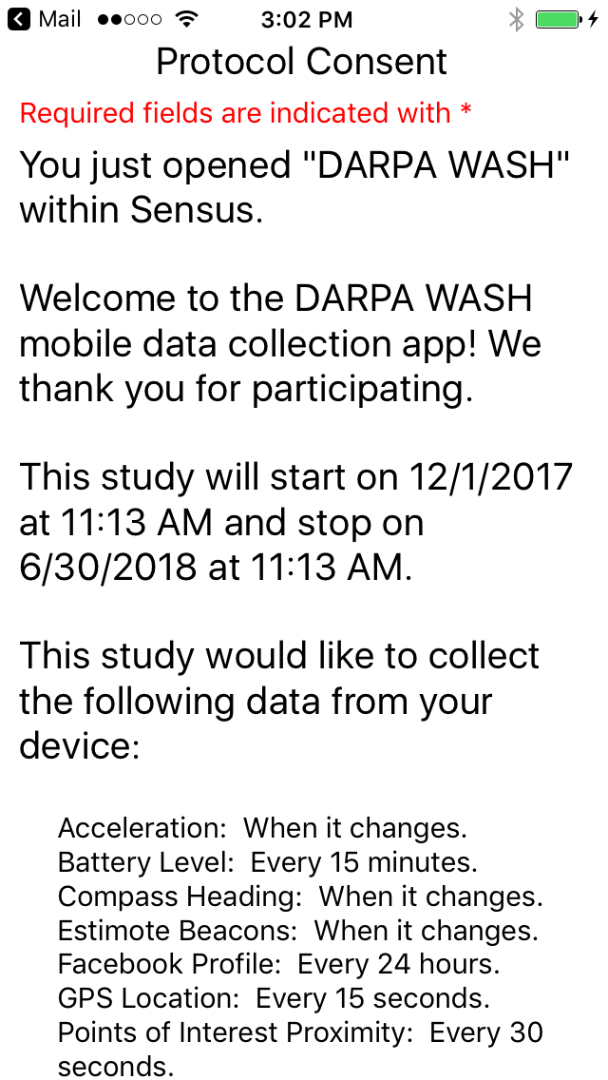
Android App
iOS App
REaDI Sense for Android
Android-specific…
library references, e.g., to SensorManager for accelerometer.
unit and automated UI testing.
REaDI Sense for iOS
iOS-specific…
library references, e.g., to CMMotionManager accelerometer.
unit and automated UI testing.
20% of codebase
Few changes
Minimal errors
Cross-Platform, Shared Codebase
Platform-independent logic that implements…
REaDI Sense study management
participant enrollment
sensor configuration and tasking
data anonymization, encryption,
local storage, and transfer to cloud
80% of codebase
Frequent changes
Most errors
networking and security
power management
user interface design
unit and automated UI testing

