Slide 1
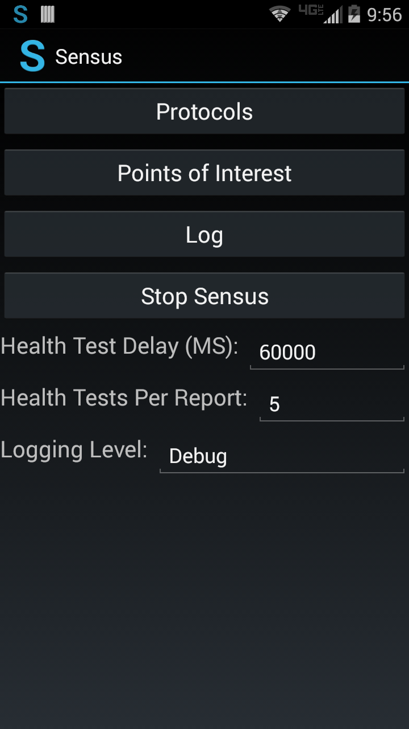
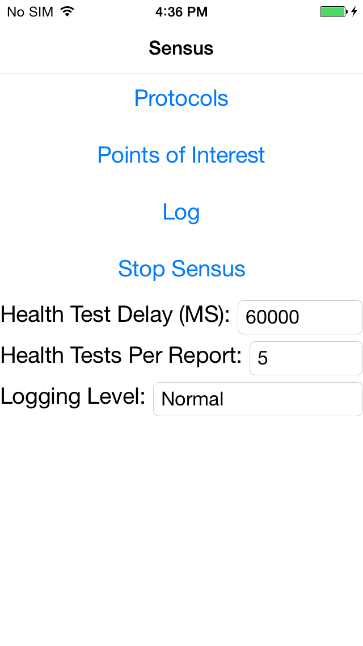
Android
iOS
Windows Phone
Coming soon…
Sensus.Android
Android-specific implementations (e.g., AndroidAccelerometerProbe).
Sensus.iOS
iOS-specific implementations (e.g., iOSAccelerometerProbe).
Sensus.WinPhone
Windows-specific implementations (e.g., WinPhoneAccelerometerProbe).
Foundational Shared Projects
SensusService
Protocol: Full implementation
Probe classes: Many are abstract
DataStore classes: Full implementations
…
SensusUI
UI pages: All full implementations

