Slide 1
ENGI 301 Automated Jewelry Box Proposal
<2/19/2024>
<Matthew Gutierrez>

Slide 2
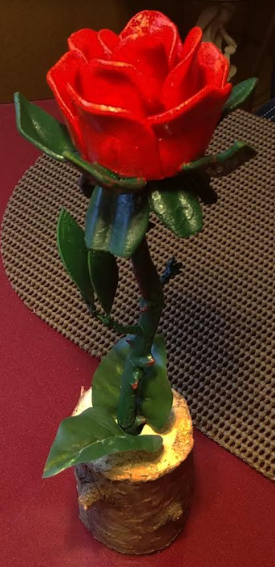
Motivations
I like making gifts for my Mom’s birthday, such as the 3D printed rose pictured to the right.
I have not done it in a while, so I feel this project would be a nice little gift.

Slide 3
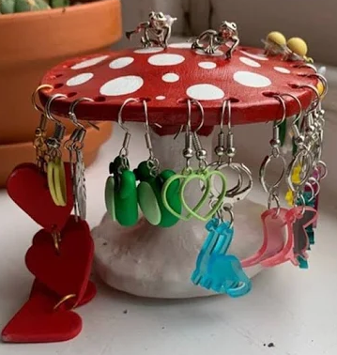
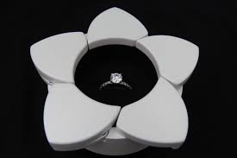
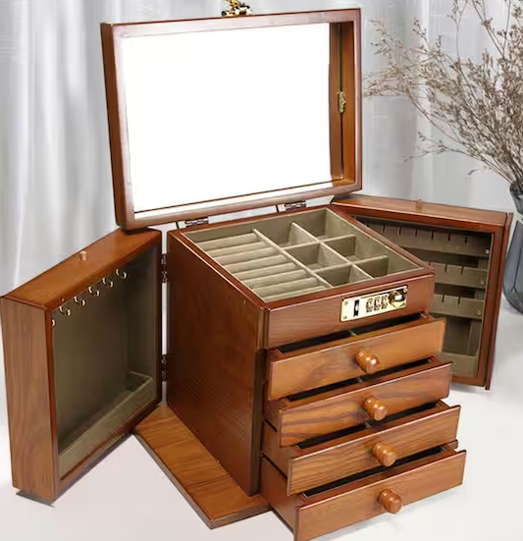
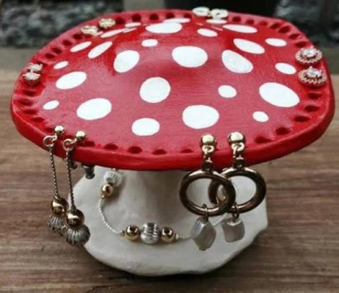
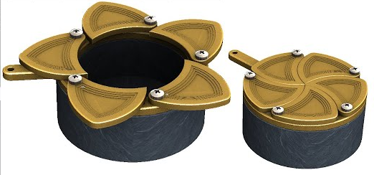
Inspiration

Slide 4

Sketches of Potential Design

Slide 5
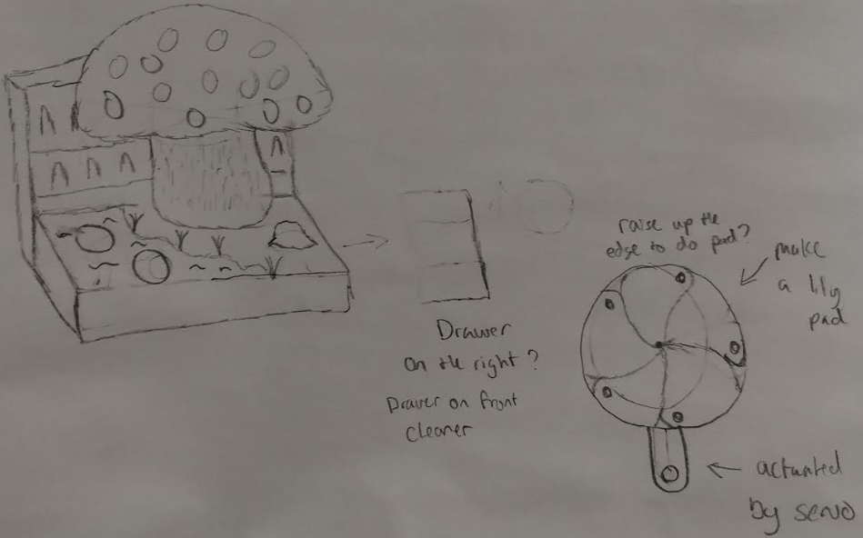
Sketches of Potential Design

Slide 6
Proposed Improvements
Custom and Controllable Lighting
Motorized Mushroom Head for Jewelry Selection
Limit Switch to Help Conserve Power for Ring Box

Slide 7
System Block Diagram

Slide 8
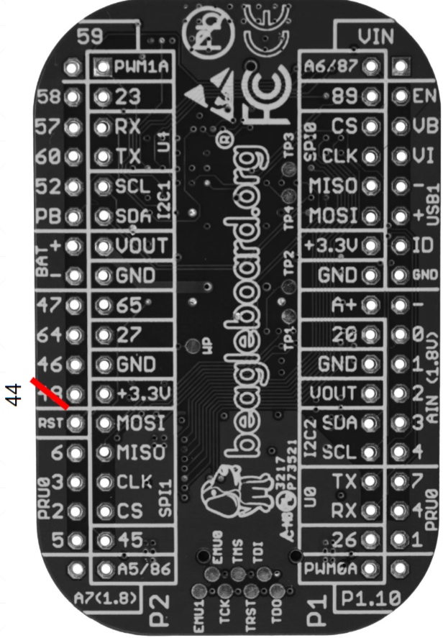
Motorized Jewelry Selection
Stepper Motor
UART4_RX (P2_05)
UART4_TX (P2_07)
GPIO (P2_09)
SPIO_CS (P2_31)
3.3 V (
GND (
Adjustable Light Control
AIN 1 (P1_21),
VOut (P1_23),
Gnd (P1_22),
PWM0 (P1_36)

Slide 9
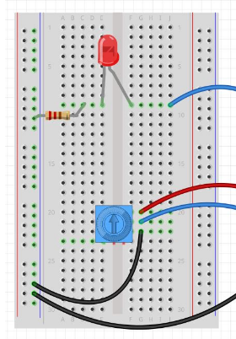
Fairy Light Control System
Fairly Lights
PWM0 (P1_36)
VOut (P1_23)
AIN 1 (P1_21)
Change
Color
Dimming Knob
On/Off
Switch
Gnd (P1_22)
Notes:
https://toptechboy.com/beaglebone-black-lesson-10-dimable-led-using-potentiometer/

Slide 10
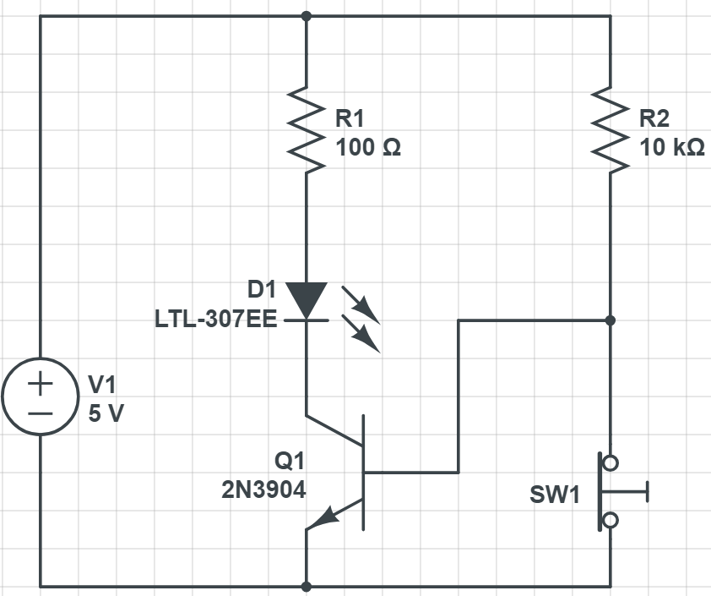
Ring Box Light Control System
When connection is broken, led placed inside the container will be turned on.
Look into Limit Switch

Slide 11
Jewelry Selection System
Bipolar Stepper Motor
Left
Random
Right
Notes:
Motors — BeagleBoard Documentation

Slide 12
Power Block Diagram
Bipolar Stepper Motor
3.3 - 5V
1.5 A
Fairly Lights
4.5V
? A

Slide 13
Components / Budget
Component | ENGI301 to Buy? | Cost
Fairy Lights | Y | 6.00
Battery Holder | Y | 10.00
Stepper Motor | Y | 10.00
Limit Switch | N
H Bridge | Y | 9.00
See Next Slide for Instructions

