Slide 1
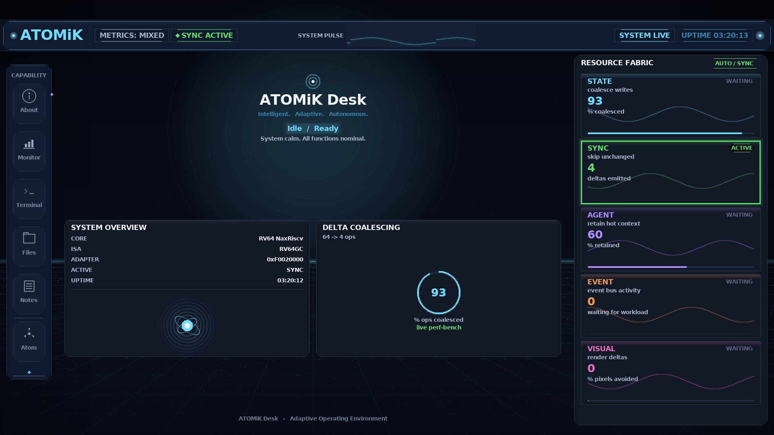
ATOMiK
Investor deck | May 2026 | matthew.h.rockwell@gmail.com
01
PRE-SEED | $5M TARGET
Make change the unit of compute
Bring one workload. Measure wasted state movement. Decide fit with evidence.
Public proof image is a hardware-validated UI artifact, not customer workload proof.

Slide 2
ATOMiK
Investor deck | May 2026 | matthew.h.rockwell@gmail.com
02
PROBLEM
Customers already know the pain
Battery
Hardware
Heat
Cost
dies too quickly
is maxed out
systems run hot
more performance is needed

Slide 3
ATOMiK
Investor deck | May 2026 | matthew.h.rockwell@gmail.com
03
MECHANISM
Reference state plus accumulated change
current_state = reference_state XOR accumulated_delta
LOAD
ACCUM
READ
SWAP
set reference
add deltas
reconstruct
commit boundary

Slide 4
ATOMiK
Investor deck | May 2026 | matthew.h.rockwell@gmail.com
04
PROOF TODAY
Real, specific, evidence-labeled
Zynq UI v0.40-A
Live Workloads demo
HARDWARE_VALIDATED
LIVE_MEASURED 800 Mevents/s on AX7020
Parallel banks
Linux-to-FPGA
LIVE_MEASURED 1/2/4/8x on AX7020
HARDWARE_VALIDATED
AX7020 matrix
Lean4 algebra
LIVE_MEASURED with caveats
FORMAL_PROOF where audited
Formal claims stay bounded to specifically audited properties. AX7020 has wins and losses with caveats.

Slide 5
ATOMiK
Investor deck | May 2026 | matthew.h.rockwell@gmail.com
05
COMMERCIAL PATH
Show the problem path; measure fit
Show us
Evaluate
Show evidence
Call no-fit
the constrained path
fit against baseline
measurement + impact
if ATOMiK does not help

Slide 6
ATOMiK
Investor deck | May 2026 | matthew.h.rockwell@gmail.com
06
ASK
$5M to reach measured workload proof
Capital
Entry wedge
$5M target pre-seed
paid evals -> licensing optionality
Output
Need
proof + IP packet + ASIC feasibility
workloads + design-partner/advisor intros
Planning model: entry wedge from paid evaluations to licensing/strategic optionality if proof holds. Final SAFE terms require counsel/CFO.
This round does not fund tape-out.

