Slide 1
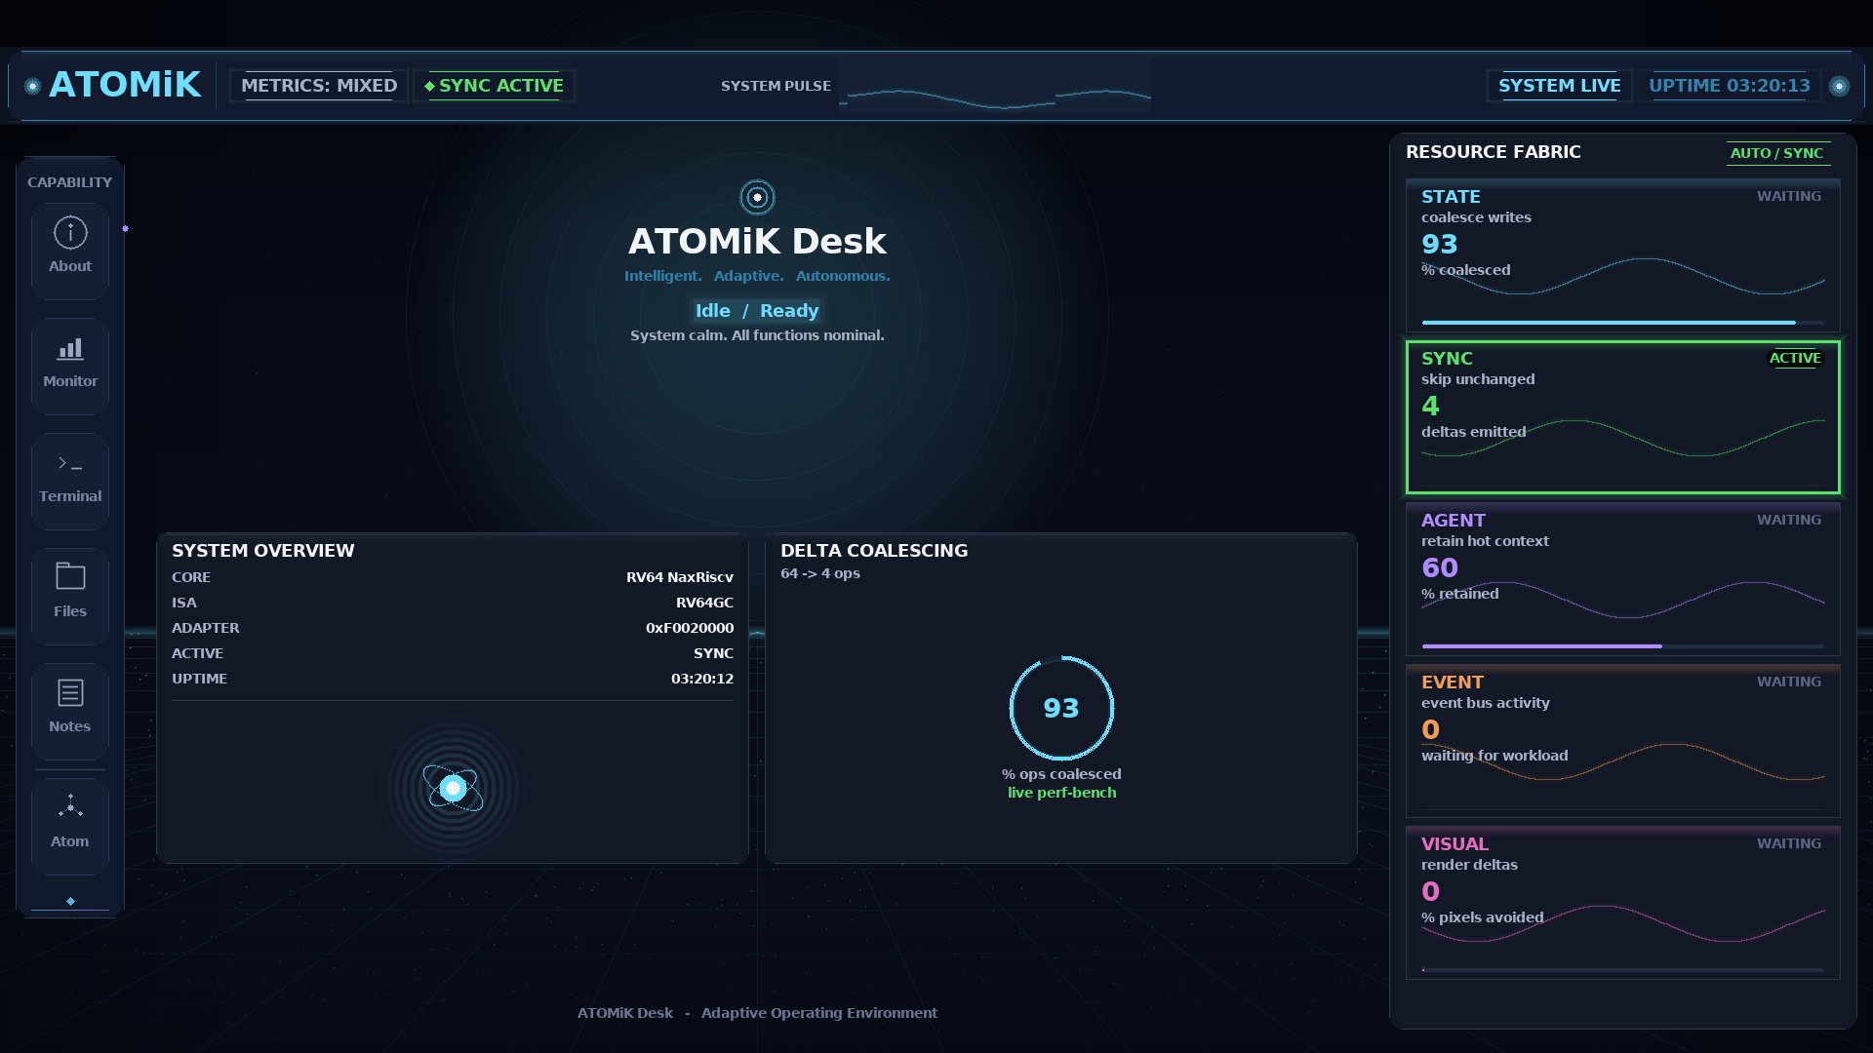
ATOMiK
Investor deck | May 2026 | matthew.h.rockwell@gmail.com
01
PRE-SEED · $5M TARGET · PLANNED SAFE
Make change the unit of compute
For edge and embedded teams whose battery, heat, bandwidth, latency, or footprint is constrained by repeated state work.
1
1
1
$5M
workload
baseline
constraint
ask
Start with one constrained state path.
Measure against the current system.
Battery, heat, latency, bandwidth, footprint, or hardware limit.
18-24 month proof round. No tape-out funding.
Current Zynq UI proof image - caption-bound, not a customer benchmark
Public proof image is a hardware-validated UI artifact, not customer workload proof.

Slide 2
ATOMiK
Investor deck | May 2026 | matthew.h.rockwell@gmail.com
02
PROBLEM
Customers already know the pain
- Batteries die too quickly.
- Hardware is maxed out.
- Systems run hot.
- Devices are too big or too heavy.
- Costs keep increasing.
- More performance is needed.
Before they spend more money
- bigger hardware
- larger batteries or cooling
- more bandwidth or a redesign
ATOMiK checks whether a constrained state path can get more out of the system they already have.
Customer-language pain framing. Outcomes remain workload-specific until measured.

Slide 3
ATOMiK
Investor deck | May 2026 | matthew.h.rockwell@gmail.com
03
END-GAME VALUE
Customers do not buy delta-state algebra
Bytes
Latency
Ops
Power
avoided
reduced
coalesced
proxied
less state movement against the baseline
faster local state paths where fit exists
less repeated work in change-heavy paths
follow-on measurement when instrumentation exists
Customer ROI is measured after the workload shows reduced state movement while preserving correctness.
Battery, heat, cooling, water, footprint, and power-bill outcomes remain evaluation targets until measured end to end.

Slide 4
ATOMiK
Investor deck | May 2026 | matthew.h.rockwell@gmail.com
04
MARKET OPPORTUNITY
Large pressure pool, focused wedge, strategic optionality
$1T+
$112B-$169B
$10M-$40M
TAM context
SAM context
entry wedge
2026 semiconductor revenue context. Backdrop only; ATOMiK does not address all semiconductor spend.
Embedded systems market range from 2024 estimate to 2030 forecast; edge AI adds adjacent pressure.
early annual revenue path from evaluations, design partners, and licensing; not a ceiling.
Venture logic: proof-backed IP can support licensing and strategic optionality if workload evidence and partner diligence hold.
Sources: SIA/WSTS, Gartner, Grand View Research, MarketsandMarkets. Semiconductor IP: $8.14B 2025 to $11.2B 2029. Planning targets are not forecasts.

Slide 5
ATOMiK
Investor deck | May 2026 | matthew.h.rockwell@gmail.com
05
FOCUS MARKETS
Growth pressure meets constrained state work
Edge AI
$24.9B 2025 -> $118.7B 2033 21.7% CAGR
Robotics / industrial
$33.8B 2024 -> $131.5B 2030 26.5% CAGR
Target examples: NVIDIA Jetson ecosystem, Qualcomm, Ambarella, Hailo, Advantech
Target examples: Rockwell Automation, Siemens, ABB, FANUC, Universal Robots
Drones / remote autonomy
$30.0B 2024 -> $54.6B 2030 10.6% CAGR
Smallsat / remote sensing
$4.0B 2024 -> $14.0B 2030 22.8% CAGR
Target examples: Skydio, AeroVironment, Anduril, Shield AI, Teledyne FLIR
Target examples: Planet, Spire, BlackSky, Maxar, Rocket Lab
Sources: Grand View Research segment reports. Target examples are account hypotheses only; no relationship or endorsement implied.

Slide 6
ATOMiK
Investor deck | May 2026 | matthew.h.rockwell@gmail.com
06
COMPETITIVE LANDSCAPE
Alternatives are real; proof-bound IP is the wedge
More silicon / accelerators
Processor and IP incumbents
Software/status quo
NVIDIA Jetson, Qualcomm, Ambarella, Hailo, Google Coral; FPGA upgrades from AMD/Xilinx, Intel/Altera, Lattice
Arm, Synopsys ARC, Cadence Tensilica, CEVA, Andes/RISC-V ecosystem, Imagination
compression, caching, dedup, delta sync, CRDT/event sourcing, hand optimization, bigger batteries, more cooling
Defensibility wedge
Lean4-checked formal algebra + FPGA hardware validation + IP/proof registry. Exact formal claims stay tied to audited properties.
Competitor names are buyer alternatives/status quo references, not partnership, customer, or displacement claims.

Slide 7
ATOMiK
Investor deck | May 2026 | matthew.h.rockwell@gmail.com
07
PRIMITIVE
Make change the unit of compute
state = reference_state XOR accumulated_delta
LOAD
ACCUM
READ
SWAP
set reference
add deltas
reconstruct
commit boundary
Plain English: track meaningful change and reconstruct only when the system needs full state.

Slide 8
ATOMiK
Investor deck | May 2026 | matthew.h.rockwell@gmail.com
08
FIT
ATOMiK has a wedge, not a universal claim
- updates dominate reads
- state changes are sparse
- bandwidth or latency is expensive
- power budget or hardware margin is tight
- sync, replay, rollback, or context retention creates overhead
Not the claim
- CPU/GPU/NPU replacement
- universal speedup
- thermal or battery result before measurement

Slide 9
ATOMiK
Investor deck | May 2026 | matthew.h.rockwell@gmail.com
09
USE CASES
Same waste, different customer budgets
Robotics / industrial
AI at the edge
heat, latency, reliability, control-state churn
context movement, memory pressure, local response
Remote systems
Defense-adjacent
drones, satellites, field runtime, packet budget
constrained hardware, power, rugged reliability
ICP is defined by constraint and measurable state path, not by industry label alone.

Slide 10
ATOMiK
Investor deck | May 2026 | matthew.h.rockwell@gmail.com
10
LIVE PROOF
Current Zynq UI artifact with caption
What it shows
current Zynq UI captured from /dev/fb0, driven by real measured on-board data
What to quote
caption-bound hardware-validated UI artifact
What not to quote
on-screen telemetry as customer benchmark; not an interactive demo
HARDWARE_VALIDATED UI ARTIFACT - not a customer workload benchmark or production-readiness claim.

Slide 11
ATOMiK
Investor deck | May 2026 | matthew.h.rockwell@gmail.com
11
PROOF STACK
Real, specific, evidence-bounded
Zynq Desk v0.40-A
HARDWARE_VALIDATED
current UI proof image, captured from /dev/fb0
Live Workloads demo
LIVE_MEASURED
first customer-facing workload on AX7020: 800 Mevents/s @ 8 banks, byte-identical
Parallel-bank throughput
LIVE_MEASURED
AX7020 8-bank accumulator scales 1/2/4/8x, byte-identical to software
Linux userspace to FPGA
HARDWARE_VALIDATED
documented OS-to-bus path
AX7020 board matrix
LIVE_MEASURED
wins and losses with caveats
Formal algebra
FORMAL_PROOF*
Lean4-checked algebra; exact audited properties only
Standalone boot
BUILD_ARTIFACT
not promoted until run proof
*FORMAL_PROOF applies only to specifically audited formal properties; it does not imply workload or customer outcomes.

Slide 12
ATOMiK
Investor deck | May 2026 | matthew.h.rockwell@gmail.com
12
COMMERCIAL PATH
A customer can understand the first step
1. Show us the problem path
2. We evaluate fit
3. We show the evidence
4. Or call no-fit
the part causing battery, heat, hardware, latency, size, weight, or cost pressure
measure whether ATOMiK can reduce state work against the current baseline
where the opportunity is, what was measured, and the potential impact
if ATOMiK does not help, say so and stop before wasting customer time
Design-partner work and licensing diligence come only after measured proof supports the path.

Slide 13
ATOMiK
Investor deck | May 2026 | matthew.h.rockwell@gmail.com
13
FINANCIAL MODEL
$5M funds proof, partners, and licensing diligence
Founder-prepared planning scenario, not a forecast.
$0-$150K
$250K-$750K
$1M-$3M
$3M-$8M
0-6 mo
6-12 mo
12-24 mo
24-36 mo
qualified proof reviews / technical evals
paid evaluation or design-partner SOWs
potential contracted value if proof converts
annualized potential if proof and economics hold
Use of funds: $1.5M engineering | $1.0M customer proof | $750K IP/legal | $750K ASIC feasibility | $1.0M finance/GTM/ops + reserve
Do not present ranges as booked revenue, committed pipeline, forecast, or guaranteed ROI. Material revenue requires signed SOWs or licensing terms.

Slide 14
ATOMiK
Investor deck | May 2026 | matthew.h.rockwell@gmail.com
14
RISKS AND GATES
Trust comes from saying what is still unproven
Customer validation
Downstream outcomes
pending; design partners are the wedge
battery/heat/water/ROI need end-to-end measurement
ASIC economics
Incumbents
external feasibility review before tape-out
differentiate by proof, IP, and workload focus
The risks are exactly why this is a proof round, not a tape-out round.

Slide 15
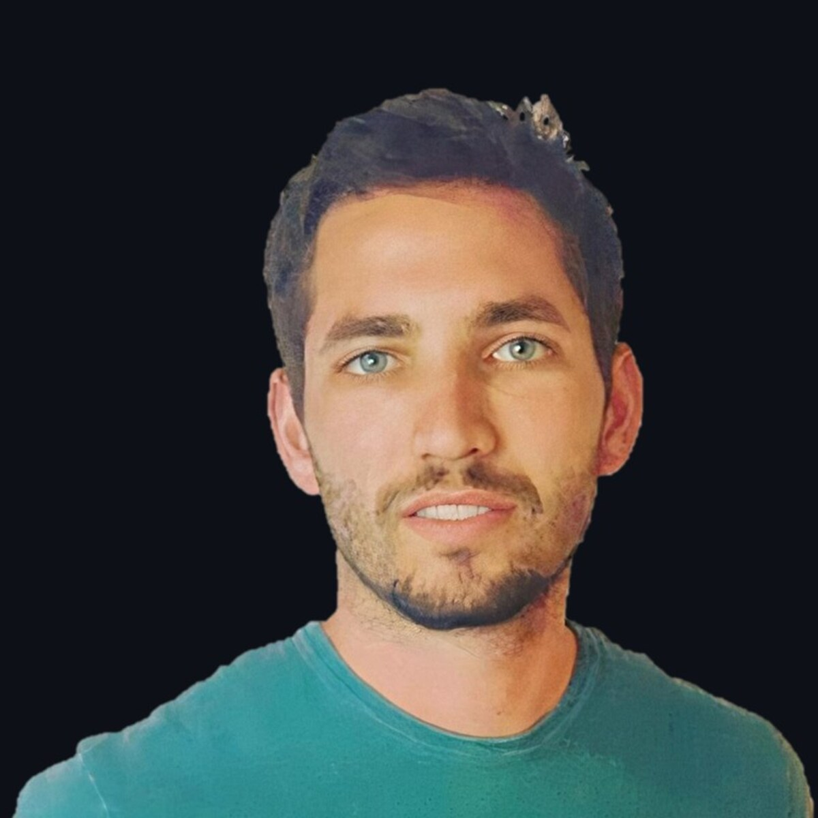
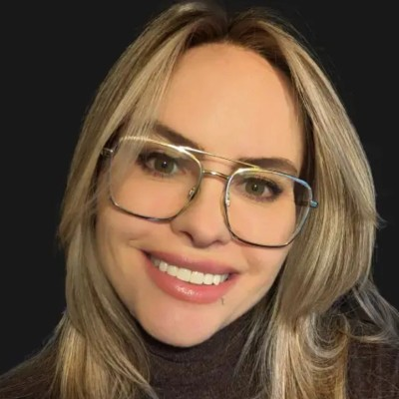
ATOMiK
Investor deck | May 2026 | matthew.h.rockwell@gmail.com
15
TEAM
Founder-led proof with commercial translation
Matthew H. Rockwell
Allison Rossi
Founder & CEO
CMO
Architecture, live proof, product direction, financial model, ask, and technical Q&A.
Messaging, positioning, buyer-language, commercialization, and go-to-market support.
Advisor priorities
ASIC/EDA feasibility reviewer | formal-methods reviewer | semiconductor IP/licensing counsel
No advisors are represented as signed until documented. These are priority asks for the round and AAN network.

Slide 16
ATOMiK
Investor deck | May 2026 | matthew.h.rockwell@gmail.com
16
THE ASK
$5M target to reach measured workload proof
- $5M target pre-seed; final SAFE terms CFO/counsel pending
- 18-24 months to measured workload proof, IP packet, ASIC feasibility
- Need: capital, qualified workloads, design-partner introductions
Priority help
not just capital
design-partner introductions plus investor feedback
Money in
Output
Upside
$5M target
proof + IP + feasibility
licensing path if proof holds
Final SAFE mechanics CFO/counsel pending. No signed traction, revenue, or customer-savings claim without supporting documents.

