Slide 1
ATOMiK Investor Deck
Make change the unit of compute
ATOMiK

Slide 2
ATOMiK
Make change the unit of compute
State-aware compute evaluation for edge and embedded teams constrained by battery, heat, bandwidth, latency, reliability, or hardware footprint.
HARDWARE_VALIDATED ATOMiK Desk v0.39-K runs as a framebuffer-native prototype UI on Zynq hardware.

Slide 3
The Hidden Tax
Many constrained systems waste energy, bandwidth, and time rediscovering what changed.
Edge devices spend limited battery on repeated scans, copies, sync, and replay.
Sealed or fanless systems turn redundant state work into heat.
AI and agent systems move context even when only a small delta matters.
Remote systems are constrained by every watt, ounce, packet, and minute.
Data-center power, cooling, water, and sustainability are expansion themes that still need workload-specific measurement.
Source context: IEA and LBNL support the broader energy, cooling, and water pressure around modern compute. These are market-context facts, not ATOMiK savings claims.

Slide 4
The First Wedge
The first customer is not everyone.
It is the team with:
one state-heavy workload
one current baseline
one painful constraint expensive enough to evaluate
Lead ICP: edge and embedded systems, AI at the edge, remote/field systems, robotics, industrial control, IoT, and defense-adjacent hardware-constrained teams.

Slide 5
The Customer Value
Customers do not buy “delta-state algebra.”
They buy evidence that a constrained state path may improve:
bytes moved or avoided
update/reconstruction latency
bandwidth pressure
operations coalesced
power or thermal proxy where measured responsibly
correctness preservation
Battery, cooling, water, and smaller hardware outcomes remain evaluation targets until measured on the workload.

Slide 6
The Primitive
ATOMiK makes change the unit of compute.
state = reference_state XOR accumulated_delta
Load a known state. Accumulate compact changes. Reconstruct only when needed. Commit clean epoch boundaries.

Slide 7
Why It Can Matter
Traditional systems often move or rebuild full state to answer a smaller question: “what changed?”
ATOMiK is designed for workloads where:
writes or updates dominate reads
state changes are sparse or coalescable
bandwidth is expensive
latency and power budgets are tight
rollback, sync, replay, or context retention create overhead
It is not positioned as a general-purpose CPU replacement.

Slide 8
Customer Use Cases
Buyer | Pain | Evaluation target
Edge / embedded | battery, enclosure heat, intermittent links, reliability | bytes moved, update latency, bandwidth, power proxy
AI at the edge | context/state movement, memory pressure | context retained, transfer avoided, response time
Remote / industrial / robotics | weight, wattage, packet budget, field runtime | runtime proxy, packet budget, update cost
Data center / infrastructure | power bill, cooling, water pressure, rack density | measured bytes moved, power/thermal path

Slide 9
Each use case needs one measured workload before ATOMiK claims savings.

Slide 10
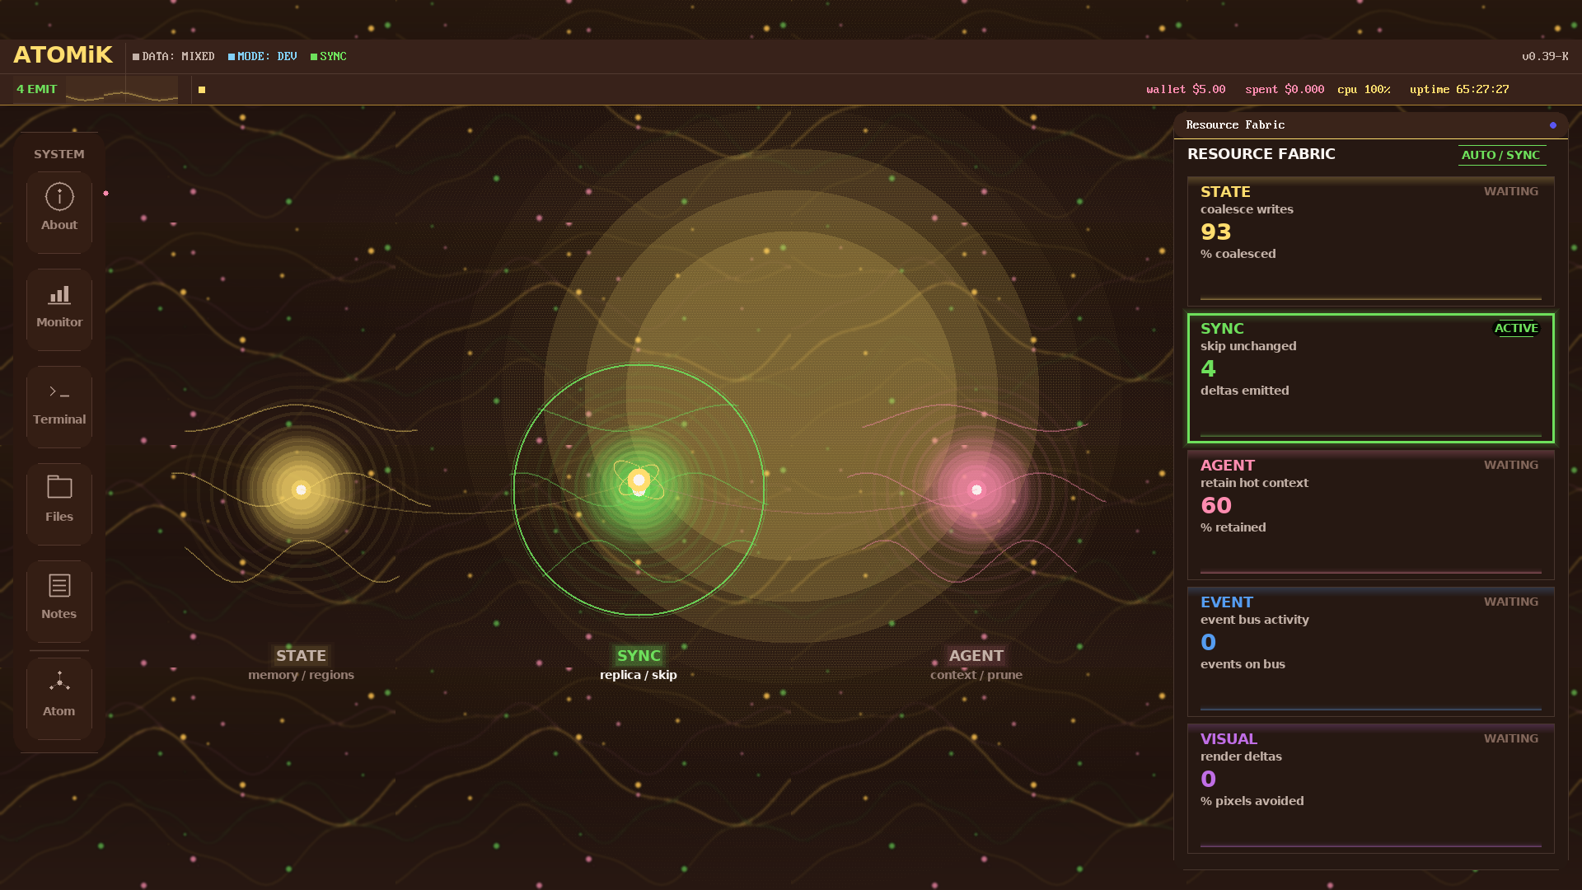
Live Proof Today
HARDWARE_VALIDATED ATOMiK Desk v0.39-K prototype UI running on live Zynq hardware. This screenshot proves the current live demo surface, not commercial product maturity or performance.
ATOMiK Desk v0.39-K prototype UI running on live Zynq hardware

Slide 11
Proof Stack
Proof | Label | Status
v0.39-K Zynq Desk UI | HARDWARE_VALIDATED | current public proof image
Linux userspace to FPGA path | HARDWARE_VALIDATED | documented path through OS and bus
AX7020 board run matrix | LIVE_MEASURED | raw artifact with caveats and wins/losses
Formal algebra | SOFTWARE_VALIDATED | proof work in repo; avoid public counts until audited
Synthesis and bank scaling | SYNTHESIS_VALIDATED | toolchain/hardware validation, not production silicon
Zynq standalone boot artifacts | BUILD_ARTIFACT | local build output exists; public power-on artifact still gated

Slide 12
Public claims stay tied to these labels.

Slide 13
Business Path
The near-term plan is focused and capital-efficient.
Convert proof into measured customer evaluations.
Strengthen IP and diligence materials.
Use design partners to identify workloads where savings are measurable.
De-risk ASIC feasibility before any tape-out commitment.
Position ATOMiK for strategic licensing, partnership, or acquisition.
ATOMiK is not trying to outspend chip incumbents.

Slide 14
Use Of Funds
Category | Amount | Proof gate
Engineering + demo hardening | $600K | repeatable Zynq proof system
Customer proof | $400K | measured workload artifact
IP + legal | $300K | counsel-reviewed IP packet
ASIC feasibility | $300K | mentor-reviewed go/no-go path
Finance/GTM/ops + reserve | $400K | runway, reporting, partner pipeline
Target ask: $2.0M pre-seed.

Slide 15
Minimum viable close: $1.25M. Stretch plan: $2.75M. Final SAFE terms require CFO/counsel approval. This round does not fund tape-out.

Slide 16
Risks And Gates
Risk | Current answer
Battery, power, thermal, cooling, water, or footprint savings are not yet measured end-to-end | Treat as evaluation targets until artifacts exist
Customer validation is pending | Paid evaluations and design partners are the validation wedge
ASIC economics require expert review | Fund feasibility review before tape-out
Incumbents can move quickly | Protect IP, build proof, and pursue strategic conversations

Slide 17
The pitch is intentionally evidence-bounded.

Slide 18
The Ask
ATOMiK is raising a $2.0M target pre-seed to reach measured proof.
$1.25M minimum viable close; $2.75M stretch plan
about 18 months of planned runway
post-money SAFE recommended; final terms by CFO/counsel
2-3 design-partner evaluations
one sanitized measured workload artifact
external ASIC/IP feasibility review
licensing-ready package
The next milestone is measured proof, not another abstract demo.

