Slide 1

New Hire Academy
All about Testing…

Slide 2

Matt Harsh
Manager
Current Project:
Test Leader at Kroger, Cincinnati OH
SKILLS:
Automation Frameworks & Architecture
Automation Leadership
Implementation of frameworks using Selenium (WebDriver & Grid), CodedUI, Appium, UFT, SOASTA, Cucumber-JVM, SpecFlow, SilkTest, Silk4J, Protractor, SoapUI, Sikuli & Tosca
Used JUnit, TestNG, MSTest, MbUnit, xUnit & Nunit unit testing frameworks in conjunction with above mentioned tools
Implemented Continuous Integration and Continuous Delivery Pipelines using Jenkins, TFS & VSTS
Certified Scrum Master (Scrum Alliance) since 2010
.
Manager
(Sr. Automation Architect)

Slide 3

New Hire Academy Training
Agenda
genda
Agenda
Introduction
Test Automation
Selenium Introduction
Setup in Eclipse IDE
Basic WebDriver commands; find elements; sample code design and execution
Automation Frameworks
Introduction to TDD, DDD and BDD
Further Reading/Training

Slide 4
Test Automation
Testing Tools You Want To Know…

Slide 5

What is Automated Testing?
The use of software to accomplish unattended execution of testing, which eases manual processes
Test automation is the use of software to control the execution of tests, the comparison of actual outcomes to predicted outcomes, the setting up of test preconditions, and other test control and test reporting functions

Slide 6
Benefits of Automation
Faster Test Execution
(Approx 75% productivity improvement)
Greater Test Coverage
Higher Test Accuracy No Human Error
Pros
Unattended Execution
Programmable
Continuous Integration/Delivery
Reliable, Repeatable & Reusable

Slide 7
Drawbacks of Automation
Maintenance
Can be Frustrating!
Licensing Cost
Cons
Technically Challenging
System Stress
Limitations

Slide 8













Automation Tools in the Market

Slide 9
Selenium Introduction
Selenium is an open source tool licensed under Apache License 2.0.
Selenium is a portable software-testing framework for web applications.
Enables simple and powerful DOM-level testing.
Supports many programming languages like Java, C#, Python, Ruby etc.
Works on multiple operating systems and browsers.
Works on all major browsers.
Supports mobile test automation using tools like Appium or Selendroid.
Parallel execution of test scripts using Selenium Grid.
Can be integrated with other tools like TestNG and Junit as well as BDD Frameworks (SpecFlow, Cucumber etc.).

Slide 10
Limitations
Selenium Introduction
Selenium supports only web-based applications.
Understanding of programming languages is required for writing better test scripts.
Unlike QTP, Selenium does not have Object Repository/Recovery scenarios.
Does not generate default test reports.
Limited usage in client-server applications.
Flavors of Selenium
Selenium is a set of tools that helps testers to automate web based applications more efficiently.
Flavors of selenium:
Selenium IDE
Selenium RC
Selenium WebDriver
Selenium Grid

Slide 11
Selenium IDE
Selenium Introduction
Selenium IDE is an integrated development environment (IDE) for Selenium tests. It is a Firefox Add-On.
Scripts can be recorded automatically and edited manually using a special test scripting language called Selenese .
Using Selenese commands, all the browser actions like clicking on a link or a button, selecting an option, entering data in the text field, retrieving data from the resulting pages etc., are performed.
Selenium RC
Selenium-RC stands for Selenium Remote Control(Selenium 1.0)
It was used for a long time before selenium WebDriver 2.0 is released.
Now Selenium RC is hardly used in industry as WebDriver has more powerful features and more easy to use.

Slide 12
Selenium WebDriver
WebDriver is popularly known as Selenium 2.0. (Selenium 3.0 was released 10/2016)
It is a programming interface, which better supports testing dynamic web applications with object oriented API that mimics the behavior of real user.
WebDriver interacts directly with the browser therefore making execution faster.
Supports several programming languages like Java, c#, Ruby and Python which enables writing test scripts using conditional operations, looping and other programming concepts, making it robust.
WebDriver can be used efficiently for complex page navigation like interacting with multiple frames, browser windows, popups, alerts, drag and drop etc.
http://docs.seleniumhq.org/download/

Slide 13
Selenium Grid
Selenium Grid is setting up multiple Selenium instances(nodes) and connecting them to one Selenium Server(hub) to run the tests in different environments simultaneously.
Using this tool, tests can be distributed across multiple physical or virtual machines so that scripts can be executed in parallel.
Test scripts are sent to hub and then commands are pushed to Selenium Server nodes that are connected to the hub.
This speeds up the testing across different browsers and platforms thereby cutting down the time required for running tests.
Selenium Grid has a Hub and a Node
Hub - The hub is a server which acts as the central point where the tests will be triggered. There is only one Hub in a Selenium Grid.
Node - Nodes are the Selenium instances that are connected to the Hub and the tests will be executed here. A Grid can have one or more nodes with any OS containing any browser supported by Selenium.

Slide 14
Browser Development Tools
Most common browsers have some built-in development tools. These tools will help you to reveal the page and understand how the page is structured.
Internet Explorer:
In Internet Explorer we can access Developer Tools by pressing F12.
Firefox:
Firefox has some built-in developer tools, but Firebug seems to be more popular and powerful.
The shortcut to open Firebug is F12.
Chrome:
Chrome comes with Developer Tools. The shortcut to open Developer Tools is CTRL + SHIFT + I or F12.

Slide 15
Driver Commands
get()
Load a new web page in the current browser window. This is done using an HTTP GET operation, and the method will block until the load is complete.
syn : driver.get(String url);
ex : driver.get(“http://google.com”);
getCurrentUrl()
Get a string representing the current URL that the browser is looking at. Returns The URL of the page currently loaded. syn : driver.getCurrentUrl();
ex : String url = driver.getCurrentUrl();
getTitle()
Gets the Title of the Current Page.
Returns the title of the current page, with leading and trailing whitespace stripped, or null if one is not already set
syn : driver.getTitle();
close()
Close the current window; quits the browser if it is the last window opened.
syn : driver.close();
quit()
Quits this driver, closing every associated window.
syn : driver.quit();

Slide 16
Driver Commands
findElement()
Find the first WebElement using the given method. This method is affected by the 'implicit wait' times in force at the time of execution.
The findElement(..) invocation will return a matching row, or try again repeatedly until the configured timeout is reached.
syn : driver.findElement(By by);
ex : driver.findElement(By.name(“userName”));

Slide 17
Locators
Locators are used to tell the Selenium with which web element we would like to do the operations (It can be any action (e.g. clicking, typing, selecting, verifying, etc.))
Selenium provides different ways of locating those web elements; we call this the locator strategy.
Selenium WebDriver provides By Class to support various locator strategies.
Find methods take a locator object as an instance of By class as an argument.
The following are the different locators supported by the WebDriver:
By ID
By Class Name
By Tag Name
By Name
By Link Text
By Partial Link Text
By Xpath
By CSS

Slide 18
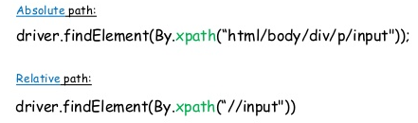
By XPath
By XPath:
XPath is a query language for selecting nodes from an XML document.
XPath is based on a tree representation of the XML document and provides the ability to navigate around the tree.
At a high level, WebDriver uses a browser’s native XPath capabilities wherever possible.
On those browsers that don’t have native XPath support, Selenium has provided its own implementation.

Slide 19
WebElement Commands
click()
Clicks the element. If this causes a new page to load, this method will attempt to block until the page has loaded.
ex : driver.findElement(By.name("login")).click();
clear()
If this element is a text entry element, this will clear the value. Has no effect on other elements. Text entry elements are INPUT and TEXTAREA elements.
ex : driver.findElement(By.name("userName")).clear();
sendKeys(CharSequence)
Use this method to simulate typing into an element, which may set its value.
ex : driver.findElement(By.name("userName")).sendKeys("name");
String getTagName()
Get the tag name of this element. Not the value of the name attribute: will return "input" for the element <input name="foo" />.
ex : String tagName = driver.findElement(By.name("userName")).getTagName();

Slide 20
Driver Commands - Navigate
WebDriver.Navigation navigate()
An abstraction allowing the driver to access the browser's history and to navigate to a given URL.
back()
Move back a single "item" in the browser's history.
forward()
Move a single "item" forward in the browser's history. Does nothing if we are on the latest page viewed.
ex :
WebDriver.Navigation nav = driver.navigate();
nav.back();
nav.forward();
driver.navigate().back();
to(String url)
Load a new web page in the current browser window. This is done using an HTTP GET operation, and the method will block until the load is complete.
ex : driver.navigate().to(“http:\\google.com”);
void refresh()
Refresh the current page.
ex : driver.navigate().refresh();

Slide 21
Automation Frameworks
A A framework is a combination of guidelines, rules, tools and set protocols that together provide an environment to run the automation test scripts.
rki considered to be a combination of set protocols, rules, standards and guidelines that can be incorporated or followed as a whole so as to leverage the benefits of the scaffolding provided by the Framework.

Slide 22
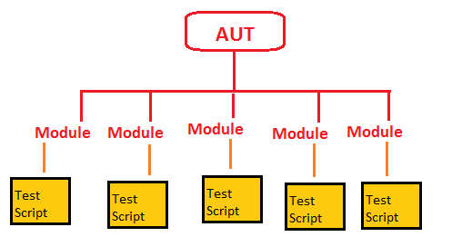
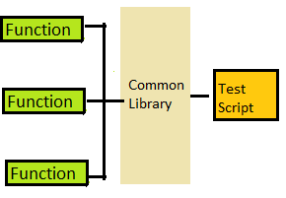
Automation Frameworks
Module Based Testing Framework
Library Architecture Testing Framework
The framework divides the entire “Application Under Test” into number of logical and isolated modules. For each module, we create a separate and independent test script. Thus, when these test scripts taken together builds a larger test script representing more than one module.
High level of modularization
The basic fundamental behind the framework is to determine the common steps and group them into functions under a library and call those functions in the test scripts. As we create common functions that can be efficiently used by the various test scripts across the Framework. Thus, the framework introduces a great degree of re-usability.

Slide 23
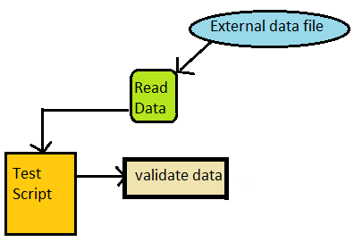
Automation Frameworks
Data Driven Automation Framework
Data Driven Testing Framework helps the user segregate the test script logic and the test data from each other. The test data is stored in external database. The external databases can be property files, xml files, excel files, text files, CSV files, ODBC repositories etc. The data is conventionally stored in “Key-Value” pairs. Thus, the key can be used to access and populate the data within the test scripts.
Repeated use of test scripts to test the same functionality multiple times with different set of input data and response data coming out of predefined dataset. Helps in reducing coding for large test cases Ease of testing of time-consuming & complex test cases.

Slide 24
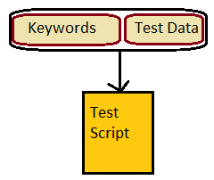
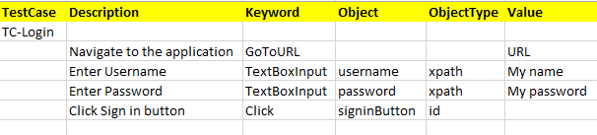
Automation Frameworks
Keyword Driven Automation Framework
The Keyword driven testing framework is an extension to Data driven Testing Framework in a sense that it not only segregates the test data from the scripts, it also keeps the certain set of code belonging to the test script into an external data file.
These set of code are known as Keywords and hence the framework is so named. Key words are self-guiding as to what actions needs to be performed on the application.
The keywords and the test data are stored in a tabular like structure and thus it is also popularly regarded as Table driven Framework.
Keywords like GoToURL, TextBoxInput and Click are defined within the code. Keywords can be reused multiple times in a single test case. Locator column contains the locator value that is used to identify the web elements on the screen or the test data that needs to be supplied.
All the required keywords are designed and placed in base code of the framework.

Slide 25
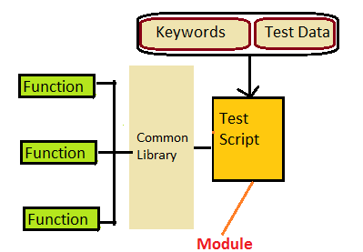
Automation Frameworks
Hybrid Automation Framework
It is the Most Popularly Implemented Framework
As the name suggests, the Hybrid Testing Framework is a combination of more than one above mentioned frameworks. Hybrid Test Automation Framework is suitable for applications that have variety of functionality and larger number of variations in terms of test data The best thing about such a setup is that it leverages the benefits of all kinds of associated frameworks. It is understood to have evolved over time and over many projects

Slide 26
Agile Automation Techniques
Fred Brooks says:
‘The hardest single part of building a software system is deciding
precisely what to build.’
precisely what to build.’” rksid
to be a combination of s
Unit tests are for developers; helps “build the thing right”
Acceptance tests are for customers; helps “build the right thing”
a whole so as to leverage the benefits of the scaffolding provided by the Framework.

Slide 27


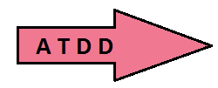
What is TDD, BDD & ATDD ?
TDD – Test-driven development is a technique of using automated unit tests to drive the design of software. TDD typically follows the below steps:
Start by writing a test → Run the test → test fails→write code to pass the test
Repeat the steps
BDD – Behavior Driven Development suggests to test behaviors, so instead of thinking of how the code is implemented, we think of what the scenario is.
It uses natural language to describe the "desired behavior" of the system, that can be understood by both the developer and the customer
ATDD – Acceptance Test Driven Development is a collaborative practice where users, testers, and developers define automated acceptance criteria early in the development process. ATDD helps to ensure that all project members understand precisely what needs to be implemented.

Slide 28
Further Reading
http://www.pluralsight.com/courses/automated-testing-framework-selenium
http://www.pluralsight.com/courses/selenium
https://github.com/cucumber/cucumber/wiki
http://behaviour-driven.org/
https://cucumber.io/

