Slide 1
Flows through an economic sector

Slide 2
Flows through an economic sector

Slide 3
Flows through an economic sector

Slide 4
Flows through an economic sector

Slide 5
Flows through an economic sector

Slide 6
Flows through an economic sector

Slide 7
Flows through an economic sector

Slide 8
Flows for US Auto Industry 2011

Slide 9
Flows through an economic sector

Slide 10
Flows through an economic sector

Slide 11
Flows through an economic sector

Slide 12
Flows through an economic sector

Slide 13
1-sector economy: materials

Slide 14
1-sector economy: energy

Slide 15
1-sector economy: economic value

Slide 16
What does all this mean?
Natural capital is depleted to:
provide short-lived goods flows
increase manufactured capital stock
overcome depreciation of capital
Implications:
for economic growth and development
for reuse, recycling, and dematerialization
Comparison to a steady-state economy

Slide 17
Implications for economic growth
Across the world, economic health is measured almost exclusively by GDP.
If GDP grows, the economy is said to be growing
GDP is a flow of value in units of $/year
A second possible measure of economic well-being is a stock; wealth
Accumulation of embodied energy (in manufactured capital) is another measure of economic well-being.

Slide 18
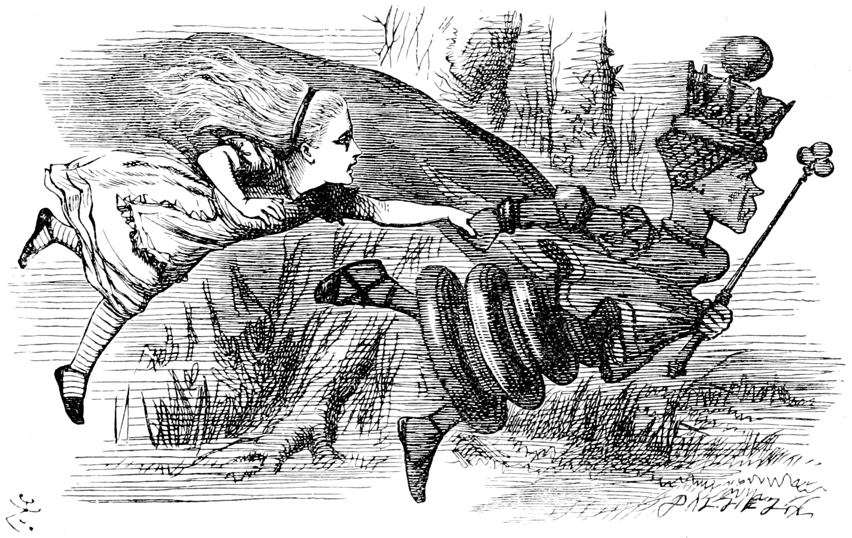
Insight from the Red Queen
“Now, here, you see, it takes all the running you can do, to keep in the same place. If you want to get somewhere else, you must run at least twice as fast as that!”
—Lewis Carroll (1897)
Through the Looking-Glass and What Alice Found There.
Henry Altemus Company, Philadelphia, p. 49.

Slide 19
Implications for economic growth
As capital stocks increase we need to:
purchase direct energy to power the capital,
purchase resources to ‘feed’ and maintain the capital,
pay workers to operate the capital
offset increasing depreciation
Increasing capital stock ‘lock in’ increased throughput of materials and energy

Slide 20
Implications for reuse, recycling, and dematerialization
Dematerialization:
economic activity can be unlinked from material or energy demands
Recycling:
reduces material depreciation and waste
may increase energy demand
may indirectly cause increase in growth of capital stock (rebound effect)

Slide 21
Comparison to a steady-state economy
Three possible criteria for steady-state:
constant level of capital stock
constant material throughput
constant level of GDP

Slide 22
Steady-state economy: constant capital stock
Natural capital is depleted for:
providing short-lived goods flows
increasing manufactured capital stock
overcoming depreciation of capital

Slide 23
Steady-state economy: constant capital stock
Sustainability criteria:
depletion of natural capital must be below replenishment rates
Harder to meet sustainability criteria with:
high short-lived goods flows (throwaway society)
high depreciation rates
more capital stock
short capital lifespan

Slide 24
Steady-state economy: constant material throughput
Sustainability criteria still applies
Capital stock can increase if material and energy use becomes more efficient
Need to maximize maintenance of capital stock per unit of material throughput

Slide 25
Steady-state economy: constant GDP
Constraining GDP may not achieve the desired restraint on material throughput
economy may become less efficient
However, increasing GDP may not produce desired increase in material wellbeing
costs (e.g., externalities and defensive expenditures) outweigh any benefits that comes from increasing GDP (‘uneconomic growth’)
increasing GDP increases relative income inequality, which decreases welfare for both rich and poor alike

Slide 26
Next steps
Data on stocks and inter-sector flows should be reported by a single, centralized agency.
National accounts should
include non-market exchanges
maintain balance sheets for both natural and manufactured capital
provide additional disaggregated values for waste flows in physical units
routinely estimate the energy intensity of economic products using a physical accounting framework
be estimated and disseminated on an annual basis

Slide 27
Next steps
All stocks and inter-sector flows should be provided in physical as well as financial units
US BEA should restart detailed Capital, Labor, Energy, Material, and Services (KLEMS) reporting

