Slide 1
Capstone Project
CITI Credit card transaction challenge

Slide 2
Valuing data
Certain markets have built incredible databases in conducting their primary lines of business
This information can in turn be used to support primary business lines, or develop new ones
One of the best examples is credit card transaction data
Millions of customers interact with many merchants
This information is already captured – use it to add value!

Slide 3
CITI Data Challenge
CITI has issued a challenge to use a credit card transaction set to do the following:
Identify the Top 10 merchants that customers have not transacted with in the past 12 months and are likely to transact with, in the next 3 months
Recommendations must be personalized at a customer level
Using historical data for the particular customer and the rest of the population, identify merchants the customer is likely to interact with

Slide 4
CITI Data Value
CITI recognizes they can use their transaction data to add value in the following ways:
Make recommendations to customers for merchants they may like
Better target merchants with possible clients – chance for additional revenue/services
Improve their RoI for their primary business lines

Slide 5
How to unlock value from CITI’s data
This challenge is primarily a recommendation problem, where individual and group data is leveraged to make user-specific recommendations.
Sparse data from many users can help inform recommendations.
Recommenderlab is an R software package which allows for the creation, implementation and evaluation of multiple recommender algorithms.

Slide 6
Recommendation Algorithms
There are many approaches, some can be better than others:
Dimensionality reduction
Popular items
Personal traits
Merchant traits
Recommenderlab let’s us try different approaches and compare them

Slide 7
Data – First Glance
The first steps in any project involve formatting the data as necessary
In this case, we note there are 18,532,355 observations of five variables:
customer id
merchant id
month of transaction
category of the merchant,
number of transactions occurring between a customer and merchant in the month

Slide 8
Data – First Glace Continued
This data contained over 18 million observations covering:
374,334 unique customers
9,822 unique merchants
1 year of data
15 categories of merchant
63,659,708 interactions
We can add value for ~375,000 customers and 9,000+ merchants across 15 fields

Slide 9
Data – Wrangling
First steps include formatting the data properly
System limitations resulted in developing a proof-of-concept using 100 customers
Proof of concept could be used to justify investment of project at scale

Slide 10
Data – Impressions
Dataset has been limited to 100 customer IDs
Still an opportunity to look at transaction patters across dates, customer IDs and merchant IDs
This could identify additional questions, insights, or opportunities beyond the original problem

Slide 11
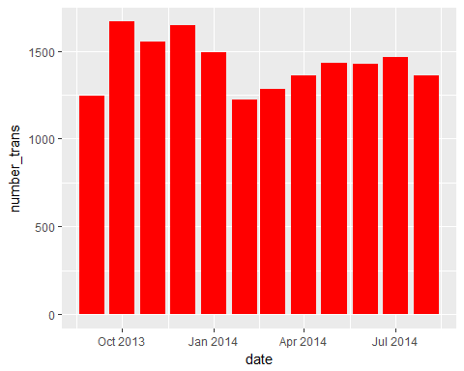
Data – Impressions
Transactions are fairly evenly distributed across all 12 months
At least 1000 transactions per month
There seems to be more transactions during the October to January period
Christmas shopping?

Slide 12
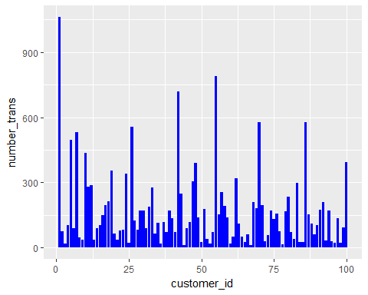
Data – Impressions
Transactions by customer ID less uniform than by date
Mean and median of 171.35 and 114.5 transactions respectively
Some customers have much higher than the average
Are they small business owners? Different habits? Follow-up studies for high RoI possibilities

Slide 13
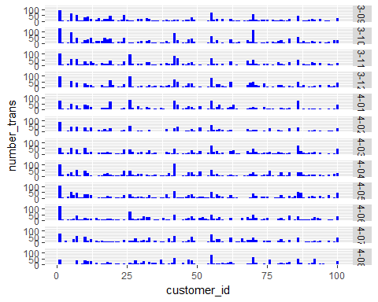
Data – Impressions
Transactions by customer ID fairly consistent across the 12 months
When habits do change, what’s prompting it?

Slide 14
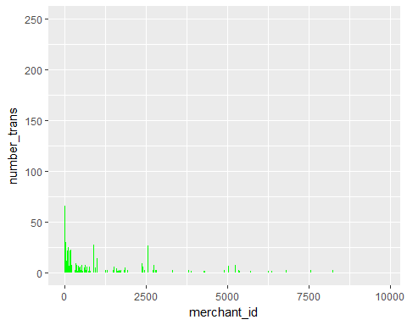
Data – Impressions
Transaction numbers by merchant IDs are more variable than by date or customer
Mean and median of 11 and 3 transactions respectively
Some merchants responsible for many transactions, many responsible for few
Different approach for high and low volume merchants?

Slide 15
Data – Assumptions
Number of transactions is used as a proxy for rating.
Assumed a good rating was a number of transactions >2
If the interaction was not good, a customer would not return to the merchant.
It was also assumed there were no refund transactions or fraudulent transactions.
Beyond the scope of the provided data to test all assumptions

Slide 16
Data – Analysis
Nine different recommender algorithms were implemented, and assessed against each other
Assessed using a Receiver Operator Curve (RoC)
RoC plots true positive rate vs false positive rate
Best performance reaches the top left corner

Slide 17
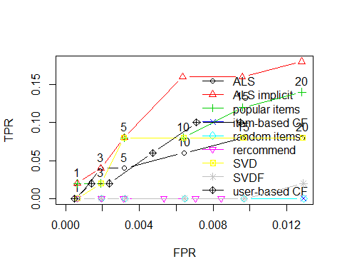
RoC

Slide 18
Data – Products
The ALS Implicit algorithm seems to have the best performance for the given dataset (TPR =15%)
Popular items and user-based collaborative filtering also performed well
Can output recommendations of merchants whom clients might like

Slide 19
Data – Value
Recommendations are a value-add for both customers and merchants
Customers get personalized recommendations they will usually like
Merchants get better information about their customers, and possibly more clients
This value-add already existed in the transaction data generated in a primary line of business
Better RoI in the primary line!

Slide 20
Next Steps
Perform analysis at scale using all data
Analysis of data subsets
Are customers and merchants homogenous, or can different populations with different needs be identified
Leverage different populations for custom solutions

Slide 21
Conclusions
Data generated from a primary business line can be leveraged for secondary purposes
Recommendation algorithms are a popular way to leverage customer choice data

