Slide 1
Synergy class
Project Team: members: Elina nili , matthew Sarkodie darkwah

Slide 2


Slide 3


Slide 4


Slide 5
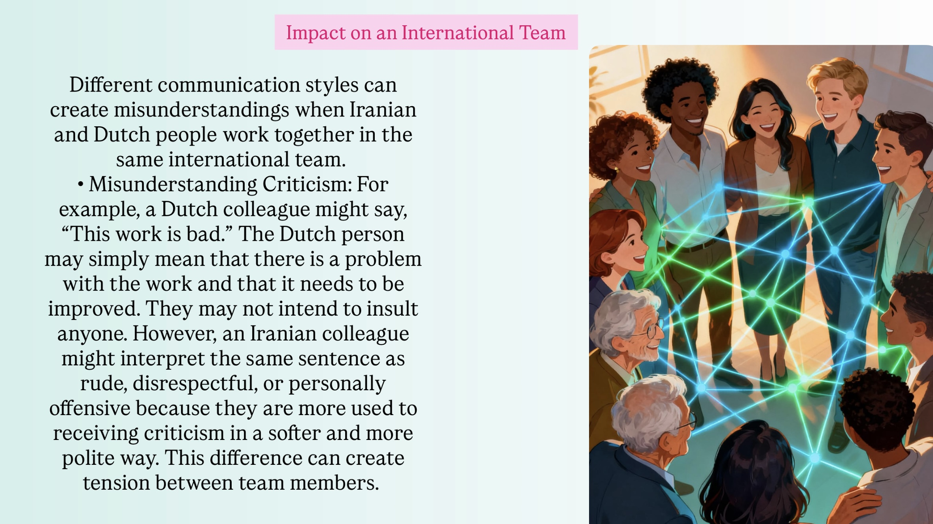

Slide 6
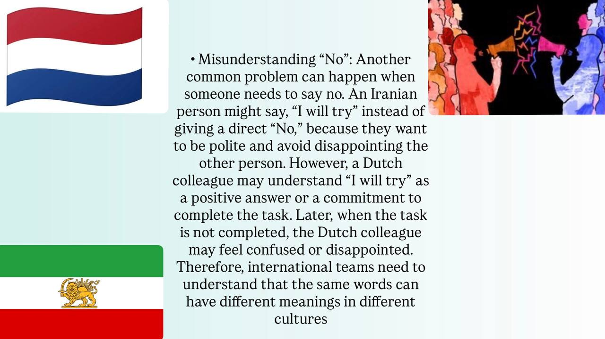

Slide 7
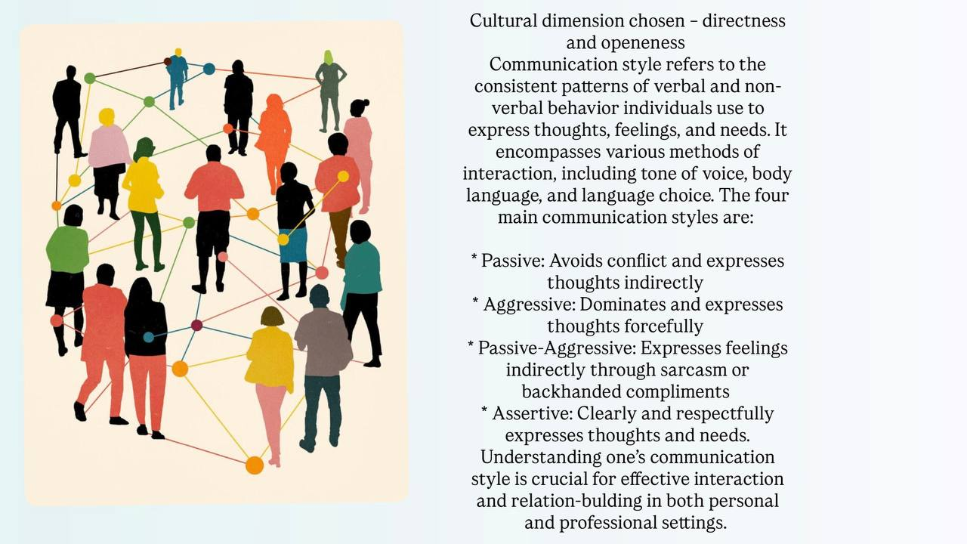

Slide 8


Slide 9
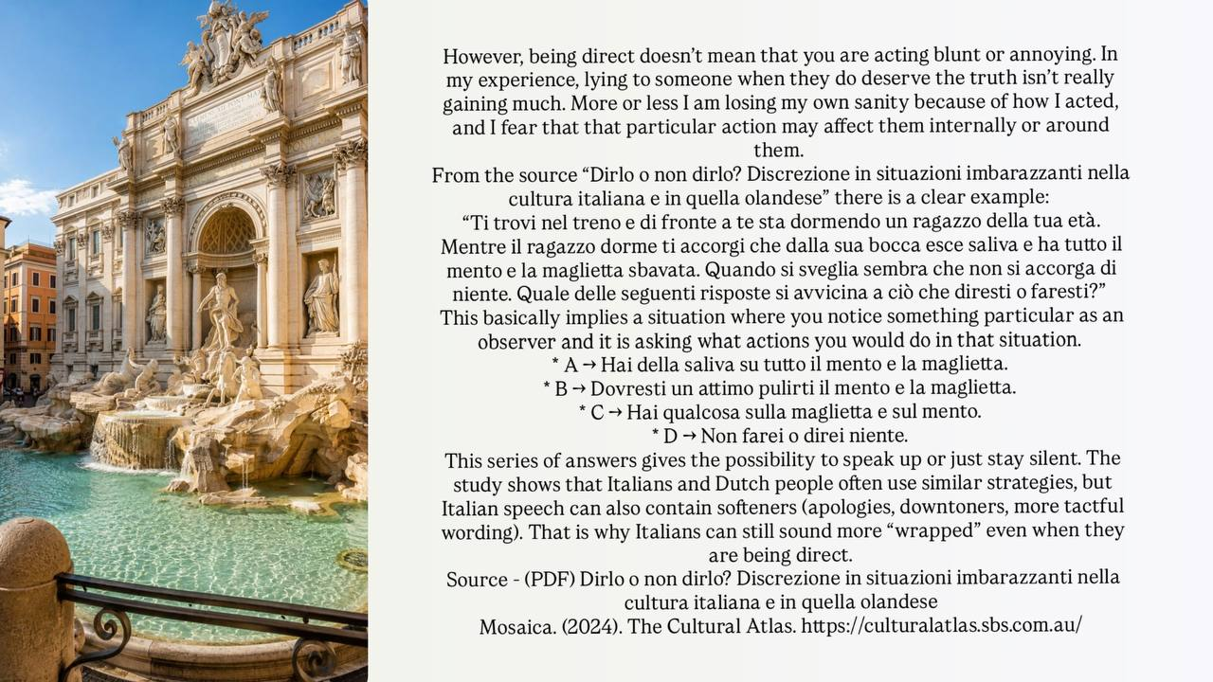

Slide 10
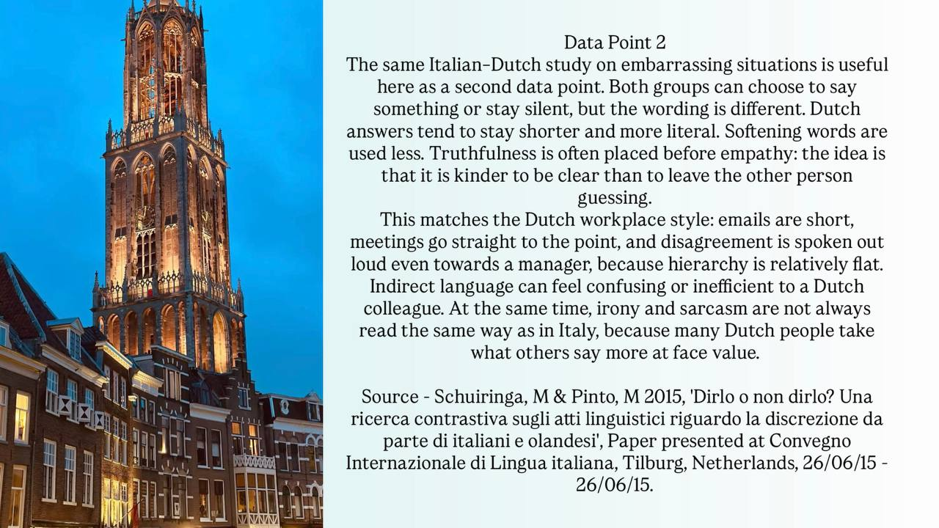

Slide 11
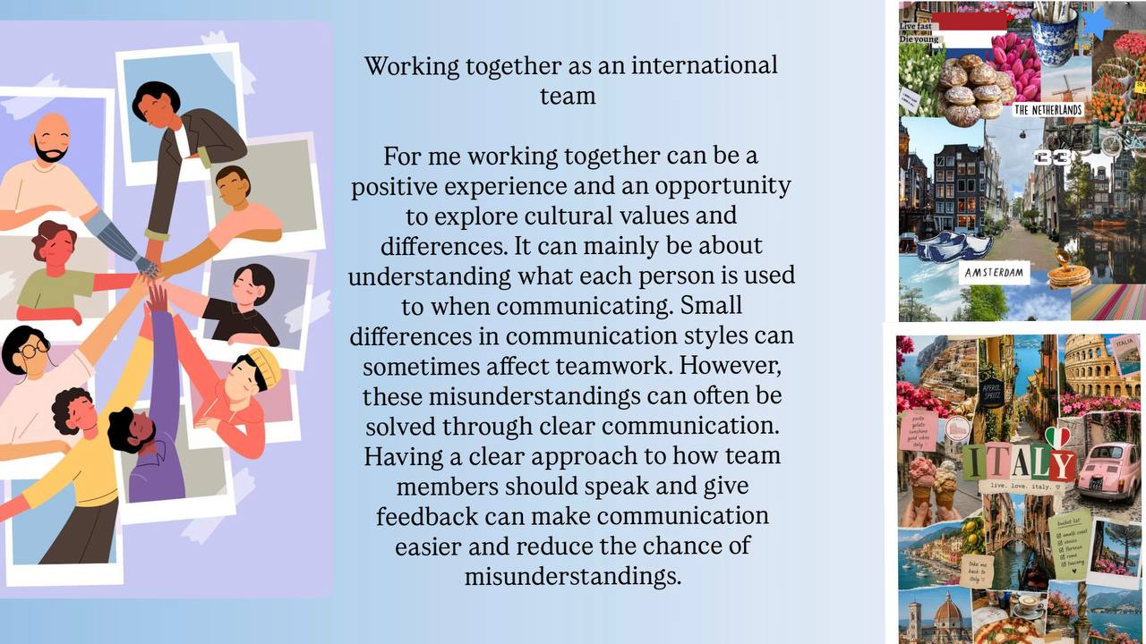

Slide 12


