Slide 1
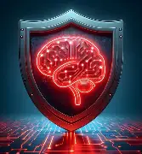

AI vs Threats: Defending the Digital Frontier
How Artificial Intelligence is Redefining Cybersecurity
Matthew Kolonich ARIN 410 04/21/2026 Professor Caramancion
Notes:
This presentation explores how artificial intelligence is transforming cybersecurity into a faster, smarter, and more proactive defense system. As cyber threats become more advanced, AI is no longer optional, it is becoming essential. I will walk through how AI works in cybersecurity, real-world applications, leading technologies, and what the future looks like.
This slide introduces the overall theme of the presentation, focusing on how AI is transforming cybersecurity. It sets the stage for the discussion and highlights the importance of AI in modern digital defense. The visuals reinforce the idea of protection and security.

Slide 2


Cybersecurity Reimagined with AI
AI = systems that learn patterns and detect threats
Protects against malware, phishing, and intrusions
Operates in real time
Shifts defense from reactive → predictive
Notes:
Artificial intelligence is redefining cybersecurity by acting as a digital bodyguard that constantly learns and adapts. Unlike traditional systems that rely on known threats, AI can detect patterns and identify new or evolving attacks. This allows organizations to move from reacting to attacks to predicting and preventing them before damage occurs.
This slide explains the role of AI in cybersecurity and how it differs from traditional approaches. It shows the shift from reactive to predictive security. The visuals emphasize AI actively protecting systems in real time.

Slide 3

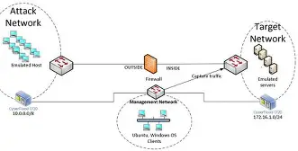
Advanced Use Case: AI Anomaly Detection Systems
AI-Driven Anomaly Detection
Detects unusual behavior in networks
Identifies unknown and zero-day attacks
Uses machine learning models
Adapts over time
Notes:
One of the most powerful use cases of AI in cybersecurity is anomaly detection. These systems analyze network behavior and identify anything that does not match normal patterns, allowing them to detect new and previously unknown threats. Research shows that AI-based anomaly detection can ‘identify deviations from normal behavior… detecting novel and subtle threats’ (Chandola, Banerjee, & Kumar, 2009) . This is far more effective than traditional systems, which rely on known attack signatures and often miss new threats.
This slide focuses on a specific and powerful application of AI in cybersecurity. It explains how anomaly detection works and why it is effective. The visuals highlight unusual activity being identified within a network.

Slide 4

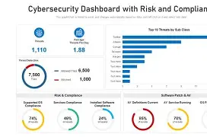
Leaders in AI Cyber Defense
Industry Leaders
Darktrace → Self-learning AI defense
CrowdStrike → AI-powered endpoint protection
Palo Alto Networks → Intelligent network security
Notes:
Several companies are leading the development of AI-driven cybersecurity solutions. Darktrace uses self-learning AI to detect threats without predefined rules, while CrowdStrike focuses on protecting endpoints like laptops and servers. Palo Alto Networks integrates AI into network security, showing how AI is becoming a core component of cyber defense across industries.
This slide introduces real-world companies that are using AI to improve cybersecurity. It shows that AI is already being applied successfully in the industry. The visuals reinforce credibility and real-world application.

Slide 5
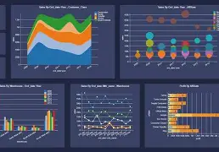
Measuring Cyber Defense Effectiveness
Key Performance Indicators
Detection speed
Response time
False positive reduction
Threat prevention rate
Notes:
To evaluate AI in cybersecurity, organizations rely on key performance indicators such as detection speed and response time. AI systems can process massive amounts of data instantly, improving both speed and accuracy. Research shows AI improves ‘automation, threat intelligence, and overall cyber defense effectiveness’(Jada, 2024) , which directly impacts how quickly organizations can respond to threats.
This slide explains how organizations evaluate AI effectiveness using key metrics. It connects technical performance to real-world outcomes. The visuals focus on dashboards and measurable data.

Slide 6
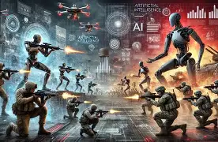

The Future: AI vs AI Cyber Warfare
Predictive cybersecurity systems
AI vs AI (attack vs defense)
Self-healing networks
Expansion into healthcare & finance
Notes:
The future of cybersecurity is moving toward predictive and autonomous systems. We are entering an era of AI versus AI, where attackers and defenders both use advanced systems. AI will also expand into industries like healthcare and finance, where protecting sensitive data is critical, making cybersecurity more intelligent and adaptive than ever before.
This slide explores where cybersecurity is heading with AI. It introduces concepts like predictive security and AI vs AI. The visuals emphasize a futuristic and evolving digital environment.

Slide 7

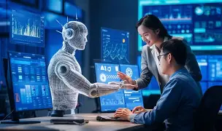
Final Takeaways
AI increases speed and accuracy
Reduces human workload
Detects unknown threats
Requires ethical oversight
Notes:
In conclusion, AI is transforming cybersecurity by making it faster, more accurate, and more proactive. However, it is not without risks, as it requires careful oversight to ensure ethical and responsible use. The strongest cybersecurity systems will combine AI efficiency with human judgment.
This slide summarizes the key points of the presentation. It reinforces the importance of AI while acknowledging the need for human oversight. The visuals support the idea of secure and balanced systems.

Slide 8
References
Mohamed, N. (2025). Artificial intelligence and machine learning in cybersecurity.
Jada, I. (2024). The impact of artificial intelligence on organizational cybersecurity.
Chandola, V., Banerjee, A., & Kumar, V. (2009). Anomaly detection: A survey. ACM Computing Surveys, 41(3), 1–58. https://doi.org/10.1145/1541880.1541882

