Slide 1
Unit 7 Marketing Assignment
QuickTurn Grading
Notes:
Hello, I am here to talk to you about my Unit 7 marketing assignment. I am working on a marketing campaign for a company QuickTurn Grading. QuickTurn Grading is a sports card grading service. We specialize in professionally grading customers cards. The company prides itself on following its 3 core values of speed, fairness, and trust.

Slide 2
Target Market
Sports Card Collectors
Memorabilia Collectors
Sports Card Traders
Sports Enthusiasts
Collectors
Notes:
The target market for our service is sport card collectors. This includes anybody looking for sports memorabilia. Our service is meant to professionally grade cards to increase there value. This should be appealing to all collectors, sports card traders, and any sports enthusiasts that want to have their cards professionally graded to increase value and worth.

Slide 3
SLogan
QuickTurn Grading You Can Trust
Notes:
I first wanted to come up with a slogan to advertise the company. Using ChatGPT we created multiple lines for slogans. We narrowed it down to the current, QuickTurn Grading You Can Trust. This slogan works because it emphasis two of our values in speed and trustworthiness. This slogan also incorporates the company name, as well as using the name in the slogan that makes grammatical sense. The name of the company flows with the slogan.

Slide 4
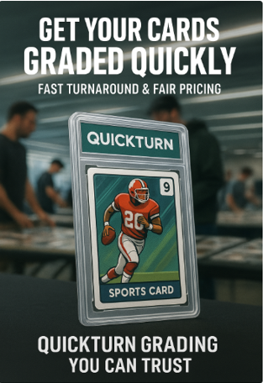
Poster Advertisement
Notes:
My next marketing artifact I created was a poster advertisement. The poster I created incorporates our 3 values of speed, accuracy, and trustworthiness. It also uses the slogan that we created on the poster. The images show card collectors in the background to resonate with hobbyists as well as having an Artificial Image of a graded sports card. We used the image for copyright issues.

Slide 5
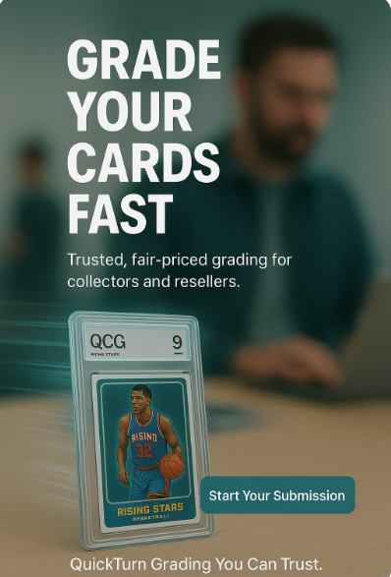
Landing Page Hero
Notes:
I next wanted to create a Landing Page Hero for a website. This is an ad found on a webpage that you can also click on. The landing page once again implies our 3 values of speed, trustworthiness, and accuracy. The background has an image of someone submitting something on a computer. This relates to what we want the consumer to do. The slogan is also visible. I included a AI created graded card image with streaks. The streaks were added to emphasize speed. There is also the start your submission button front and center to entice people to click.

Slide 6
Blog Style Explainer
We’ve all been there—you pull a hot rookie out of a live break, and now you’re itching to get it slabbed before the hype cools off. Nothing’s worse than sending your cards off and waiting months, wondering if they’ll come back in time for the next card show or before that eBay auction ends.
In this hobby, speed matters:
• Card shows don’t wait. If your slabs aren’t ready, you’re missing deals on the floor.
• Online sales move fast. eBay and Whatnot buyers want graded cards yesterday.
• Momentum is real. Grading delays kill excitement and can cost you real money.
A quick turnaround keeps your cards—and your hustle—moving.
________________________________________
Fairness and Trust
Of course, fast isn’t enough if you can’t believe the grade on the label. We all know the frustration when a card comes back and you’re left scratching your head. Consistency and fairness are everything in this game.
Why it matters:
• Trust makes trades possible. If buyers can’t rely on the grade, deals fall apart.
• Fair slabs protect value. A “9” should feel like a “9,” no matter what.
• The hobby depends on it. Without trust in grading, the whole market loses steam.
At the end of the day, you just want to know your cards are judged the same way as everyone else’s—straightforward and fair.
________________________________________
How QuickTurn Grading Delivers
That’s exactly what QuickTurn Grading is built for. We’re hobby people ourselves, and we know the pain points. Our process focuses on what matters most:
• Quick turnaround times so you’re not stuck waiting months.
• Transparent tracking so you always know where your subs are.
• Reliable, fair standards applied card after card, slab after slab.
No gimmicks, no corporate runaround—just grading that keeps you moving and gives you confidence when you’re selling, trading, or showing off at your next event.
________________________________________
Ready to Sub Your Cards?
If you’re tired of the long waits and head-scratching grades, give QuickTurn a shot. Start your submission today and see the difference.
QuickTurn Grading You Can Trust.
Notes:
The 4th marketing artifact I created was a blog style explainer. This is like a quick fact sheet for customers to use. It goes over are 3 core values and explains how we implement these values everyday. The explainer is broken into sections so consumers can go to what section is important to them. We also included the bullets for this reason as well as to make it easier to scan. Besides using our three core values we also have implemented our slogan at the end.

Slide 7

Verse] Got a card from a live break Pulled a rookie It’s no fake EBay sales They’re climbin’ high But is it mint or just alright [Chorus] Quickturn Grading Fast and true Collectors trust We’ve got you At card shows or online trades Quickturn’s how the grade gets made [Bridge] Slabs so clean Your cards shine bright Flip it fast or hold it tight [Outro] Quickturn Grading Fast and true For hobby heads just like you
Audio Jingle
Notes:
I created and audio jingle for my marketing campaign. It has a casual upbeat tone that can hook customers. Its lyrics convey our 3 core values. The company name is used repeatedly throughout to reinforce our company to consumers.

