Slide 1
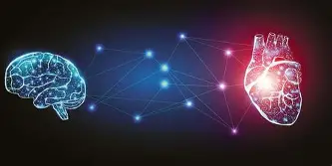
AI in Healthcare: From Diagnosis to Decision
Transforming the Future of Patient Care
By Matthew Kolonich
Arin 410
Professor Caramancion
Notes:
“This presentation explores how artificial intelligence can transform the healthcare system by improving diagnosis, optimizing operations, and supporting clinical decision-making. As healthcare faces increasing demand and complexity, AI offers new ways to improve both efficiency and patient outcomes.”
This slide introduces the overall purpose of the presentation and establishes the connection between AI and healthcare transformation. It sets the tone for a structured and analytical discussion. It also signals that the presentation will focus not just on technology, but on real-world impact. The title frames AI as a tool for change rather than replacement, which is a key theme throughout.

Slide 2
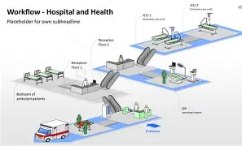
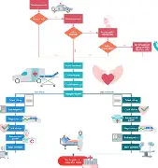
INDUSTRY OVERVIEW
Healthcare Industry Today
Complex and data-driven
High demand for services
Resource and staffing challenges
Notes:
“The healthcare system is highly complex and relies on large amounts of data, coordination, and human decision-making. As demand for services increases, providers face challenges related to staffing, efficiency, and patient care quality. These challenges create an opportunity for AI to improve how healthcare operates.”
This slide explains the current state of healthcare and why transformation is needed. AI adoption is increasing across industries, but healthcare remains a high-impact area where improvements can significantly affect outcomes (Maslej et al., 2024). It emphasizes the pressure on healthcare systems due to demand and complexity. This context helps justify why AI is not optional, but necessary for future sustainability.

Slide 3
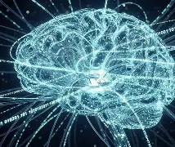
WHAT IS AI?
Artificial Intelligence
Learns patterns from data
Makes predictions and decisions
Improves over time
Notes:
“Artificial intelligence refers to systems that can learn from data, identify patterns, and make predictions or decisions. Unlike traditional systems, AI improves over time as it processes more information. In healthcare, this allows AI to support diagnosis, predict risks, and optimize operations.”
This slide defines AI in simple terms and connects it directly to healthcare applications. It builds foundational understanding for the rest of the presentation. It ensures the audience clearly understands what AI is before applying it to real problems. This clarity is important to avoid confusion when discussing more advanced applications later.

Slide 4


KEY PROBLEMS IN HEALTHCARE
Major Challenges
Delayed diagnosis
Inefficient workflows
Clinician burnout
Notes:
“One of the biggest issues in healthcare is delayed diagnosis, which can lead to worse outcomes. In addition, inefficient workflows slow down care delivery, and clinicians are often overwhelmed by administrative tasks. These problems highlight the need for smarter, more efficient systems.”
This slide identifies the core problems AI will address. Organizations struggle to scale operations and manage complexity, which limits performance and efficiency (Tavakoli et al., 2024). It highlights why current systems are not keeping up with demand. These problems directly connect to the AI solutions introduced in later slides.

Slide 5
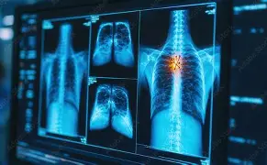
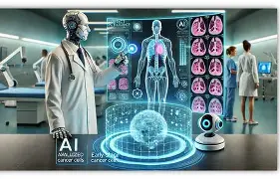
AI SOLUTION 1: IMAGE ANALYSIS
Image Analysis
Analyzes medical images
Detects abnormalities
Supports early diagnosis
Notes:
“Image analysis uses AI to examine medical images such as X-rays or MRIs and detect patterns that may not be visible to the human eye. This can help identify diseases earlier and improve diagnostic accuracy. It allows clinicians to make faster and more informed decisions.”
This slide introduces image analysis as a key AI application in healthcare. It focuses on improving diagnosis and supporting clinical decisions. It establishes one of the most impactful uses of AI in medicine. The emphasis is on accuracy and early detection, which are critical in patient outcomes.

Slide 6
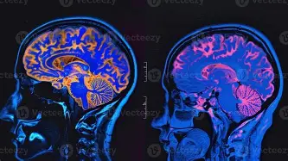
IMAGE ANALYSIS EXAMPLE
Example
AI detects early-stage disease
Alerts clinicians
Speeds up diagnosis
Notes:
“For example, an AI system could analyze a patient’s scan and detect early signs of disease before symptoms appear. The system alerts the clinician, allowing for earlier intervention and better outcomes. This reduces delays and improves patient care.”
This slide shows real-world impact of image analysis. AI is already being used to enhance medical imaging and improve early detection of disease (Zhang & Boulos, 2023). It moves from theory to application, helping the audience visualize the benefit. This reinforces the idea that AI is already actively transforming healthcare.

Slide 7
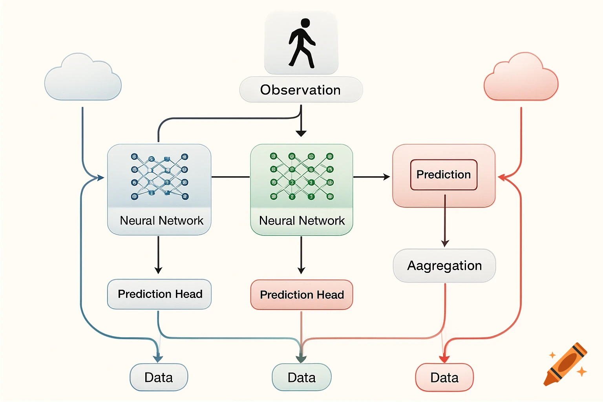
AI SOLUTION 2: PREDICTIVE ANALYTICS
Predictive Analytics
Uses patient data
Predicts disease risk
Supports prevention
Notes:
“Predictive analytics uses patient data to identify patterns and predict future health risks. This allows healthcare providers to intervene earlier and focus on prevention rather than treatment. It shifts healthcare from reactive to proactive.”
This slide introduces predictive analytics and its role in improving long-term outcomes. It shifts the focus from diagnosis to prevention. This represents a major change in how healthcare operates, moving from reactive to proactive care.

Slide 8
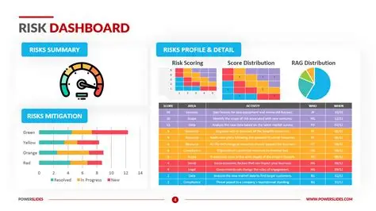
PREDICTIVE ANALYTICS EXAMPLE
Example
Identifies high-risk patients
Enables early intervention
Reduces hospitalizations
Notes:
“For example, AI can analyze patient data to predict who is at risk of developing a condition. Doctors can then intervene early with treatment or lifestyle changes. This reduces hospital visits and improves overall patient health.”
This slide demonstrates how predictive analytics improves efficiency and outcomes. AI-driven insights enable better decision-making and resource allocation (Lynch, 2023). It shows how data can be used to anticipate problems before they occur. This also highlights cost savings and improved patient management.

Slide 9
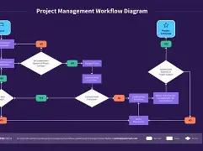
AI SOLUTION 3: PROCESS OPTIMIZATION
Process Optimization
Improves workflows
Reduces inefficiencies
Saves time and resources
Notes:
“Process optimization uses AI to streamline workflows and reduce inefficiencies. This can include scheduling, patient flow, and administrative tasks. By improving operations, healthcare providers can focus more on patient care.”
This slide introduces operational improvements as a key benefit of AI. It focuses on efficiency rather than diagnosis or prediction. This is important because operational challenges are a major source of healthcare strain.

Slide 10
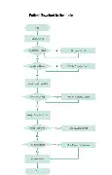
PROCESS OPTIMIZATION EXAMPLE
Example
Automated scheduling
Reduced wait times
Improved efficiency
Notes:
“For example, AI can optimize scheduling to reduce wait times and improve patient flow. This allows hospitals to operate more efficiently and provide faster care. It also reduces stress on healthcare workers.”
This slide shows how AI improves operations. AI is transforming how organizations function by improving efficiency and reducing complexity (Bain & Company, 2024). It highlights practical benefits like reduced wait times and better workflows. This connects directly to improving both patient and provider experiences.

Slide 11
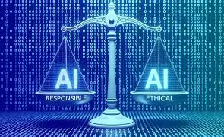
RESPONSIBLE AI
Ethical Concerns
Wrong predictions
Bias
Privacy
Notes:
“While AI offers many benefits, it also introduces risks. Wrong predictions can impact patient safety, bias can lead to unequal treatment, and privacy concerns arise from large data usage. These issues must be addressed to ensure safe and fair AI use.”
This slide introduces ethical concerns tied to AI in healthcare. It acknowledges that AI is not risk-free and must be used carefully. This prepares the audience for the importance of responsible AI practices.

Slide 12
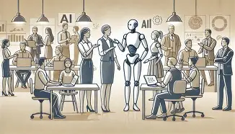

RESPONSIBLE AI SOLUTIONS
Solutions
Human oversight
Diverse data
Transparency
Notes:
“To address these risks, organizations must use human oversight, ensure diverse and representative data, and maintain transparency in AI decisions. Responsible AI ensures that technology improves outcomes without causing harm.”
This slide explains how to manage ethical risks. Responsible AI requires governance, oversight, and continuous monitoring (NIST, n.d.). It emphasizes that solutions exist but must be actively implemented. This reinforces the need for balance between innovation and safety.

Slide 13
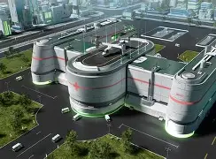
FUTURE IMPACT Future of Healthcare AI
Benefits
Challenges
Faster diagnosis
Better outcomes
Increased efficiency
Trust
Regulation
Over-reliance
Notes:
“In the next five years, AI will continue to transform healthcare by improving speed, accuracy, and efficiency. However, challenges such as trust, regulation, and over-reliance must be addressed. The future will depend on balancing innovation with responsible use.”
This slide connects present trends to future impact. AI is expected to reshape industries while also introducing new risks that must be managed carefully (IMF, 2024). It provides a forward-looking perspective on healthcare transformation. This helps the audience understand both opportunity and uncertainty.

Slide 14
CONCLUSION
Key Takeaway
AI will not replace healthcare— It will transform it
Notes:
“AI is not replacing healthcare professionals, but transforming how they work. By improving diagnosis, optimizing processes, and supporting decisions, AI has the potential to significantly improve patient care. The key is using it responsibly.”
This slide reinforces the core message and ties everything together. It emphasizes that AI is a support system, not a replacement for human professionals. The goal is to leave the audience with a clear and memorable takeaway.

Slide 15
References
Maslej, N., Fattorini, L., Perrault, R., Parli, V., Reuel, A., Brynjolfsson, E., Etchemendy, J., Ligett, K., Lyons, T., Manyika, J., Niebles, J. C., Shoham, Y., Wald, R., & Clark, J. (2024). The AI Index 2024 annual report. Stanford Institute for Human-Centered AI. https://aiindex.stanford.edu/report/
Tavakoli, A., Harreis, H., Rowshankish, K., & Bogobowicz, M. (2024, September 5). Charting a path to the data- and AI-driven enterprise of 2030. McKinsey & Company. https://www.mckinsey.com/capabilities/mckinsey-digital/our-insights/charting-a-path-to-the-data-and-ai-driven-enterprise-of-2030
Zhang, P., & Boulos, M. N. K. (2023). Generative AI in medicine and healthcare: Promises, opportunities and challenges. Future Internet, 15(9), 286. https://doi.org/10.3390/fi15090286
Lynch, S. (2023, December 8). What to expect in AI in 2024. Stanford Human-Centered AI. https://hai.stanford.edu/news/what-expect-ai-2024
Bain & Company. (2024, September 25). Five ways AI is changing how we work and live. https://www.bain.com/insights/five-ways-ai-is-changing-how-we-work-and-live-interactive/
National Institute of Standards and Technology. (n.d.). Artificial intelligence risk management framework. https://www.nist.gov/artificial-intelligence
International Monetary Fund. (2024). High uncertainty and the unknown. https://www.imf.org/external/pubs/ft/ar/2024/in-focus/high-uncertainty-and-the-unknown/

