Slide 1
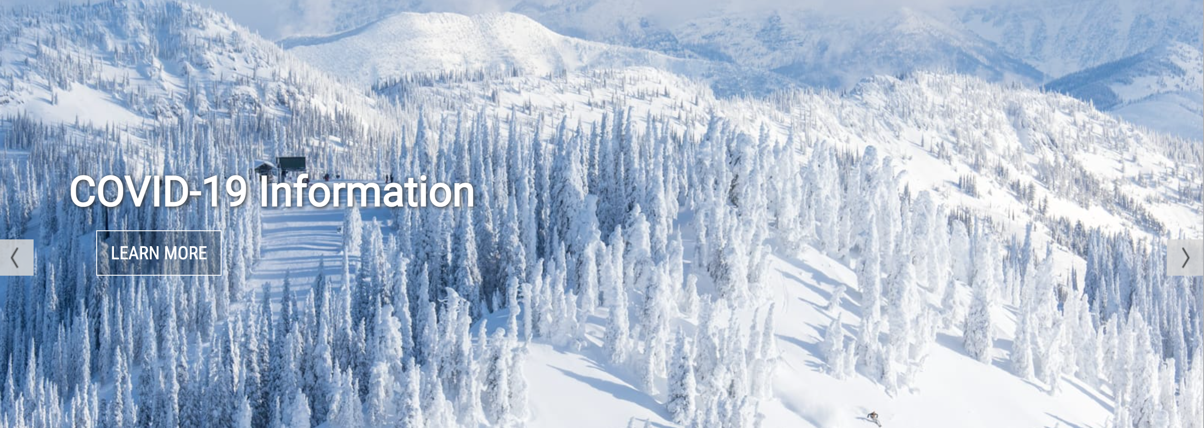
Big Mountain Ski Resort
Ticket Price Analysis by Matt Madden

Slide 2
Problem to be solved
Big Mountain Ski Resort wants to select a better value for its ticket price, but is unsure what is the best approach
It is suspected that there is an opportunity to better capitalize on existing facilities
Recently made a big investment in an additional ski lift that needs to be recouped by increasing ticket price, reducing costs, or some combination of the two
Wants to take a data-driven approach to help determine the best past forward for solving these problems

Slide 3
Recommendation and Key Findings
Top Recommendations:
Add an additional run that results in an extra 150 feet of vertical drop at the resort
Install an additional FastQuad chair lift for the new run
Add 2 acres of additional snowmaking to the new run
Increase ticket price by ~$18.50 per ticket
Net Expected Result of Implementing These Recommendations:
Over $3M+ in additional revenue per year (assuming 350,000 visitors per year that each ski for an avg of 5 days per year)
Key Findings Behind this Recommendation:
Our modeling suggests that this combination of enhancements would support and justify the biggest ticket price increase

Slide 4
Modeling results and analysis
Our approach:
Combined ski resort market data with a useful state dataset
Cleaned the data and scaled to make useful for analysis, so that we can be confident in the net output of our models
Determined which facilities (i.e., features) of resorts have the strongest correlation to higher pricing
Trained our model on these features, and in the process optimized so that it could generalize price predictions as accurately as possible when exploring various scenarios

Slide 5
Modeling results and analysis
Analysis Step #1 - Determine the Key Features of Resorts:
After data wrangling and cleaning, our initial exploration of the data revealed that the following resort features had the strongest relationship to higher pricing:
Vertical Drop
Total Snow Making (by acreage)
Total Chairs
Total FastQuad Ski Lifts
Total Runs
Longest Run Length (by mileage)
Total Trams
Total Skiable Terrain (by acreage)

Slide 6
Modeling results and analysis
Analysis Step #1 - Determine the Key Features of Resorts:
Using several analysis approaches to refine our focus on the highest impact features, it became clear that the following features had the highest correlation with our target feature, ticket price.
Vertical Drop
Total Snow Making (by acreage)
Total Chairs
Total FastQuad Ski Lifts
Total Runs
Longest Run Length (by mileage)
Total Trams
Total Skiable Terrain (by acreage)

Slide 7
Modeling results and analysis
Analysis Step #2 – Determine the Best Performing Model:
With our 4 key features narrowed down, we trained, tested, then compared the model performance results of a linear model and a random forest model
The winner?
Random Forest
Because the random forest model performed best, we choose to to use this model for the remaining analysis

Slide 8
Modeling results and analysis
Analysis Step #3 – Generate model predictions on the pricing impact of various scenarios:
After learning of the 4 highest impact resort features that we determined, the business developed 4 specific scenarios that they wanted to test, using our new model. What pricing could we expect if we:
Permanently close up to 10 of the least used runs. This doesn't impact any other resort statistics.
Increase the vertical drop by adding a run to a point 150 feet lower down but requiring the installation of an additional chair lift to bring skiers back up, without additional snow making coverage
Same as number 2, but adding 2 acres of snow making cover
Increase the longest run by 0.2 mile to boast 3.5 miles length, requiring an additional snow making coverage of 4 acres
We tested these various scenarios against our model and found that Scenario 3 would lead to the highest justifiable ticket price increase.

Slide 9
Summary and conclusion
Ultimately, our model suggested that Big Mountain Resort could achieve the greatest ticket price increase by:
Adding a run to a point 150 feet lower down, which would increase the resort’s vertical drop
Adding an additional FastQuad chair lift to bring skiers back up the new run
Adding 2 additional acres of snowmaking in the process
In Conclusion, the data and model suggest that implementing these actions would justify a ticket price increase of $18.50/ticket, which would gross an additional $3M+ revenue per year.
This would recoup the cost of the recent lift investment that Big Mountain already made, as well as the cost of the additional chair lift purchase that we are suggesting, within approx. 1 year, putting Big Mountain in a much better cash flow position heading into the subsequent years.

