Slide 1
Ranked Choice Modelling
Matthew Q. Knipfer

Slide 2
Voting Models
Plurality
Approval
Scoring
Ranked choice

Slide 3
Voting Models
Plurality
Approval
Scoring
Ranked choice

Slide 4
Ranked choice
Rank the candidates.
Last place from the 1st round has their ballots redistributed by the second choice picks.
Repeats until a candidate has >50% of the remaining vote.

Slide 5
Tideman-Matje Model
Candidates and voters exist as points in an axis-free space.
Candidates are placed in an equilateral triangle.
Voters are placed in the space based on their closeness of ideology to each candidate.
Voters rank the candidates by shortest to greatest distance.
Crossover point defined as the bisector of the line between two candidates
Along the bisector’s width, voters are indifferent between the candidate on either side.
Tideman, T. N., & Matje, T. (n.d.). A Statistical Characterization of Rankings from Political Survey Data [Scholarly project]. Retrieved 2018.

Slide 7
A
B
C

Slide 8
A
B
C

Slide 11
C, B, A

Slide 14
B, C
C, B

Slide 15
My Model
Candidates and voters exist as points in an axis-free space.
Distance in this space between a voter and a candidate is defined as a composite of favorability in ideology, enthusiasm, and other all other factors.
Around each candidate exists a circular boundary of radius r_{n} within which a voter will add that candidate to their ballot.
Voters rank candidates that appear on their ballot in the order of least to greatest distance from them to each candidate.
Voters exist as a point in this space, but are only observed as a contribution to area.

Slide 17
A
B
C

Slide 18
A
B
C

Slide 19
C
A
B

Slide 22
C
A
B

Slide 23
C
{AB, CA}
{BC, CB}
{AC, CA}
A
B

Slide 24
{ABC, ACB, BAC, BCA, CAB, CBA}
C
{AB, CA}
{BC, CB}
{AC, CA}
A
B

Slide 25
Area of A = A + AB + AC + ABC + ACB + BA + BAC + BCA + CA + CBA + CAB
r_{a}
r_{a} = (Area of A / π)^(-1/2)

Slide 26
r_{c}
r_{b}
r_{a}

Slide 27
r_{c}
r_{b}
r_{a}

Slide 28
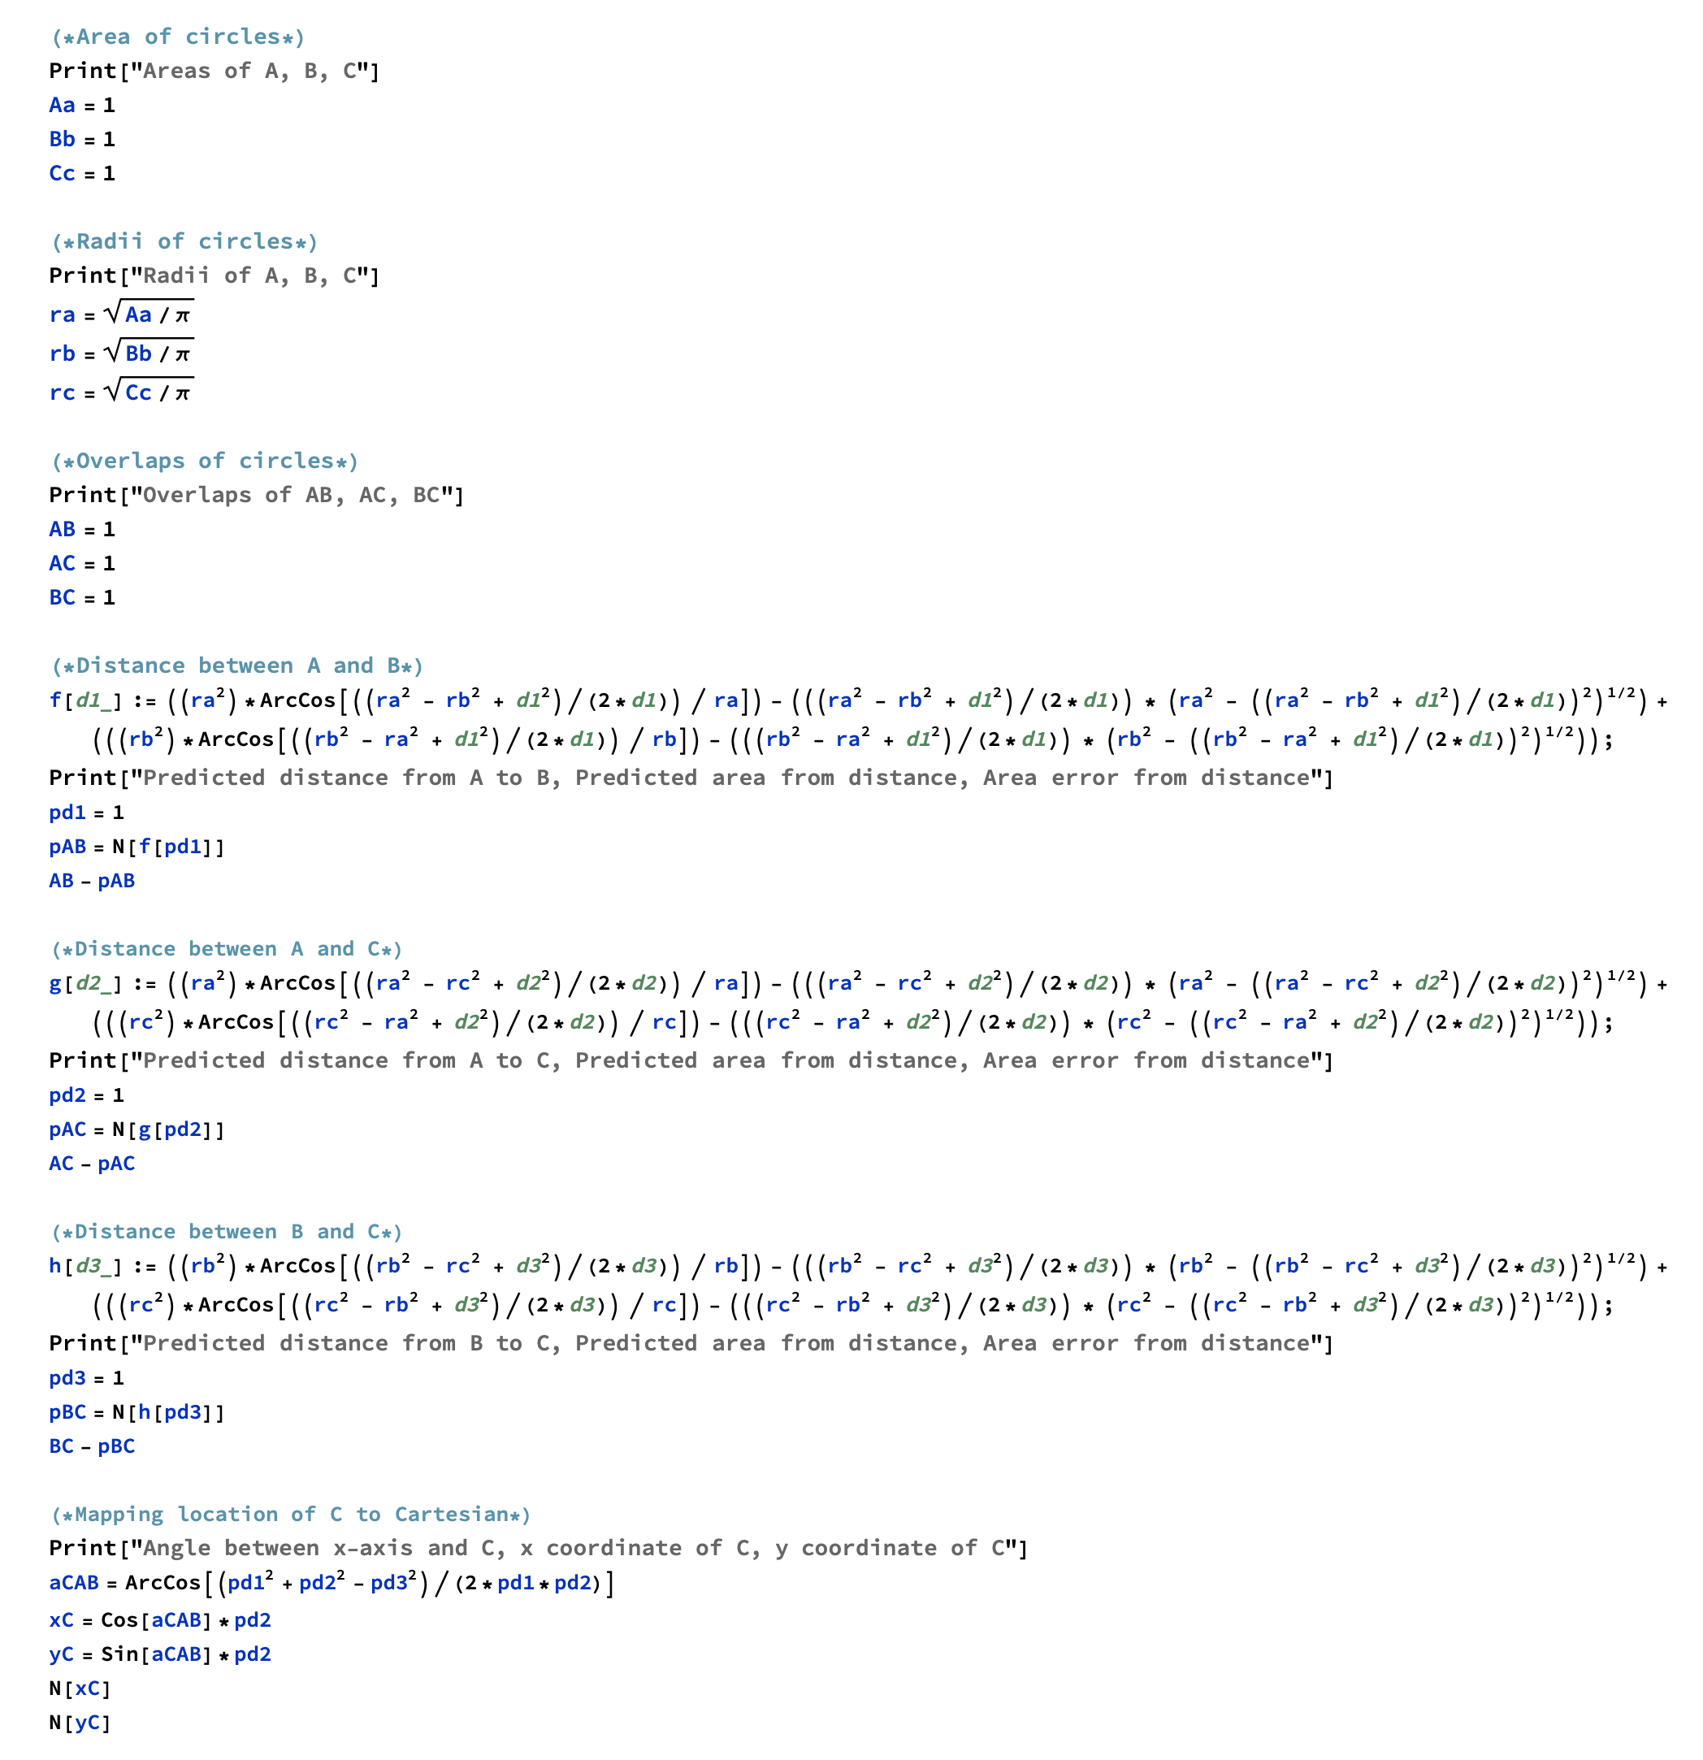

Slide 29
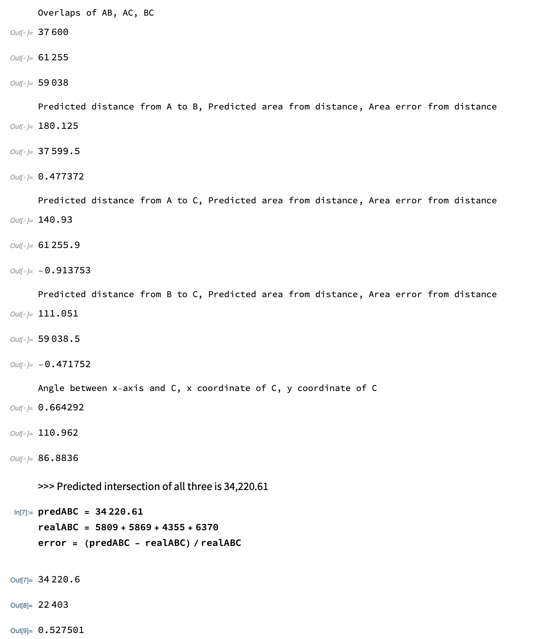

Slide 30
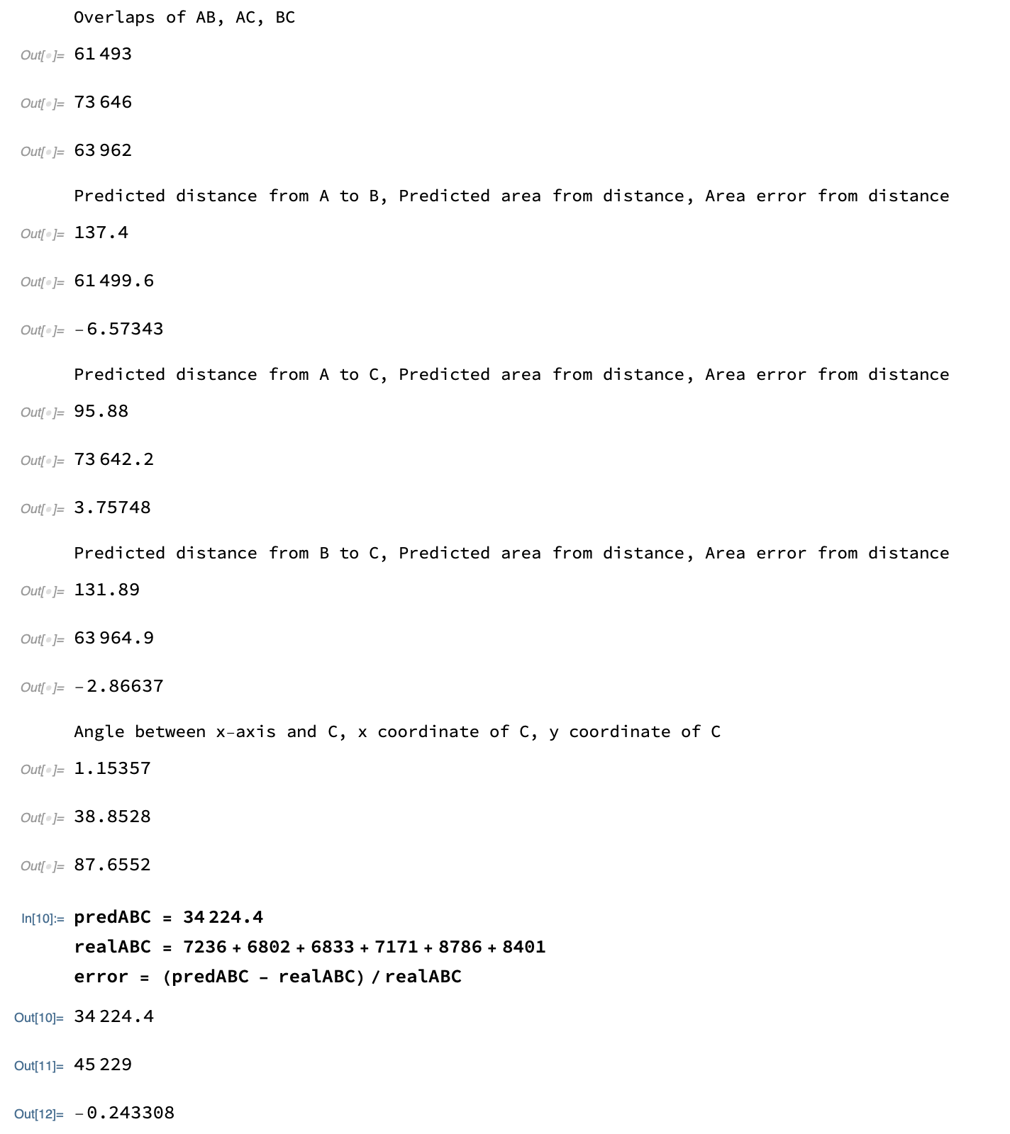

Slide 31
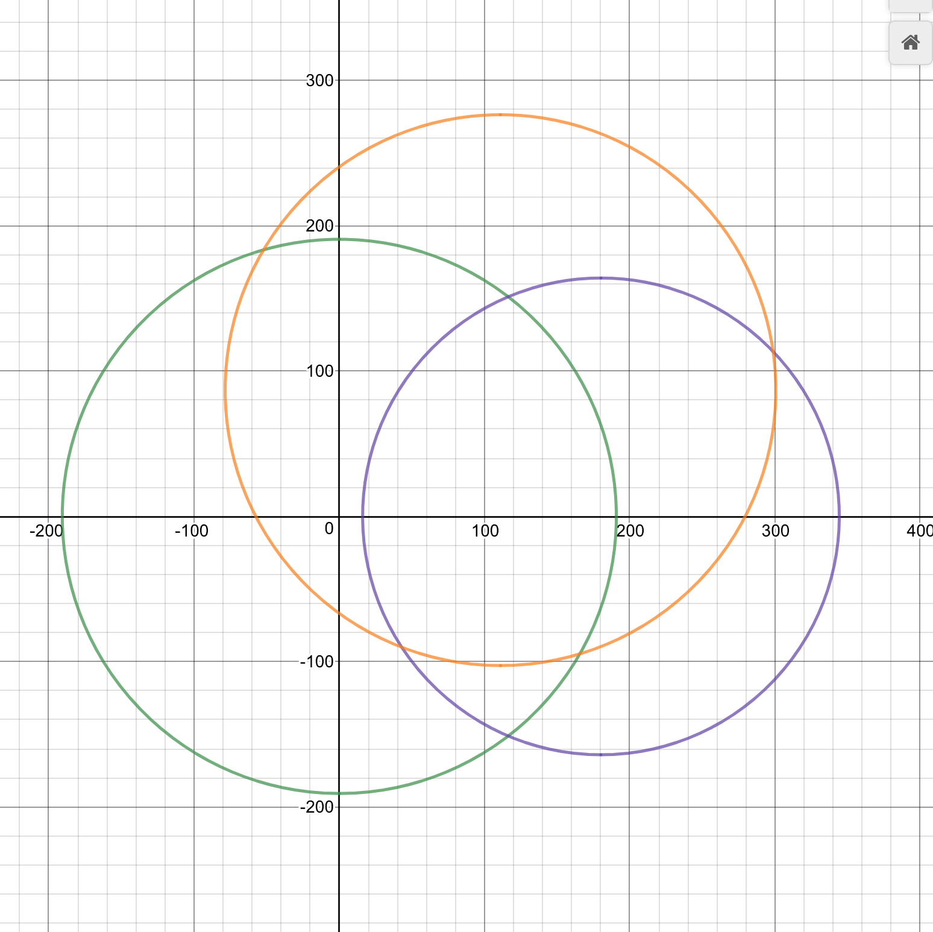

Slide 32
Issues and limitations
I’m a rubbish programmer.
Impossibility of geometry
Inconsistent error of triple overlap
I think I’m actually wrong.
Ranked choice is still rare in the US.
Still lacks predictive power.
Assumption of wave particle interaction could be compromising between spread of candidates and voters rather than just one or the other.

Slide 33
Going forward
Verify or disprove error calculations
MORE DATA
Explanation of geometry crunches as possible indicators
New ranked choice method based on scaled cutoff for choices to advance each round

