Slide 1
Graphs

Slide 2
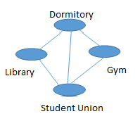
What is a Graph
A Graph consist of:
Vertices – May contain interesting data
Edges – May contain interesting data
Example

Slide 3
SubGraph
A subgraph is a portion of a graph that is stand alone.
It contains
Vertices – A subset of the Vertices of the Graph
Edges – A subset of the Edges of the Graph

Slide 4
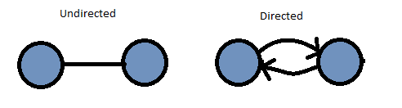
Directed or Undirected
In an undirected graph, there is at most, one edge between any two vertices.
In a directed graph, you can have up to two (one pointed to vertex i and one pointed to vertex j) edges. Each edge must be pointed to a unique vertex.

Slide 5
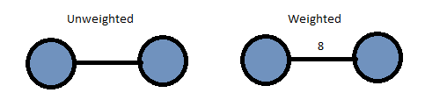
Weighted or Unweighted
A weighted graph is one that has a numeric value on each edge. This is the cost of the edge (the cost to traverse through this edge).
An unweighted graph is one with no cost on an edge.

Slide 6
As an ADT
#pragma once
template <class LabelType>
class GraphInterface
{
public:
// get the number of verticies in the graph
virtual int getNumVertices() const = 0;
// get the number of edges in the graph
virtual int getNumEdges() const = 0;
// add an edge to graph
virtual bool add(LabelType start, LabelType end, int edgeWeight) = 0;
// remove an edge
virtual bool remove(LabelType start, LabelType end) = 0;
// get the weight of an edge
virtual int getEdgeWeight(LabelType start, LabelType end) const = 0;
// perform a depth-first search
virtual void depthFirstTraversal(LabelType start) = 0;
// perform a breadth-first search
virtual void breadthFirstTraversal(LabelType start) = 0;
};

Slide 7
Implementation (simple)
We first must choose which to implement, an adjacency matrix or an adjacency list.
An Adjacency Matrix is an array of n x n bools (or integers) to hold a true or false (or a 1 and 0) to indicate if there is an edge going from i to j.
If it is weighted, then you can have the weights instead of true (or 1’s). A false would have a null or a 0 (assuming the weight cannot be a zero) or infinity.
An Adjacency List is an array of n lists that are the vertices of the graph and point to the indexes that the vertex goes to.

Slide 8
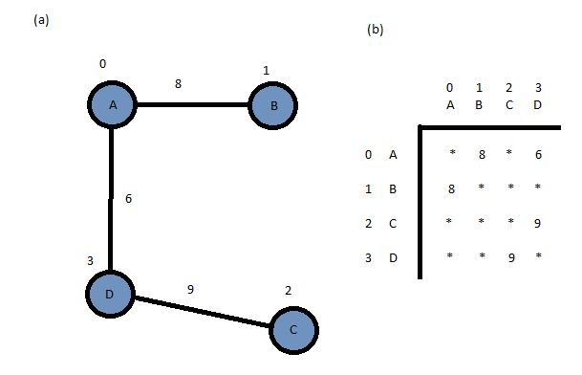
Adjacency Matrix (weighted)

Slide 9
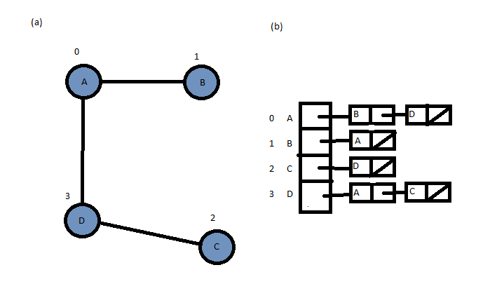
Adjacency List (unweighted)

Slide 10
Implementation Choice
class Graph : GraphInterface<int>
{
private:
int maxSize; // Maximum size
int size; // Current size (number Vertices)
int edges; // Number Edges
int *vertices; // Listing of each vertices
int **graph; // Adjacency Matrix

Slide 11
Next, the constructor
Graph::Graph()
{
size = 0;
maxSize = 100;
graph = new int*[maxSize];
vertices = new int[maxSize];
for (int index = 0; index < maxSize; index++)
{
graph[index] = new int[maxSize];
for (int jndex = 0; jndex < maxSize; jndex++)
graph[index][jndex] = 0;
Vertices[index] = 0;
}
}

Slide 12
The Destructor
Graph::~Graph()
{
clearGraph();
for (int index = 0; index < maxSize; index++)
delete[] graph[index];
delete[] graph;
}

