Slide 1

Bird’s Eye Statistics: Final Group Presentation
Group 4:
Amal Krishna, James Christensen, Peter DiMaria,​
Matthew Scott, John Staley, Patrick Ryan, Siwei He
Boston University | Metropolitan College | CS673 D1 Software Engineering (Spring 2018) | Team 4

Slide 2

Design: Web Framework
Django:
Version used: Django 1.11.10
Django is a free and open-source web framework, written in Python.
Django controls the front-end and the back-end
Django Design:
Based on an MVC framework (with different names for some elements)
Templates for the front-end (MVC – Views)
Views for methods and database queries (MVC – Controller)
Models for the back-end (MVC – Models)

Slide 3

Design: Database
SQLite 3
SQLite3 is the primary Django database by default.
Simple and easy to allow for fast queries, storage, and data integrity.
Does have limitations (limits on number of columns, max query length, etc.).
Environment:
SQLite3 database is housed within the Django framework.
Queries can be written directly in SQL or can be “framed” in python.
Can specify other database languages if the project requires a different language or format.

Slide 4




Design: Programming Languages
Primary Scripting Language: Python 3.6
Python provides a readable script that can hold logic and implement libraries.
Python is also imbedded in Django’s HTML pages to generate visualizations.
Primary Database Language: SQL
SQL provides direct querying to return data quickly for effective visualization.
Front-end: (HTML, CSS, JavaScript and Python)
HTML: language for describing the structure of Web pages.
CSS: language for describing the presentation of Web pages, including colors and fonts.
JavaScript: Used to make interactive webpages and provide plug-in free online programs.
Python: Script also allows the integration of visualizations.

Slide 5
Design: Django System Overview
Django (MVT) Components:
Project/Urls.py
url(r'^indeed/', indeed),
App/views.py
def indeed(request): if request.method == 'GET‘: return render(request, 'indeed.html', context)
Templates/indeed.html
{% extends 'base.html' %} {% block head %} {{block.super}} {% endblock %}
Templates/base.html

Slide 6
Design: Django Template Overview
Templates in Django:
Variables – get replaced with values when the template is evaluated
Filters – modify variables for display (e.g. “lower” for lowercase)
Tags
Control Flow (if and for)
“Block” and “Extend” for template inheritance
Template Inheritance
Define “Base” or “Skeleton” template for all common elements
Define blocks that child templates can
Extend – start with block.super keyword
Override – don’t use keyword
Outside of blocks is directly inherited
Avoids boiler plate code / increases code reuse

Slide 7




Design: Libraries and Tools
PyCharm 2017.3.2
Python IDE with large module ecosystem and integrated command line
Beautiful Soup 4.6.0
Python module which parses HTML and facilitates extraction from various page elements
Plotly:
Python module which generates beautiful interactive python visualizations and charts
Bootstrap 3.3.7
Bootstrap is a user friendly open source toolkit for developing HTML, CSS, and JS
GitHub
Web-based hosting service for version control using Git
Current Version Used: GitHub Desktop 1.0.11

Slide 8
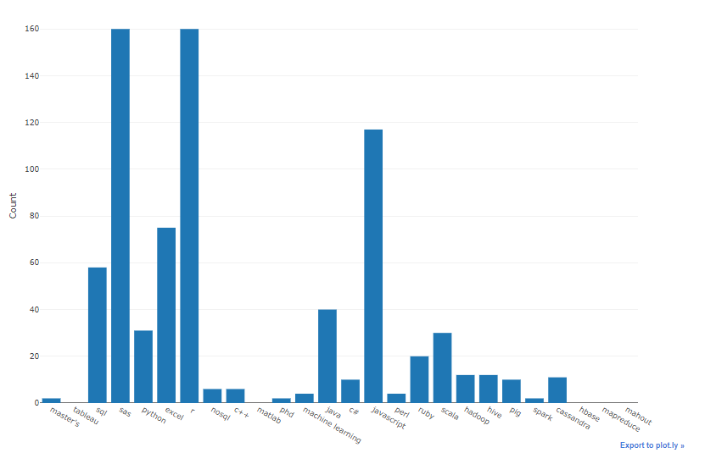

Design: Algorithms: Primary Scraper
Begins with a predetermined list of job titles (hard coded into the scraper)
Continually scrapes individual job posts on indeed on a preset schedule.
For each observation (i.e. job post), identifies the number of mentions of preselected job skills, location, salary range, company and job description (text).
Returns job post data into Django’s SQLite3 database.
Indeed.com
SQLite3 DB
Scraper()

Slide 9
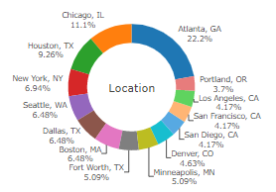
Design: Algorithms: Secondary Scraper
national_scraper():
Takes a user-fed job title and scrapes the general US metadata for that job posting (Parses HTML metadata into integers and categories
Separates into appropriate lists, and loads into Plotly donut charts
state_scraper():
Takes user-fed job title (no database or assigned names beforehand)
Generates a list of indeed urls to loop through and scrape for data.
As the scraper loops through the url list, metadata is scraped for each US state, separated into appropriate lists, and loaded into Plotly to create county-based choropleth charts.
Indeed.com
Scraper()

Slide 10
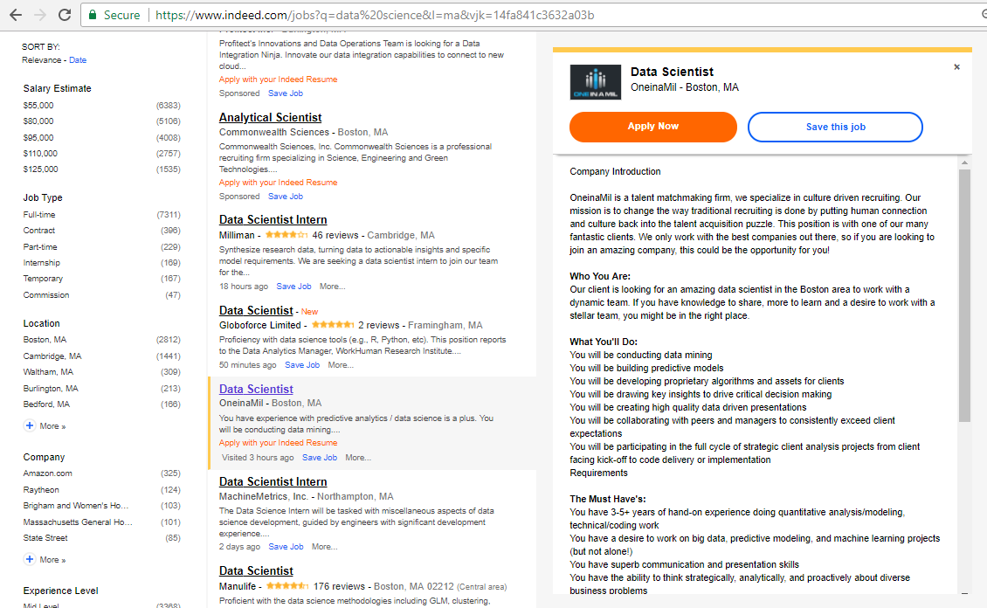
Design: Algorithms: Target Data per Scraper
Primary Scraper Data
Secondary Scraper Data

Slide 11
Requirement Analysis: Functional Requirements
Functional Requirements
Primary Scraper: Scrapes all indeed posts for a fixed job titles, which stores in a database, analyzes and quantifies the mentions of selected skill keywords.
Glassdoor visualization
Job skill comparison
Non-Functional Requirements:
Secondary Scraper: Scrapes indeed on the fly to show a detailed summary of the market for a user-fed job title.

Slide 12
Requirement Analysis: User Stories
User Story 1: Skill Bar Chart By Region and Job Title
User Story:
As a user, I want to be able to see data from job postings on indeed.com, specifically information about skills that are mentioned in those job postings, so that I can know what skills are needed for jobs in regions of the US
Acceptance Tests:
Given a database of data on skills needed for jobs and regions of the US and a UI with drop downs for job type and region, when I select a job type and a region, then a bar chart is displayed showing count of times skills were mentioned in job postings for that job and that region

Slide 13
Requirement Analysis: User Stories
User Story 2: Job Comparison Plot
User Story:
As a user, I want to be able to compare the skills required for two different types of jobs, so that I can have an idea about where jobs overlap on skills required
Acceptance Tests
Given data on jobs and skills, when I choose two jobs from drop-down menus, then I will see a plot comparing the skillsets for each
Given data on the skills required for data scientist positions in the US and data on the skills required for network architect positions in the US and a UI with one drop down for each job type, when I choose those two jobs from those drop downs, then a plot comparing the skills associated with each job is shown

Slide 14
Requirement Analysis: Use Case Example:(Secondary Scraper)
Use Case Name | Job Title Summary
Participating Actors | User/Job Applicant
Entry Condition | User navigates to choropleth page
Flow of Events | User visits choropleth page. User clicks on the form and enters in a job title that they would like to see information displayed for. User clicks submit button to post their answer to the Django frontend The views page runs the scraping algorithms, and returns Plotly charts as raw HTML. User sees Plotly graphics rendering on template, and can view additional information on cursor overlays or can pursue editing options through Plotly’s hosted site.
Exit Condition | User navigates away from choropleth page, or searches for another job title.

Slide 15
Requirement Analysis: Completed User Stories (Iteration 0 &1)
Iteration 0 | Points | Iteration 1 | Points
Functional SQL Database | 2 | Unit Test on Data Collection | 2
Database population | 2 | Unit Test on Scraper | 2
Deduping / Title Scrubbing | 2 | Populate City Database | 1
Skill Bar Chart (Job/Region) | 2 | Job Comparison Plot | 2
Functional Webscraper | 3 | Plot and DB Integration | 1
Total | 11 | Total | 8

Slide 16
Requirement Analysis: Completed User Stories (Iteration 3 & 4)
Iteration 2 | Points | Iteration 3 | Points
Selenium Integration | 2 | Jobs by Region (US State and Skill) | 3
Selenium UI Test Cases | 3 | Skill Summary by Job Title | 2
SDD Completion | 1 | Visually Assess Frequency of Skills | 3
Glassdoor Data Visualizations | 2 | On-theFly Scraping and Graph Display | 3
Selenium UI Tests | 1 | - | -
Total | 9 | Total | 11

Slide 17
Unit and System Testing
Auto (A) or Manual (M) | Unit/System/ Acceptance | Module (if unit) | Total Count | Passing Count | Failures
A | Unit | CollectData | 5 | 5 | 0
A | Unit | Scraper Function | 10 | 10 | 0
A | Unit | UI | 17 | 16 | 1
A | Acceptance | Selenium | 6 | 6 | 0
M | Acceptance |  | 3 | 2 | 1
Total |  |  | 41 | 39 | 2

Slide 18
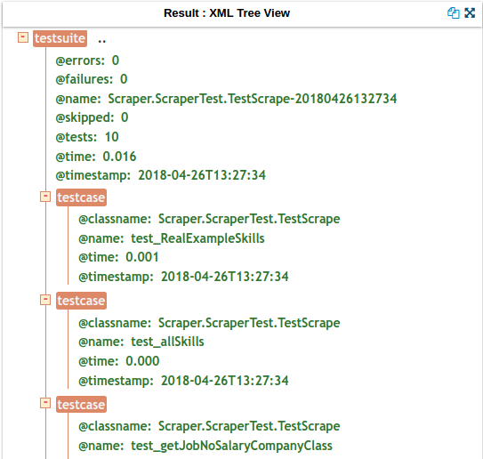
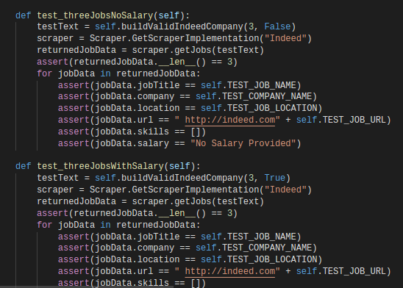
Testing: Scraper

Slide 19
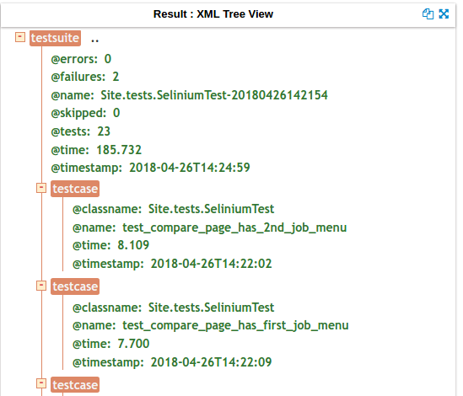
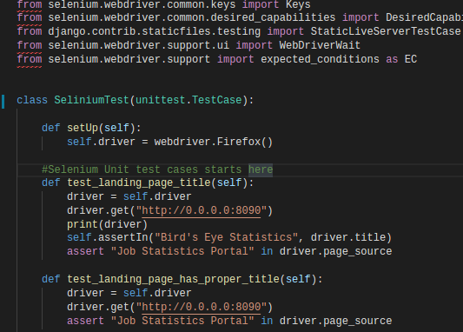
Testing: Selenium

Slide 20
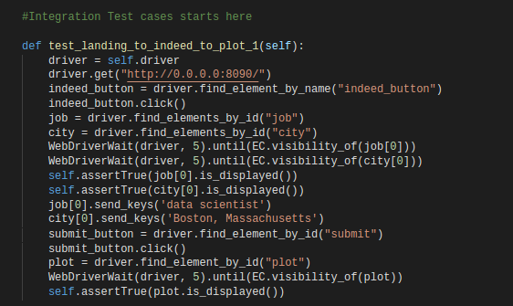
Testing: Selenium Integration

Slide 21



Deployment to cloud
http://amalrkrishna.pythonanywhere.com/
AWS - learning curve of AWS Elastic beanstalk is very high.
Heroku - Uses posgresSQL as their database, timeout problems after 60 seconds.
pythonanywhere - much more easier, but blocks requests to websites that are not on their whitelisted pages, cannot hit indeed without their api.

Slide 22
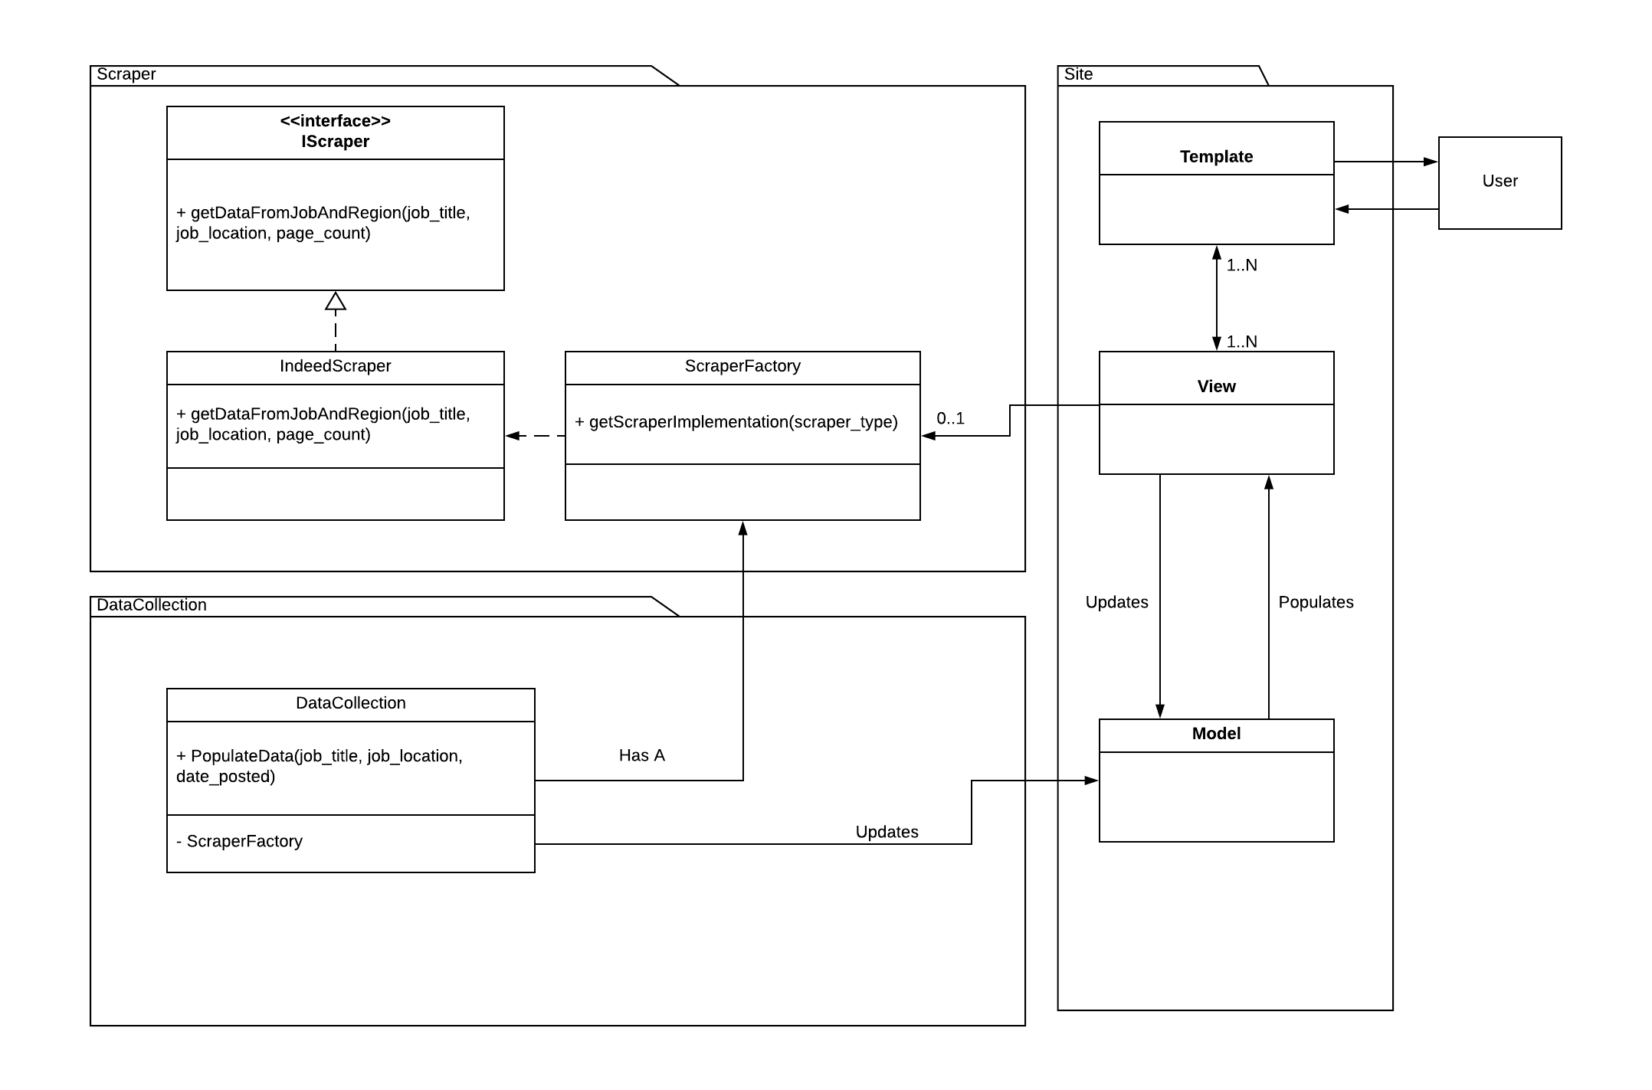
Project Structure: Class and Design Patterns (MVC)

Slide 23
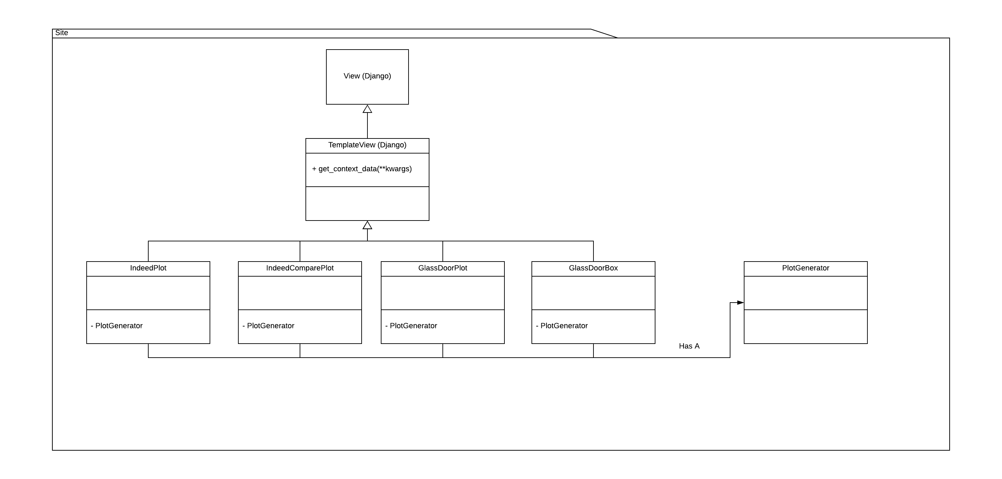
Project Structure: Class and Design Patterns (MVC)

Slide 24
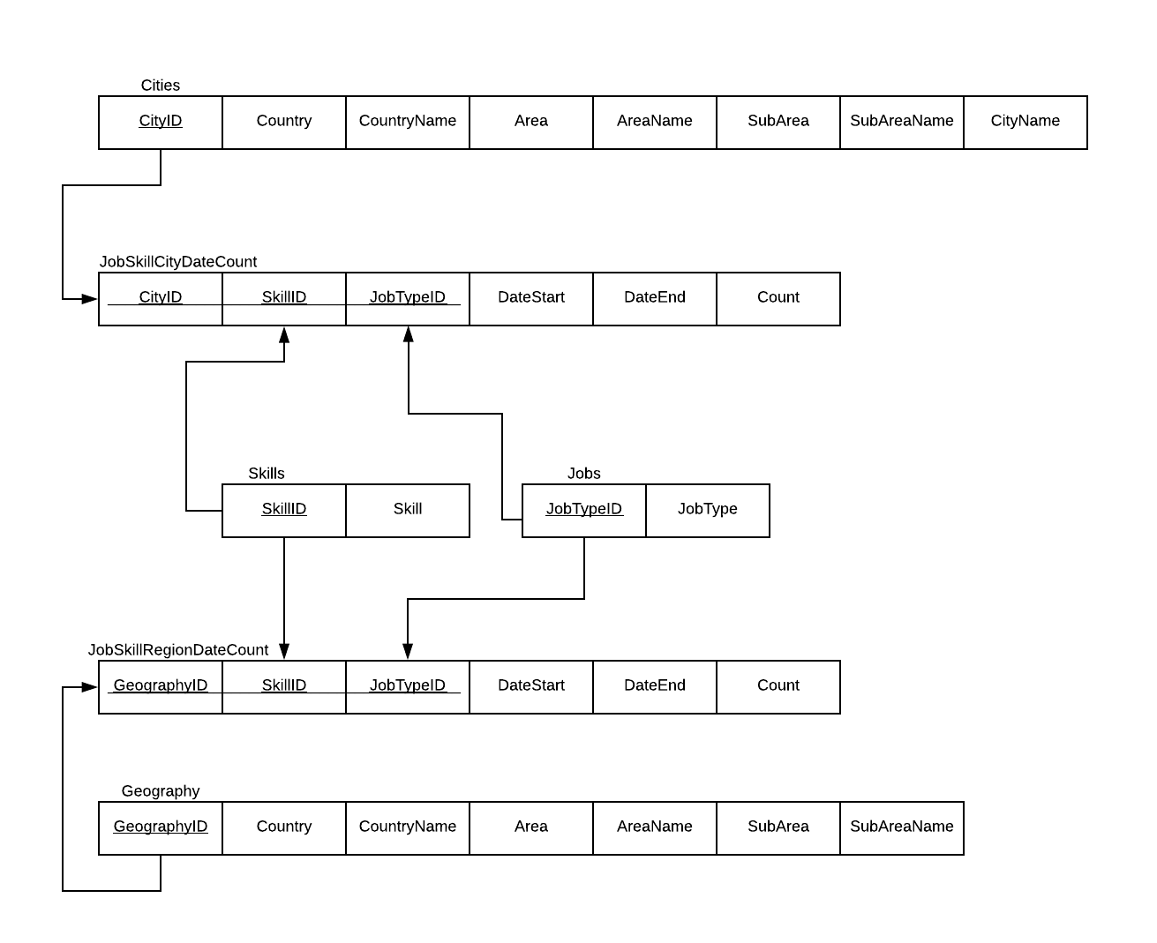
Project Structure: Class and Design Patterns (Database)

Slide 25
Project Structure: Refactoring Example: Scraper Class to Factory
Before
Scraper module IndeedScraper.py methods
def getJobSkills(self, pageText): def getJobs(self, pageText): def getDataFromJobAndRegion(self, job_title, job_location, page_count):
CollectData and Views methods
… Scraper.IndeedScraper.getDataFromJobAndRegion(….) …
Problems
What if I want to use a different scraper?

Slide 26
Project Structure: Refactoring Example: Scraper Class to Factory
Naïve Implementation
CollectData and Views methods
(… scraperType) { … if (scraperType == “Indeed”) Scraper.IndeedScraper.getDataFromJobAndRegion(….)
else …
}
Problems
Basically that I have to put this same code everywhere I need a scraper and extend it every time I add a new scraper type

Slide 27
Project Structure: Refactoring Example: Scraper Class to Factory
Scraper Factory Implementation
CollectData and Views methods
(… scraperType) { … scraper = GetScraperImplementation(scraperType) scraper.getDataFromJobAndRegion(….)
else …
}
Problems Solved
Conditional logic goes entirely into GetScraperImplementation (makes adding new types easy)
Scraper object can now be used throughout the whole method without checking scraperType a second time.

Slide 28
Security
Risk Assessment
No sensitive information
No user authentication
SQL Injection, CSRF, XSS
Query parameterization
CSRF Protection
Auto-escaping
Security Options in Django:
Django has built-in protection against most types of CSRF (cross site request forgery) attacks,
Django’s querysets are protected from SQL injection since their queries are constructed using query parameterization. A query’s SQL code is defined separately from the query’s parameters.
Django contains clickjacking protection in the form of the X-Frame-Options middleware which in a supporting browser can prevent a site from being rendered inside a frame.

Slide 29
Project Management: Team Contributions
Member Name | Team Role | Contributions
Amal Krishna | Quality Assurance | Glassdoor and Indeed job skill visualizations Unit tests and selenium frameworks
James Christensen | Security | Job comparison plot Statistics and analysis support
Peter DiMaria | Environmental | Django framework initialization Troubleshooting, debugging and template design
Matthew Scott | Team Leader | Indeed Job skill bar Batch database population
John Staley | Requirements | User interface and HTML visuals Navbar implementation
Patrick Ryan | Assistant Team Leader, Design | Primary and secondary scrapers / unitests Implementation of choropleth Django page
Siwei He | Configuration | Unit tests

Slide 30
Project Management: Quality Metrics
User Stories Implemented:
Count and weight of user stories completed in pivotal tracker.
Test Cases:
Completion of test cases using selenium and Python’s unittest module
Runtime and Responsiveness:
Comparative length of runtime intervals (using Python’s timeit module)
Qualitative:
User experience, look and feel
Degree to how intuitive each page feels to other team members.

Slide 31
Project Management: Iteration Evolution
Iteration 0 | Indeed scraper prototype Django setup
Iteration 1 | Data visualization (Glassdoor and Indeed charts) Database population
Iteration 2 | Testing Job Comparison Plot Code Refactoring
Iteration 3 | Choropleth charts Unit and Integration Testing UI Improvements Code refactoring Scraper improvements

Slide 32
Project Management: Achievements
Integrating Multiple Components:
Web scraper
Django framework
Plotly
Test frameworks (Selenium and Unittest)
Efficiency:
HTML parsing
Data retrieval and processing
Page responsiveness
Team Collaboration:
Communication on slack
Avoiding redundant user stories on pivotal tracker.

Slide 33
Project Management: Challenges
Integration:
Complexity
UI updates
Web scraping
Has to be customized to specific site
Potential for IP ban, rate limiting
Large team:
Branch/version management
Module and dependency alignment/troubleshooting

Slide 34
Project Management: Lessons Learned
Focus on Task Definition and Scope:
Defining tasks at start of iteration.
Communicate objectives so performed work is not redundant.
GitHub Strategies:
One person managing merges to master.
Each team member should maintain their own branch.
Leverage Different areas of Expertise:
Identify team member’s skills and competencies .
Don’t be afraid to ask your team members questions.

Slide 35
End of Presentation
Questions?
For any additional questions or feedback
please contact the developers on Team 4:
Matthew Scott: Project Leader - matt86@bu.edu
Patrick Ryan: Backup Leader /Design Leader: patr@bu.edu
Amal Krishna: Implementation/QA Leader amalrkrishna94@gmail.com
James Christensen: Security Leader: jchriste@bu.edu
Peter DiMaria: Environment and Integration Leader: pdimaria@bu.edu
John Staley: Requirement Leader: jstaley@bu.edu
Siwei: Configuration Leader - hesiwei@bu.edu

