Slide 1

Indeed Scraping Web App – Querying and visualizing industry-specific skills for the current job market.
Group 4:
Amal Krishna, James Christensen, Peter DiMaria,​
Matthew Scott, John Staley, Patrick Ryan, Siwei He
Boston University | Metropolitan College | CS673 D1 Software Engineering (Spring 2018) | Team 4

Slide 2









Project Setup and Design Basics
Software Architecture:
Framework: Django, with logic written in Python, front end in HTML5
Database Type: SQLite3 (Django Built-in)
Visualization Packages: Plotly, Matplotlib, Bokeh
QA: Unittest, Selenium
Engineering and Design Specs:
Program Size: <10,000 lines, < 5 MB
Estimated Development Time: 500 Hours
Communication Tool: Slack
Version Control Tool: Github
Process Metrics: Timeit module (runtime complexity)(overall and time/job)
User Interface:
Front End Input: Search Fields (Job Title + Location)
Front End Output: Visualizations (Bar Chart, Line Chart, Histogram, Pie Chart, etc.)

Slide 3
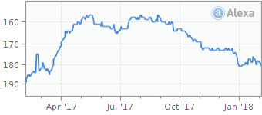

Intro to Indeed.com
Indeed.com is an American employment search engine for paid job listings, and is co-headquartered in Austin, Texas and Stamford, Connecticut.
As a single-topic search engine, it is also an example of vertical search. Indeed is currently available in over 60 countries and 28 languages.
In October 2010, Indeed.com surpassed Monster.com to become the highest-traffic job listing website in the United States.

Slide 4
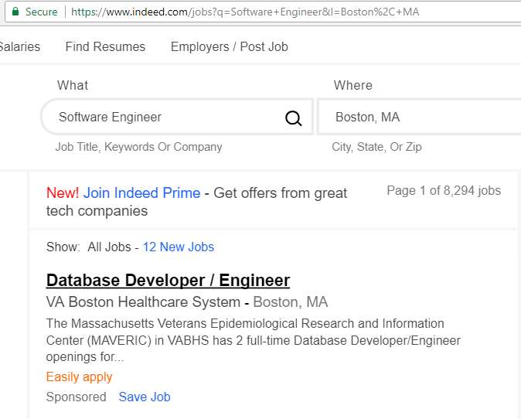
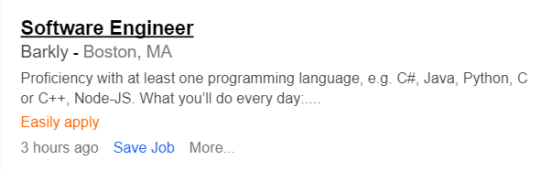
Indeed Page Elements
URL
Job Title
Location
Job Title & Post
Location
Company Name
Input Element
Description Summary
Output Element
Time Since Posting

Slide 5
Project Basis and App Concepts
Basis for Selecting Indeed.com
Consistent page and URL structure allows quick and easy HTML extraction.
Popularity of site provides high-quality and current job market information.
Scraping algorithm can be scaled and reused across a variety of jobs and sectors.
Two App Development Concepts:
Primary Web App: (Job-Skill Search)
A basic job skills (e.g. Software Engineer + Boston, MA) which returns visuals that inform the user of the skills mentioned in post for a given job type in a given region. (Proven Feasibility)
Secondary Web App: (Multiregional Search)
A multiregional search which allows the user to enter a job title (e.g. Data Analyst) and returns visuals that quantitatively describes the volume of postings for that job by US county. (Will approach if the primary web app is fully developed.)

Slide 6
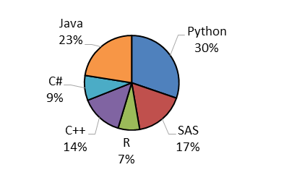
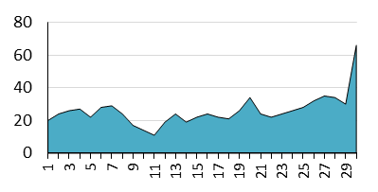
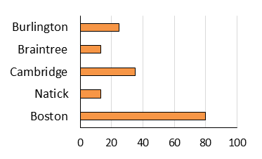
User Interface: (Job-Skill Search)
(Inputs)
Nurse
(The job title input field is provided as a drop down menu, showing the options for which database tables exist.)
Java
Registered Nurse
C++
Software Engineer
Software Engineer
Boston, MA
Python
Truck Driver
(Results)
(While searching, a loading animation replaces the input field)
(When search and scraping is finished, the loading animation is replaced with a field of interactive charts and visualizations.)

Slide 7
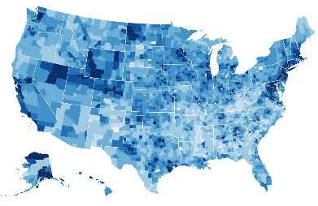
User Interface: (Multiregional Search)
(Inputs)
Software Engineer
(The job title input field is provided as a drop down menu, showing the options for which database tables exist.)
(Results)
(While searching, a loading animation replaces the input field)
(When search and scraping is finished, the loading animation is replaced with a field of interactive charts and visualizations.)

Slide 8
Job Skill Search - Stage I: Scraping and Data Frame
(Front End)
(Back End)
(Each Indeed page is scraped for basic info, then the job description text is scraped from each post’s sub-page.)
Job Post Data Frame
Job Title | Company | Location | Date Posted | Post URL | Job Description | Skills Dictionary
(User Input via Django’s Front End)
URL List
https://www.indeed.com/jobs?q=software+engineer&l=Boston,+MA&start=0
https://www.indeed.com/jobs?q=software+engineer&l=Boston,+MA&start=10
https://www.indeed.com/jobs?q=software+engineer&l=Boston,+MA&start=20
…
Location
URL Generator Function
User
Job Title
A table associated with job title is used to create and increment a skills dictionary for each job post
(Each loop cycle (for each indeed page) operates in chunks of 15 – 16 jobs)
SQLite3 Database

Slide 9
Job Skill Search - Stage II: Data Cleansing
Job Post Data Frame
Job Title | Company | Location | Date Posted | Post URL | Job Description | Skills Dictionary
Job Post Data Frame
Job Title | Company | Location | Date Posted | Post URL | Job Description | Skills Dictionary
Cleansing Function-Set
Remove Incomplete Jobs
Remove Redundant Jobs
Remove Off Topic Jobs
Refine Locations
Re-form Date Posted
(Back End)

Slide 10
Job Skill Search - Stage III: Reporting and Visualization
Job Post Data Frame
Job Title | Company | Location | Date Posted | Post URL | Job Description | Skills Dictionary
Skills Mentioned
Date Posted
Job Locations
Company Name
(Column data is converted to interactive visuals in Django using plotly)
(Back End)
(Front End)

Slide 11
Project Challenges and Risks
Team Inclusion:
Maximizing team communication while allowing team members to work on segments that align with their technical background. (Scraper vs. Django vs. HTML vs. Visualization)
Runtime Minimization:
If runtime in basic or multi-regional search is too long for a reasonable user, then our engineering team will need to decide where and what limits must be implemented.
If runtime cannot be reduced, searches may need to be supplemented with pre-scraped information (obtained on a regular run-schedule).
Data Harmonization:
Reformatting of different data types(location, date posted, etc.)is crucial to ensure that they can be correctly interpreted and visualized.
Web Hosting:
Setup and hosting of Django on a dedicated system, allowing access to one or more users at a given time.

Slide 12
Directions for Improvement
Aesthetic:
Make decisions on design, color pallet and aesthetics (HTML fill design)
Agree on visualization methods, chart types and interactive protocols.
Functional:
Implementation of scraping algorithm within Django environment.
Design and implement cleansing function-set.
Design and implement logic system to identify when the scraper has reached the last page.
Expansion selection of job title - skill table.
Research Google’s geocoding system to convert job location information to area code. (for multi-regional scraping)
Efficiency:
Removal of unused metadata and legacy structures.
Minimize time complexity for scraping and ETL methods.
Quality:
Bug and Quality Assurance Testing.
Unittest and functionality testing.
End-to-end integration testing​
Data integrity between database and scrapping outputs

Slide 13
End of Presentation
Thank you for attending this presentation.
For any further questions or feedback
please contact the developers on Team 4:
Matthew Scott: Project Leader - matt86@bu.edu
Patrick Ryan: Backup Leader /Design Leader: part@bu.edu
Amal Krishna: Implementation/QA Leader amalrkrishna94@gmail.com
James Christensen: Security Leader: jchriste@bu.edu
Peter DiMaria: Environment and Integration Leader: pdimaria@bu.edu
John Staley: Requirement Leader: jstaley@bu.edu
Siwei: Configuration Leader - hesiwei@bu.edu

