Slide 1

Job Market Web App: Implementation Stack and Associated Tools
Group 4:
Amal Krishna, James Christensen, Peter DiMaria,​
Matthew Scott, John Staley, Patrick Ryan, Siwei He
Boston University | Metropolitan College | CS673 D1 Software Engineering (Spring 2018) | Team 4

Slide 2



Operating System
Primary Operating System: Windows
Our project is being developed using the Windows operating system
Each collaborating team member may be using a different version
Every version after Windows 7 is compatible with our platform
Secondary Operating System Options:
Small system adjustments would be required for compatibility with Linux or Mac users.

Slide 3
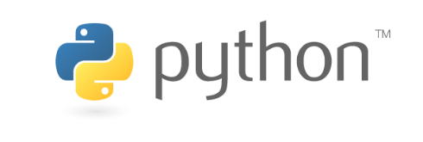
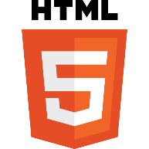


Programming Languages
Primary Scripting Language: Python 2.7
Python provides a readable script that can hold logic and implement libraries.
Python is also imbedded in Django’s HTML pages to generate visualizations
Primary Database Language: SQL
SQL provides direct querying to build and generate visualizations quickly
Front-end: (HTML, CSS, JavaScript and Python)
HTML: language for describing the structure of Web pages.
CSS: language for describing the presentation of Web pages, including colors and fonts.
JavaScript: Used to make interactive webpages and provide plug-in free online programs.
Python: Script also allows the integration of visualizations.

Slide 4

Web Framework
Django:
Version used: Django 1.11.10
Django is a free and open-source web framework, written in Python.
Django controls the front-end and the back-end
Django Design:
Based on an MVC framework (with different names for some elements)
Templates for the front-end (MVC – Views)
Views for methods and database queries (MVC – Controller)
Models for the back-end (MVC – Models)

Slide 5

Database
SQLite 3
SQLite3 is the primary Django database by default.
Simple and easy to allow for fast queries, storage, and data integrity.
Does have limitations (limits on number of columns, max query length, etc.).
Environment:
SQLite3 database is housed within the Django framework.
Queries can be written directly in SQL or can be “framed” in python.
Can specify other database languages if the project requires a different language or format.

Slide 6

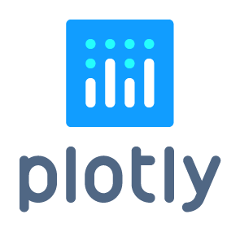


Applications, Software and Tools
PyCharm 2017.3.2
Python IDE with large module ecosystem and integrated command line
Beautiful Soup 4.6.0
Python module which parses HTML and facilitates extraction from various page elements
Plotly:
Python module which generates beautiful interactive python visualizations and charts
Bootstrap 3.3.7
Bootstrap is a user friendly open source toolkit for developing HTML, CSS, and JS
GitHub
Web-based hosting service for version control using Git
Current Version Used: GitHub Desktop 1.0.11

Slide 7
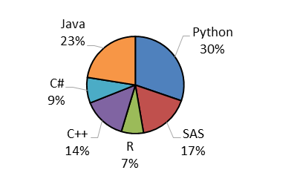
Summary of Stack and User Interaction
Indeed.com
(User inputs location and job title)
Location
Indeed website is scraped on a regular basis to build database
SQL Query
(Python)
Job Title
User)
SQLite3 (Database)
Beautiful Soup
(Scraper)
Plotly
(Plotly updates the Django template, updating the User’s view)
Template:
(HTML, CSS, JS)
(Django)
(Browser)

Slide 8
End of Presentation
Questions?
For any additional questions or feedback
please contact the developers on Team 4:
Matthew Scott: Project Leader - matt86@bu.edu
Patrick Ryan: Backup Leader /Design Leader: part@bu.edu
Amal Krishna: Implementation/QA Leader amalrkrishna94@gmail.com
James Christensen: Security Leader: jchriste@bu.edu
Peter DiMaria: Environment and Integration Leader: pdimaria@bu.edu
John Staley: Requirement Leader: jstaley@bu.edu
Siwei: Configuration Leader - hesiwei@bu.edu

