Slide 1
Team 4, Bird’s Eye Statistics Iteration 2
Matthew Scott, Pat Ryan, James Christensen, Peter DiMaria, Siwei He, John Staley, Amal Krishna

Slide 2
User stories: Unit testing
13 unit tests of UI
As a developer, I want to perform unit tests on Python files so I can deliver reliable code and a reliable product.
As a user, I want to run test cases to automate the website UI, so that I know the website wire frame stays intact during frequent updates.

Slide 3
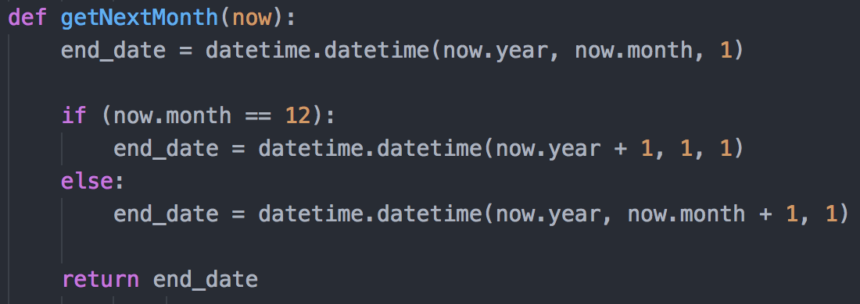
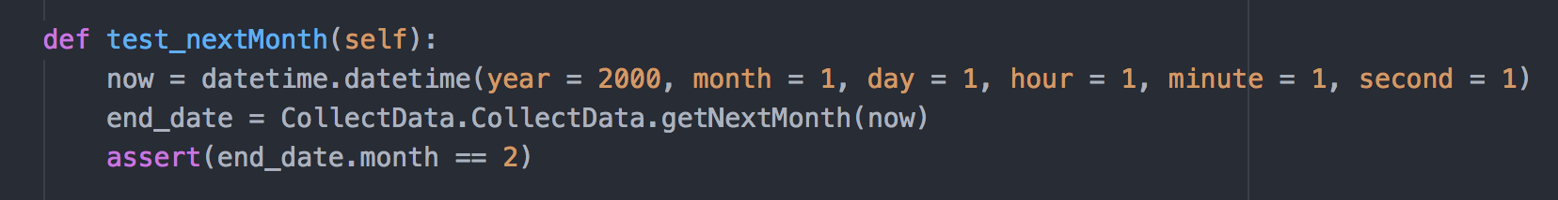
Show us the code!
Unit tests of data collection

Slide 4
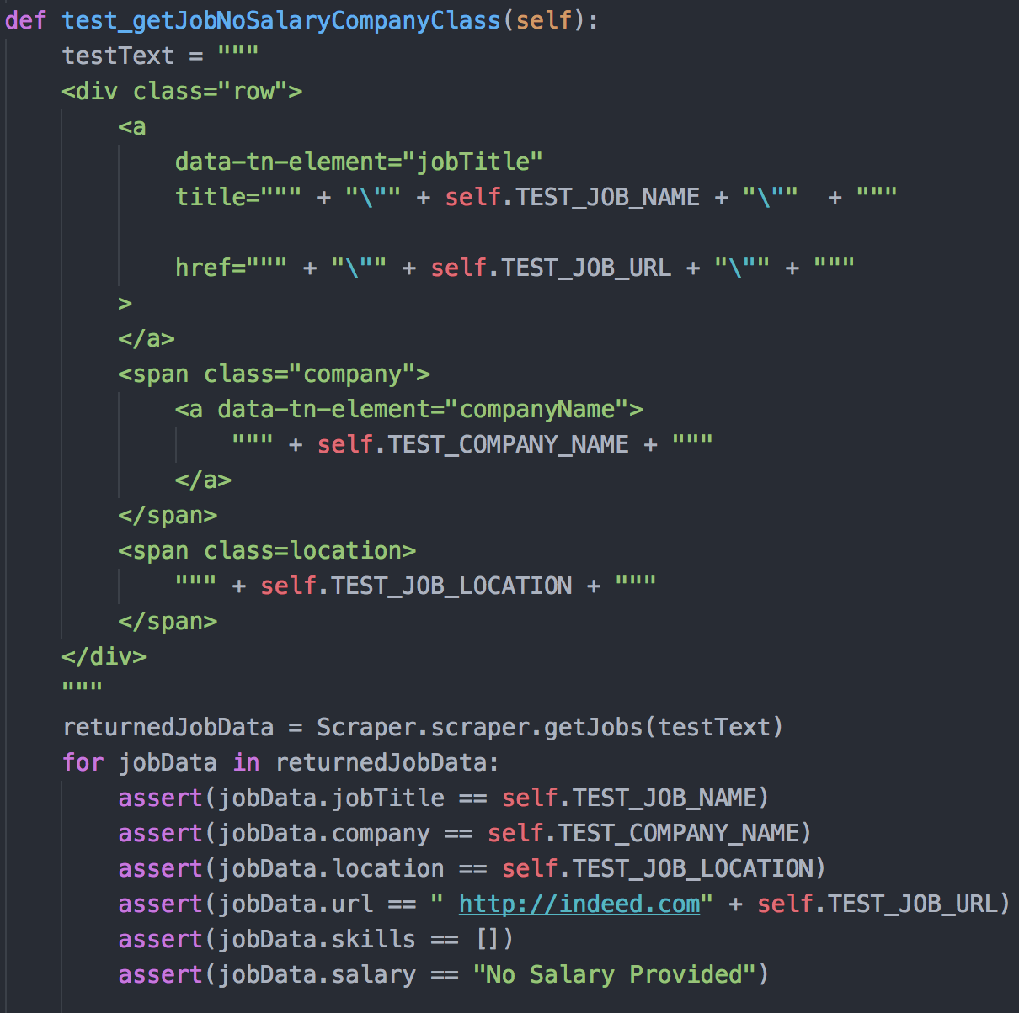
Data collection test
5 data collection tests

Slide 5
User stories: Selenium testing
13 selenium tests
As a user, I want Selenium integrated to the Django framework, so that I can write UI unit test cases

Slide 6
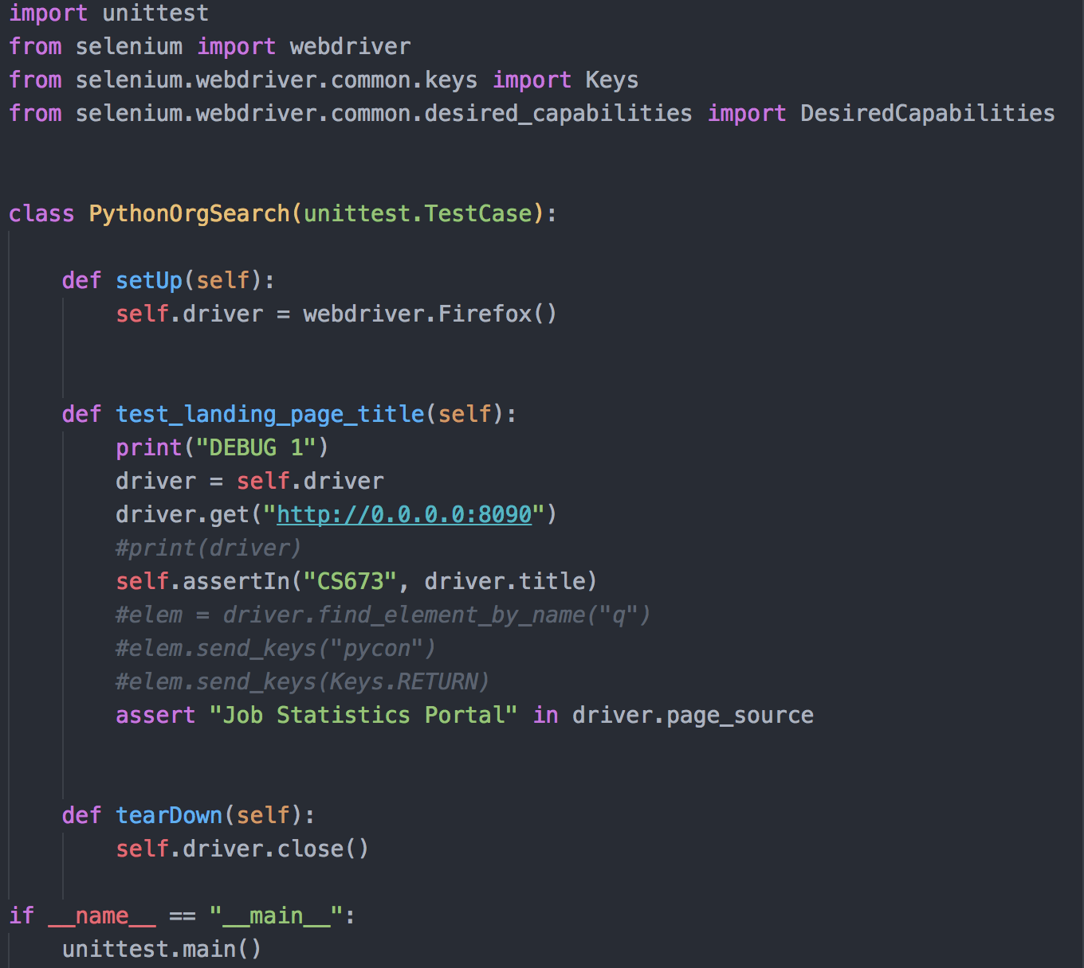
Show us the code!
Selenium test

Slide 7
User Story
Scraper.py unit test
10 total
As a developer, I want to test Python scraper files so the application has accurate and functioning data

Slide 8
Show us the code!
Scraper unit test

Slide 9
Accepted user stories: multidimensional graphs
As a user, I want to be able to select regions and job titles from a drop down and have that generate selection specific graphs so that I can more easily view available data

Slide 10
Accepted user stories: city database
As a software developer, I want to populate a database with up to date data on jobs, skills, and regions scraped from indeed.com so that I can query that data and populate various maps and charts from it.

Slide 11
Accepted user stories: comparing job data
As a user, I want to be able to compare the job skills from different Indeed postings so I can evaluate the job market and prioritize relevant skill acquisition.

Slide 12
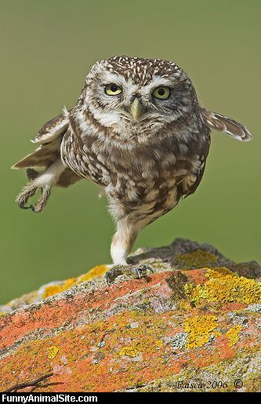
Thank you! -Bird’s Eye Stats

