Slide 1
Simple Scheduler Design
Jason Santana, Matthew Pinneo, and Matthew Spitzley

Slide 2
Our Classes
-Task
-TaskList
-Category
-CategoryList
-SettingsButton
-Settings

Slide 3
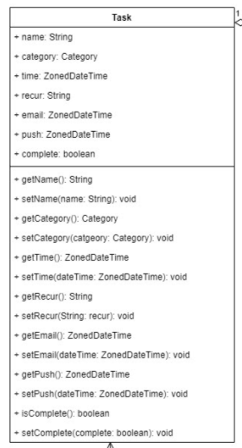
Task
The Task class is the most important class in the Simple Scheduler.
This class will be responsible for the makeup of each task a user makes.

Slide 4
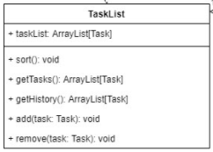
TaskList
The TaskList class is made of an array of the existing tasks the user has made.
The sort function will sort each task in the array by its due date.
getTasks and getHistory will make a list of tasks that are either not yet completed or have already been completed.
The add and remove function are to add and remove tasks from the task list.

Slide 5
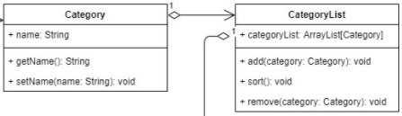
Category/CategoryList
Because the categories are not as complicated as tasks…
-The Category class will have a set and get function for the name of the category
-The CategoryList class will have a sort function (alphabetically)
-The CategoryList class will have an add and remove function to add or remove user made categories.

Slide 6
How will the Task List, History, and Calendar Screen work?
The Task List Screen, History Screen, and Calendar Screen will all use the TaskList class in order to display tasks.
-The Task List Screen will list out all of the non-completed tasks.
-The Calendar Screen will display the exact same information but in a different UI on a calendar.
-The History Screen will display all of the completed tasks.

Slide 7
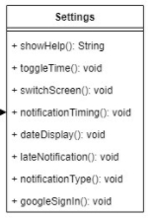
SettingsButton/Settings
Each screen on the application has a button to go to the settings screen.
toggleTime switches daily time between 12 to 24 hour time.
dateDisplay changes what the date format looks like based on user preference
For example 3/3/2021, March 3rd 2021, or 3 Mar. 2021
late Notification will either turn on or off the ability for a user to receive notifications for a task that is past its due date.

Slide 8
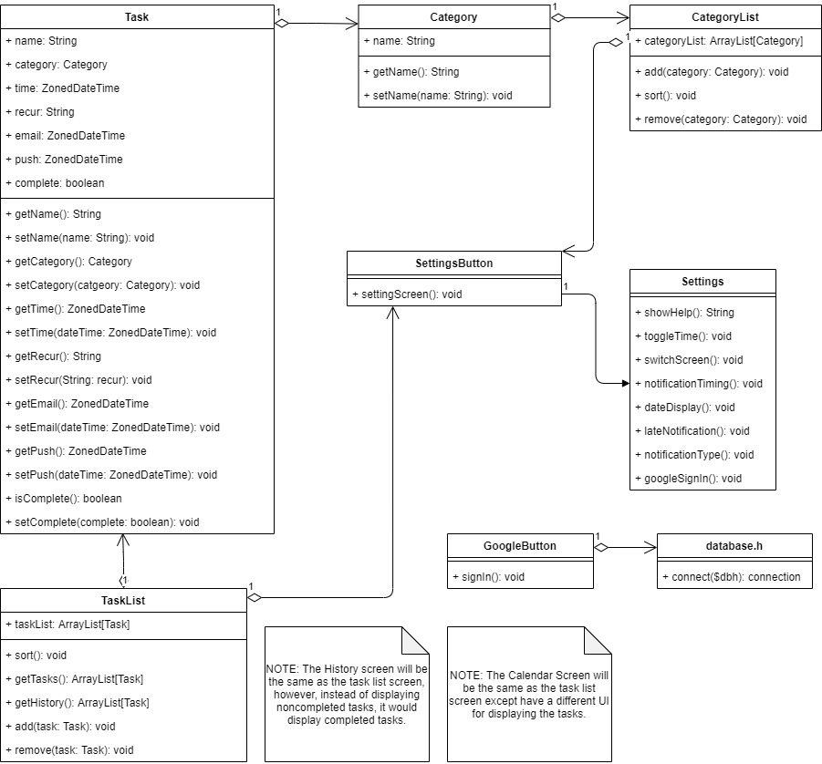
Overall Diagram

Slide 9
Messages and Storage
8 Message events:
Startup
Opening the add task screen
Closing the add task screen
Opening the task edit screen
Closing the task edit screen
Completing a task
Restoring a task
Deleting a task
Category table
Category char(50)
Primary Key
Task table
task_name char(200) NOT NULL
Primary Key
category char(50)
Foreign Key
time datetime
recur char(10)
email_notification datetime
push_notifications datetime
completed boolean
SQLite local storage with android.database.sqlite
MySQL synchronization with a single PHP script

Slide 10
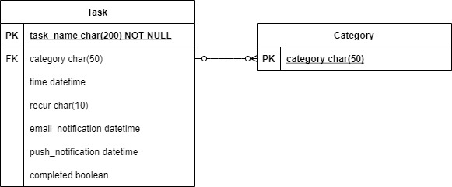
Database

