Slide 1
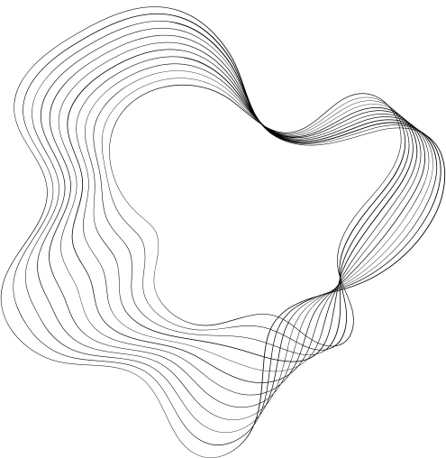

Robotic Arm for Automated Fiber Placement
Team 3
Matthew Hutchinson, Shirley Shah, Jae-An Wang

Slide 2
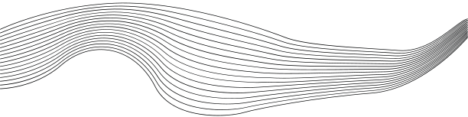
CONTENT
01
OVERVIEW
02
CONTROLLER DESIGN OBJECTIVES
03
METHODS
04
RESULTS
05
DISCUSSION
06
FUTURE DIRECTIONS
1

Slide 3

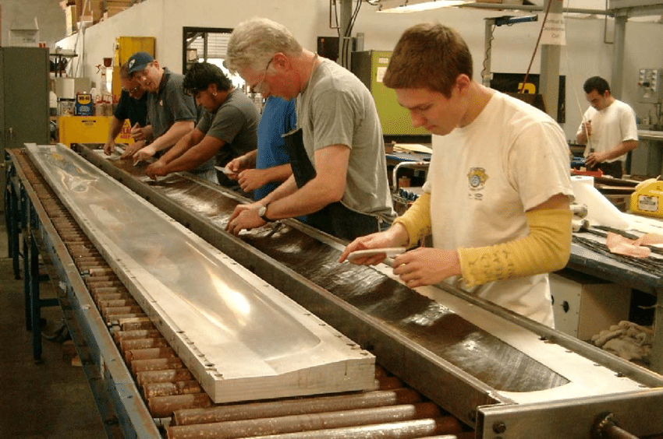
OVERVIEW
Motivation
Composites have many applications in aerospace
  Composite manufacturing historically performed manually
Automation is desirable over having human operators
  Avoid defects due to human error
  Increased manufacturing efficiency
  Reduction of labor costs
Automated Fiber Placement (AFP) is one method for automating composite manufacturing
  Fiber placement and orientation accuracy needs to be high based off the application
  AFP does currently exist but is limited to simpler trajectories
Fig 1: Human operators working on a layup for a wind turbine blade
2
Notes:
Composites are fundamental in aerospace for their strength-to-weight ratio, corrosion resistance, and design flexibility, enhancing aircraft performance and efficiency.
Traditionally, composite manufacturing has been manual, leading to potential inconsistencies. Automation minimizes human error, increases efficiency, and reduces labor costs.
AFP is a key method in automating composite production. It precisely places fibers in set paths, crucial for structural integrity in aerospace applications.
AFP works well for simpler trajectories, however there's a big opportunity to improve it for more complex geometries.

Slide 4
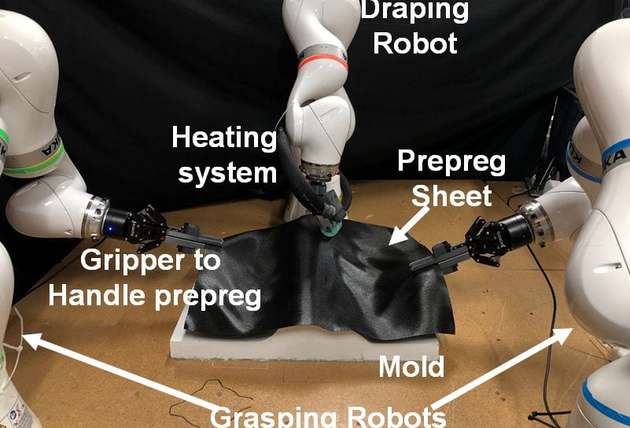
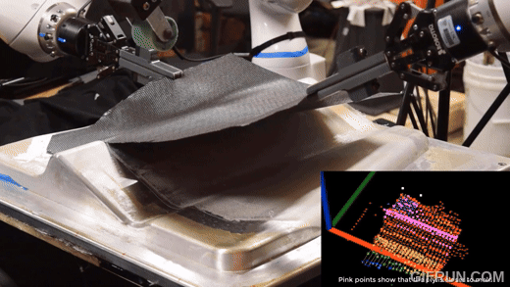
OVERVIEW
Literature Review
Hybrid Cells for Multi-Layer Prepreg Composite Sheet Layup [1]
The USC ARM institute developed a robot cell comprised of three KUKA iiwa 7 arms. These arms implemented impedance and force control. A custom roller end effector was used to fit the ply over the mold and flush out any air bubbles. The robots arms are seen doing multiple tasks draping, grasping the prepreg and rolling to the the mold.
Our team will mainly focus on the rolling motion and developing a controller that can traverse various types of geometry using one robotic arm. Another difference is that our project will involve the laying of individual fiber tows as opposed to full sheets.
Fig 3: Three-arm robot cell for prepreg sheet layup from the ARM institute of USC [2]
Roudy Wehbe, Brian Tatting, Sreehari Rajan, Ramy Harik, Michael Sutton, Zafer Gürdal,Geometrical modeling of tow wrinkles in automated fiber placement,Composite Structures,Volume 246,2020,112394,ISSN 0263-8223, https://doi.org/10.1016/j.compstruct.2020.112394.
Rishi K. Malhan, Aniruddha V. Shembekar, Ariyan M. Kabir, Prahar M. Bhatt, Brual Shah, Scott Zanio, Steven Nutt, Satyandra K. Gupta, Automated planning for robotic layup of composite prepreg, Robotics and Computer-Integrated Manufacturing, Volume 67, 2021, 102020, ISSN 0736-5845, https://doi.org/10.1016/j.rcim.2020.102020.
3
Fig 4: Coordination of robot cell to set prepreg layers
Notes:
At the USC ARM Institute, a setup with three KUKA robotic arms used force and impedance control to operate a roller end effector. The end effector smoothed the ply over the mold, flushing out any air bubbles.
Our project focuses on developing a controller for a single robotic arm to navigate various trajectories, laying individual fiber tows instead of full sheets. This requires precise motion control for adapting to the unique contours of different molds

Slide 5
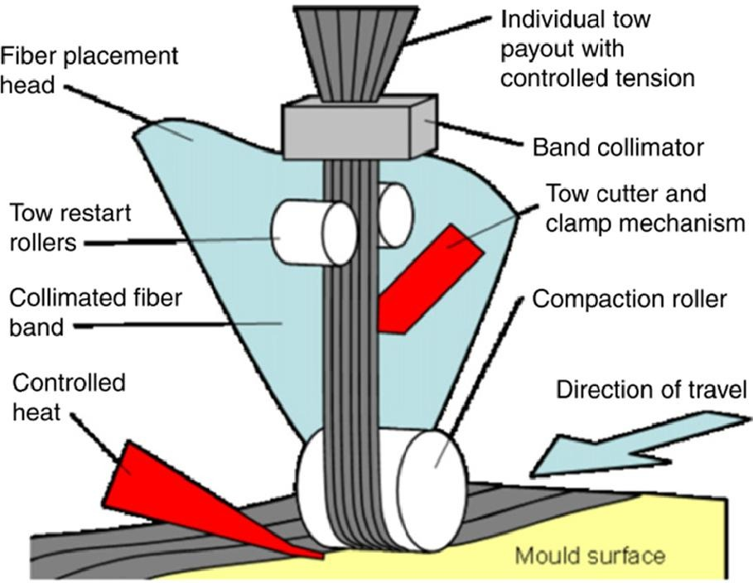
OVERVIEW
Goal
Simulate a robot arm performing Automated Fiber Placement
A crucial step is the compaction of layers - often using a roller
  Makes fibers flush against the mold
  Improves mechanical performance
  Eliminates air bubbles (may cause premature failure)
This rolling action can be automated but the unpredictable shape of the mold can result in unconventional trajectories
Generate various trajectories representing the different fiber directions
Model the force interaction between the end effector and the environment and demonstrate impedance control
Fig 4: Schematic of AFP roller
4
Notes:
The goal of our project is to simulate a robot arm that performs Automated Fiber Placement. A crucial step of AFP is compacting the layers. This involves using a roller to press down the layers, ensuring the fibers are flush against the mold and improving mechanical performance
The rolling action is automated. However, the mold’s curved shape often requires the robot to follow unconventional trajectories. To handle this, we generate various trajectories that represent different fiber directions. This allows us to adapt the robot's path to the mold’s contours effectively.
Additionally, we modeled the force interactions between the robot’s end effector and its environment. This is critical for demonstrating the impedance controller, which ensures that the correct amount of force is applied consistently, regardless of the mold’s complexity or the trajectory changes.

Slide 6
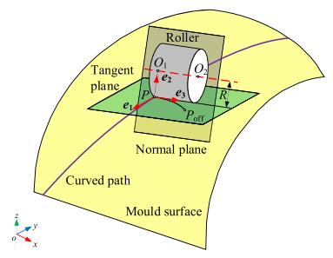
METHODS
Trajectory Generation
Constraints
Roller pressure must remain normal to surface
Rolling direction must be tangent to path
Roller path must cover entire mold surface
Fig 5: Roller position and orientation relative to defined trajectory and mold surface [2]
Rishi K. Malhan, Aniruddha V. Shembekar, Ariyan M. Kabir, Prahar M. Bhatt, Brual Shah, Scott Zanio, Steven Nutt, Satyandra K. Gupta, Automated planning for robotic layup of composite prepreg, Robotics and Computer-Integrated Manufacturing, Volume 67, 2021, 102020, ISSN 0736-5845, https://doi.org/10.1016/j.rcim.2020.102020.
5

Slide 7
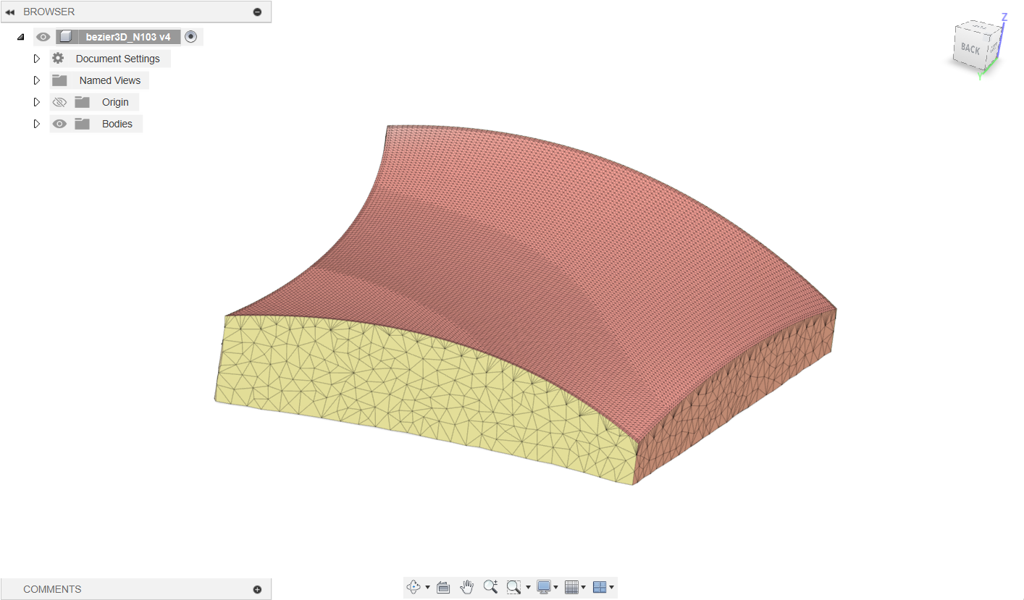
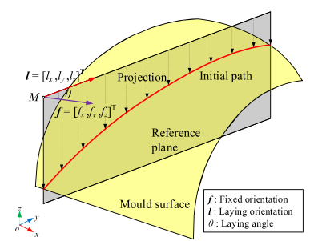
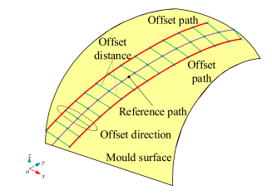
METHODS
Trajectory Generation
Preliminary Modeling [2]
Mold surface modeled as Bezier surface
  To simplify initial control design, started with flat mold
  Mold surface points converted to mesh using ball-pivoting method for Drake hydroelastic force model
Initial path generated using surface-plane intersection
  Reference plane aligned with desired laying orientation
Offset paths also generated using surface-plane intersection
  Reference planes are offset from initial reference plane along normal by maximum allowable distance
Rishi K. Malhan, Aniruddha V. Shembekar, Ariyan M. Kabir, Prahar M. Bhatt, Brual Shah, Scott Zanio, Steven Nutt, Satyandra K. Gupta, Automated planning for robotic layup of composite prepreg, Robotics and Computer-Integrated Manufacturing, Volume 67, 2021, 102020, ISSN 0736-5845, https://doi.org/10.1016/j.rcim.2020.102020.
Fig 6: Roller position and orientation relative to defined trajectory and mold surface [2]
6
Notes:
talk about creating mesh from pointcloud using ball-pivoting method
calculated normals and converted to vtk for drake hydroelastic force sensing models
created meshes for planar mold as well for preliminary testing

Slide 8
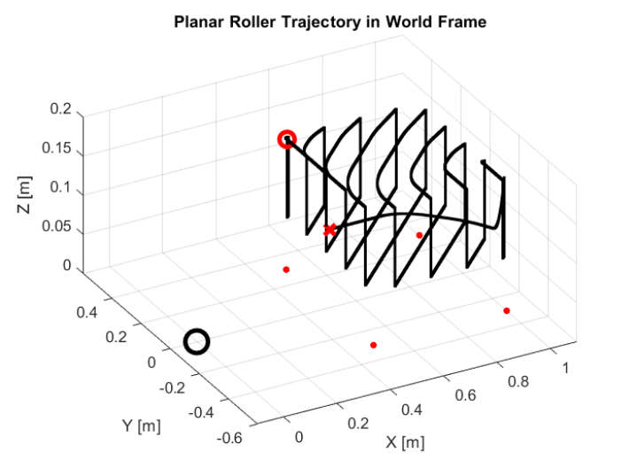
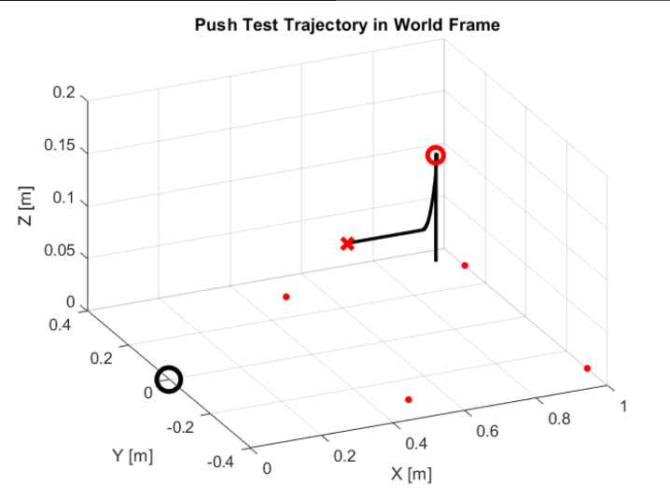
Methods
Trajectory
Fig 7: Trajectory of Planar Case
Fig 8: Trajectory of Push Test
7
Notes:
Generated paths consist only of points for each pass on mold surface; additional waypoints added to transition between passes
Full trajectories generated with trapezoidal velocity profiles using maximum allowable rolling velocity and free space translational velocity
Controller testing plan with simplified test cases using planar mold:
Vertical push test against planar mold
Single pass on planar surface (not shown)
Planar mold with full trajectory

Slide 9
CONTROLLER DESIGN
Objectives
Since the manipulator must not inflict any more defects on the pieces, the force applied by the end effector must be controlled
The manipulator must be able follow along the curvature of the mold
Smooth and controlled motion
Assumptions
Force acting on the end effector are NOT negligible
  Ensuring that there are no defects into the final product
The geometry of the mold is already known
Perfect force and orientation feedback
For the planar case:
  Desired end effector orientation and angular velocities are constant, with angular velocities set to zero
Controller Evaluations
The controller will be evaluated on how well the arm follows the trajectory. This error bound is currently set to 2.5 offset millimeters in the constrained directions.
The controller should have a non-zero force value when the end effector is interacting with the mold as well perform. The end effector should also exert a constant force
8
Notes:
For this controller to be successful, we need to first ensure that the roller can’t inflict any defect on the mold. So the force at the end effector must be monitored and controlled. We also want the roller to be able to traverse different trajectory
These objectives feed into our assumptions to simplify the problems as much as possible

Slide 10
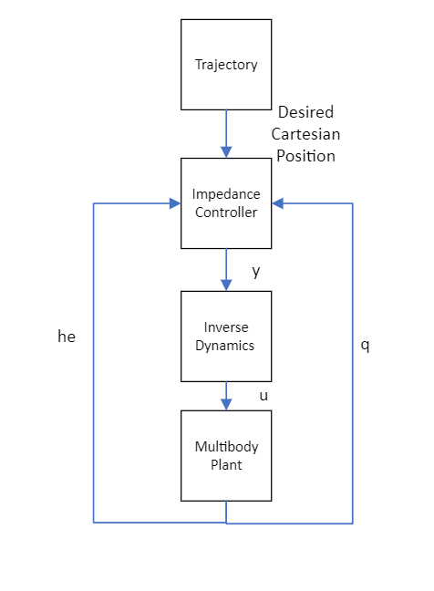
CONTROLLER DESIGN
Impedance Controller
Our controller choice was an impedance controller with the assumption of a wrist sensors as well as orientation feedback
  This allowed the output of the impedance controller to be directly equal to desired angular acceleration
  The inverse dynamics was computed by the in built inverse dynamics module in PyDrake
With these assumptions, we get the following equation for the desired acceleration
9
Fig 9: Impedance Controller High Level Design
Notes:
We decided to use an impedance controller in the operational task space since we’re trying to follow a trajectory while controlling force. We made the assumption that we would have a wrist sensor with orientation feedback, which allows output of the controller be equal to the desired acceleration. Following this, we calculated the inverse dynamics using Drake which generated. the desired torques. In the end, we are tuning the the Kp, Kd and Md gains

Slide 11
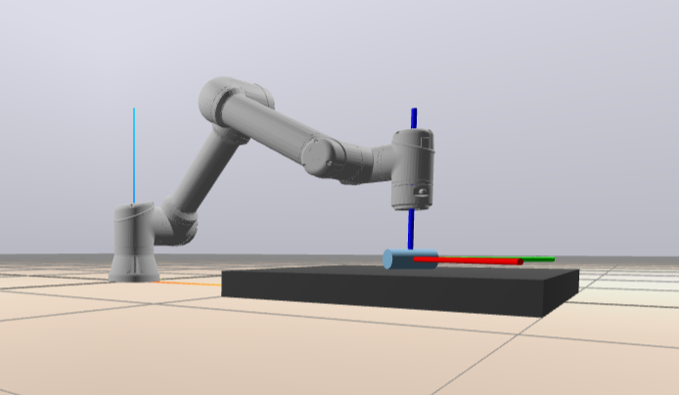
METHODS
Simulation Set Up
The Controller:
Implemented in Pydrake using the Diagram Builder,Leaf System, and Contact Model
The Robot:
UR5e robot arm URDF from Github database [3]
The Environment:
The roller is assumed to be rigid and the mold is assumed to be compliant in the hydrostatic force model
The robot is fixed to the world frame
The mold can be moved relative to the world frame
Force feedback is received from a Contact Model baked into the Drake model
Fig 10: Environment Set Up with the UR5E and Robot Arm
10
Daniella1/urdf_files_dataset. (n.d.). GitHub. https://github.com/Daniella1/urdf_files_dataset
Notes:
The simulation was done in python with Pydrake. The robot arm URDF was taken off from a database. The mold was generated separately and ported into a SDF file which was then added into the plant. The whole idea here is to utilize drake’s multibody plant function to build the environment. The environment was built off the following assumption. The roller is assumed to be rrigid while the mold is assumed to compliant in the hydrostatic force model. We also utilized drakes’s in built contact model to simulate the force sensing

Slide 12
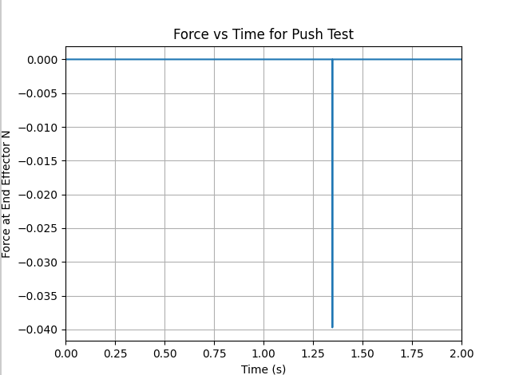
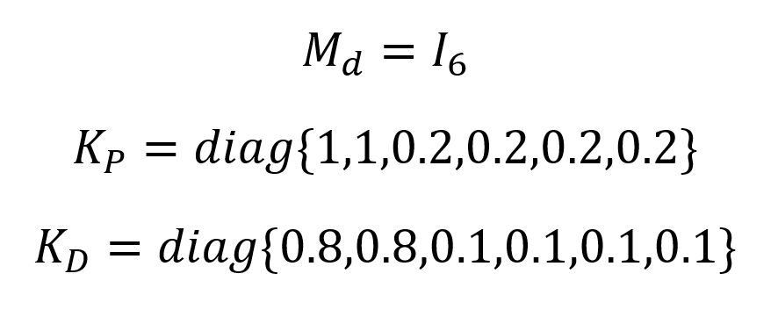
RESULTS
Push Test
Unfortunately, we’ve been having difficulties with the controller implementation using Drake.
We were successful in completing a push test with the following gains
Video
Fig 11: Force Readings from the Roller End Effector for the push test
11
Notes:
Demo: jerkiness in path is due to untuned gains, high v_freespace in trajectory design compared to v_roll, roller speed

Slide 13
DISCUSSION
Discussion
The push test shows that we are able to get some force readings of the end effector
However, the learning curve with PyDrake pushed us back so we have yet to get around to the planar case.
Future Works
We still have to play around with the controller gains and tune for the planar case
If time allows, see how the controller works with a curved surface
  Will need to modify the controller to account for change in DESIRED orientation
12

Slide 14
Thank you!
Notes:
Rebecca

