Slide 1

Autonomous Disk Stacking Robot
“Scoop N’ Do”
MAE 162E, UCLA Spring 2024
John Lee, Justin Lee, Jacob Sayono, Matthew Tamin, Matthew Hutchinson
Notes:
Good to go

Slide 2
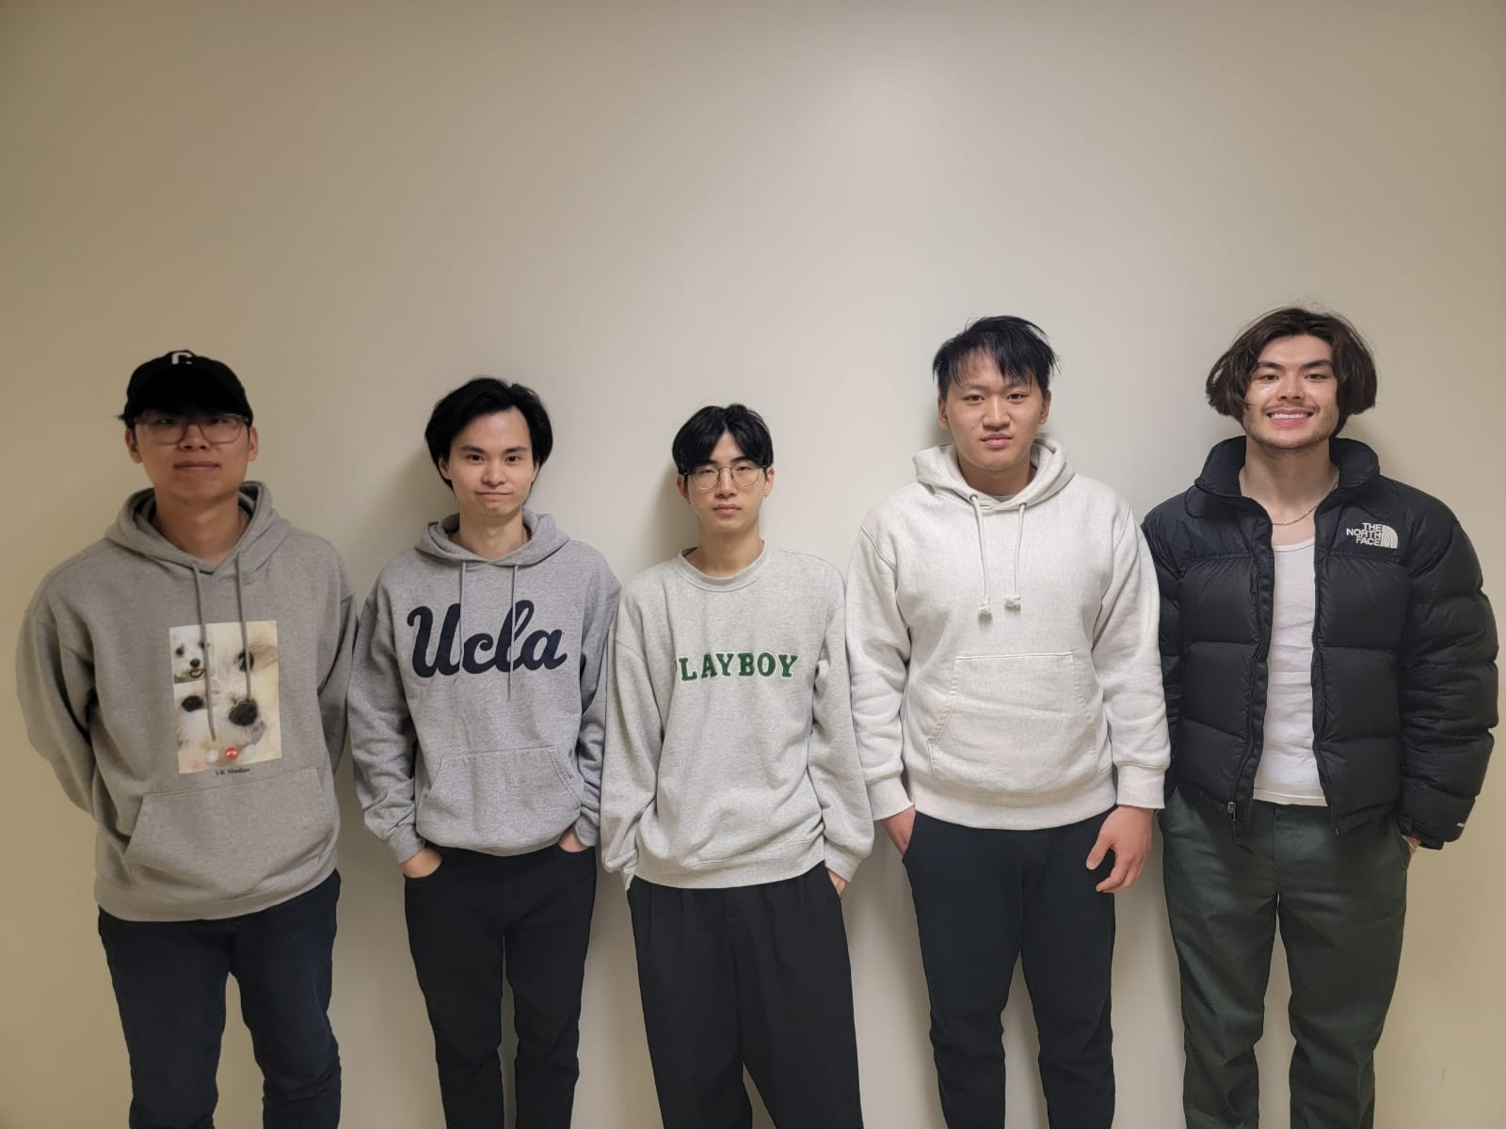
Meet the Team
Group 10 (pictured left to right): John Lee, Jacob Sayono, Justin Lee, Matthew Tamin, Matthew Hutchinson
Notes:
Good to go

Slide 3
High Level Design Requirements
High Priority:
Fit within 30x25x20 cm volume
Functions after a 6” drop
Medium Priority:
Autonomous navigation to specific stations
Picks up and drops off disks on elevated platforms
Drops off disks in specified order
Low Priority:
Marketable and aesthetically pleasing design

Slide 4
Low Level Design Requirements
High Priority:
Minimal DOFs and motors
Lowest possible center of mass
Medium Priority:
Length and width close to dimension limits for stability
Fit into volume with 5 mm tolerances
Low Priority:
Task completion within five minutes
Modular design for easy part exchange and repair

Slide 5
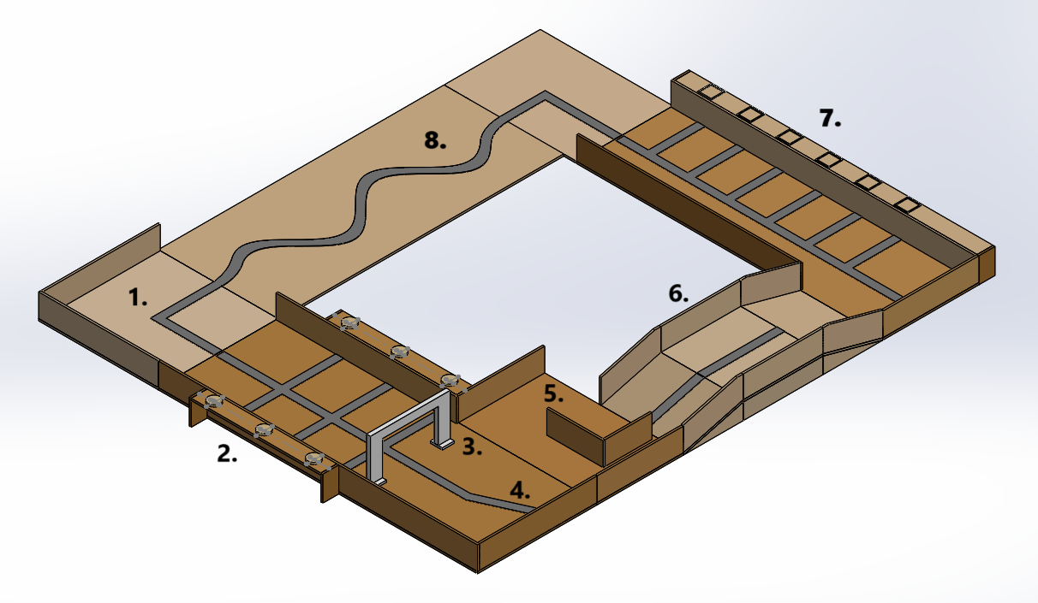
The Testing Venue
Starting Position
Disk Pickup
Sizing Gate
45 Degree Turn
Obstacle
Ramp
Disk Drop Off
Curved Path
Notes:
Good to go

Slide 6
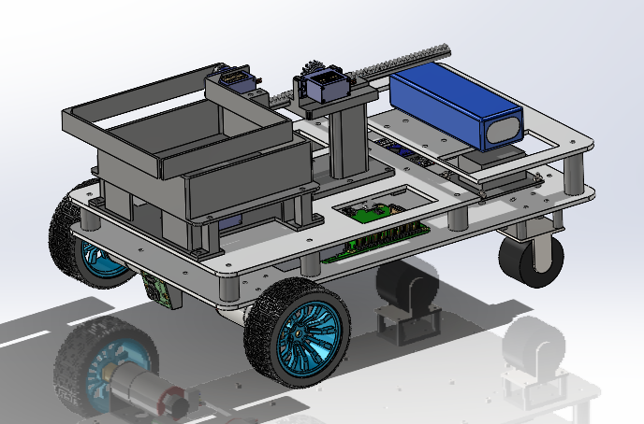
Design
Divides into 3 major parts:
Chassis
Arm (Rack and Pinion)
Basket-Lift
Chassis contains drive and electronics
Arm designed for loading and unloading disks
Basket-lift carries disks and elevates them for unloading
Notes:
Wheels too?

Slide 7
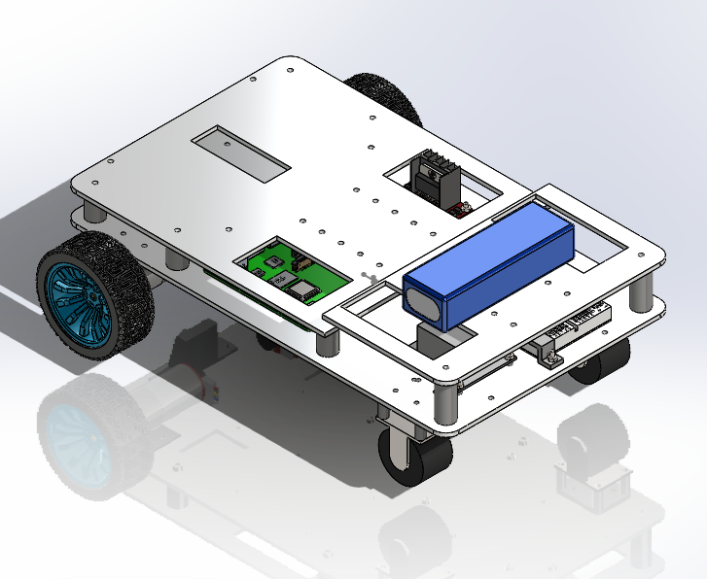
Main Chassis
Key Points:
Stacked layers of 3mm-thick acrylic held apart by 3D printed standoffs
Front-wheel drive design with two 12V motors and 65mm wheels
1 inch swivel caster wheels used for the rear two wheels to allow for easier turning with FWD
Notes:
Good to go

Slide 8
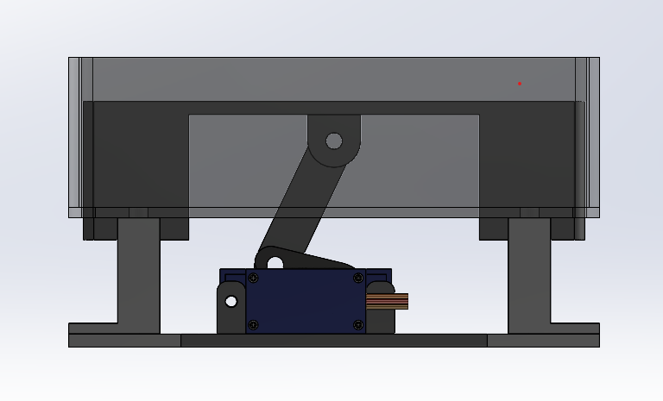
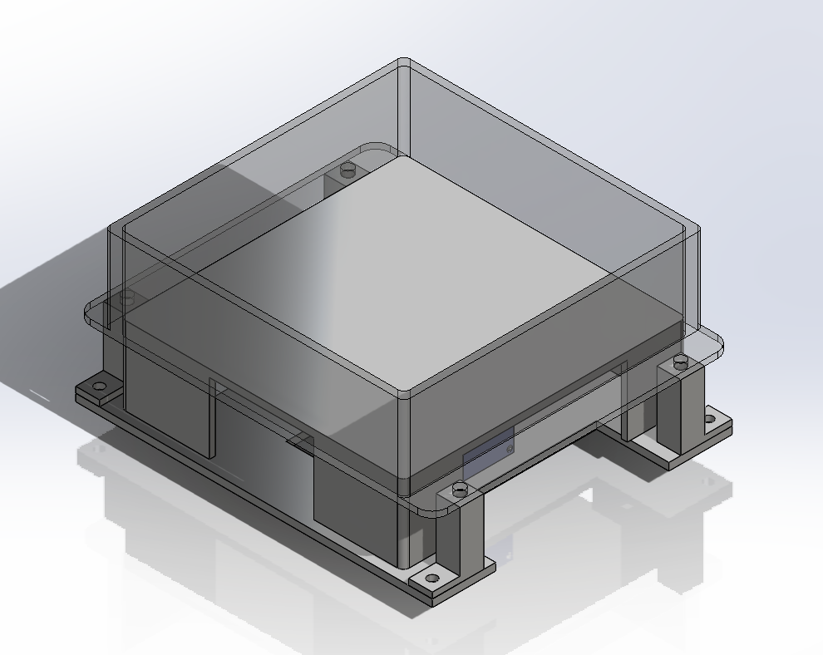
Basket-lift
Key Points:
Utilizes a crank and slider mechanism
Achieves a 1-inch lift
Predominantly 3D printed using PLA
Cost-effective but time-consuming due to print duration
Positional servo motor (SG90) rotates crank
0 degrees for platform down, 180 degrees for platform up

Slide 9
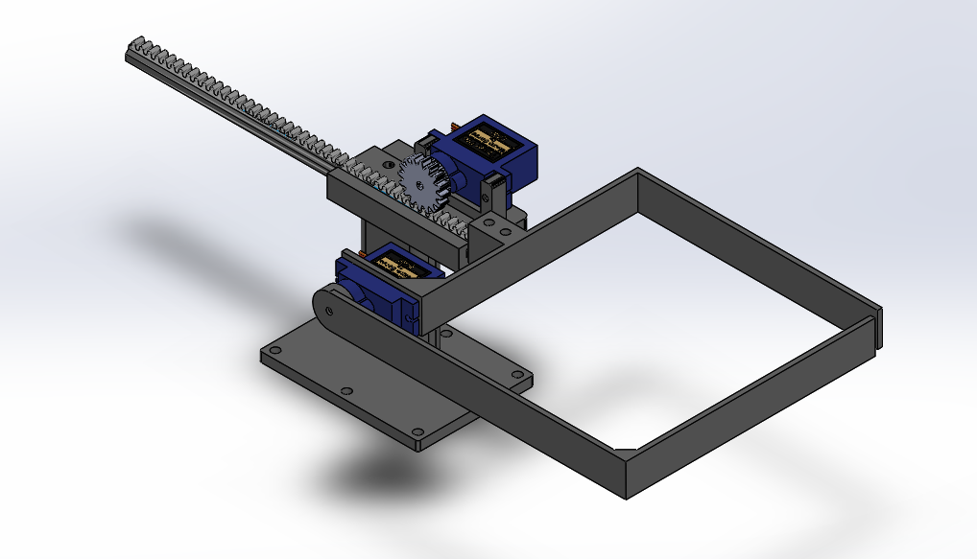
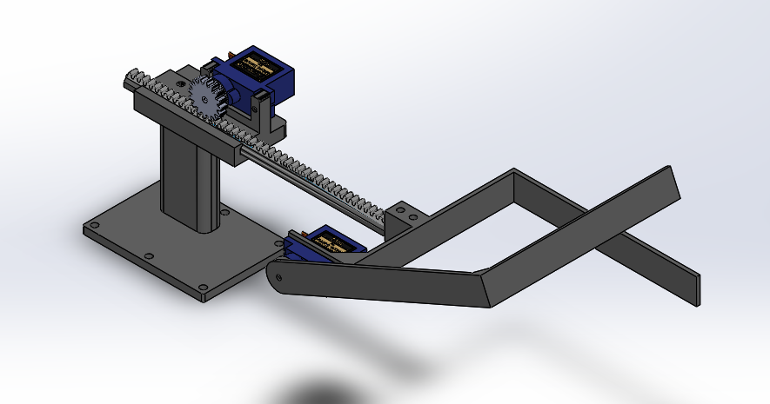
Arm (Rack and Pinion)
Key Points:
Also almost entirely 3D printed using PLA
Cost-efficient, but not very time efficient due to multiple reprints
Positional servo motor (SG90) for rotation of scooper opening
Continuous servo motor (FS90R) for translational motion of the scooper
Notes:
Good to go, maybe talk about range of motion?

Slide 10
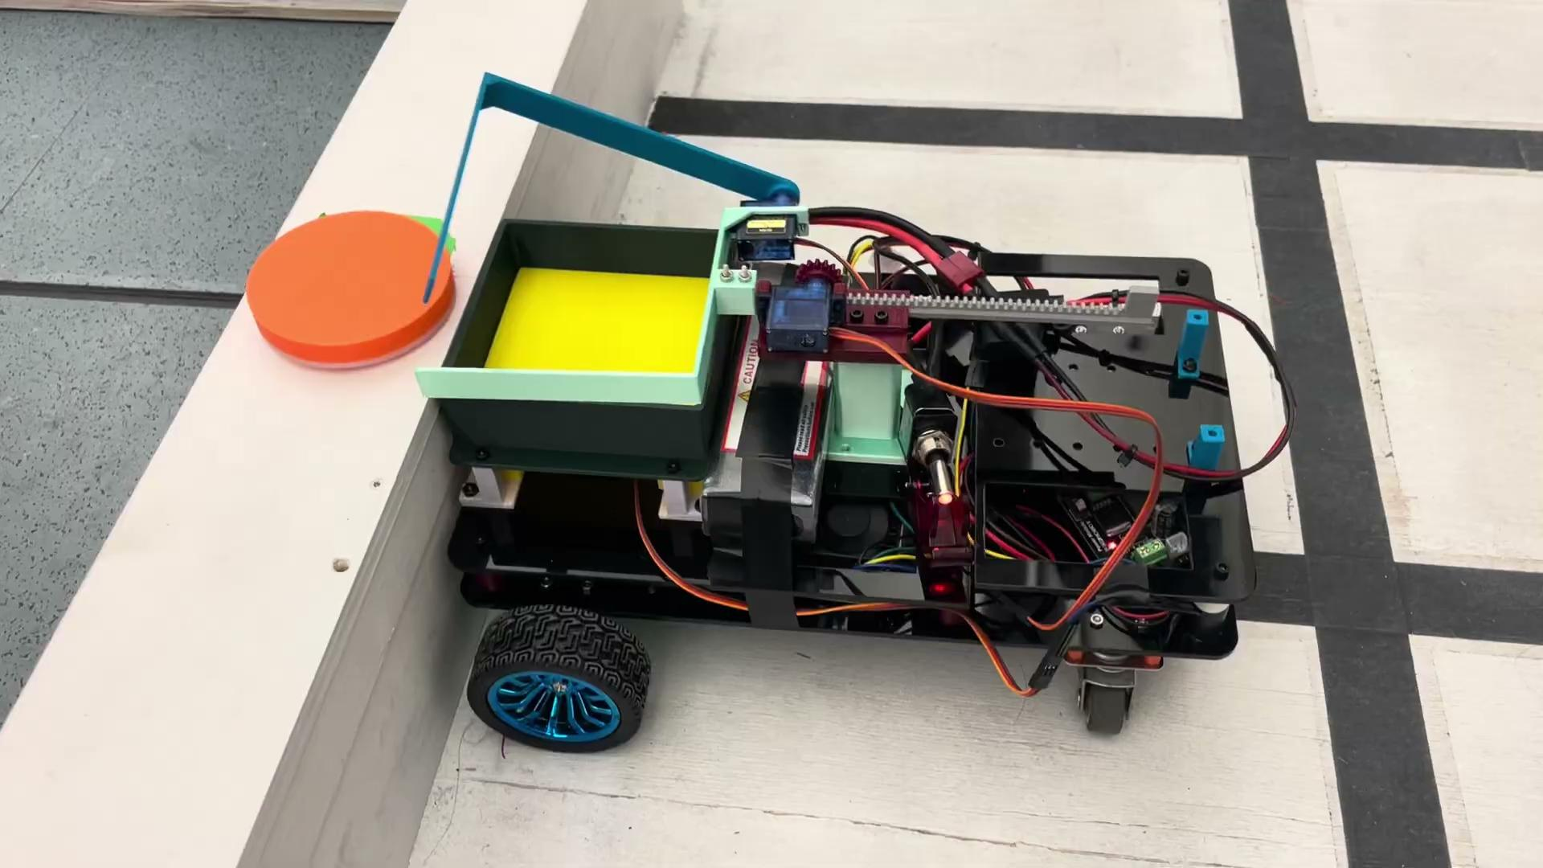
Pick Up Process
Notes:
Good to go

Slide 11
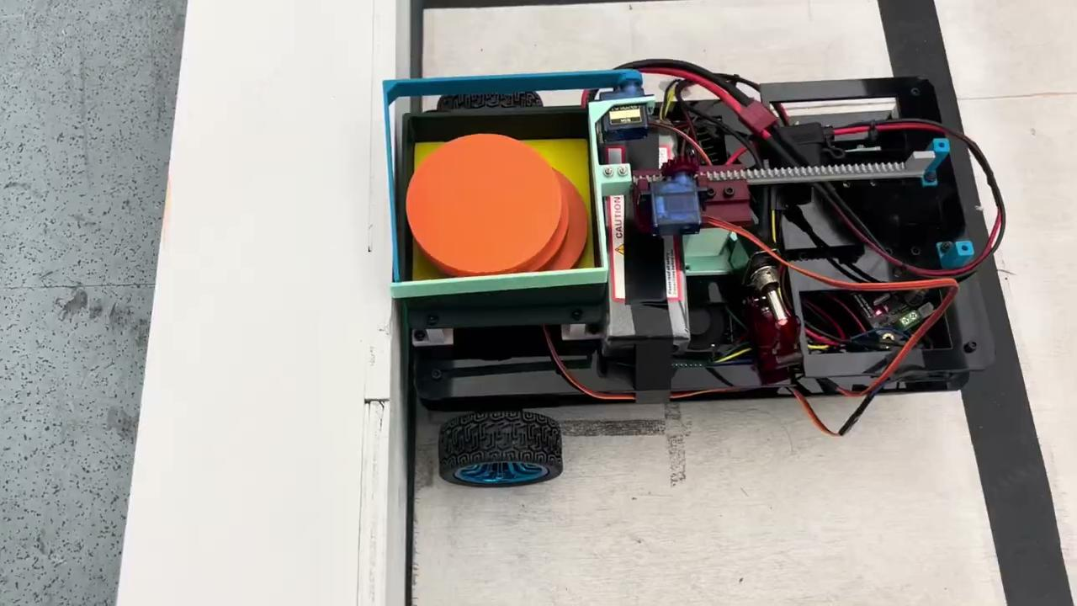
Drop Off Process
Notes:
Good to go

Slide 12
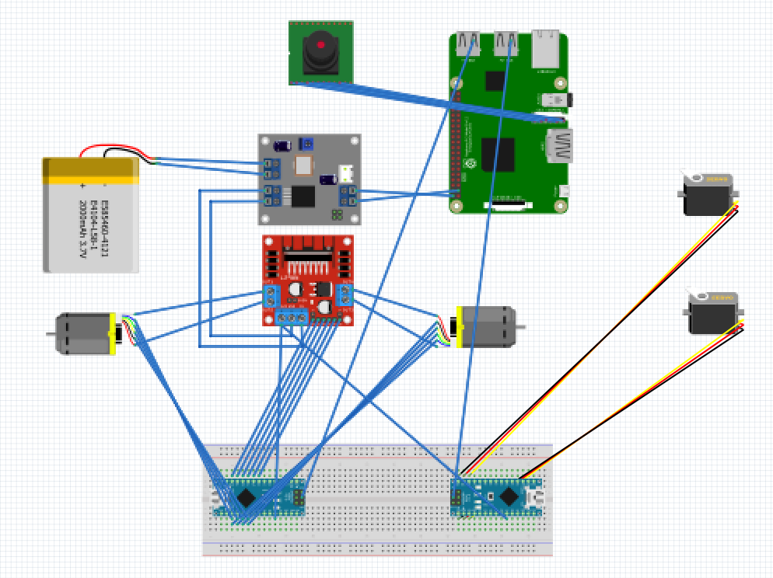
Electronics
12V rechargeable battery
Buck Converter: Splits 12V and 5V for respective components
L298N motor driver
12V DC motors with encoders
5V 90g positional & continuous servos
Arduino Nano (low-level control)
Raspberry Pi (high-level compute)
Pi camera

Slide 13
Controls / Sensors
Motor controls (ROS & Arduino)
Motors run at about 1975 encoder counts per revolution
Controller runs PID loop 30 times per second (30 Hz)
We send a PWM signal value of 70 (from 0 to 255) to run the motor at exactly 1 rev/sec
Motor encoder PID is set to:
Kp = 20, Kd = 12, Ki = 0, Ko = 50 (scaling factor)
Camera (OpenCV)
Used as a reference rather than a closed loop control for motor steering angle
Image is segmented into 3 areas (white-black-white) to estimate the x-coordinate of the black pixels (i.e. the black line to follow)
x-coordinate value is extracted and sent to motor commands to fix the error from the center of the image with an adjusted proportional rate of 0.005
Arm Servos
Directly hooked to the Raspberry Pi, where a bash script is run using pigpiod library.
Continuous servo (1x) for extending the arm based on linear time
Positional servos (2x) for opening & lifting arm based on angular position

Slide 14
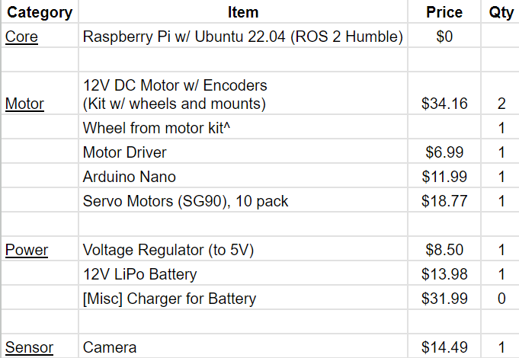
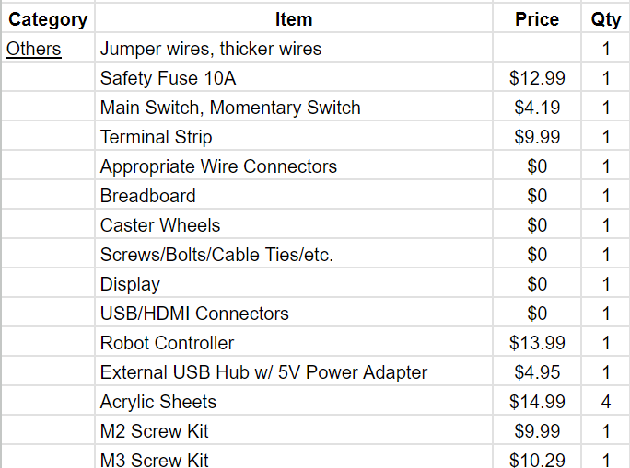
Bill of Materials
Total: $222.25/500

Slide 15
Project Review: Successes and Setbacks
Successes:
Functionalities of designs (lift and arm) worked perfectly
Drive system is smooth and strong enough to go up/down the ramp
Raspberry Pi camera performs object detection and line tracing
Electronics work as intended leading to smooth performances
Setbacks:
Drive system operates too fast for camera to process data efficiently
Causes line tracking to be unreliable at sharp turns
Design relies heavily on consistent platform heights
Variations in platform height disrupts the loading and unloading of disks
Notes:
Good to go

Slide 16
Learning Experiences
Task Division: Improve efficiency in task delegation
Programming Challenges: Raspberry Pi (camera) programming is more complex and time-consuming compared to Arduino
Python has a lot more capabilities, however difficult to debug and code
Time Management: Ensure tasks are completed on schedule (setting deadlines)
Adaptability: Unforeseen issues are common when it comes to manufacturing (3D printing) and design
Communication: Efficient communication within the team to improve collaboration
Notes:
Good to go

Slide 17
Furthering the Project
Dynamic Dimension Adaptability: Modify the platform design to accommodate varying dimensions, ensuring adaptability to different testing venues
Sensor Integration for Robustness: Integrate additional sensors (IR and ultrasonic sensors) to enhance robustness and reliability in case the primary sensors fail
Transition to Off-the-Shelf Components: This transition will improve the design robustness and reliability, reducing the potential for errors and increasing the overall quality of the components, despite the higher costs.
Optimization for Efficiency: Reducing the size and weight for a more efficient design
Notes:
Will finish this asap -john

Slide 18
Thank you!

Slide 20
Header w/editable table (optional slide)
Title | Title | Title
Title | 00% | 00%
Title | 00% | 00%
Title | 00% | 00%
Title | 00% | 00%
Title | 00% | 00%
Title | 00% | 00%
Title | 00% | 00%
Title | 00% | 00%

