Slide 1
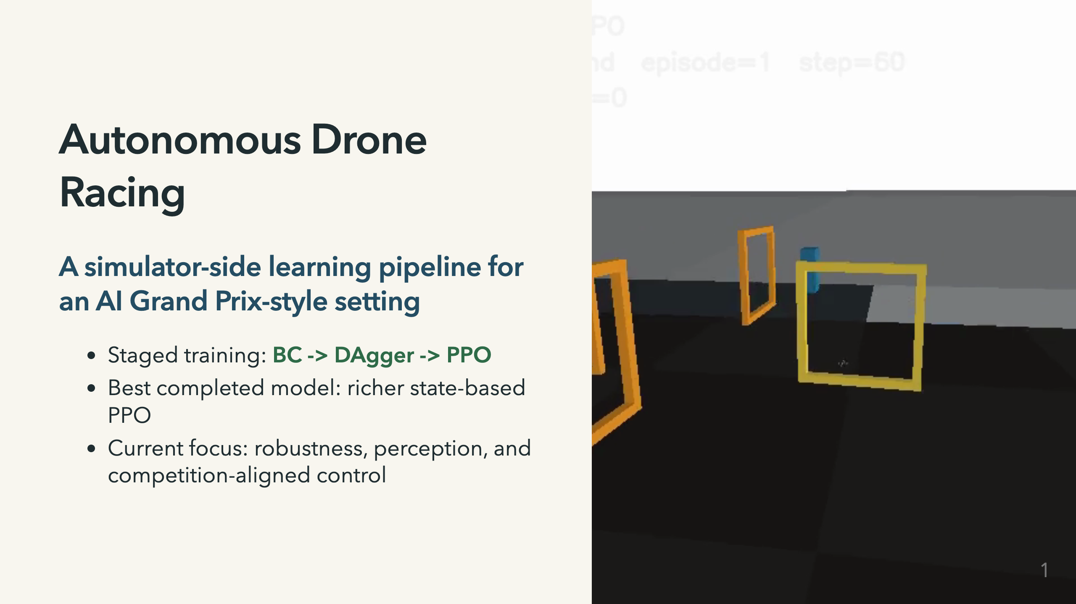
Notes:
Speaker notes: I built this as an autonomous drone racing project motivated by the AI Grand Prix / Anduril competition setting. The important constraint is that this is not a hand-flown drone: the system needs to perceive a course, plan through gates, and send control commands. For this short talk, I am going to focus on three things: how I got stable flight, what actually improved the learned policy, and what still does not generalize well enough.

Slide 2
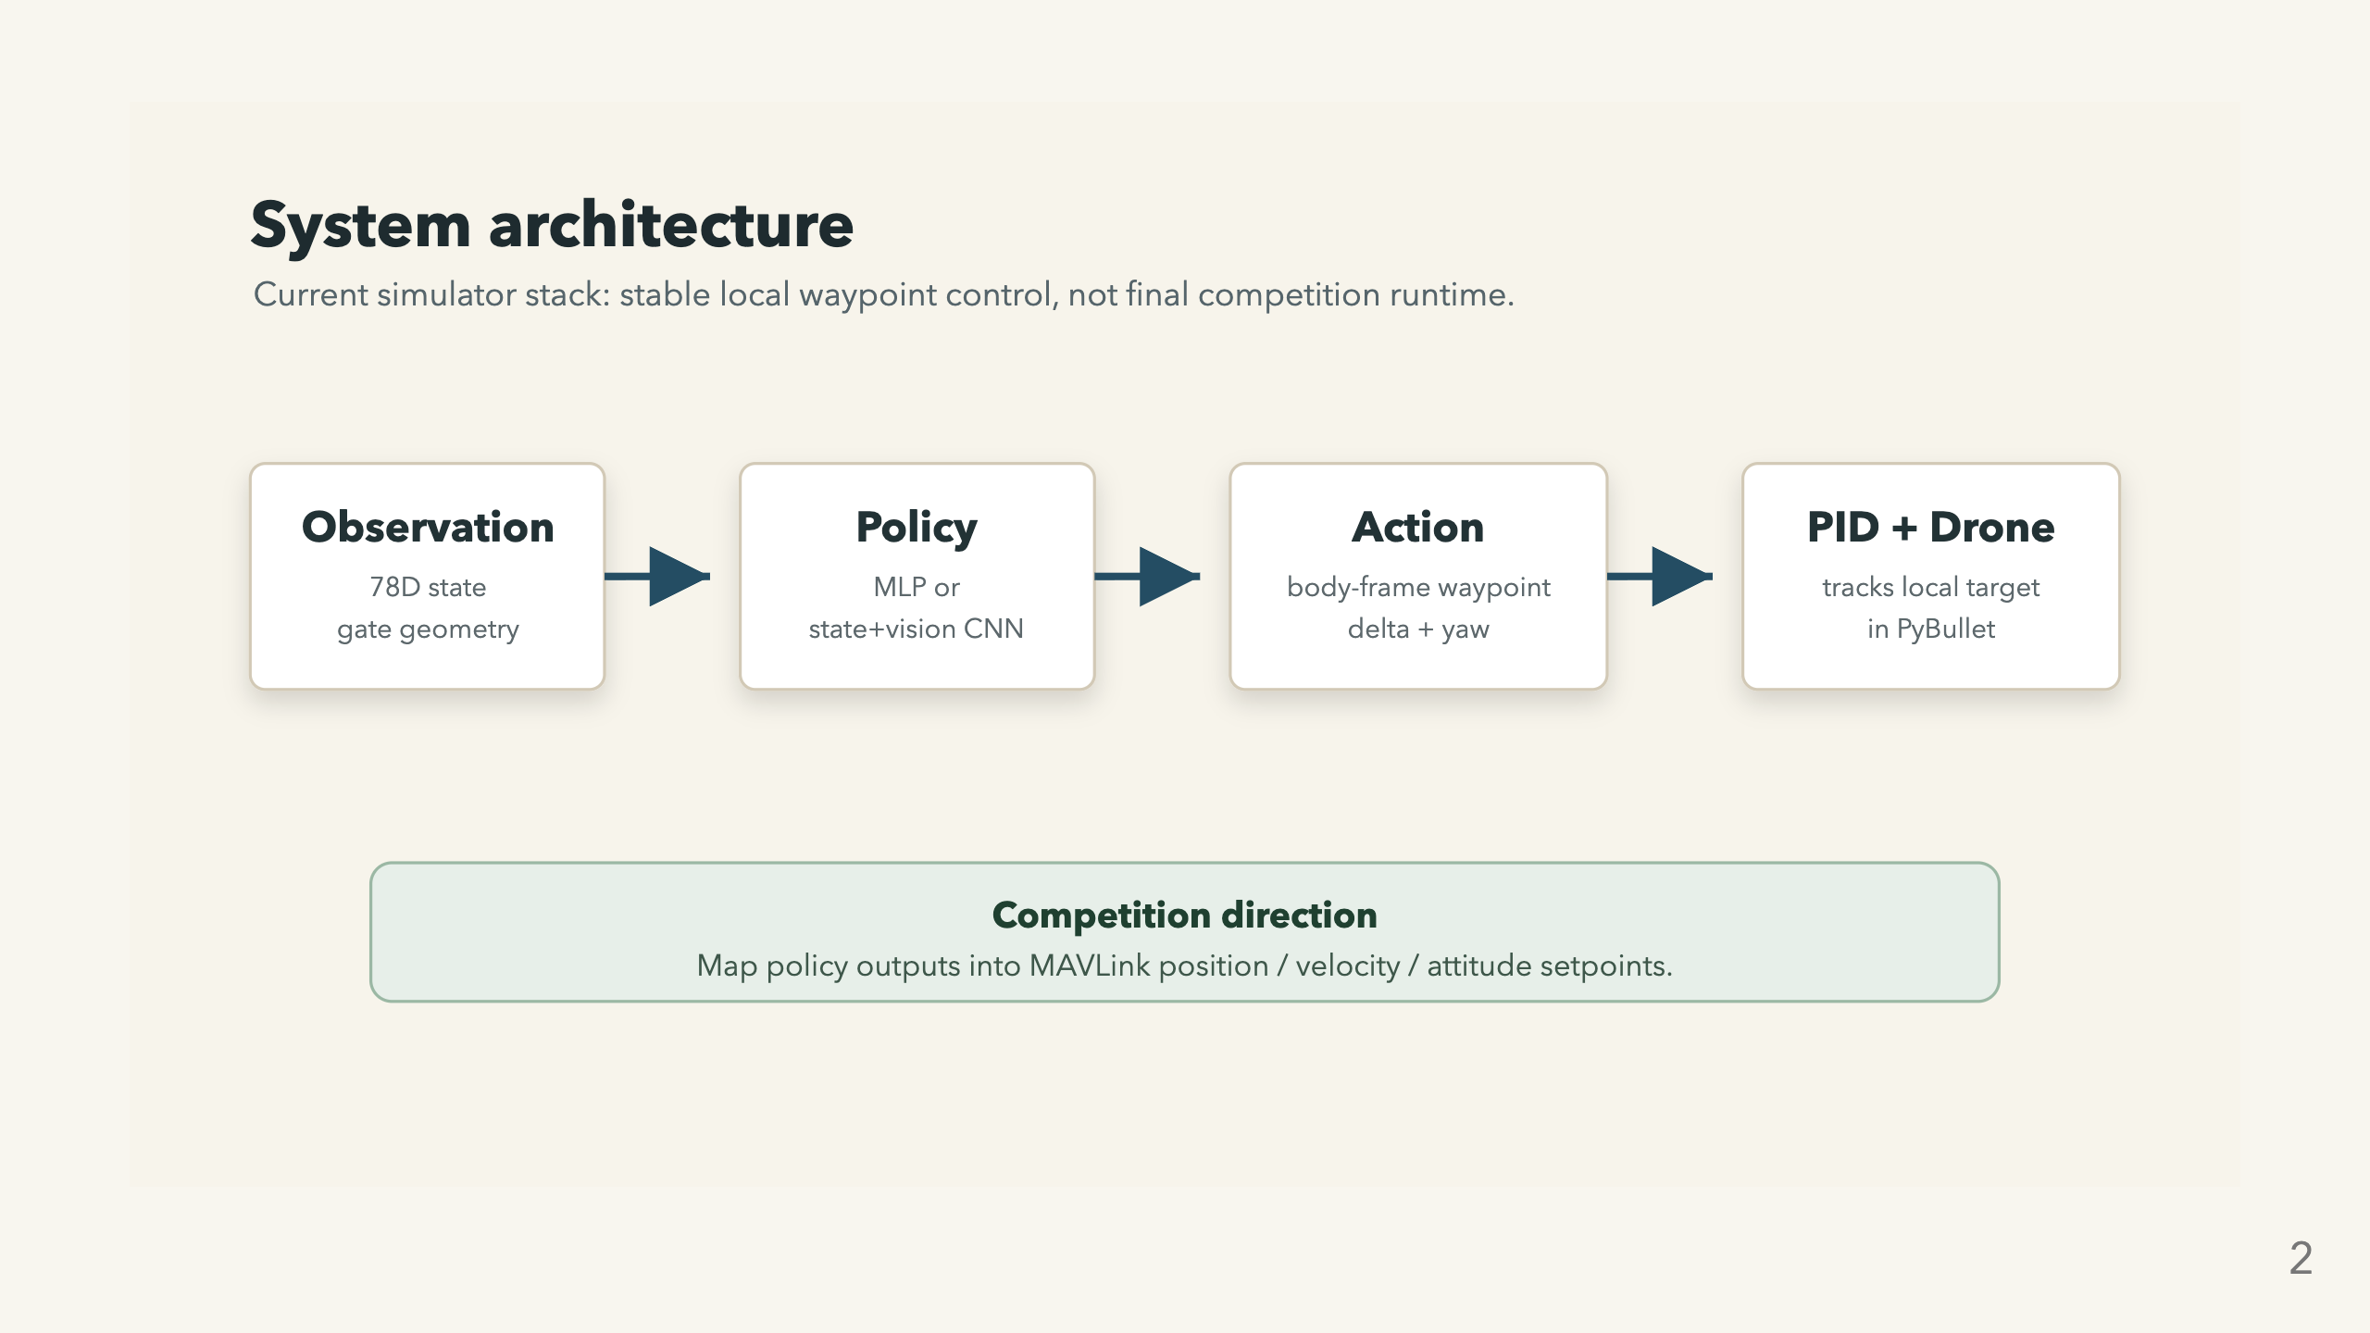
Notes:
Speaker notes: The system starts in simulation. I use gym-pybullet-drones, then add custom race gates, track randomization, richer observations, onboard camera rendering, and evaluation scripts. The current best policy is state-based. It does not output raw motor thrusts. It outputs a local body-frame waypoint delta and yaw delta, and a low-level PID controller tracks that target. That abstraction made learning stable, but it is not the final competition command interface.

Slide 3
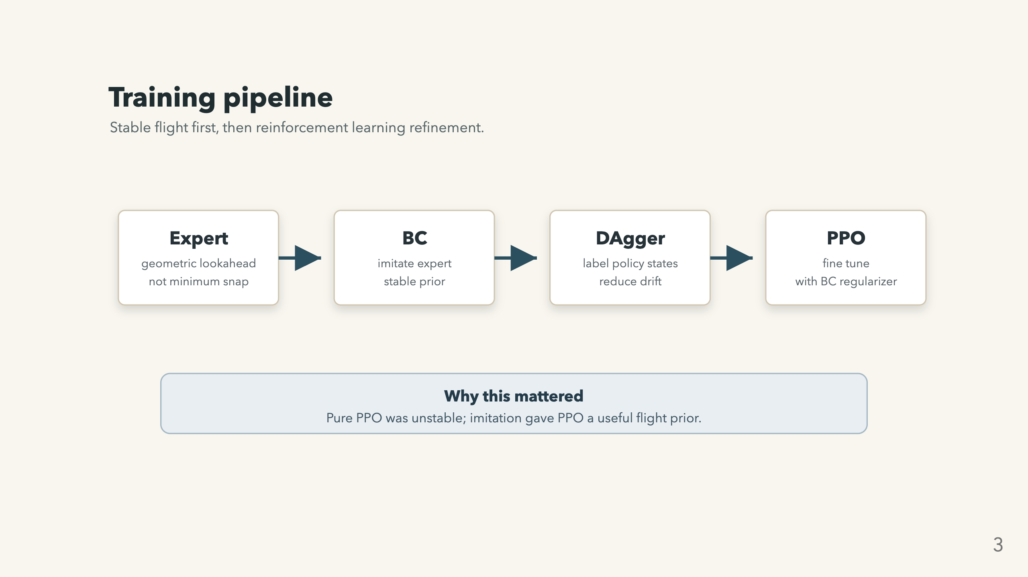
Notes:
Speaker notes: Pure PPO was brittle early on, so I used a staged pipeline. First, I collect expert demonstrations and train behavioral cloning. Then DAgger lets the learned policy visit its own states and asks the expert what it should have done there. Finally, PPO fine-tunes from that warmer start while keeping a BC regularizer so it does not immediately forget how to fly. One clarification: the current expert is not minimum snap. It is a geometric lookahead controller that aims through and beyond gates using future gate direction and gate normals.

Slide 4
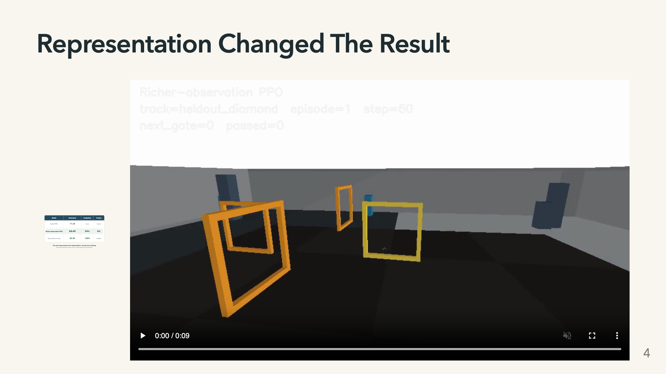

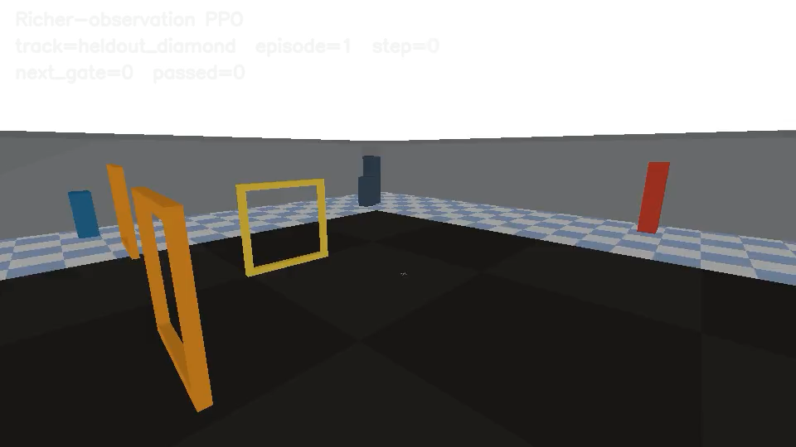
Notes:
Speaker notes: The biggest gain was not just training longer. It was giving the policy better geometry. The stronger observation space adds three-gate lookahead, gate normals, and relative heading to the gate plane. With that representation, the best PPO checkpoint reached 99 percent completion, 0 percent crashes, and 82.49 mean return on the harder held-out suite. On the easier held-out suite, it reached 100 percent completion and 82.95 mean return. This is the main positive result of the project.

Slide 5
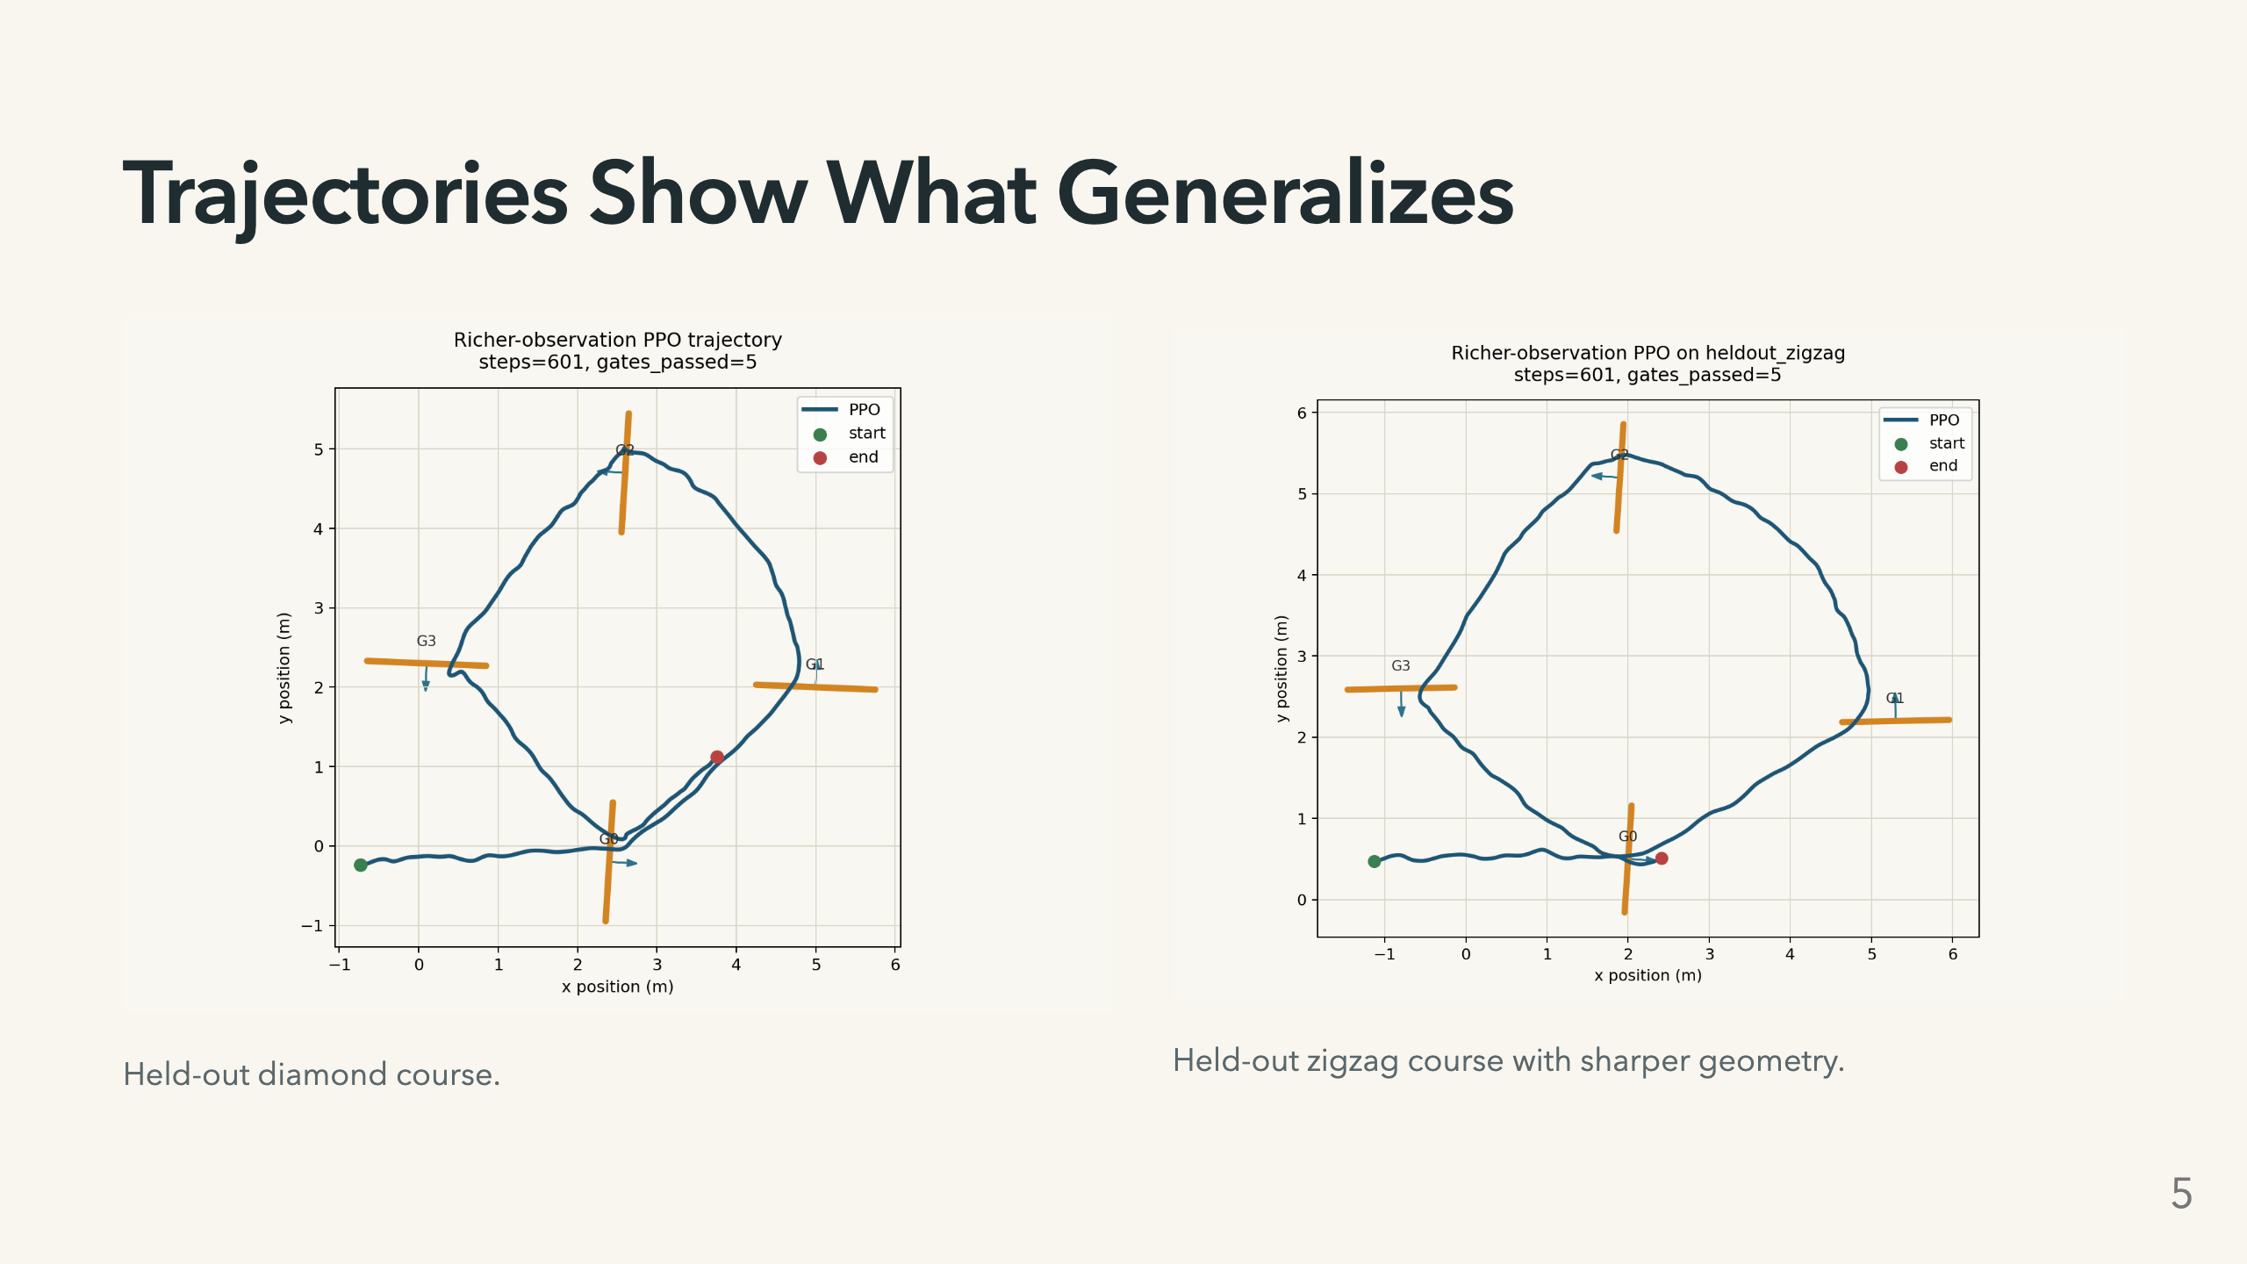
Notes:
Speaker notes: I also wanted the presentation to show more than one happy-path course. The left plot is the current state champion on the held-out diamond, while the right plot is a different held-out zigzag layout. This is useful because a drone racing policy can look good on one four-gate loop and still be brittle. Trajectory plots make the behavior inspectable: where it cuts corners, how smooth the line is, and whether it is actually passing gates rather than just scoring well accidentally.

Slide 6
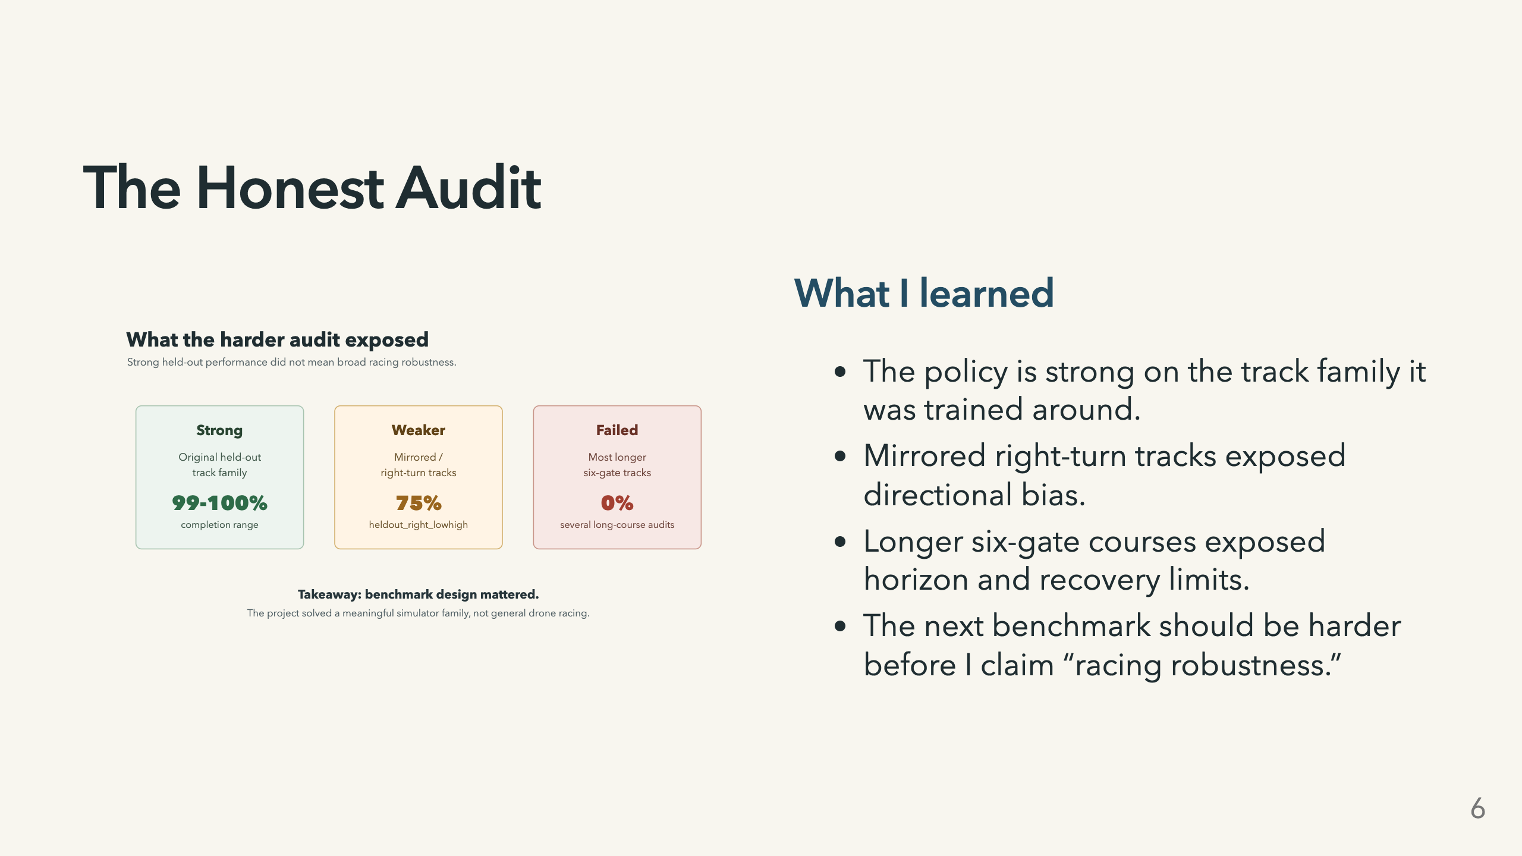
Notes:
Speaker notes: The harder audits are what made the project more honest. The policy looked strong on the original held-out suite, but that did not mean broad racing robustness. Once I added mirrored right-turn tracks and longer six-gate tracks, the state champion became much less reliable. So I would not claim this solves general drone racing. I would claim it solves a meaningful simulator family and gives me a concrete path toward broader robustness.

Slide 7
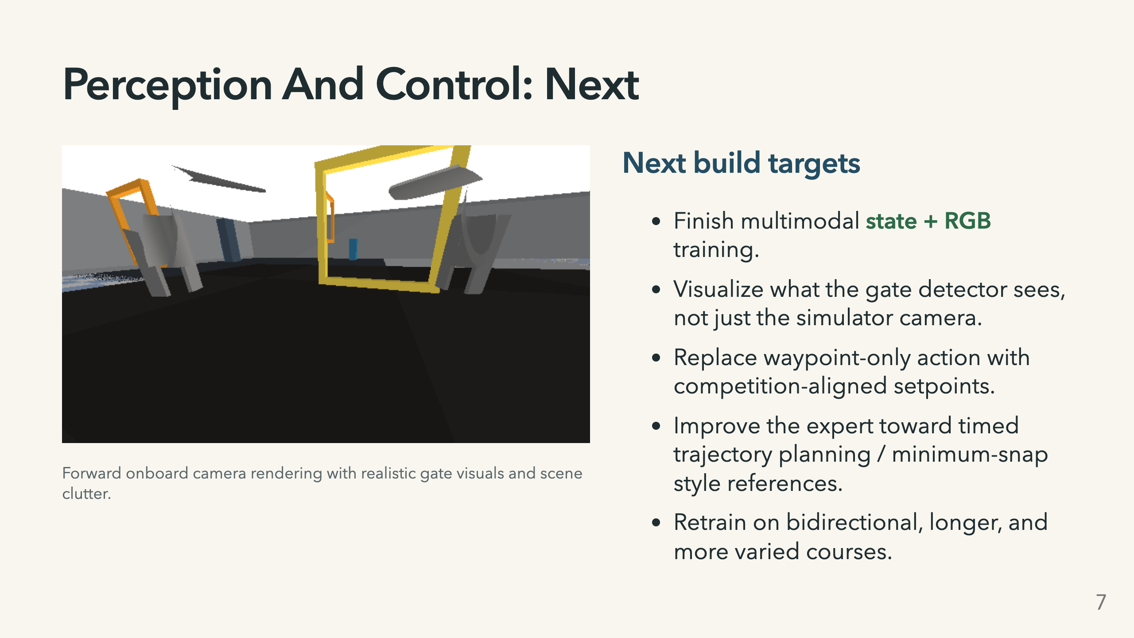
Notes:
Speaker notes: I also built the first perception branch. The simulator can render onboard RGB, randomize visuals, and train a state-plus-vision policy. That branch is implemented, but it is not yet the best completed model. The other big next step is control. The current waypoint target is stable but conservative. A deployment-style version should map into MAVLink-like position, velocity, acceleration, or attitude setpoints. That means the learning target and the expert trajectory need to become more time-aware. My closing takeaway is: staged imitation-to-RL made flight stable, representation design produced the biggest win, and honest evaluation showed exactly what still needs work.

