Slide 1
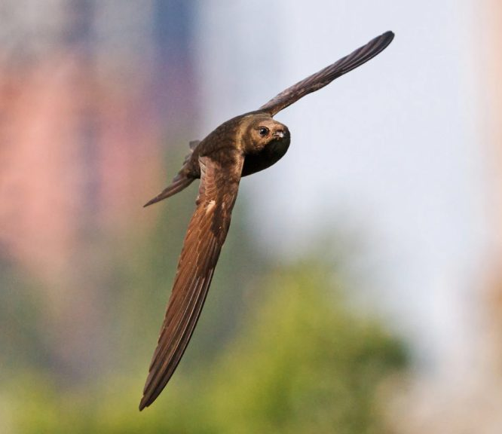
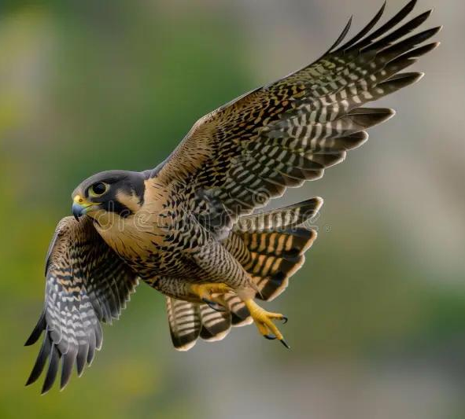
263F Project Proposal
Simulation of Twist-Camber Morphing Wing
Andrew Tran and Matthew Hutchinson
Birds continuously adapt wing shape for efficiency and control.
We aim to simulate flexible, continuous wing morphing inspired by nature.
Notes:
Birds like falcons and swifts can twist and camber their wings mid-flight, giving them incredible agility and efficiency. We’re drawing inspiration from these mechanisms to simulate similar shape morphing in a flexible, continuous wing structure

Slide 2
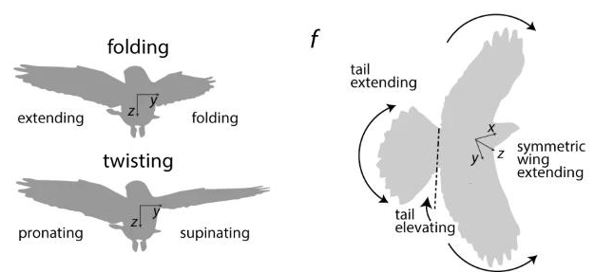
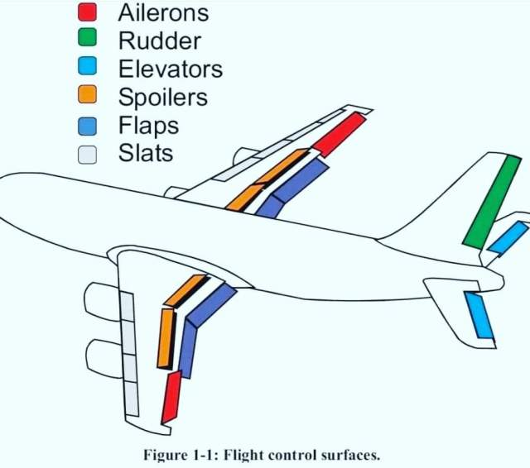
Limitations of Fixed Wings in Conventional Aircraft
Two main strategies for rolling
Turning
Hinged flaps, ailerons, and rudders introduce surface discontinuities
Flow separation during dynamic maneuvers reduces lift efficiency
High actuator count adds weight and complexity
No passive adaptation to gusts or turbulence
Discrete control surfaces = limited spanwise adaptability
Smooth, continuous shape change maintains clean airflow
Twist and camber adjust across entire wing span
Lower mechanical complexity with fewer actuators
Passive compliance enables instant gust rejection
Birds roll, pitch, and yaw via shape alone; no separate control surfaces
Notes:
Conventional aircraft rely on discrete flaps and rudders, which create sharp geometry changes that can cause flow separation and reduce efficiency—especially during dynamic maneuvers. Birds achieve similar control by smoothly twisting and cambering their wings, which reduces drag and enables passive gust rejection.
For rolling, birds often twist one wing side—pronating and supinating—or fold one wing while extending the other. These strategies allow smooth, continuous control without the need for ailerons or rudders.

Slide 3
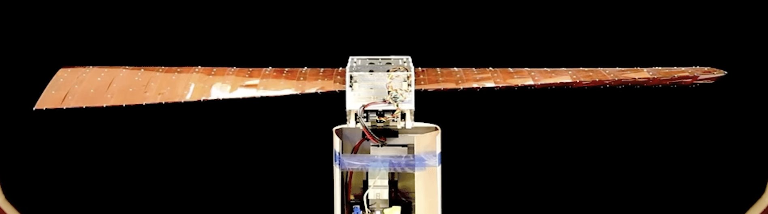
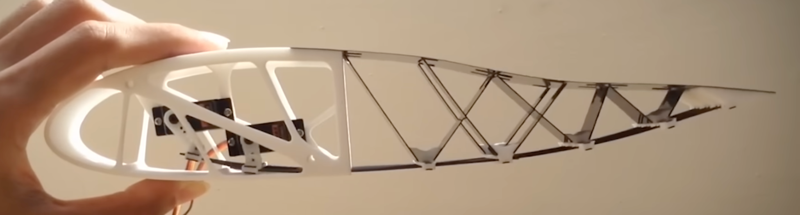
Why Twist and Camber Matter
Twisting morphing
Wing twists along span
Enables roll control and passive gust rejection
Use torsional rod
Camber morphing
Wing curvature changes
Adjust lift coefficient dynamically
Use beam bending
Birds adjust both continuously to stay agile and efficient
Notes:
Camber controls the curvature of the wing and influences lift, while twist lets birds change the angle of attack along the span—essential for roll, stability, and gust adaptation. If we can replicate this in a continuous flexible structure, it could transform how UAVs respond in real-time flight

Slide 4
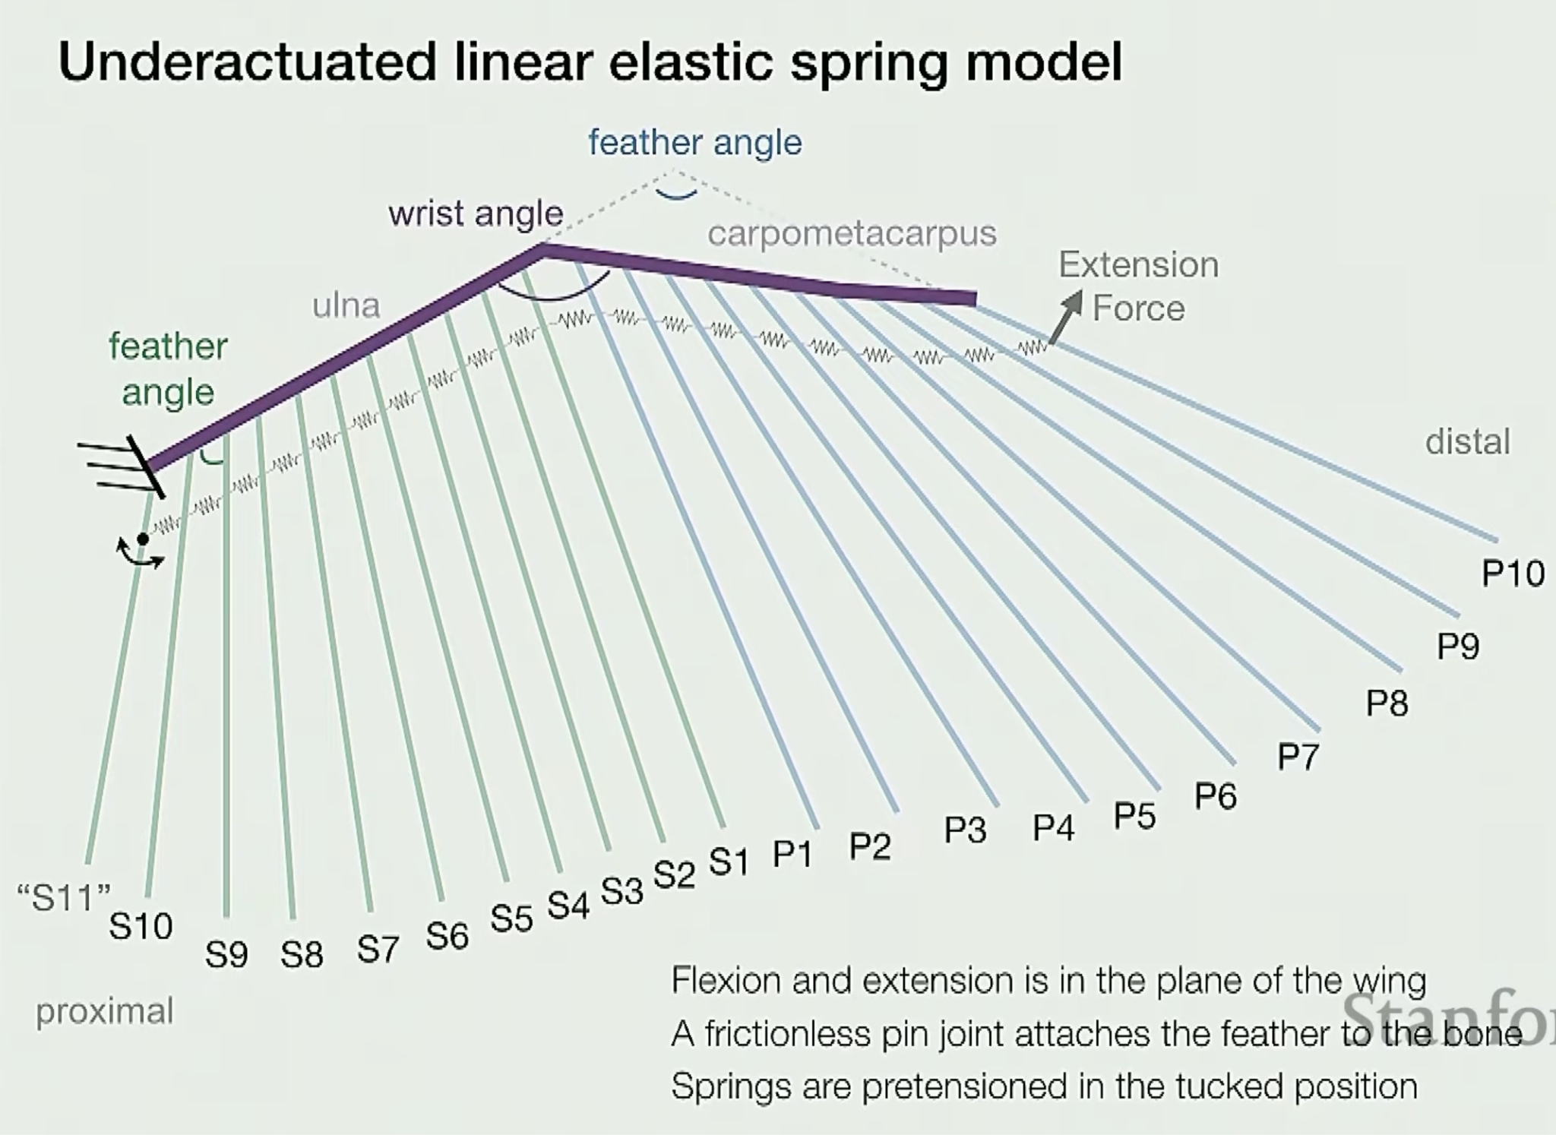
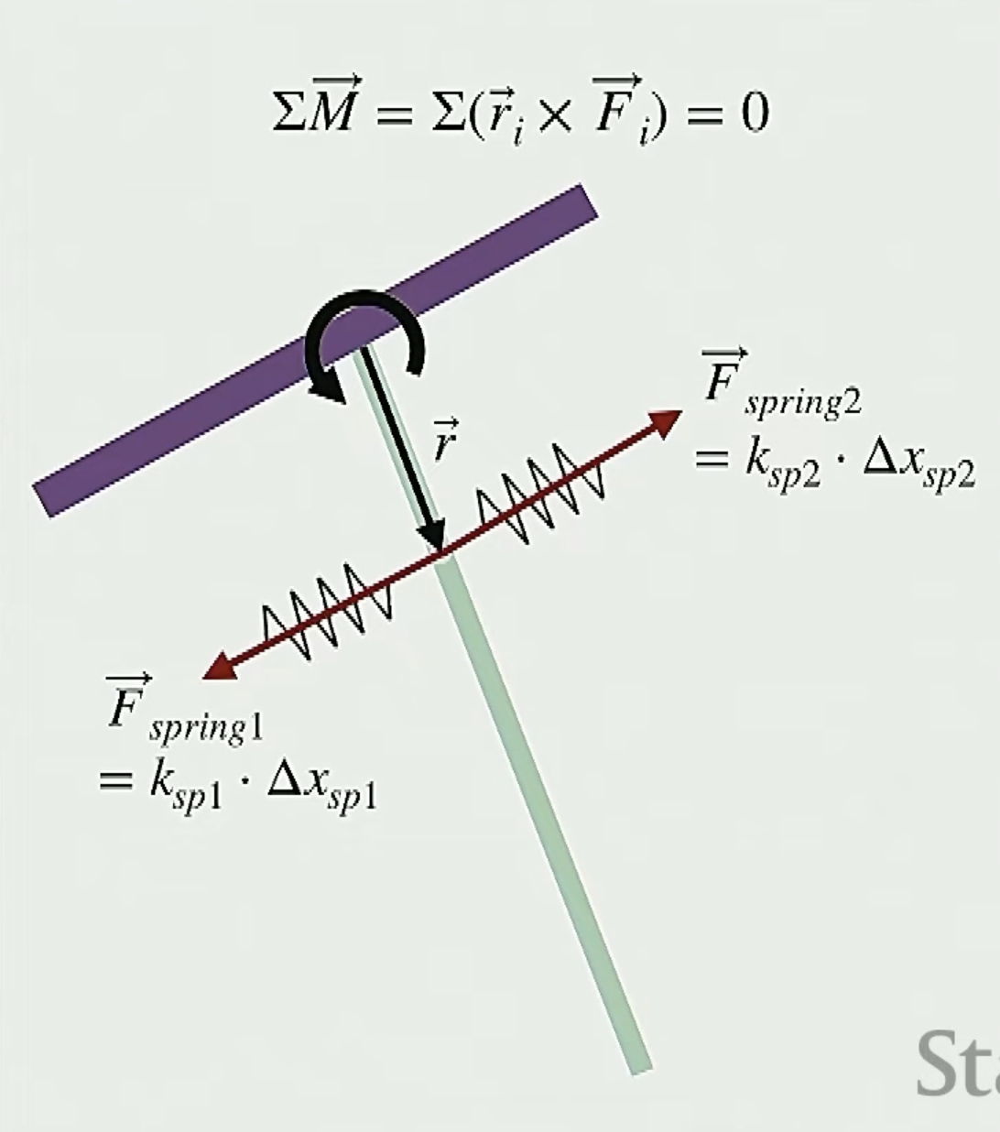
Simulation Plan
Model
2D elastic beam (discrete elastic rod or mass-spring model)
Simulates deformation under applied torque and constraint
Inputs
Boundary conditions (e.g., fixed root, free or actuated tip)
Internal actuation (twisting force, bending moment)
Variable stiffness (uniform vs. gradient)
Outputs
Shape profile (camber and twist deformation)
Internal moment and strain energy distributions
Curvature and torsion vs. beam length
Comparisons
Baseline vs. twist
Baseline vs. camber
Optional: Combined twist-camber coupling
Notes:
We’re modeling the wing as a continuous elastic beam and applying torque and bending to simulate twist and camber deformations. We’ll analyze the resulting shape, curvature, and internal stress to understand how morphing can emerge from structure alone—without hinges or actuators

