Slide 1
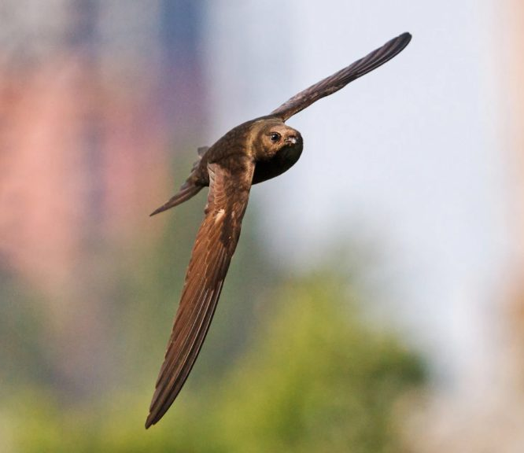
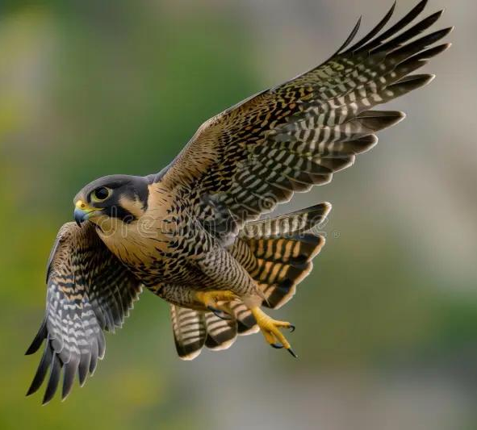
263F Midterm Presentation
Simulation of Camber Morphing Wing
Andrew Tran and Matthew Hutchinson
Notes:
Birds like falcons and swifts can twist and camber their wings mid-flight, giving them incredible agility and efficiency. We’re drawing inspiration from these mechanisms to simulate similar shape morphing in a flexible, continuous wing structure

Slide 2
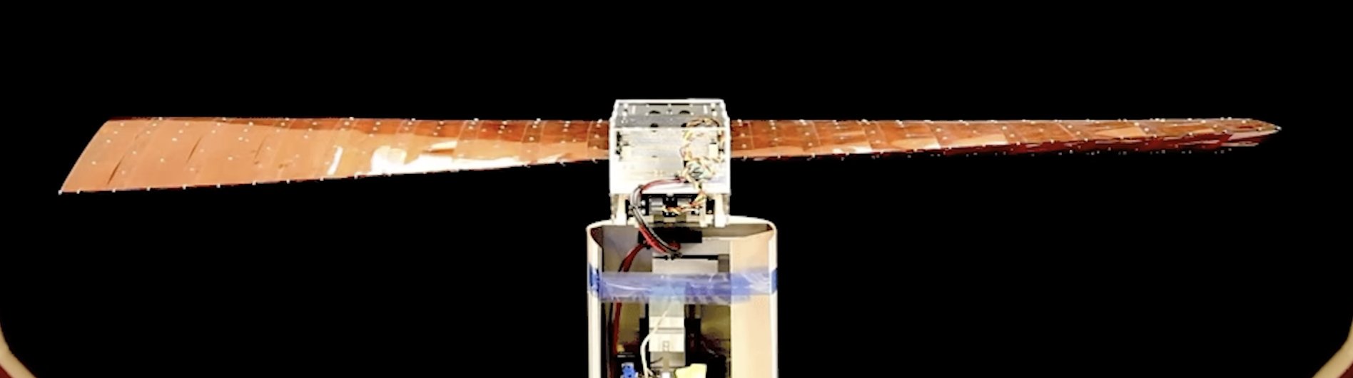
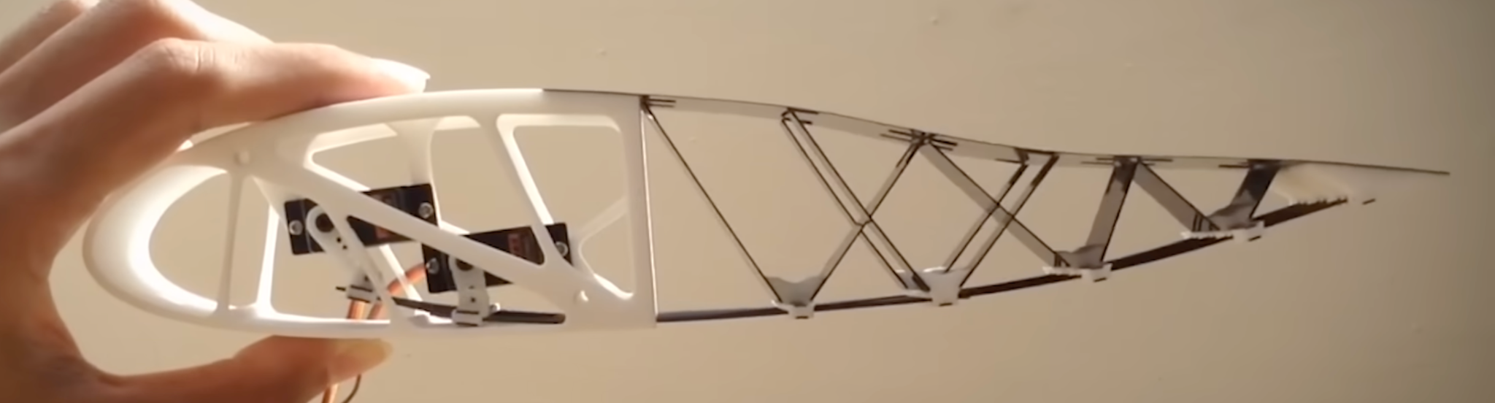
Motivation
A continuous camber-morphing wing, which enables smooth shape change, cleaner airflow, and more efficient lift modulation.
We model an airfoil section as a 2D elastic beam and simulate camber deformation using applied bending moments and trailing-edge actuation.
Notes:
Camber controls the curvature of the wing and influences lift, while twist lets birds change the angle of attack along the span—essential for roll, stability, and gust adaptation. If we can replicate this in a continuous flexible structure, it could transform how UAVs respond in real-time flight

Slide 3
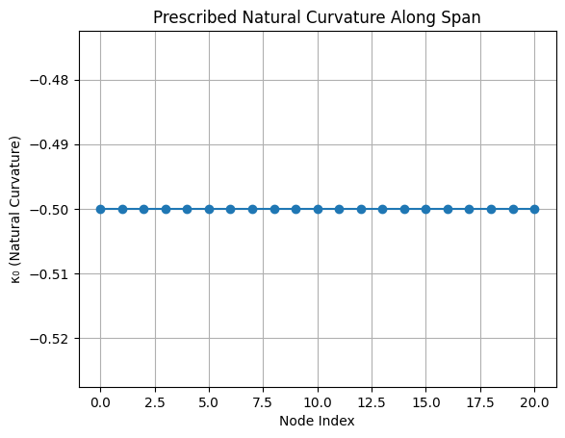
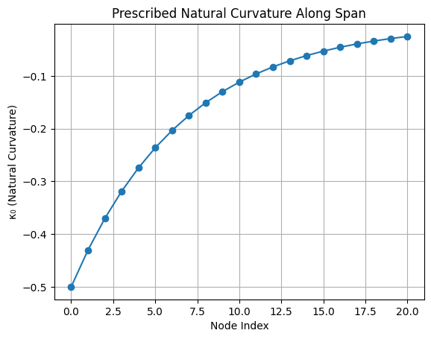
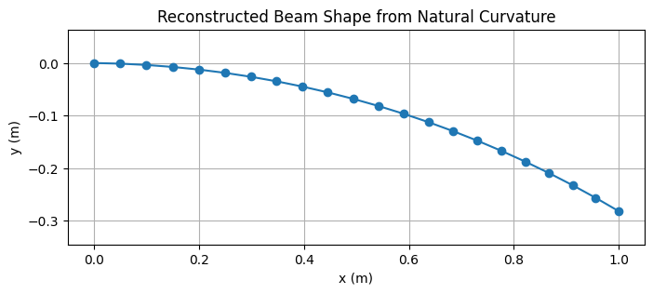
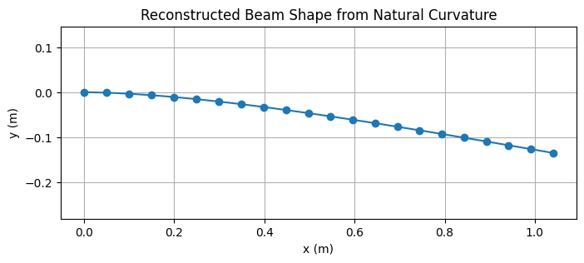
Progress to Date: Variable-Camber Simulation
Prescribed natural curvature (κ₀) to simulate elastic shape morphing.
Natural curvature generated from functions: uniform, exponential, linear, and gaussian curves
Variable-stiffness functionality integrated — stiffness gradients change deformation sensitivity and response.
Uniform κ₀
Exponential κ₀
Notes:
We have implemented variable-camber and variable-stiffness simulations, allowing us to control curvature through trailing-edge actuation and stiffness gradients. Initial results show smooth, predictable deformation and clear energy–curvature tradeoffs, with compliant regions requiring less actuation for the same camber.

Slide 4
Next Steps
Implement time-dependent actuation to morph between two camber profiles (Dynamic Morphing)
Run parametric sweeps: transition time vs. actuation energy vs. peak stress.
Compare total internal bending energy across time for both static & morphing beam
Add torque input to accelerate morphing, or test under external forces like gusts
Analyze transient metrics: curvature evolution, internal moments, damping/oscillation, and stability.
Notes:
Next, we will simulate dynamic morphing, transitioning the beam between two camber profiles using time-dependent actuation and shape-interpolation routines. This will let us study transient behavior—including curvature evolution, internal moments, and energy usage—and produce performance metrics.

