Slide 1
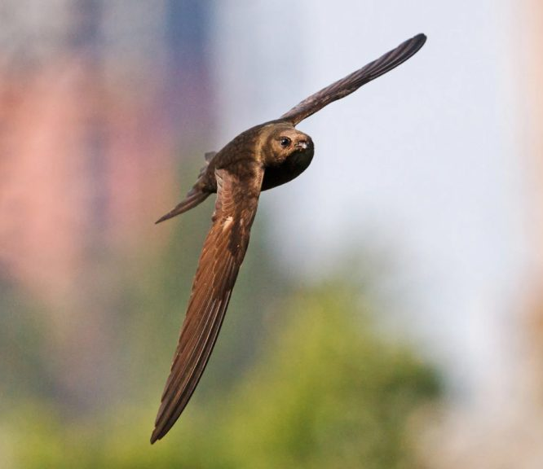
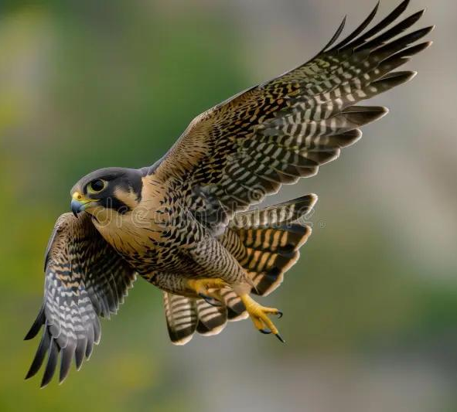
263F Final Presentation
Simulation of Camber Morphing Wing
Andrew Tran and Matthew Hutchinson
Notes:
Birds like falcons and swifts can twist and camber their wings mid-flight, giving them incredible agility and efficiency. We’re drawing inspiration from these mechanisms to simulate similar shape morphing in a flexible, continuous wing structure

Slide 2
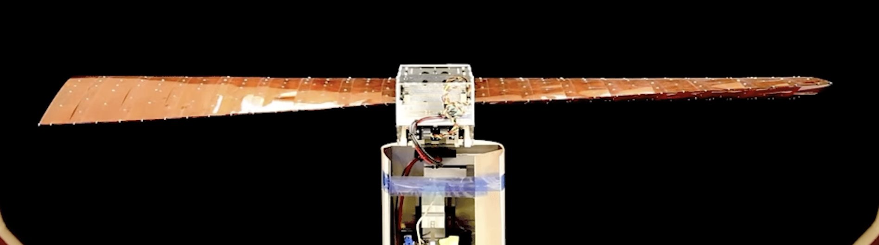
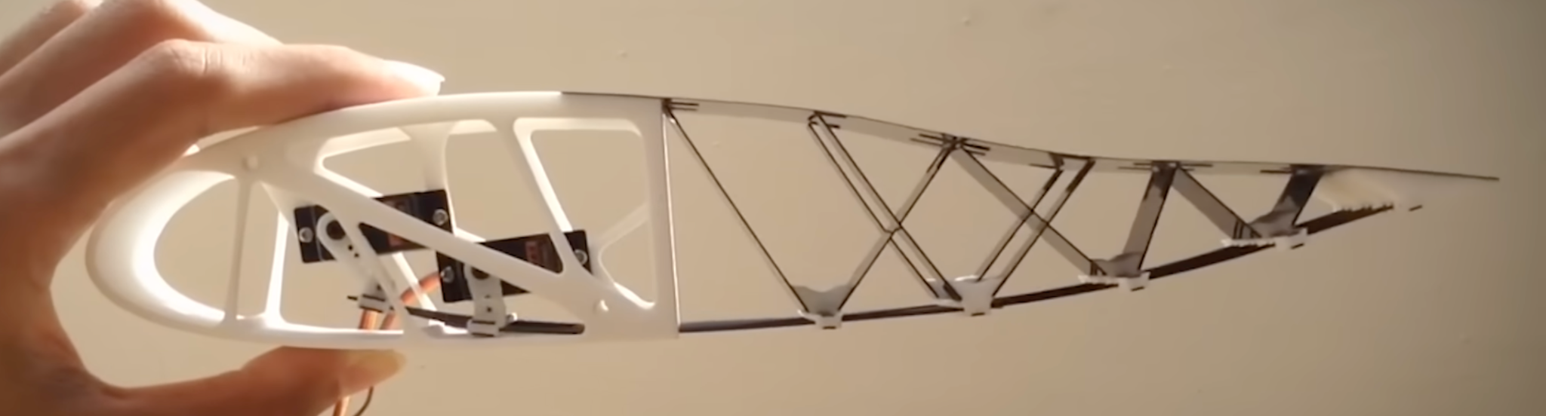
Motivation
A continuous camber-morphing wing, which enables smooth shape change, cleaner airflow, and more efficient lift modulation.
We model an airfoil section as a 2D elastic beam and simulate camber deformation using applied bending moments and trailing-edge actuation.
Notes:
Camber controls the curvature of the wing and influences lift, while twist lets birds change the angle of attack along the span—essential for roll, stability, and gust adaptation. If we can replicate this in a continuous flexible structure, it could transform how UAVs respond in real-time flight

Slide 3
Simulation Setup
21 nodes
Material: Carbon Fiber
Density: 1700 kg/m^3
Young's Modulus: 200 GPa
r0, R = 0.011, 0.013
Max kappa is -0.1
Drag_Model: None & High Reynolds Model
Forward airspeed: 0 or 20 m/s
Kappa Profile: ‘uniform', 'exponential', 'linear', 'gaussian'
Stiffness Profile (EI): 'uniform', 'linear_taper', 'center_soft', 'tip_soft'
Aerodynamic Properties
Ct = 2.0 # Tangential resistance (low-Re)
Cp = 10.0 # Normal resistance (low-Re)
Cd = 1.2 # Drag coefficient (high-Re)
Rho_air = 1.2 # Fluid density (air)
Mu = 1.8e-5 # Dynamic viscosity (Pa.s)

Slide 4
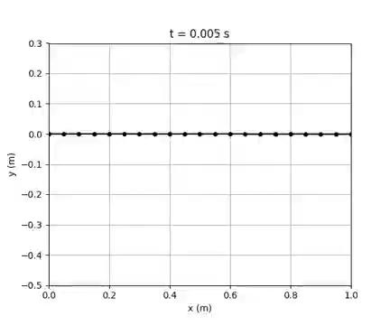
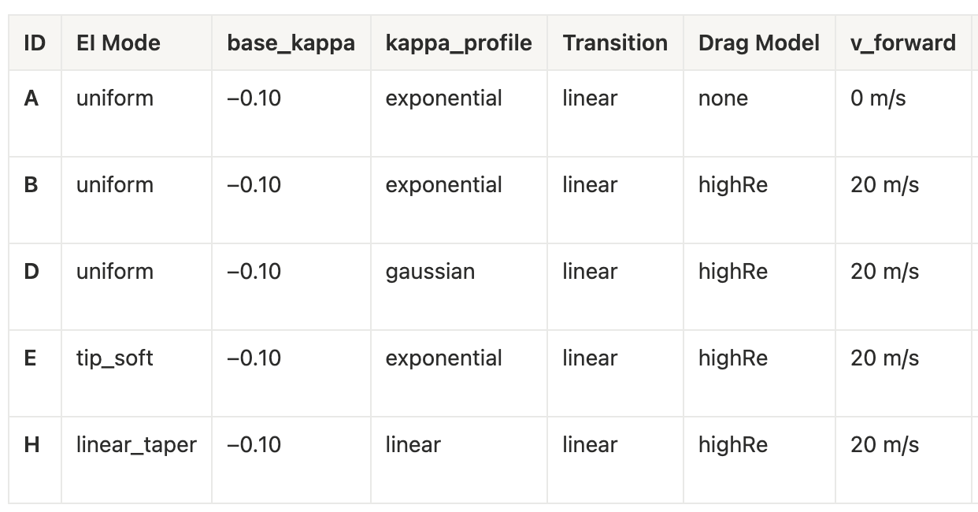
Animation of Dynamic Morphing
We simulate 5 morphing cases:

Slide 5
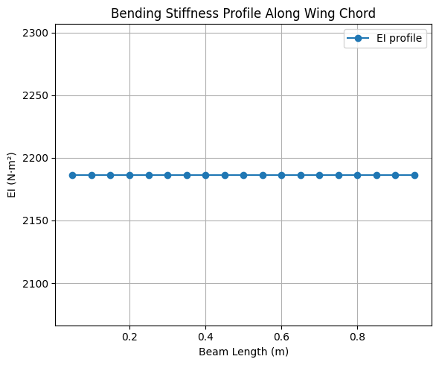
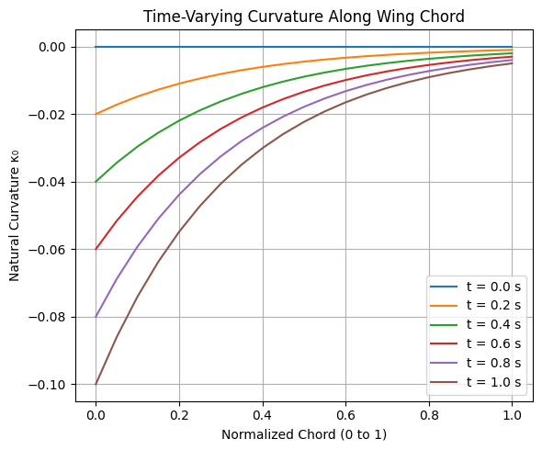
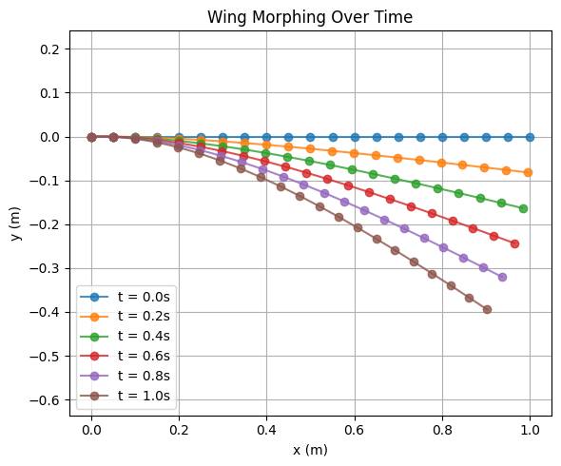
Baseline Morph – Case A
Purpose: Provides baseline morphing wing absent of aerodynamics effects (pure structural response)
Notes:
Setup:
Uniform EI
Kappa set to -0.10
Exponential kappa profile
Linear kappa transition (0 → -0.10)
No drag model applied
Zero airflow

Slide 6
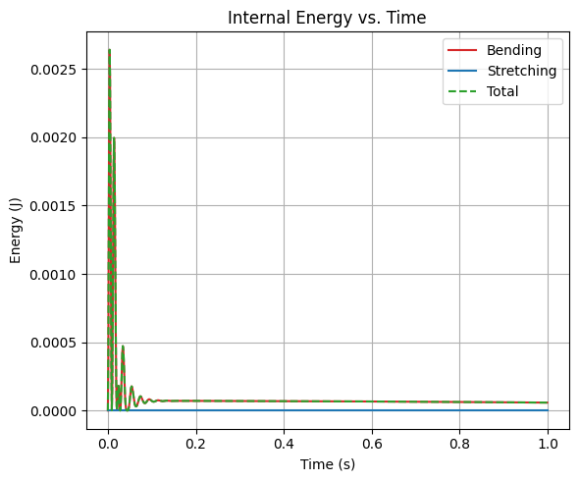
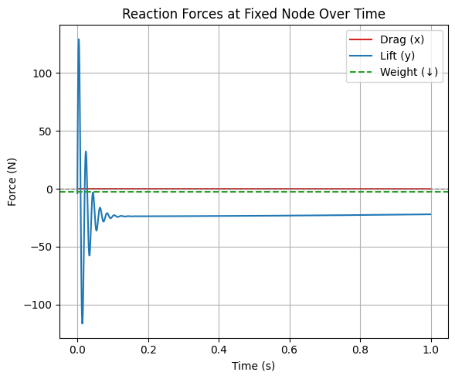
Baseline Morph – Case A
Final Internal Energies:
• Stretching Energy: 0.000000 J
• Bending Energy: 0.000059 J
• Total Energy: 0.000059 J
Max Internal Energies During Simulation:
• Max Stretching: 0.000000 J
• Max Bending: 0.002640 J
• Max Total: 0.002640 J
Final Tip Displacement:
• Δx = -0.096817 m
• Δy = -0.394540 m
• Total Tip Displacement = 0.406245 m
---------------------------------------
Final Reaction Forces at Fixed Node:
• Drag (x): -0.0952 N
• Lift (y): -22.0259 N
Weight: 2.6406 N
Net Lift Margin at Final Time: -19.3853 N

Slide 7

Aerodynamic Loading – Case B
Purpose: Shows how aerodynamic drag resist morphing (aeroelastic coupling)

Slide 8
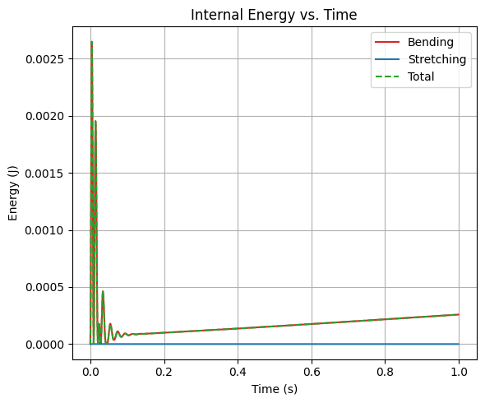
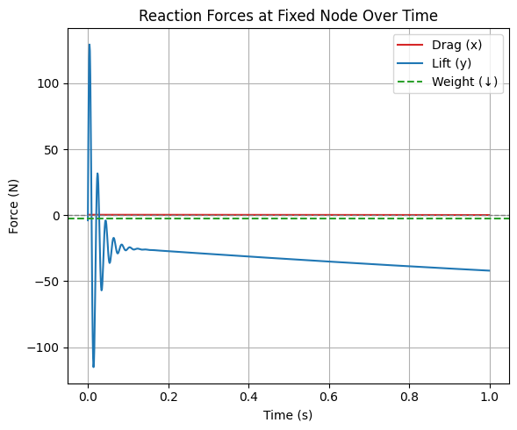
Aerodynamic Loading – Case B
Final Internal Energies:
• Stretching Energy: 0.000000 J
• Bending Energy: 0.000258 J
• Total Energy: 0.000258 J
Max Internal Energies During Simulation:
• Max Stretching: 0.000000 J
• Max Bending: 0.002648 J
• Max Total: 0.002649 J
Final Tip Displacement:
• Δx = -0.096882 m
• Δy = -0.394663 m
• Total Tip Displacement = 0.406380 m
---------------------------------------
Final Reaction Forces at Fixed Node:
• Drag (x): +0.1357 N
• Lift (y): -41.9909 N
Weight: 2.6406 N
Net Lift Margin at Final Time: -39.3503 N

Slide 9
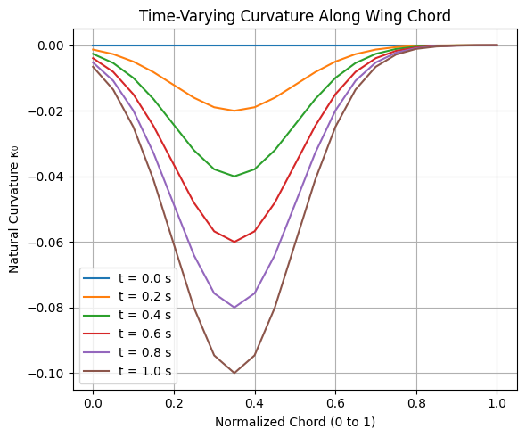
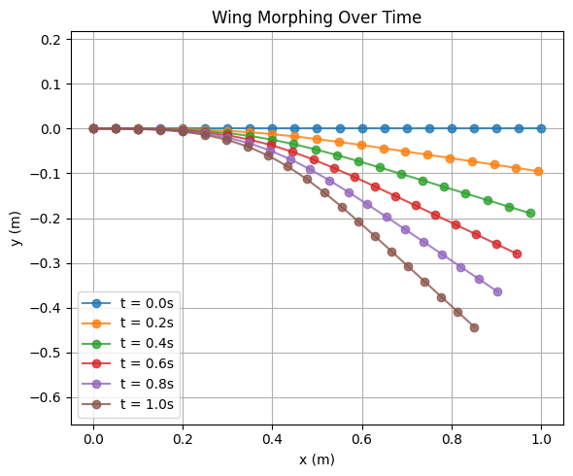
Kappa Profile Variation – Case D
Shows a more biologically inspired curvature profile
Notes:
Setup:
Uniform beam
Kappa set to -0.10
Gaussian camber profile (kappa)
Linear transition
High Reynolds drag model
20 m/s airflow from left to observe drag resistance

Slide 10
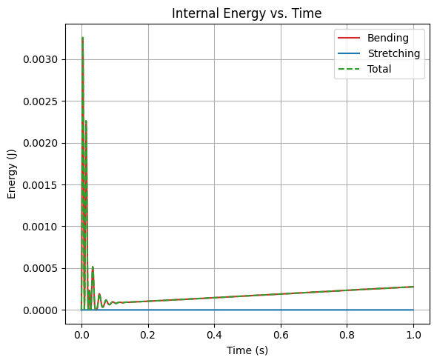
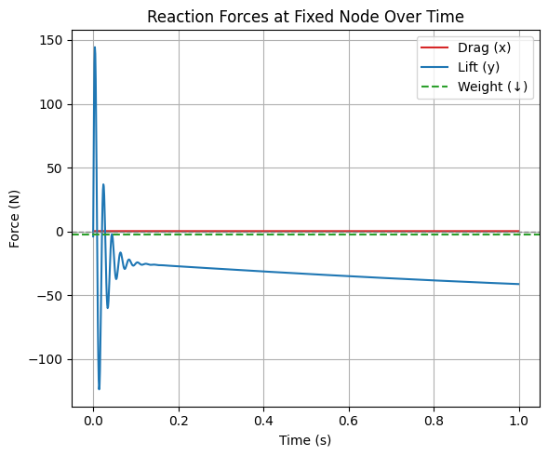
Kappa Profile Variation – Case D
Final Internal Energies:
• Stretching Energy: 0.000000 J
• Bending Energy: 0.000276 J
• Total Energy: 0.000276 J
Max Internal Energies During Simulation:
• Max Stretching: 0.000000 J
• Max Bending: 0.003256 J
• Max Total: 0.003257 J
Final Tip Displacement:
• Δx = -0.148528 m
• Δy = -0.443097 m
• Total Tip Displacement = 0.467328 m
---------------------------------------
Final Reaction Forces at Fixed Node:
• Drag (x): +0.2889 N
• Lift (y): -41.1904 N
Weight: 2.6406 N
Net Lift Margin at Final Time: -38.5498 N

Slide 11
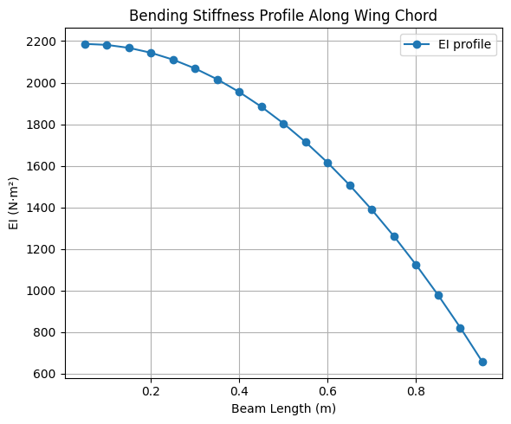

Tip Softening Effect – Case E
Purpose: Does a flexible tip amplifies wing bending under load or decrease bending energy

Slide 12
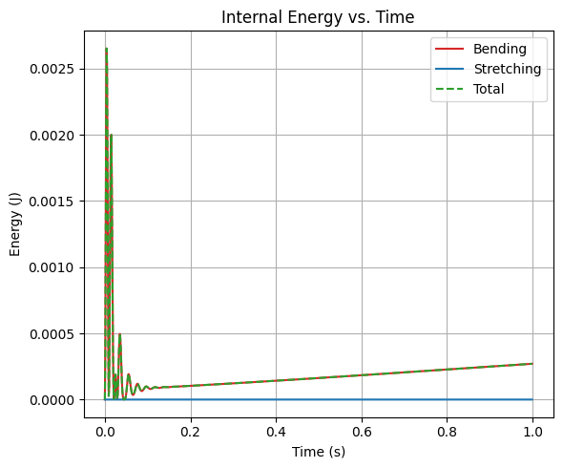
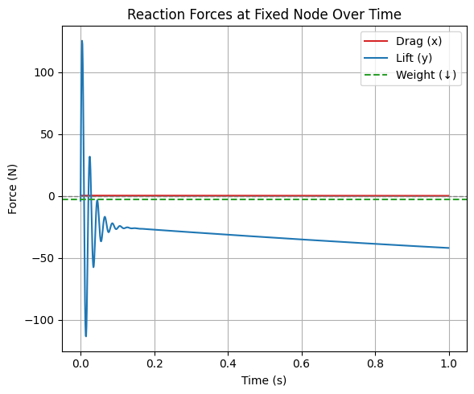
Tip Softening Effect – Case E
Final Internal Energies:
• Stretching Energy: 0.000000 J
• Bending Energy: 0.000271 J
• Total Energy: 0.000271 J
Max Internal Energies During Simulation:
• Max Stretching: 0.000000 J
• Max Bending: 0.002653 J
• Max Total: 0.002653 J
Final Tip Displacement:
• Δx = -0.096891 m
• Δy = -0.394677 m
• Total Tip Displacement = 0.406397 m
---------------------------------------
Final Reaction Forces at Fixed Node:
• Drag (x): +0.1357 N
• Lift (y): -41.9913 N
Weight: 2.6406 N
Net Lift Margin at Final Time: -39.3508 N

Slide 13
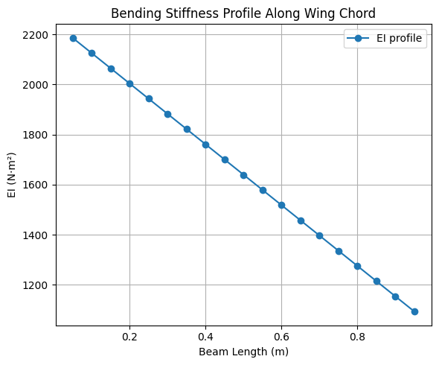
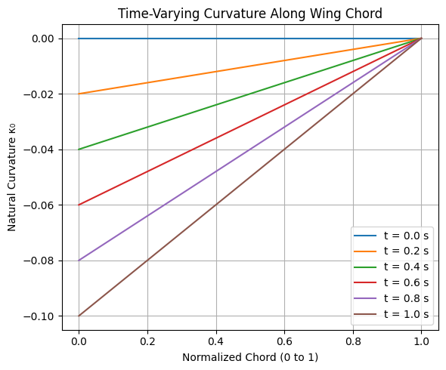
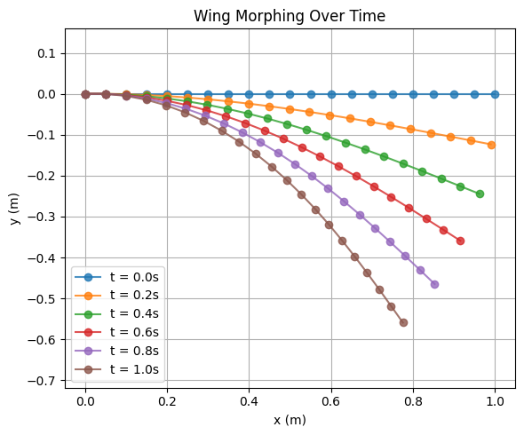
Tapered Stiffness – Case H
More realistic EI distribution for aircraft wings (linear taper)
Setup:
Kappa set to -0.10
Linear camber profile
Linear transition
High Reynolds drag model
20 m/s airflow from left to observe drag resistance
Purpose: Mimics real aircraft wings with tapered stiffness

Slide 14
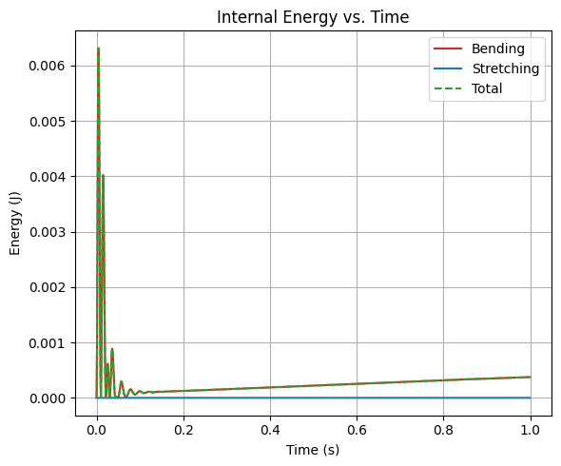
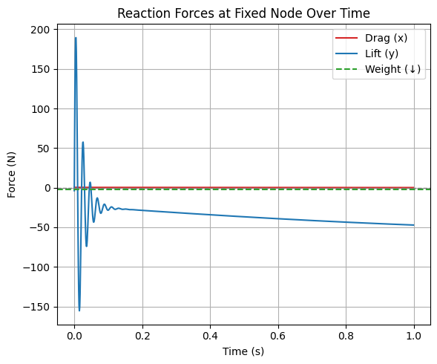
Tapered Stiffness – Case H
Final Internal Energies:
• Stretching Energy: 0.000000 J
• Bending Energy: 0.000375 J
• Total Energy: 0.000375 J
Max Internal Energies During Simulation:
• Max Stretching: 0.000000 J
• Max Bending: 0.006312 J
• Max Total: 0.006312 J
Final Tip Displacement:
• Δx = -0.224082 m
• Δy = -0.559252 m
• Total Tip Displacement = 0.602474 m
---------------------------------------
Final Reaction Forces at Fixed Node:
• Drag (x): +0.0922 N
• Lift (y): -47.1960 N
Weight: 2.6406 N
Net Lift Margin at Final Time: -44.5554 N

Slide 15
Final Metrics (lift & drag forces are fixed node reaction forces)
Case | Description | EI Profile | Kappa Profile | Drag | Tip Δx (m) | Tip Δy (m) | Tip Displacement (m) | Bending Energy (J) | Lift Force (N) | Drag Force (N)
A | Baseline morph | Uniform | Exponential | None | -0.0968 | -0.394 | 0.406 | 0.000059 | -22.03 | -0.0952
B | With aerodynamic drag | Uniform | Exponential | High-Re | -0.0969 | -0.395 | 0.406 | 0.000258 | -42.00 | +0.1357
D | Exponential curvature profile | Uniform | Gaussian | High-Re | -0.1485 | -0.443 | 0.467 | 0.000276 | -41.19 | +0.2889
E | Tip-softened stiffness | Tip Soft | Exponential | High-Re | -0.0969 | -0.394 | 0.406 | 0.000271 | -41.99 | +0.1357
H | Tapered stiffness | Linear Taper | Linear | High-Re | -0.2241 | -0.559 | 0.602 | 0.000375 | -47.20 | +0.0922

Slide 16
Future Implementations / Improvements
3D Wing Extension (Twist + Camber)
Expand the 2D beam model into a 3D thin-shell model to capture spanwise twist or bending
Enable combined twist–camber morphing, allowing comparison with biological roll-control mechanisms seen in bird

Slide 17
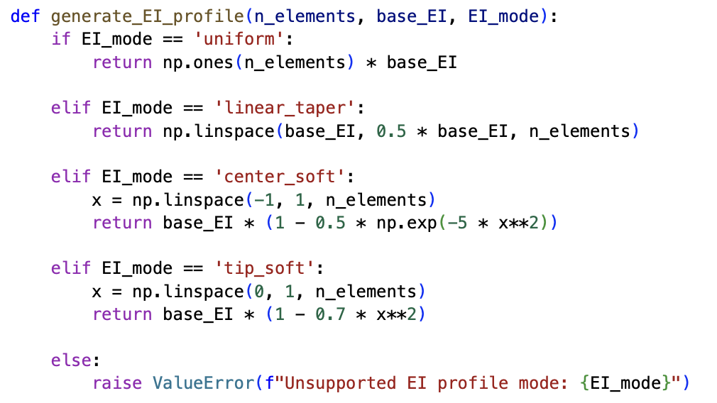
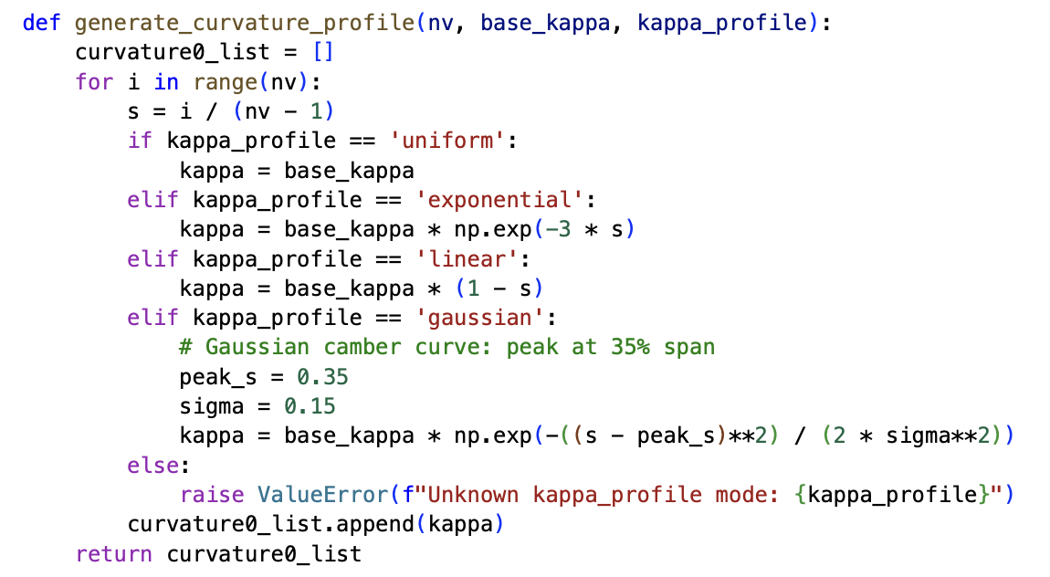
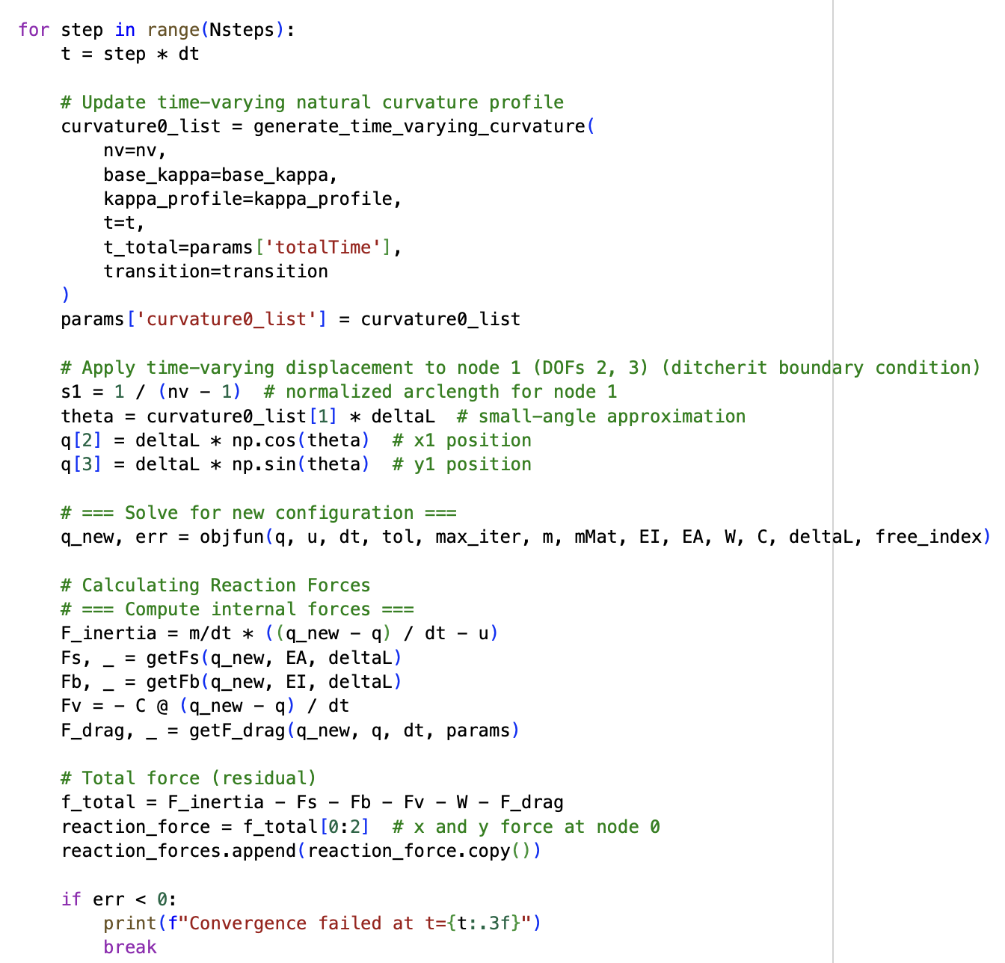
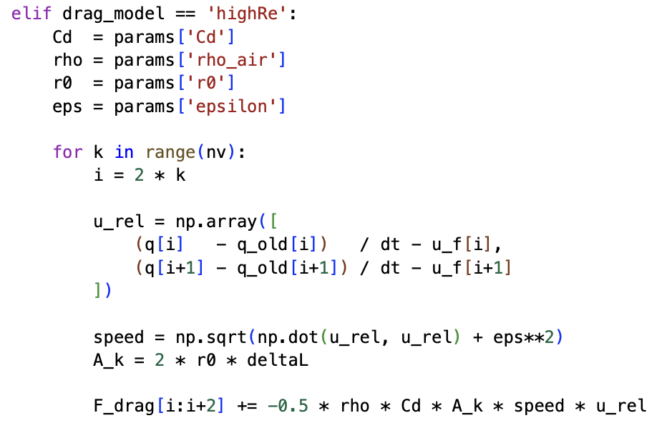
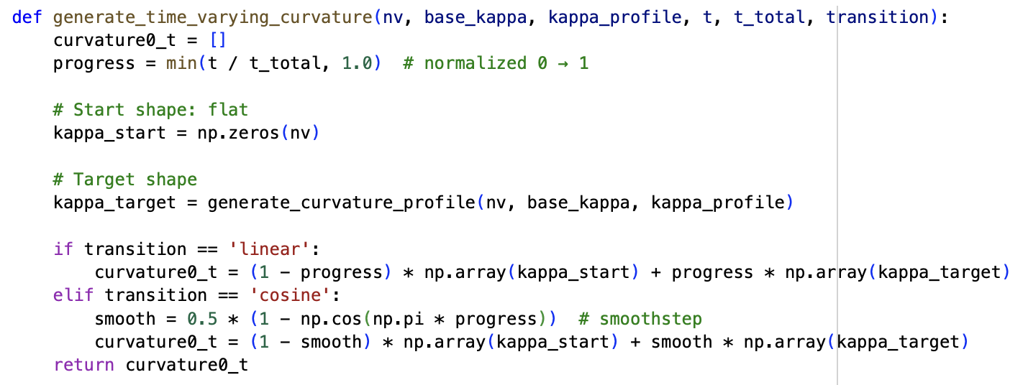
Coding Implementation
simulate_dynamic_morphing()

