Slide 1
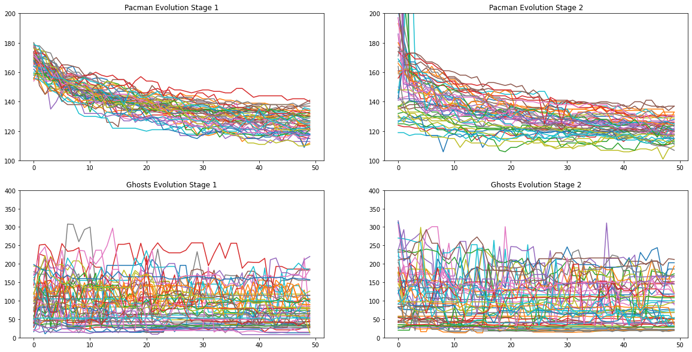
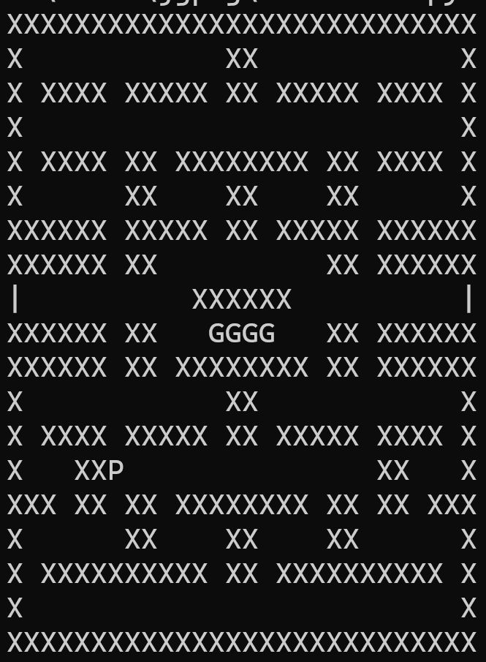
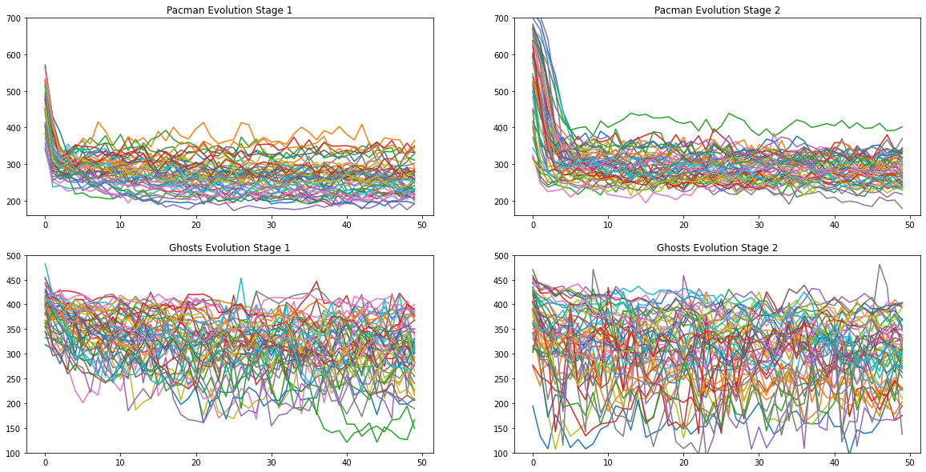
Predator v. Prey: Pacman v. Ghost
Jacob Page and Matthew Walters
Introduction/Motivation:
Goal: To create and visualize a predator/prey evolution simulation between Pacman and the Ghosts
      Pacman will learn to run away from the Ghosts
      The Ghosts will learn to hunt down Pacman
      After one side evolves, the other side must improve to defeat their opponent's new tactics
      Should expect mutual improvement over time
  Initial Tests involve 4 stages: Evolve Pacman, Evolve the Ghosts, Evolve Pacman Again, Evolve the Ghosts Again
      Will Pacman be better at running from the Ghosts or will the Ghosts be better at catching Pacman?
Methods/Approach:
Visualization of the game
      X = Wall
      | = Portal to Opposite Side
      P = Pacman Starting Position
      G = Ghost Starting Position
Pacman starts at map location x = 6 and y = 13
      Initial movement determined by a set-length random list of numbers, 0 = 'up', 1 = 'left', 2 = 'down', 3 = 'right'
      Pacman’s fitness is based on the number of spaces on the map that he reaches in the set time, and the number of time-steps that he survives
  Ghosts start at x = 13 and y = 9
      Initial movement determined in the same way
      The Ghost’s fitness function is the number of time-steps before one of the 4 Ghosts catches Pacman, plus the sum of each Ghost's minimum distance from Pacman throughout the game
  Both Pacman and the Ghosts use the same method for selection and the same numbers for mutation, crossover, population size, and number of generations
      Tournament selection is used to take a general average of the best paths being used from the population
      There is a set 1% chance for mutation
      There is a set 10% chance for crossover
      The population size of each generation is 200
      Each stage contains 50 generations of evolution
  Minimize the fitness score
      Higher fitness scores mean lower performance
Results:
Best Fitness Scores
Average Fitness Scores
Our tests show consistent improvement in Pacman's fitness score but wild inconsistency for the ghosts
      For statistical reliability, we tested the simulation 50 times.
      While Pacman's best fitness score from any given population does generally improve, the average score of the entire population varies
      The ghosts’ evolution stage seemingly improves Pacman’s score even though their own scores cannot reliably improve
Conclusion:
Pacman
      He does not touch as many spaces as we would like
      Usually covers no more than 1/3 to ½ of the map
      We look to further improve coverage while still avoiding the Ghosts
      Although in general Pacman’s fitness is greatly improved from the initial to the final version
Ghosts
      There is very little improvement in Ghost’s fitness scores
      There are certain cases that do perform well, but those cases are few in numbers and seem to get lost in the mutation and crossover
      Look into farther increasing these cases or farther preserving their characteristics
Future work
      First general goal is to compare hyper-parameter combinations of different generation sizes, population sizes, mutation probability, and crossover probability
      After finding optimal hyper-parameters we want to run 50 or more stages instead of the current 4 to see if that allows for more improvement

