Slide 1

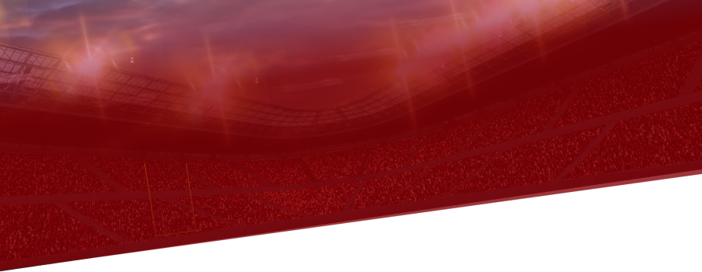




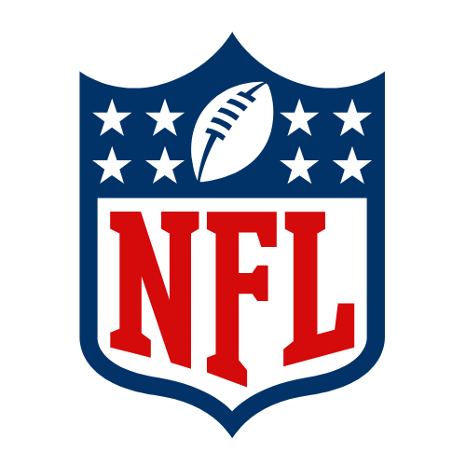
NFL
Fourth Down in the NFL
2016-2025
NFC
AFC

Slide 2
Goal of Study
This analysis seeks to investigate how NFL teams approach fourth downs, specifically the context surrounding them and what drives their success.

Slide 3
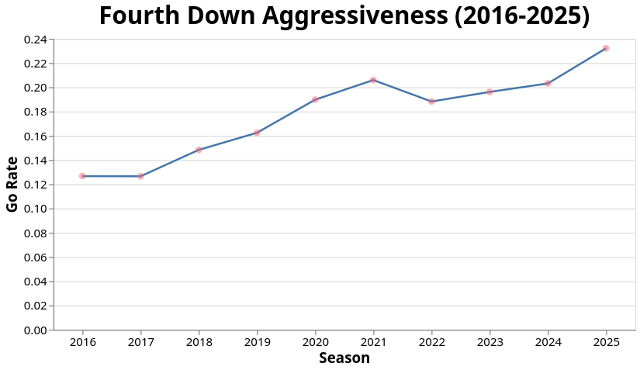
Overall Trend
Fourth down attempt Rate on the rise
12% in 2016
23% in the most recent season
Rate has nearly doubled

Slide 4
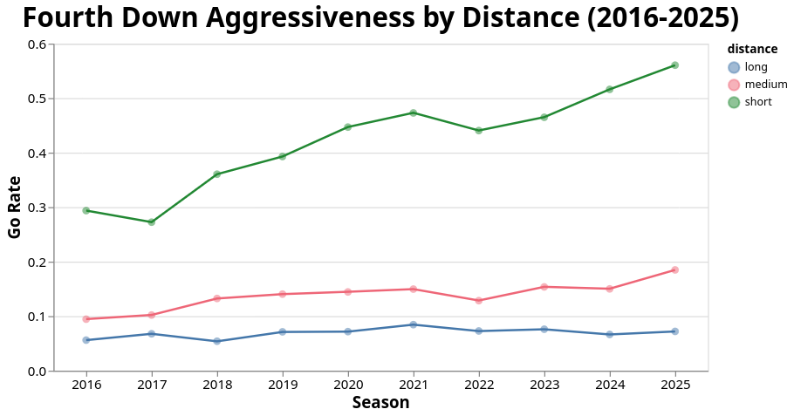
Distance
Yards to go can be broken up into 3 distinct categories:
Short: 1-3 yards
Medium: 4-6 yards
Long: 7+ yards
Short attempts have seen the most growth (up to over 50%)
Followed by Medium (doubled from 9-18%)
Long attempts have seen the least growth (5-7%)

Slide 5
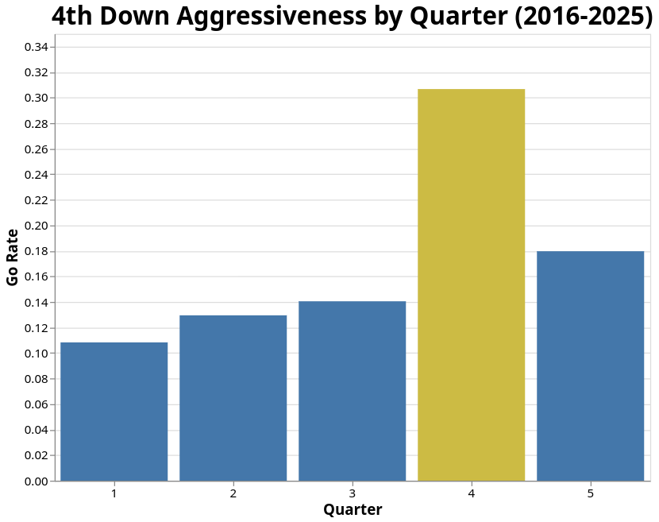
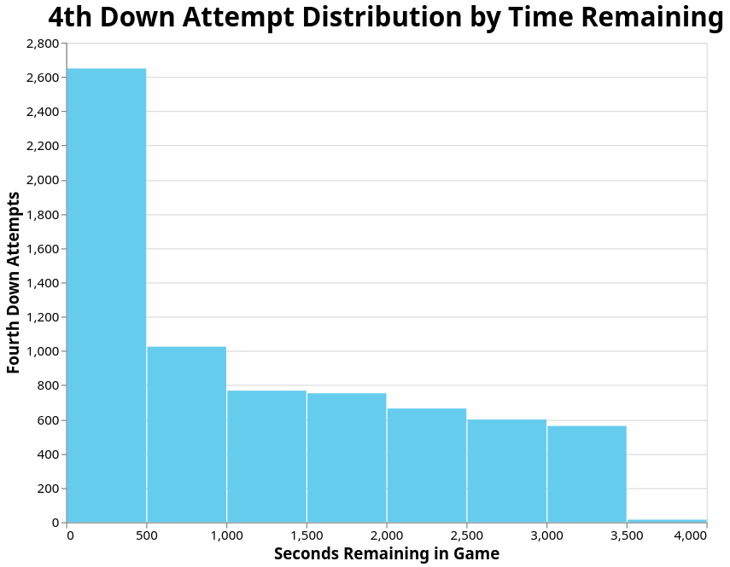
Time
Highest Go Rate in Fourth Quarter
There are two ways to view time in an NFL game, quarter and time remaining
Lowest Go Rate in first quarter
Most fourth down attempts occur with 0-500 seconds left in game

Slide 6
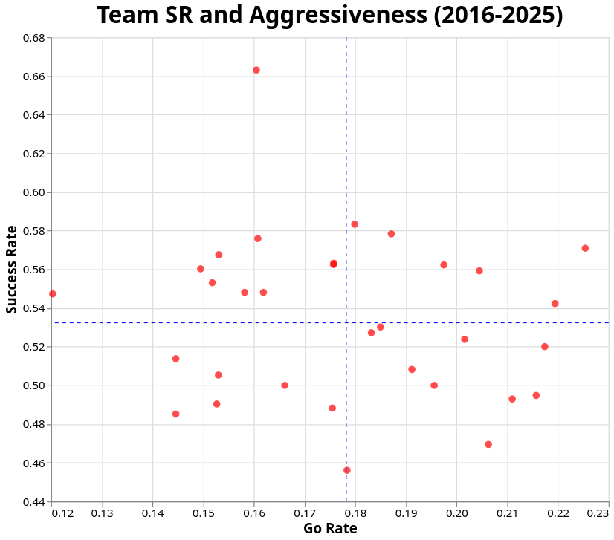
Team Success Rate and Go Rate
quadrant 1: successful and aggressive
quadrant 2: successful and conservative
quadrant 3: unsuccessful and conservative
quadrant 4: unsuccessful and aggressive

Slide 7
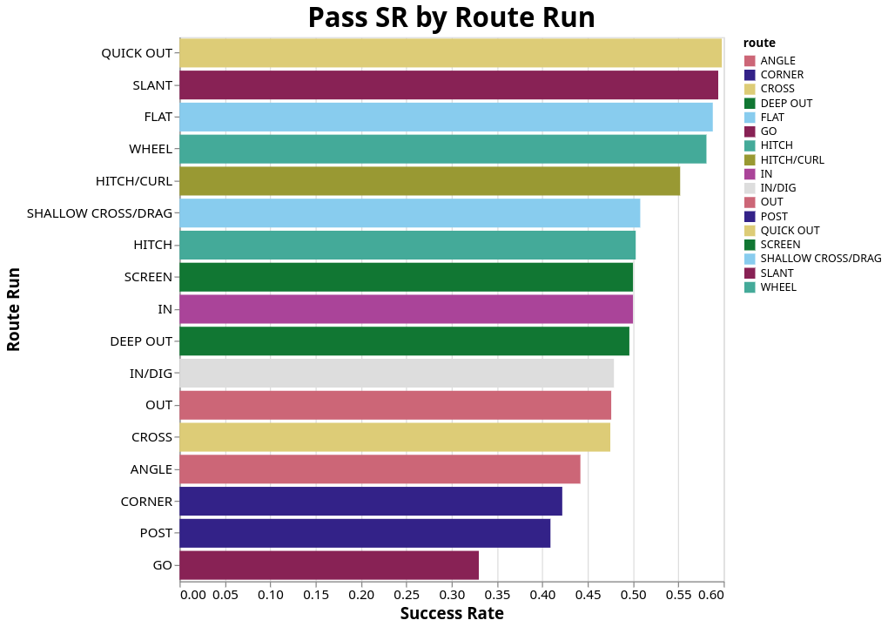
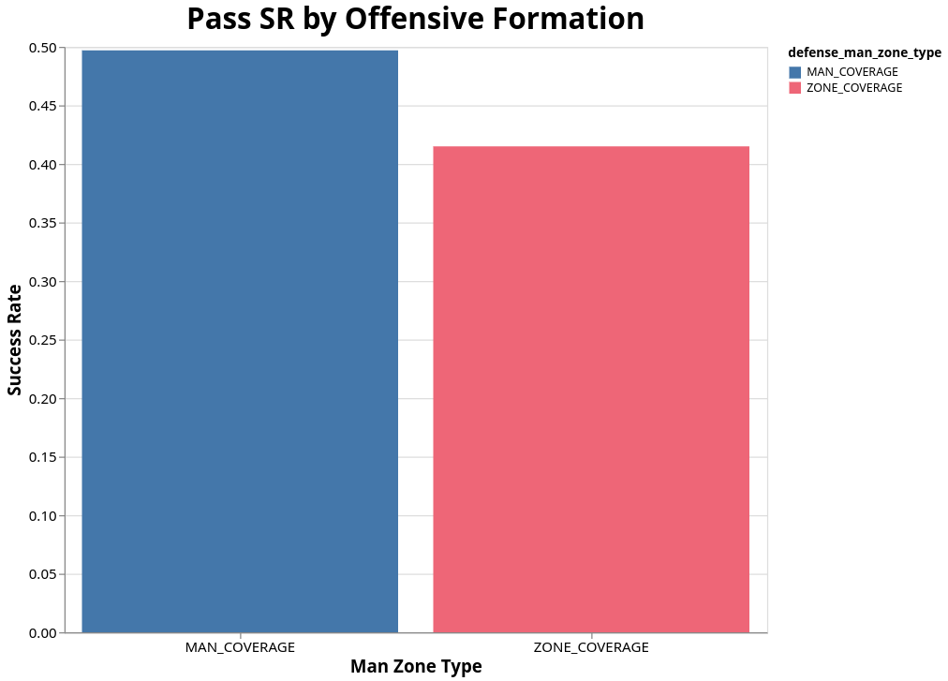
Pass Success Rates
Offenses have more success vs man rather than zone
Man vs Zone comparisons may carry some bias
Quick outs and slants most effective
Posts and Gos least effective

Slide 8
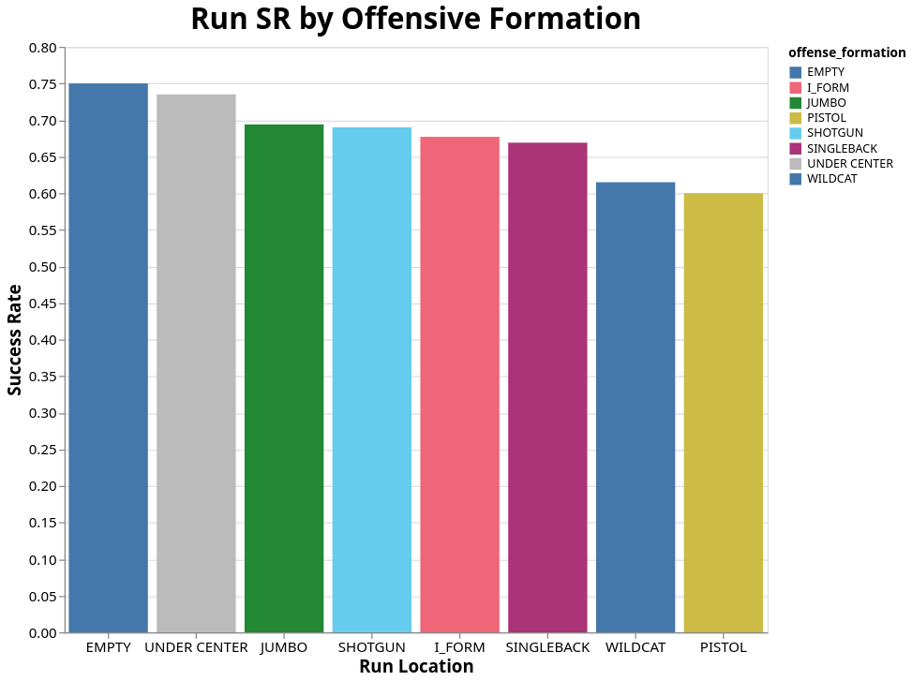
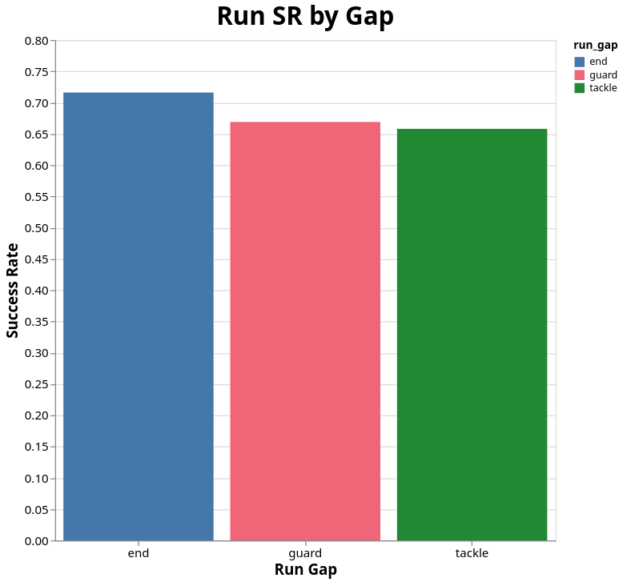
Run Success Rates
Empty most successful offensive formation
End Most successful run gap

Slide 9
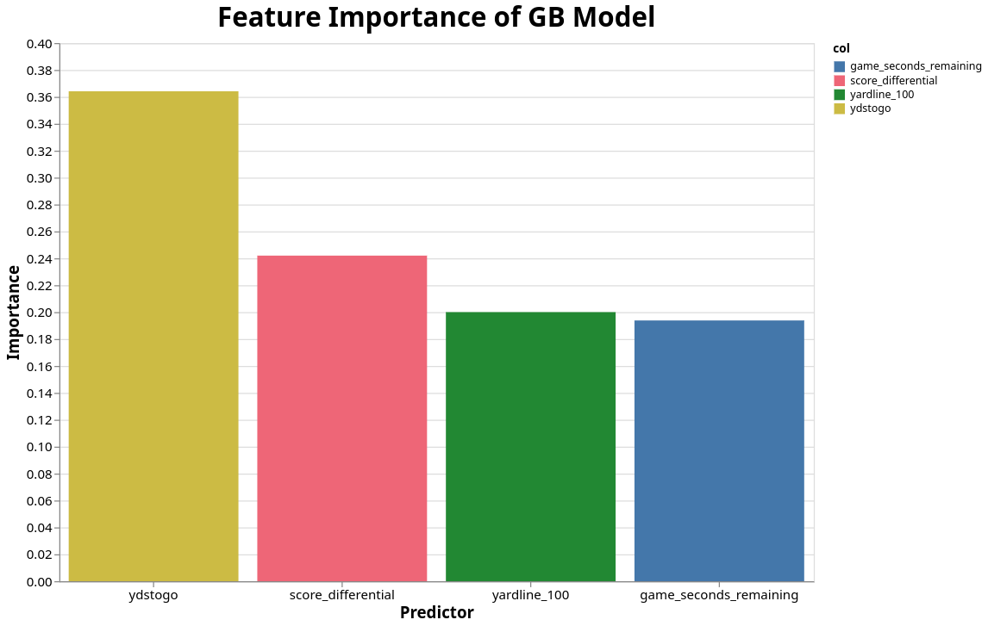
Modeling Fourth Down Attempts
Gradient Boosting Model was fit (30% learning Rate)
92% Accuracy on 20% holdout set
Yards to go most important feature

Slide 10
Recommendations And Conclusions
Teams should take advantage of pass situations where the defense lines up in zone.
Teams should run more into the end gap
Yards to go, time remaining, yardline, and score differential are the most important variables in determining if a team goes for fourth down or not

