Slide 1
Assessing Protein-Protein interactions using Manifold Embeddings
Matthew Wolff et al.
CMU Computational Genomics 02-710
Spring 2021

Slide 2
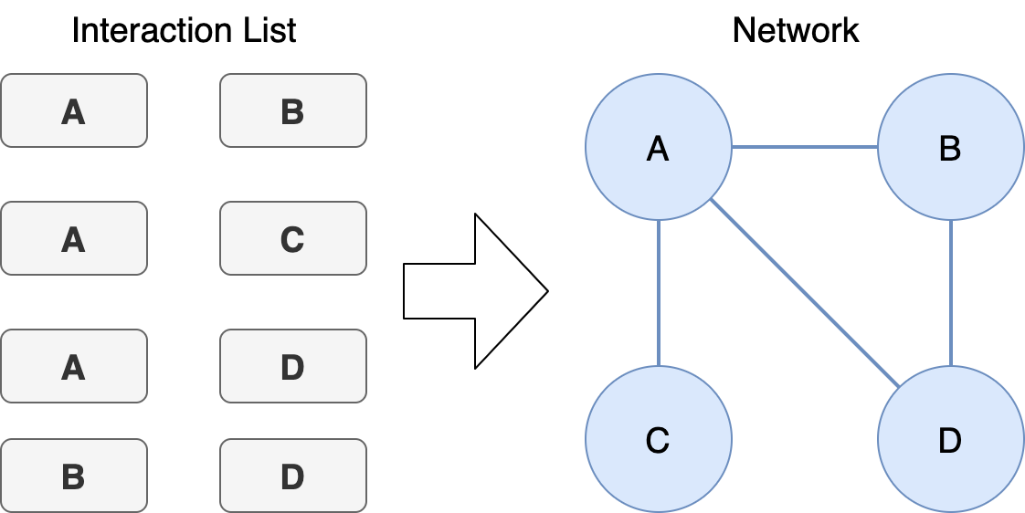
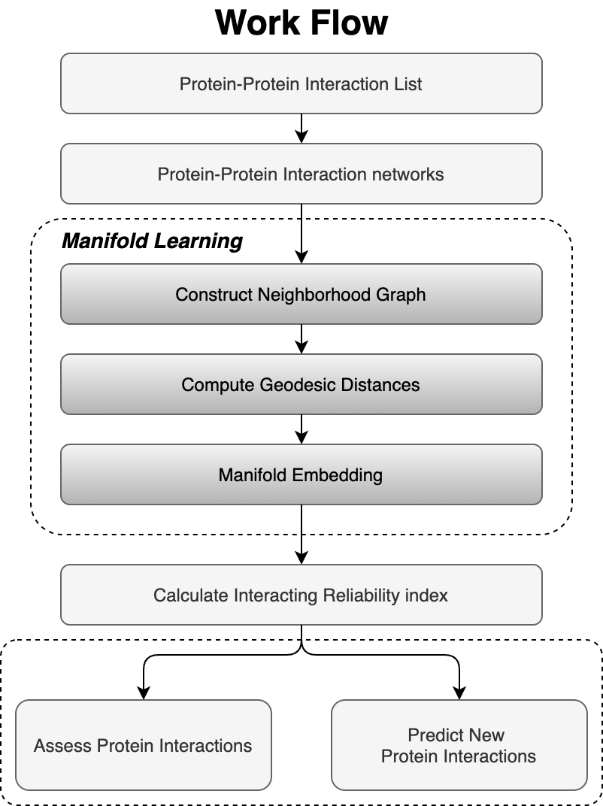
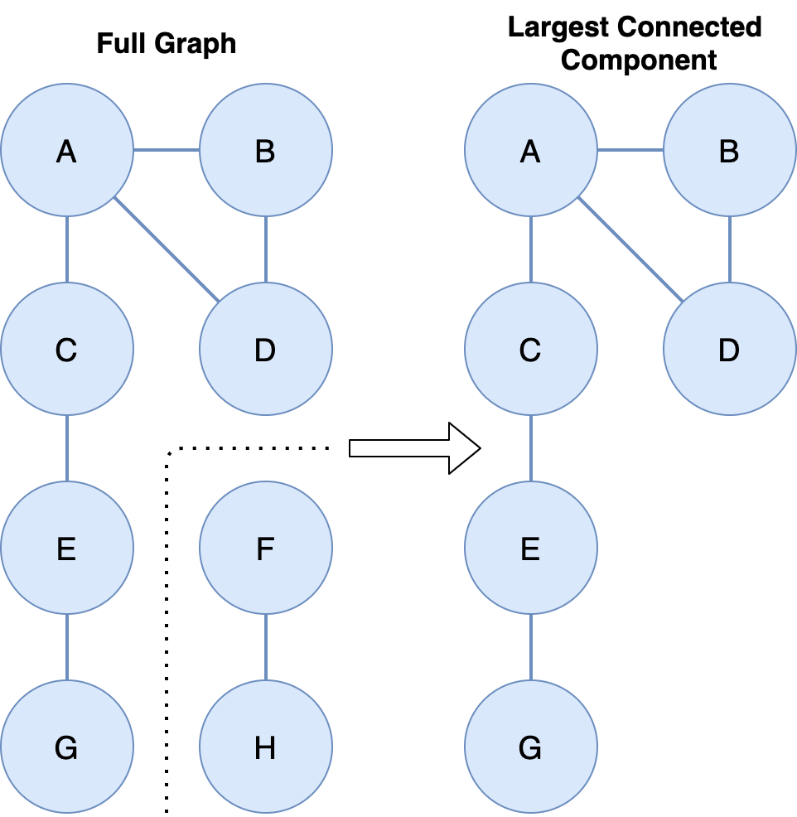
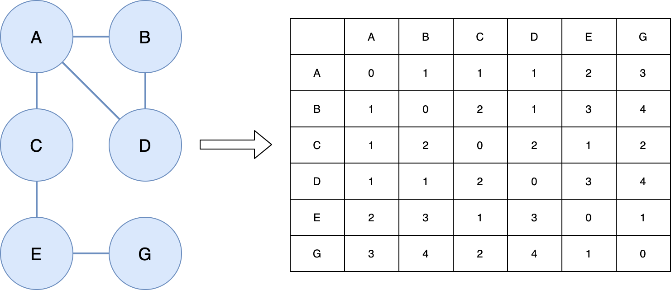
Motivation
We extend a 2010 paper:
Using Manifold Embedding for Assessing and Predicting Protein Interactions from High-Throughput Experimental Data
Leverage the ever-increasing volume of high-throughput protein interaction data to develop embeddings of protein-protein interaction networks and predict new interactions

Slide 3
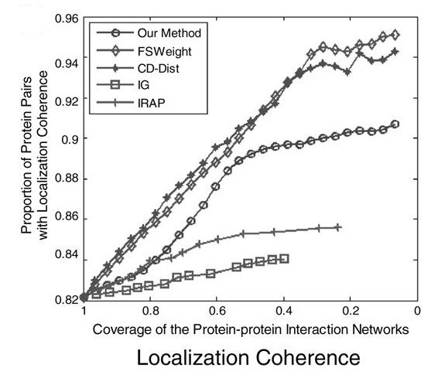
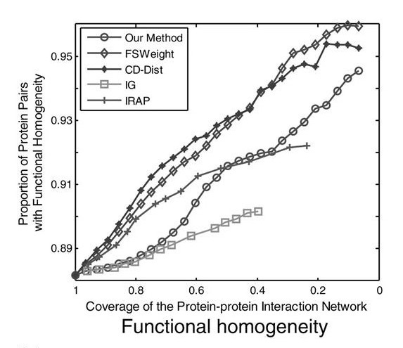
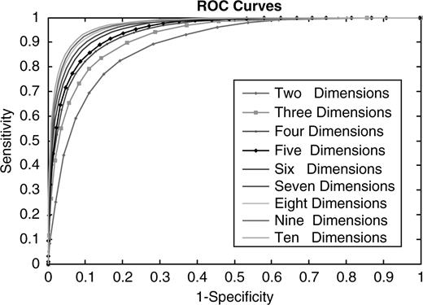
Result Validation
ROC curve -> How well were we able to recover the PPI network from the embedding?
Using 10-d embedding, do comparisons with various methods to evaluate functional homogeneity and localization of top protein pairs

Slide 4
Protein-Protein Interaction Data
Interest: Mutated proteins implicated in cancer
proteinatlas.org/humanproteome/tissue/cancer
Chose Somatic Mutations (most common)
Lots of interactions
From IntAct: Molecular Interaction Database
ebi.ac.uk/intact
Searched for ABL
Test data size: 6.4MB
Geodesic distance generation step is O(n^3)
Can't go too big, or computation time ↑

Slide 5
Methods
Original code was in MATLAB
The 2010 paper's original code is gone
It stopped being hosted in recent years
We used Python
Numpy
Pandas
Scikit-Learn
Original Paper used IsoMap manifold embedding only
We benchmark 4 methods total:
Multi-Dimensional Scaling (MDS)
Isometric Feature Mapping (IsoMap)
t-distributed Stochastic Neighbor Embedding (t-SNE)
Spectral Embedding
Challenges?

Slide 6
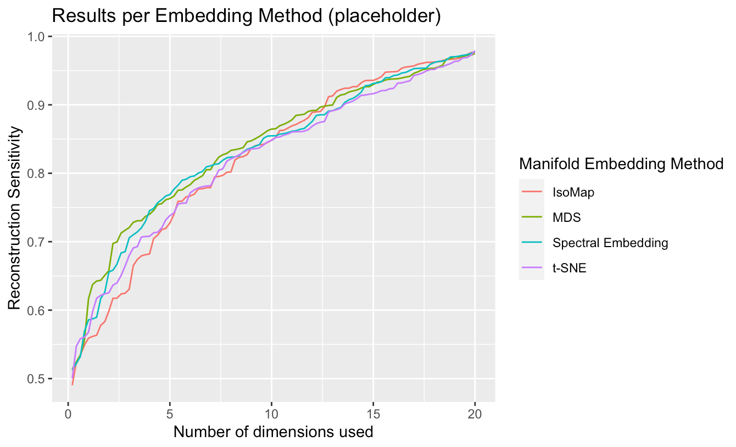
Results

