Slide 1
markov tweets
~A Markov Chaining Twitter Bot~

Slide 2
Goal
Create a Twitter bot that can generate pseudo-random tweets to mimic any given Twitter user.

Slide 3
Approach
Utilize n-gram language models/Markov chains to create tweets
Utilize Twitter’s API (Tweepy) to tweet and potentially interact with other users

Slide 4


What it uses
Python
Tweepy – Twitter’s API
Selenium – Python module used to scrape using web driver
n-gram language models

Slide 5
Overall Bot Process
Receive username
Scrape their timeline for tweets
Tokenize into Corpus
Note frequency of word use – create a dictionary
Choose min. freq. -> threshold dictionary -> vocabulary
Regenerate corpus with only words from vocabulary
Set arbitrary number n as a limit for words in a chain
Analyze corpus - note all permutations of n-words
Stochastically generate word sequences
Notes:
From the dictionary, set some arbitrary minimum for how often a word must occur for the bot to use it – create a vocabulary for the bot
Note all permutations of n-words - where n goes from 1 up to but excluding n

Slide 6
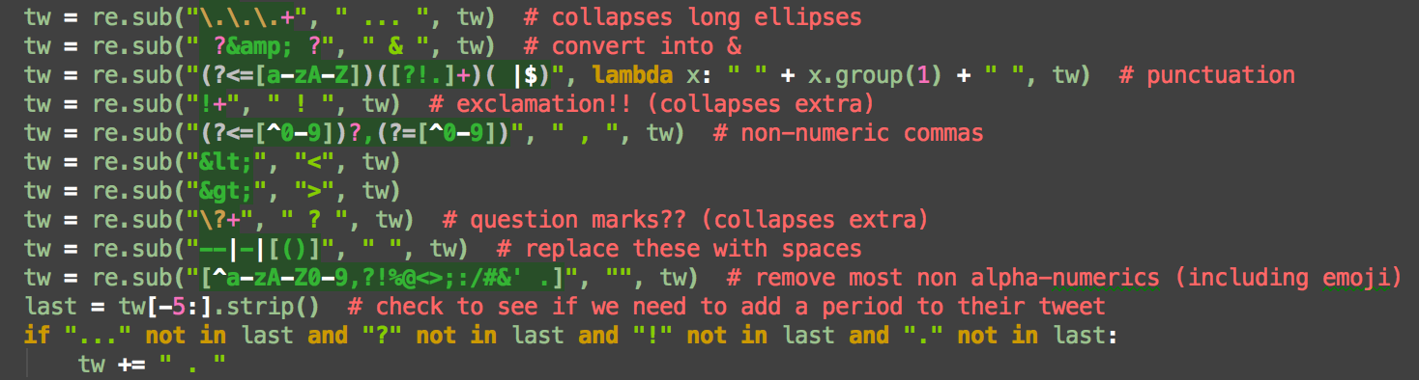
Tokenizing
Tokenize using Regular Expressions
Clean up confounding elements
links, emoji, numeric commas, hyphens, parentheses
Punctuate, if needed
ex.

Slide 7
Corpus Construction
Readable Corpus vs. the Corpus file
Previously we generated vocabulary
readable_corpus: aggregate of all their tokenized tweets
user_corpus is the readable corpus, but each word swapped out for its index in the vocabulary

Slide 8
Language Modeling
corpus – series of n “tokens”
word: token; unique word: word type
vocabulary: set of v unique word types, w ^{[1]}
i.e. w₀, w₁, . . . , w_{v−1}
Unigram Model Generation
word count as c(w = i)
Each word has a distinct probability of appearing^{[2]} & all together sum to 1^{[3]}
Notes:
\newline \vspace{5mm}[1]\ \ \ \ \ \ \ \ w \in \left \{ 0,1,..., v-1\right \} \newline [2]\ \ \ \ \ \ \ \ p_i \equiv p(w=i) = \frac{c(w=i)}{n}\newline[3]\ \ \ \ \ \ \ \ \sum_{i=0}^{n} p(w) = 1
c(w = i), where i is the index in vocab of a word
note: words that are below the frequency threshold are represented as OOV (out of vocabulary)

Slide 9
Language Modeling
Multigram Model Generation
Repeat process with permutations of n-words instead of word types
User supplies n
Walk through corpus reading each sequence of n-1 words

Slide 10
Language Modeling
Multigram Model Generation (cont.)
While walking through corpus:
Use n-1 words as a key in hashmap
The n-1 words are the history that precede an n^{th} word
with this key, maintain an array of n^{th} words
As n grows, computation time will increase – takes longer to add new key-values to dictionary than to modify existing key-values
Notes:
The higher the number of chains, the more unique permutations there will be and thus the more keys to add

Slide 11
Randomly Sampling the Model
Unigram selection:
Split the interval [0,1] into v segments
Segment 0 is [l₀ = 0, r₀ = p₀] – closed on right AND left^{[1]}
allows for 0
All other segments are OPEN on left, closed on right
Notes:
\newline [1]\ \ \ \ \ \ \ \ \left ( l_i=\sum_{j=0}^{i-1} p_j, r_j = \sum_{j=0}^{i} p_j\right ]\vspace{10mm}\newline [2]\ \ \ \ \ \ \ \ \ p(w|h) = \frac{c(h,w)}{\sum_{u=0}^{v-1}c(h|u))}

Slide 12
Randomly Sampling the Model
Multigram selection:
Similar – each interval [0,1] will be split into the x permutations present in the hashmap for a given history word
e.g. if, for a trigram model you used the key “the man”, you would likely find the following as the value array (essentially):
“the man” : [“did”, “was”, “did”, “had”]
Notes:
\newline [1]\ \ \ \ \ \ \ \ \left ( l_i=\sum_{j=0}^{i-1} p_j, r_j = \sum_{j=0}^{i} p_j\right ]\vspace{10mm}\newline [2]\ \ \ \ \ \ \ \ \ p(w|h) = \frac{c(h,w)}{\sum_{u=0}^{v-1}c(h|u))}

Slide 13
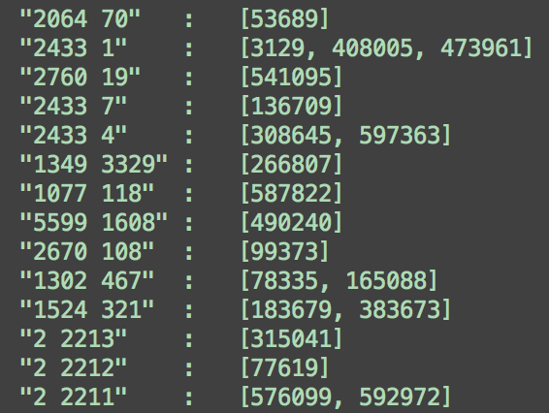
Visualizing the Multigram Model
Reminder: words are stored as their vocabulary index

Slide 14
Twitter’s API
Only allows API users to instantly access the last 3200 tweets – regardless of whether it’s just a retweet
Using Selenium can help circumvent this by accessing the tweets in chunks, albeit ”manually”
Basically brute-force, but no good way around it

Slide 15
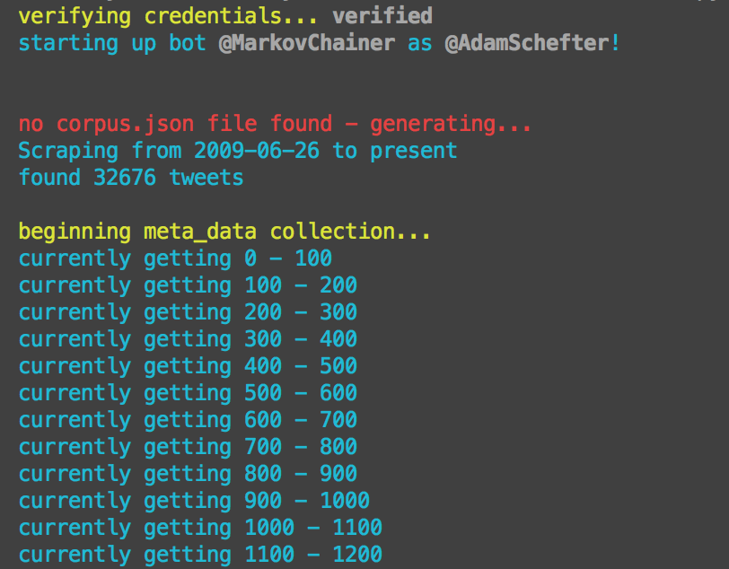
Data Scraping
Checks for the date they joined twitter and how many tweets they have.
if < 3200, quick-scrape
else automated scraping
then meta-data collection

Slide 16
Code Breakdown
bot_runner.py
The script that starts up bots
keys.py
holds a python object with various API keys for bots
MarkovBot.py
The instance that the user creates – requires a Twitter API key, and a username to mimic

Slide 17
Code Breakdown
twitter_scraping folder
Code borrowed from bpb27
– uses Selenium and a web driver to conduct automated scraping of a twitter user’s timeline – bypasses Twitter API’s 3200 limit on number of most recent tweets that can be accessed
Tokenizer.py
a class to tokenize and generate vocab + dictionary + corpus for a given user’s tweets.
MarkovChains.py
a class to generate chains given vocab + corpus

Slide 18
Code Breakdown
colors.py
a collection of functions to color code output
bot_files folder
holds the metadata of all previously analyzed twitter users

Slide 19
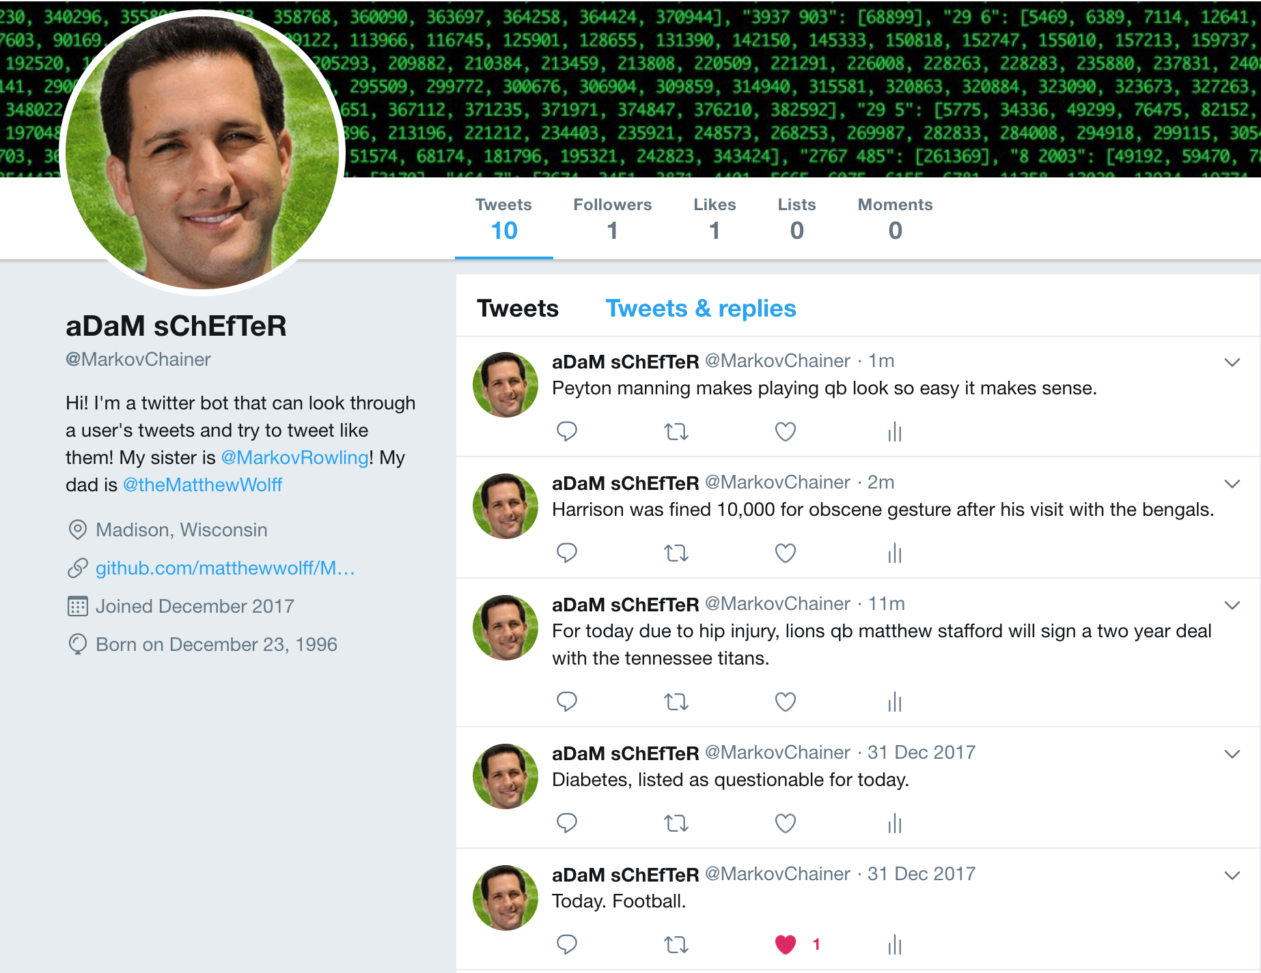
Results
Currently have two bots active
@MarkovChainer
@MarkovRowling

Slide 20
Questions?

Slide 21
EXTRA INFO SLIDES

Slide 22
Quick Note:
Why I’m speaking about a recent project
Although I’ve done other projects:
clustering metabolomic data (hierarchical and k-means) in R
image analysis with mice DNA from microscope slides in MATLAB
Analyzing and evaluating Random Forests in Java
I’m excited about this!
Solo instead of mentor-guided
Explore object-oriented Python
Notes:
I did the other projects with a lot of guidance from mentors – this was solo. Concepts were learned more deeply.
Taught myself Python over the summer – this was an exercise to explore the object-oriented side of Python

Slide 23
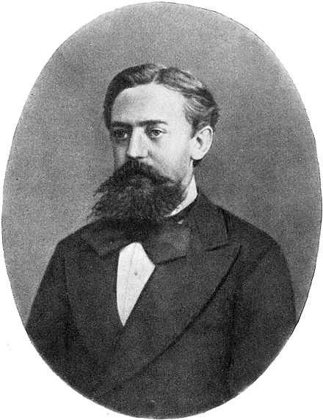
Markov Chains
Named after Andrey Markov (1856-1922)
Strictly: a stochastic model describing a sequence of possible events in which the probability of each event depends only on the state attained in the previous event.
In terms of how I use it: Given 1 or more words, randomly select a word that can be the next in that sequence.
“Can”, as in that permutation of words has occurred before in the body of text that I analyze

Slide 24
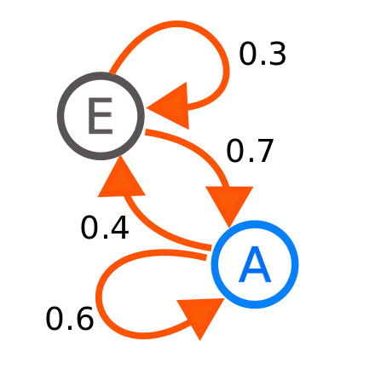
Consider a bot that predicts the next letter in a word
Train it on a corpus of two-letter sequences:
EE EE EE EA
EA EA EA EA
EA EA AA AA
AA AA AA AA
AE AE AE AE

Slide 25
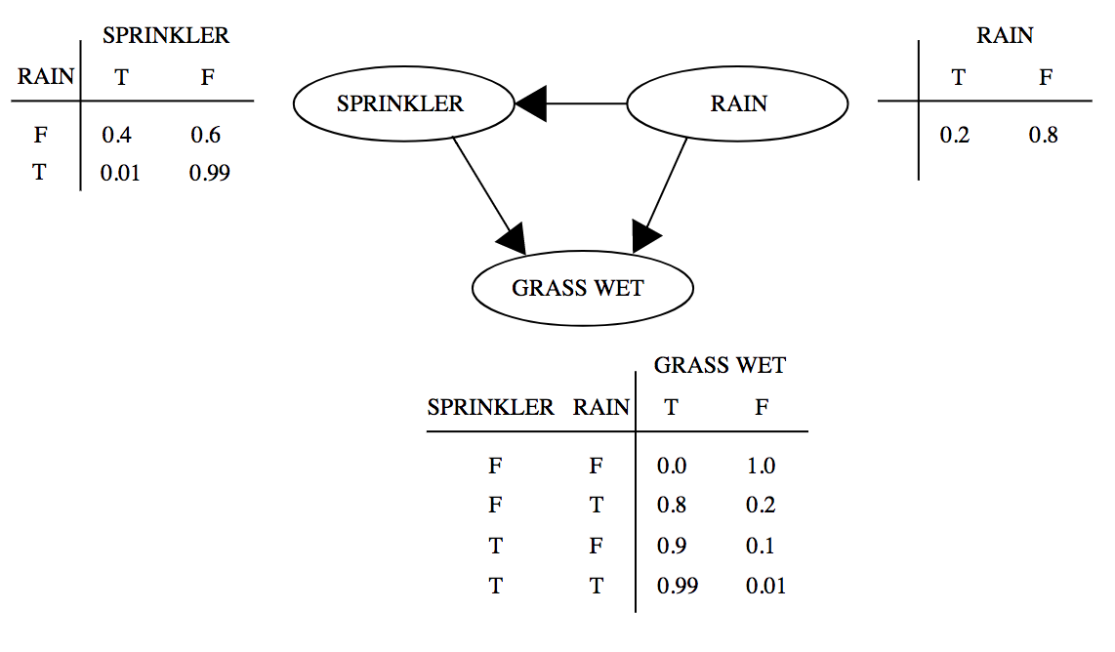
Sounds like a Bayesian Network? Almost.
The two are very similar (Markov is a subset)
What I use is one of the simplest Markov-processes – a discrete & finite space, and a discrete time Markov chain.
Markov chains ONLY depend on the present state to get to the next one
Represented as a weighted, directed graph.
weighted by frequency, so that random selection still favors the more likely event
Bayesian Network would be a factorization of some joint probability distribution (see pic)
Would be represented as a directed, acyclic graph

Slide 26
Conception
Beginning of December & classes were wrapping up
Itching to start another project
Drew inspiration from a notoriously erratic tweeter – thought computer-generated sentences could sound the same
Artificial Intelligence class previously had us make a chat bot – it used Markov Chains, though they didn’t tell us that
I had experience with the Tweepy from a previous project: @theDNABot

Slide 27
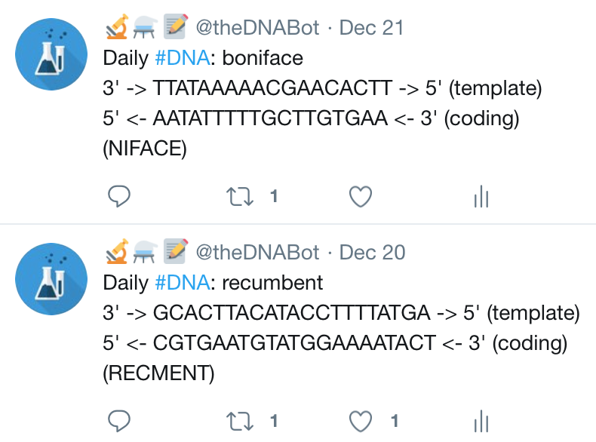
Previous Project
Combined interest in Genomics with Computer Science
Was in the middle of Biochem 501 and learned that the 20 amino acids had 1-letter abbreviations
Twitter bot that utilized R and Python
Brief Explanation: amino acids -> RNA -> DNA
Convert words into amino acid sequences (minus a few letters)
Convert the amino acids into a sequence of RNA bases
Convert RNA sequence into the DNA segment it would have originated from

Slide 28
Project Timeline
December 6th – Got idea, but had midterms
December 14th – Acquired the corpus: bpb27 had used his code to compile a collection of all tweets made by my project’s inspiration. Also my birthday 🎉
included all meta-data, like favorites and time made
grabbed only text, although considered adding weights based on number of replies (good indicator of controversiality)
December 16th – Wrote tokenizer to digest corpus
I love regular expressions
December 17th-18th – Implementing Chaining
Initially only was doing 3-word chains
2 days later, made extensible to any number
December 19th – Bot had it’s first, non-sensical words
December 20th – Added ability to scrape any user (borrowed & modified code)
December 21st – Bot could now form sensical (but incoherent) sentences
Since then: Adding color coding and dialogue + improving adding customizability for different users and improved quality of code (had been hackathon quality)

