Slide 1
Git: Version Control
CMU 02-601: Recitation 3 - Matthew Wolff

Slide 2


Getting Started
Download
Download [Github Desktop](https://desktop.github.com/)
Join
Join [GitHub](https://github.com/join) by creating an account
Use a professional-enough name, since you'll typically include this in your résumé

Slide 3
What is Version Control?
Why do we need it?
Why should we use it?
What are the benefits?

Slide 4

What is Git?
> "By far, the most widely used modern version control system in the world today is Git. Git is a mature, actively maintained open source project originally developed in 2005 by Linus Torvalds, the famous creator of the Linux operating system kernel. A staggering number of software projects rely on Git for version control, including commercial projects as well as open source."

Slide 5


What is GitHub?
z

Slide 6
So what's the meaningful difference between them?
GIT
A command line tool developed by Linus Torvalds
Independent from GitHub
GITHUB
A Platform built around Git
No need to understand Command Line

Slide 7
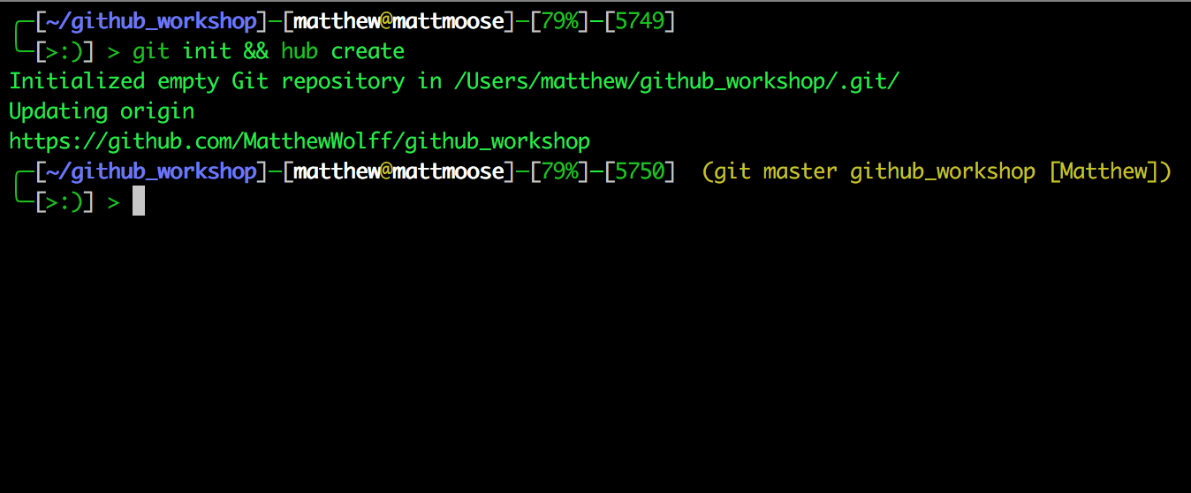
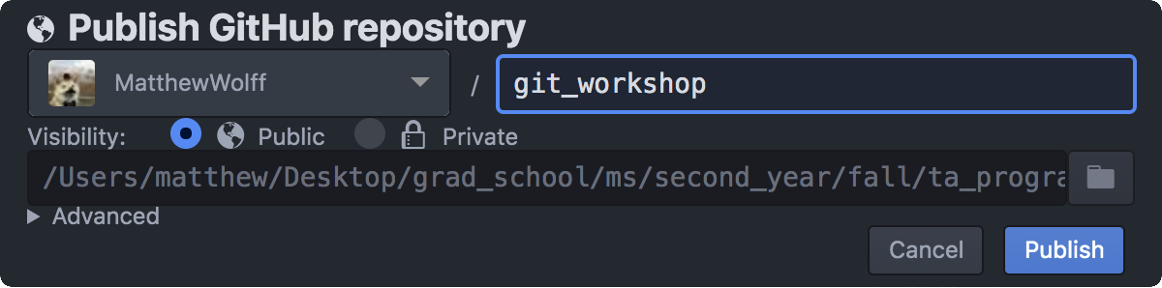
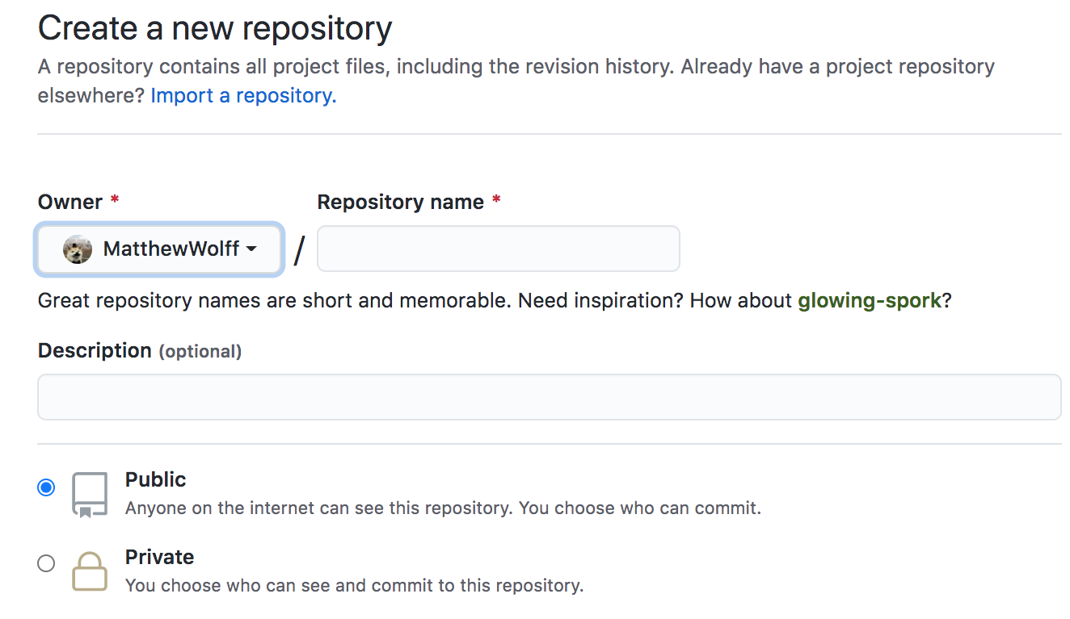
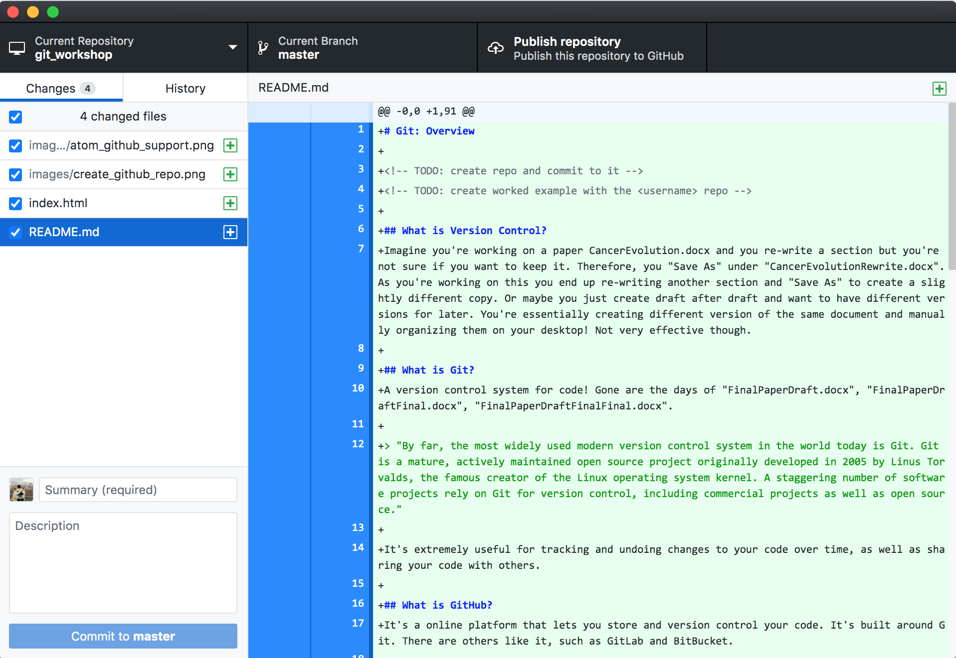
How to use GitHub?

Slide 8
Note: Free GitHub Premium for students
As a note, being a student gets you a [premium version (Github Student Dev pack) of GitHub for free: https://education.github.com/pack
>”It includes everything in GitHub Free, unlimited collaborators for private repositories, and advanced code review tools for private and public repositories.”

Slide 9
Git Concepts
z

Slide 10
Git Concepts
The Repository
Cloning
Commiting
Pushing, Pulling
Branching
Merging
Pull Requests
Forking

Slide 11
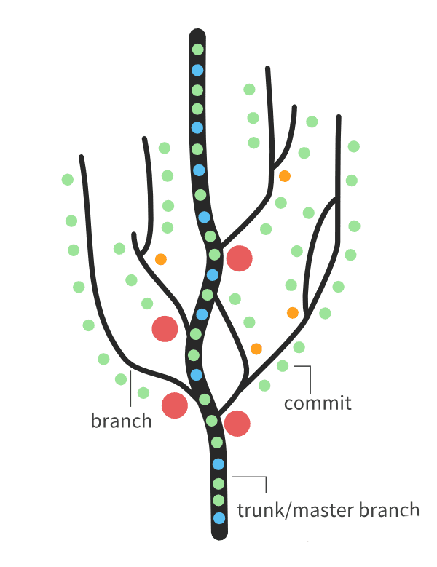
Tree Analogy
Bed of soil
Seed
Nutrients
Growing Branches
Merging Branches
z
https://betterqa.co/blog/managing-your-local-git-repository/

Slide 12
What’s Under the Hood?
Written in C
Complex
a Hash Map (like a Python dictionary)
Graph-structured
Most people don’t worry about the underlying implementation
It doesn’t drastically improve how you use it

Slide 13
Example Exercise!
z

Slide 14

1. Open GitHub Desktop

Slide 15
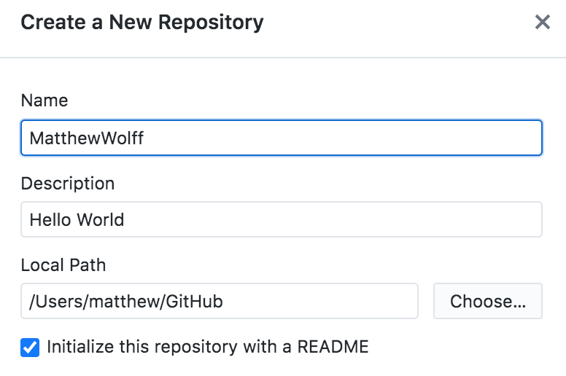
2. Create a new (local) repository
* Initialize it with a README
- what is a readme?
- what is markdown?
z

Slide 16
3. Publish your repository
- Make sure it's public!
- There's already one automatic commit to it

Slide 17
4. Go to [GitHub](https://github.com) on your profile
z

Slide 18
5. Enable this "special" repo so others can see it!
z

Slide 19
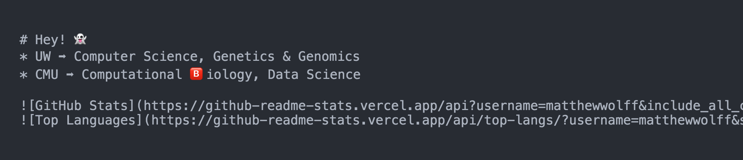
6. Go back to your files. Change the README.
You now have a local repo. Let's change the README to a small intro for your github account.
Mine is below!

Slide 20

7. Commit with a message and Push/Publish!
z

Slide 21
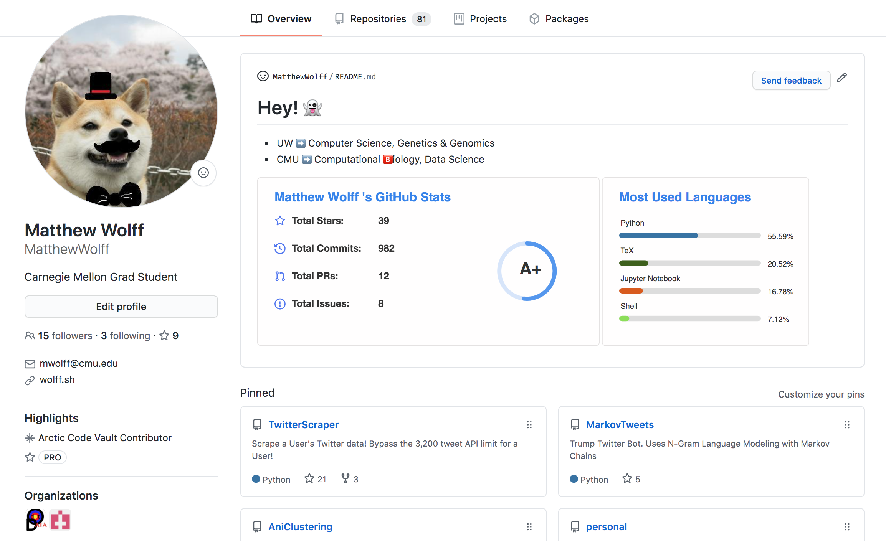
8. Go to on your profile again!
z

Slide 22
Let’s do a Pull Request!
1. Create a new branch using GitHub desktop
2. Make some changes
3. Commit them! Push them to origin!
4. Create a pull request! (will open GitHub)
5. Merge the pull request

Slide 23
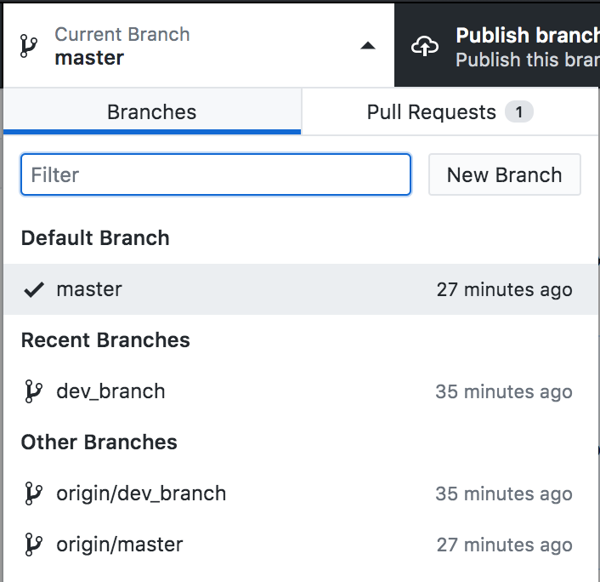

Slide 24
Make a change!
z
example: echo >> README.md

Slide 25
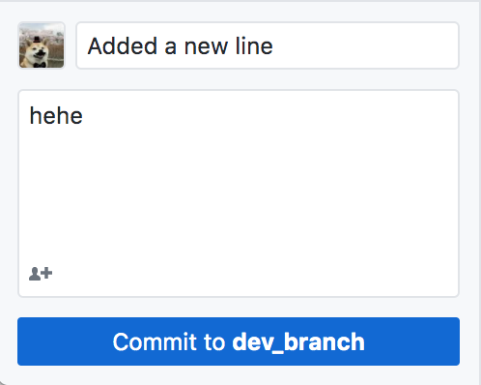

Slide 26
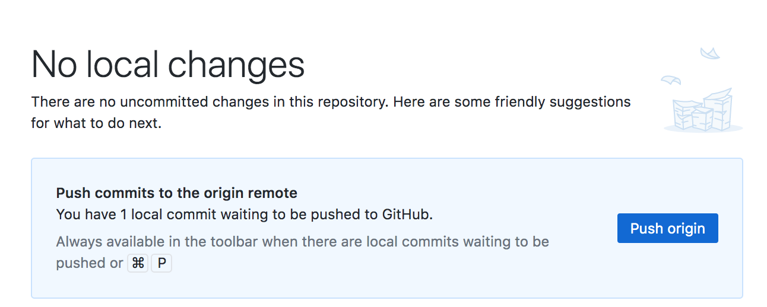

Slide 27
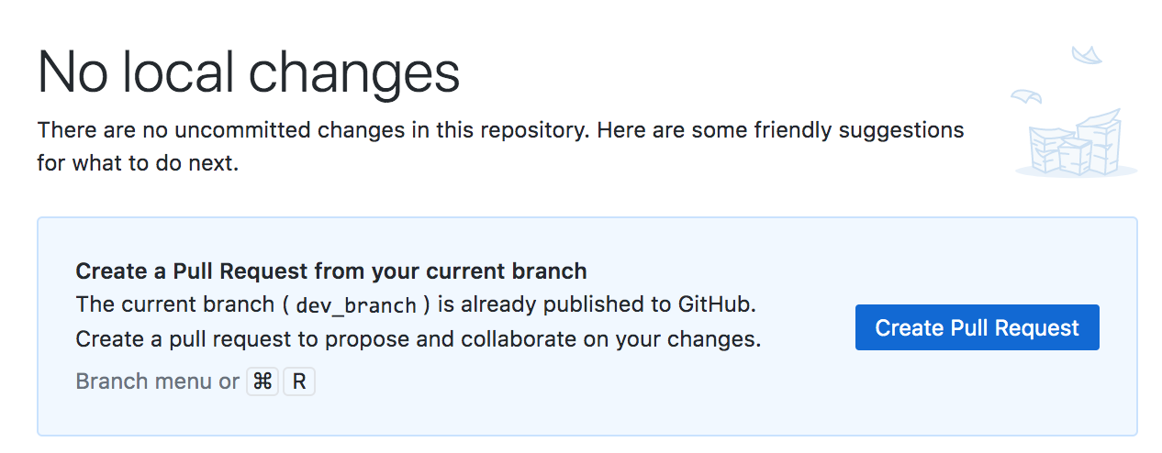

Slide 28
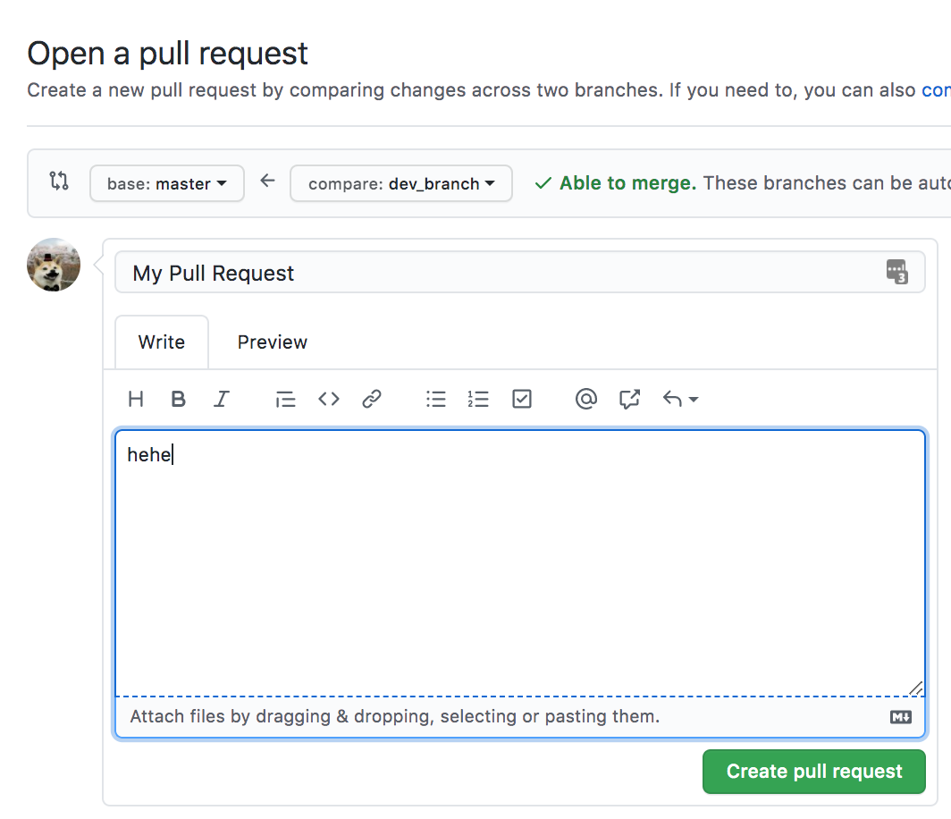

Slide 29
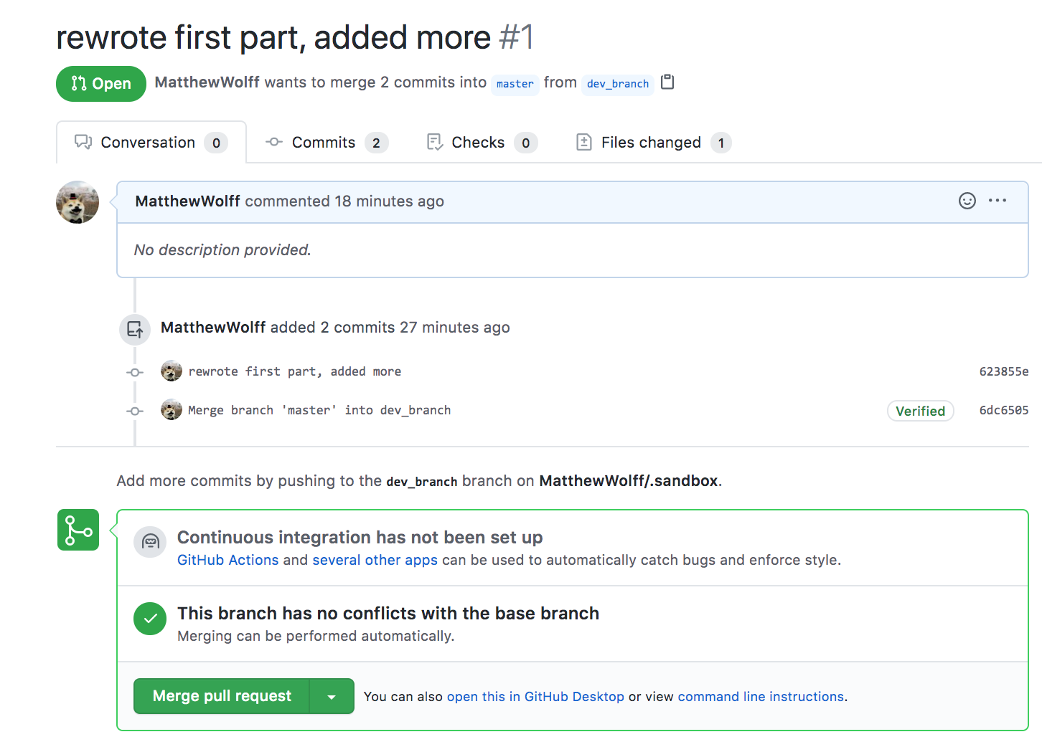

Slide 30
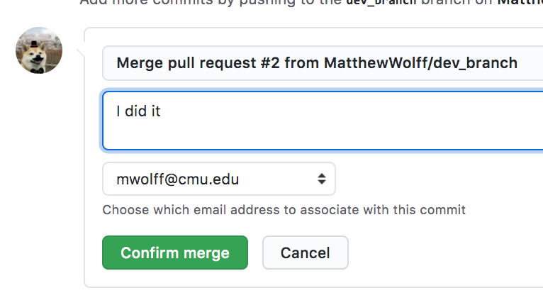

Slide 31
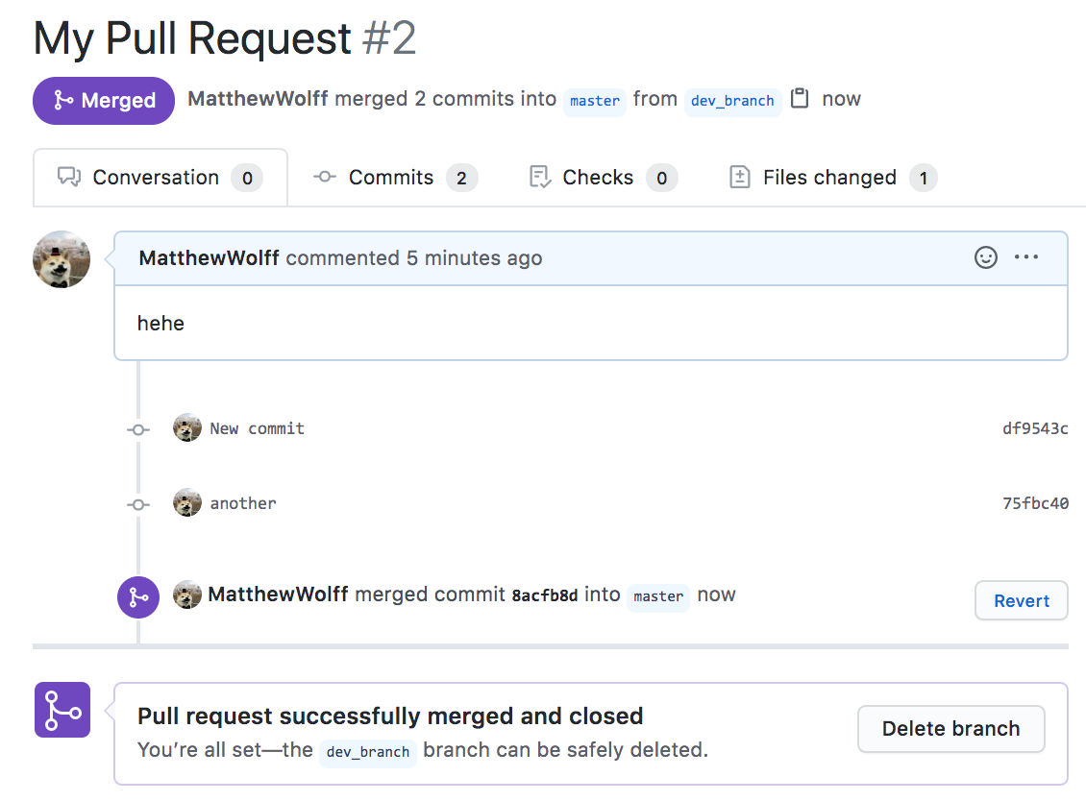

Slide 32
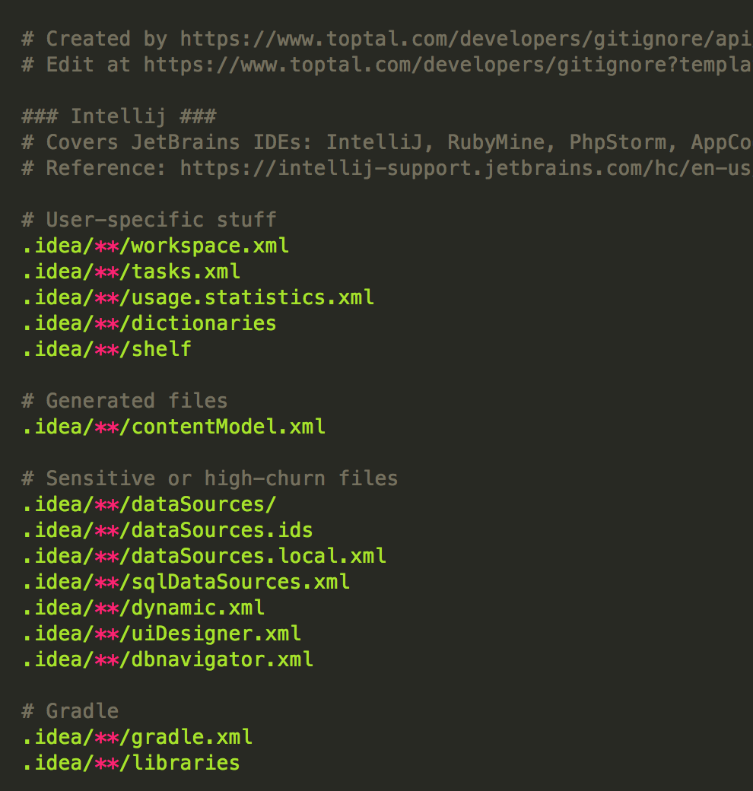
.gitignore
z

Slide 33
Command Line Git Key Commands
http://commands.wolff.sh
z

Slide 34

Questions?
z

