Slide 1
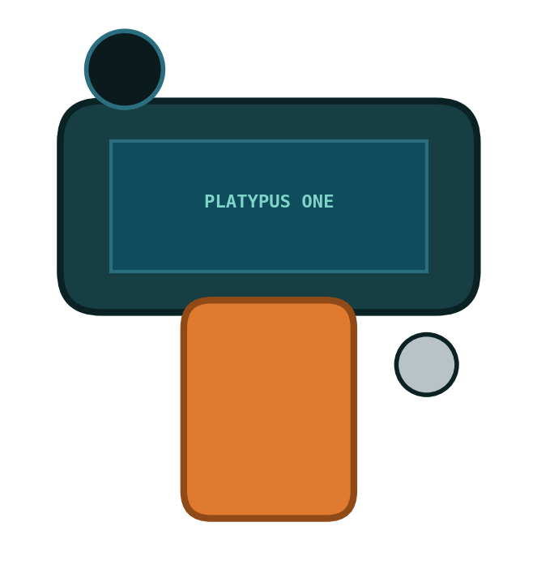
Platypus One
BOM — Components Under Consideration (rev B, 2026-08-24)
Handheld multi-sensor instrument on the Arduino UNO Q · Autodesk Arduino Q hardware contest · PlatypusOS (C++20)
Gates: hardware recipients Sep 18 · display fallback Sep 30 · carrier PCB freeze Nov 10

Slide 2
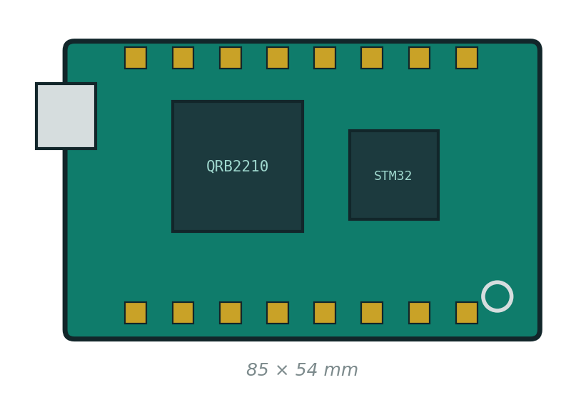
Core Compute — Arduino UNO Q (4G)
Fixed by contest · $59 or contest-provided · 85 × 54 × 20 mm
SoC
Qualcomm QRB2210 running Debian Linux + STM32 MCU side
Display out
MIPI-DSI via ANX7625 → USB-C DP Alt-Mode, muxed with a DSI connector — one output at a time; drives the display decision
Storage
microSD 32 GB A1 (~$12) — OS + data partition
Bench power
USB-C PD 5 V / 3 A supply + cable (~$15)
Status
PLANNED — contest hardware recipients announced Sep 18
Why it matters: the DSI/USB-C mux is the single fact that shaped the display architecture (ADR-0002).

Slide 3
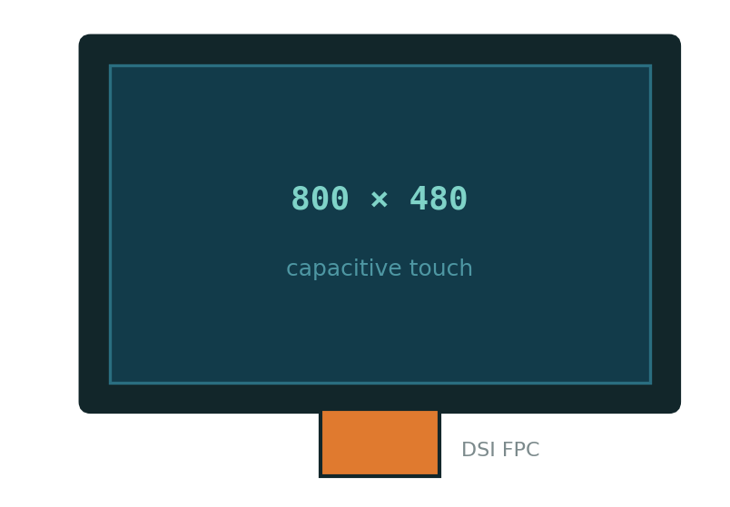
Display — DECIDED: MIPI-DSI Panel (ADR-0002)
The only path that is product-grade and keeps USB-C free for charging + USB host
✅ 4a — 4.3–5″ MIPI-DSI 800×480 capacitive · $30–45 · SELECTED
Native Linux DSI on the internal connector. Exact panel TBD — compatible-panel research due (connector P/N + pinout from ABX00162), gate Sep 30.
4b — 4.3″ parallel-RGB + ESP32-S3 bridge · ~$35+bridge · FALLBACK
SUB3-class (ST7262E43 + GT1151). Activated only if DSI panel sourcing fails by Sep 30.
4c — 3.2″ ILI9341 SPI resistive · $16 · DESCOPE NET
Matches renderer/sim as currently built. Safety net only.
BLOCKS
Battery sizing (display dominates the power budget), enclosure aperture, and the renderer target all wait on the exact panel spec.
4d — USB-C / HDMI portable monitor · $40 · DEV FIXTURE
Zero-driver prototyping path. Never the product — it consumes the only charging port.

Slide 4
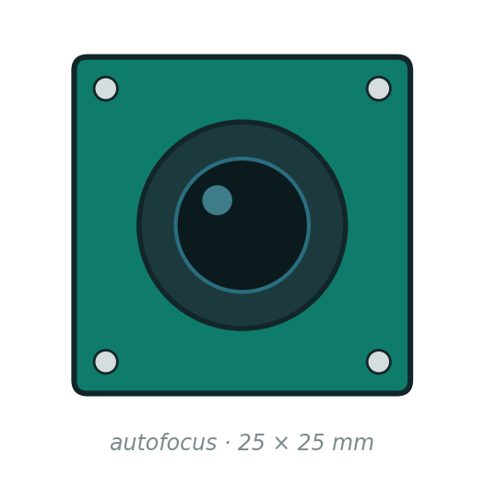
Camera — 7a vs 7b (open)
Blocked on confirming the UNO Q's camera input paths (UVC vs MIPI-CSI)
7a — USB UVC OV5640-class autofocus · $25 · ✦ primary
Simplest Linux path: plug into V4L2 and go. Autofocus, 25×25×10 mm envelope. Lowest driver risk — the pragmatic choice if UVC bandwidth and quality clear the bar for ShadowScan.
7b — 13 MP autofocus module · $40
Higher fidelity for ShadowScan captures. Open question: does the UNO Q expose a usable MIPI-CSI input, or is this also UVC? Confirm before choosing — CSI would mean device-tree and driver work.
Decision driver: ShadowScan image quality vs bring-up time. 7a wins unless 7b's fidelity is demonstrably needed and the input path is confirmed.

Slide 5
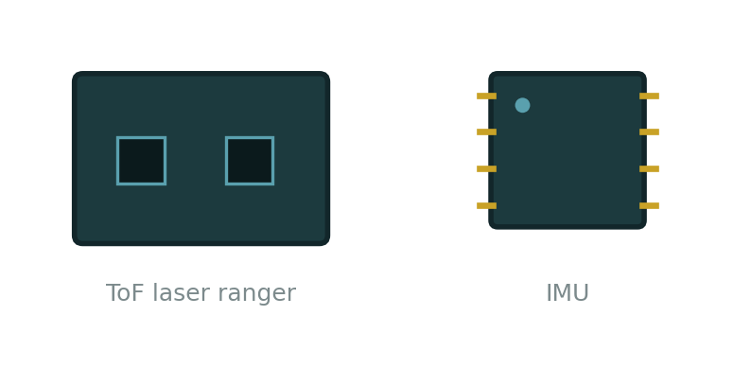
Ranging & Orientation — Open Pairs
Both pairs are I²C and carrier-PCB-compatible either way — they don't block the schematic, only final placement
8a — VL53L1X · $12 · ✦
8b — VL53L8CX · $20
Single-zone ToF, 4 m range, 13×18 mm breakout. Proven and cheap — fully covers the distance-measure app.
8×8 multizone — a coarse depth grid that assists ShadowScan. 6×6×3 mm. More driver work.
9a — BNO055 · $25 · ✦
9b — BMI270 · $8
Analysis pending (Matthew).
Rule of thumb in the BOM: primaries favour bring-up speed; alternates favour ShadowScan capability and cost.
Sensor fusion on-chip: orientation out of the box, fastest path to a working level/angle app. 20×27 mm breakout.
Cheaper and smaller (10×10×3), already proven in Project Platypus — but fusion runs on our side.

Slide 6
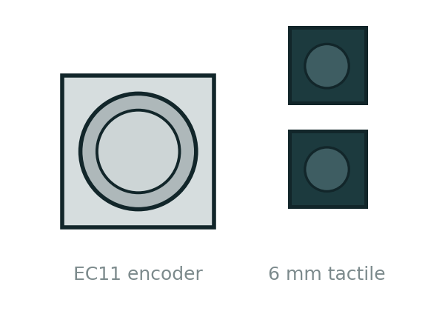
Rotary Encoder — 5a / 5b / 5c
Primary nav control at left thumb — BOM currently lists EC11 only; alternates added for consideration
5a — EC11 mechanical, detented, w/ push (e.g. Bourns PEC11R) · $3 · ✦ primary
24 detents give free tactile feedback, integrated push = select, threaded bushing panel-mounts cleanly into the grip. Proven, cheap, zero driver work — just debounce. Contact wear is the only real weakness.
5b — Magnetic: AS5600 + magnet shaft · ~$8
Contactless — smooth continuous rotation, no bounce, no wear, absolute position. I²C, so it drops straight onto the carrier hub. No detents and no push: needs a separate tactile for select, and “clicks” would come from the haptic motor (pairs with item 17).
Decision driver:
5a unless the UI wants smooth scrolling (5b + haptics) or wheel-nav consolidation (5c, which also deletes item 6).
5c — Adafruit ANO directional nav encoder (P/N 5001) · $9
Scroll wheel + 5-way buttons in one iPod-style part — could replace the encoder AND the 4 tactile function keys (item 6), simplifying the front face. Larger footprint; commits the UI to wheel-centric navigation.

Slide 7
Input, Aux Sensing & Feedback
Settled commodity parts — no open decisions here
Encoder
EC11-style rotary w/ push, $3 — primary nav, at left thumb per ID doc
Buttons
4× 6 mm tactile, $2 — trigger + function keys
Color
TCS34725, $8 — multi-measure lineage feature
Illumination
2× high-CRI white LED + driver, $2 — controlled shadow casting
Audio
Piezo or 1 W speaker + PAM8302, $6 — IAudioOutput
Haptics
Vibration disc, $2 — stretch goal
Radar
Grove BGT24LTR11 Doppler, $30 — DEFERRED to V2 (machine-health app); envelope reserved, not in Rev A

Slide 8
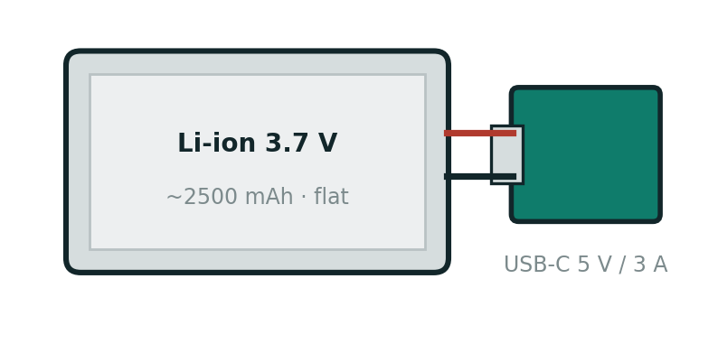
Power
Exact cell waits on the display decision — the panel dominates the budget
Battery ✦
Flat Li-ion/LiPo 3.7 V ~2500 mAh, protected, $15 — 100×60×8 mm flat pack per packaging direction
Charge/boost
USB-C board, 5 V / 3 A, $20 — must hold a stable 5 V under Linux load; port exits the grip base
Switch
SPDT slide, $1
Open item
Cell capacity is provisional until the DSI panel's draw is measured — don't order the battery first

Slide 9
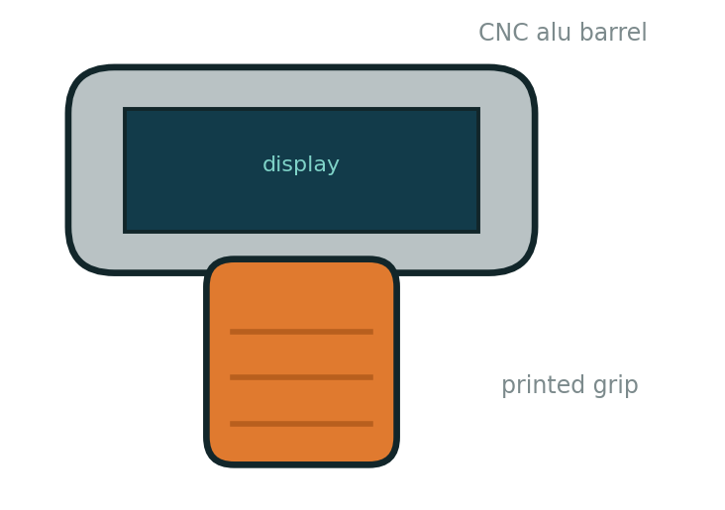
Enclosure & Interconnect — PCBWay Scope
$300 PCBWay credit if selected · carrier PCB freeze gate Nov 10
Carrier PCB
I²C hub + buttons + encoder + power distribution, ~$60 assembled — Fusion Electronics design
Enclosure
Hybrid: CNC aluminium barrel + printed polymer grip (per INDUSTRIAL_DESIGN.md), ~$120–250 — metal barrel alone likely $150–250, quote early; RF window required
Fasteners
JST-SH/Qwiic cables, headers, M2/M2.5 standoff kit, $15
Misc
Hookup wire, heat-shrink, $10
Risk: the alu barrel is the biggest single cost swing in the build — get the PCBWay quote before locking the hybrid approach.

Slide 10
Budget & Pending Decisions
≈ $200–230
1 · Display panel
4a decided; exact DSI panel selection due — blocks battery, enclosure, renderer. Fallback gate Sep 30.
out of pocket with contest hardware + $300 PCBWay credit
≈ $450–500
2 · Camera 7a vs 7b
Blocked on confirming UNO Q camera input paths (UVC vs CSI).
fully self-funded worst case, + tools
3 · ToF 8a/8b · IMU 9a/9b
Analysis pending. I²C either way — doesn't block carrier PCB schematic start.
Alternates are kept deliberately — no option is deleted without a decision note.

